Slide 1

Most people never open a wallet app.
They open chats.
We grew up using WhatsApp, Telegram, and Instagram DMs, not crypto wallets.
So why should onchain finance feel any different?
That's why I built AgentFlow.
Intent in. Execution out.
agentflow.one · Arc Testnet

Slide 2

The Problem
Crypto isn't difficult because of blockchain.
It's difficult because every financial task lives in a different interface.
Need to send money?
Need to swap or vault?
Need to bridge funds?
Need prediction-market research or a trade?
Invoice or portfolio?
Open one app.
Open another.
Another.
Another.
Another.
The experience is fragmented. People don't want more apps.
They want one conversation.
agentflow.one · Arc Testnet

Slide 3
The Solution
AgentFlow turns natural language into verified onchain actions.
Pay alice.arc 5 USDC
Request 10 USDC from alice.arc
Create a payment link for snehal.arc for a 25 USDC consultation
Bridge 1 USDC from Base Sepolia to Arc
Swap 10 USDC to EURC
Research the next Fed meeting and explain how it affects my portfolio
Chat → Preview → Confirm → Execute
Money-moving actions preview first — nothing settles until you confirm with YES.
agentflow.one · Arc Testnet

Slide 4
Capabilities
AgentPay
•Send & request USDC
•.arc · contacts · addresses
•Payment links & QR
•Invoices · Approvals
•Split · Schedule · Batch
•Chat + CSV Integration
•Telegram payments
Research
•Any-topic reports + citations
•Research → Analyst → Writer
•Portfolio-impact analysis
•Prediction-market research
•Self-hosted evidence index
DeFi
•Swap · Vault · Bridge
•Prediction markets (trade)
•Portfolio — balance & PnL
•Vision + Voice input
•Chat-first for every agent
12 Core Agents in the Agent Store · Chat for all · CSV templates for Batch, Split, Schedule, & Invoice
agentflow.one · Arc Testnet

Slide 5
Product demo — Intent → YES → Receipt
One real money flow. Same pattern for swap, bridge, batch, and more.
01 ASK
02 PREVIEW
03 SETTLED
User Intent
"Pay alice.arc 5 USDC for dinner"
Enter any natural language command to initiate an action.
AgentFlow Verification
To: alice.arc
Amount: 5 USDC
Network: Arc
Confirmation required:
Say YES to confirm
Onchain Receipt
✓ Transfer confirmed
Tx: Arc Testnet
Type: x402 nanopayment
agentflow.one · Arc Testnet

Slide 6
Live today
Not a mock — Arc Testnet with real USDC settlement.
9,303+
12
8,440+
Onchain transactions
Core agents
A2A nanopayments
What “12 core agents” means
The 12 Agent Store system agents: Research, Swap, Vault, Prediction Markets, Bridge, Portfolio, Invoice, Vision, Voice Input, Schedule, Split, Batch.
Analyst + Writer are stages inside the Research pipeline (extra x402 hops) — not separate store listings.
AgentPay send/request/links/QR are product surfaces powered by those agents + chat — not a 13th store agent.
Stack: Arc · Circle USDC · x402 · DCW/Gateway · .arc · ERC-8004
agentflow.one · Arc Testnet

Slide 7
Why not just a wallet or ChatGPT?
Wallets
General AI
Single-purpose
crypto agents
AgentFlow
Natural language
—
Yes
Partial
Yes
Onchain execution
Yes
—
Narrow
Yes
Preview → YES
Manual
—
Varies
Yes
Payments + DeFi + Research
Apps
Talk only
One job
One chat
x402 A2A nanopayments
—
—
Rare
Native
Chat + CSV workflows
—
—
Rare
Yes*
* Batch, Split, Schedule, Invoice — chat and CSV. All other core agents are chat-first.
agentflow.one · Arc Testnet

Slide 8
How it works
Surfaces
Intelligence
Agents
Confirm
Settle
Web · Telegram
Vision · Voice
→
Classify → Route
Validate · Memory
→
12 core agents
+ Research stages
→
Preview
User YES
→
x402 · DCW
Arc USDC
Hermes Agent vs Hermes LLM
Semantic stack
Hermes Agent — orchestrates workflows (chat runtime, tools, routing).
Hermes LLM — provides reasoning (Hermes-4 model API).
Agent uses the LLM. Research/report often calls the LLM via /run so the chat brain can’t invent citations.
01 Classification — understand the ask
02 Intent Router — dispatch to the right agent
03 Validation — previews & guardrails
04 Semantic Memory — wallet-scoped contacts & prefs
Research infra: Meilisearch evidence index (~ms local reuse) → Firecrawl/SearXNG on VPS when needed · fail-open
agentflow.one · Arc Testnet

Slide 9
Agents & x402 nanopayments
Pay per task in USDC. Research pipeline = agents paying agents.
Research
$0.005
Portfolio
$0.015
Analyst*
$0.003
Invoice
$0.025
Writer*
$0.008
Schedule
$0.005
Swap
$0.010
Split
$0.005
Vault
$0.012
Batch
$0.010
Pred Markets
$0.012
Vision
$0.004
Bridge
$0.009
Voice
Free
* Analyst & Writer = Research pipeline stages (full report $0.016). Chat + CSV: Batch, Split, Schedule, Invoice.
Vision benchmark: ~94% field accuracy · 7/8 sections · OCR, invoices, charts, injection defence strong · grid spatial still improving
agentflow.one · Arc Testnet

Slide 10
Where AgentFlow goes next
Now
Web + Telegram
12 core agents live
AgentPay · Research · DeFi
Vision · Voice
x402 A2A on Arc
Next
Android + iOS apps
Push for YES confirms
QR + camera Vision
Deeper mobile Voice
Then
AgentFlow SLM
Trained on product usage
Faster routing · lower cost
Stronger product moat
agentflow.one · Arc Testnet

Slide 11
Team
Snehal
Solo founder · AgentFlow
Building the full stack — product, agents, and Arc / x402 settlement.
Live at agentflow.one · X @AgentFlowone
agentflow.one · Arc Testnet

Slide 12
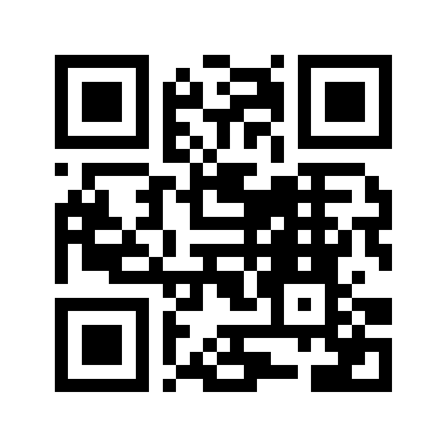
Today's AI answers questions.
AgentFlow completes financial work.
The future isn't opening more apps.
It's expressing your intent — on web, Telegram, and soon mobile.
Intent in. Execution out.
Built by Snehal · Solo founder · X @AgentFlowone
Try AgentFlow today
Scan -> agentflow.one
Live on Arc Testnet
Access codes · one per person
P2K5K7RW · 4RUYHW5X · S3SQFXYB · 9VDFRSRD · F6EBUWQP
agentflow.one · Arc Testnet

