Slide 1
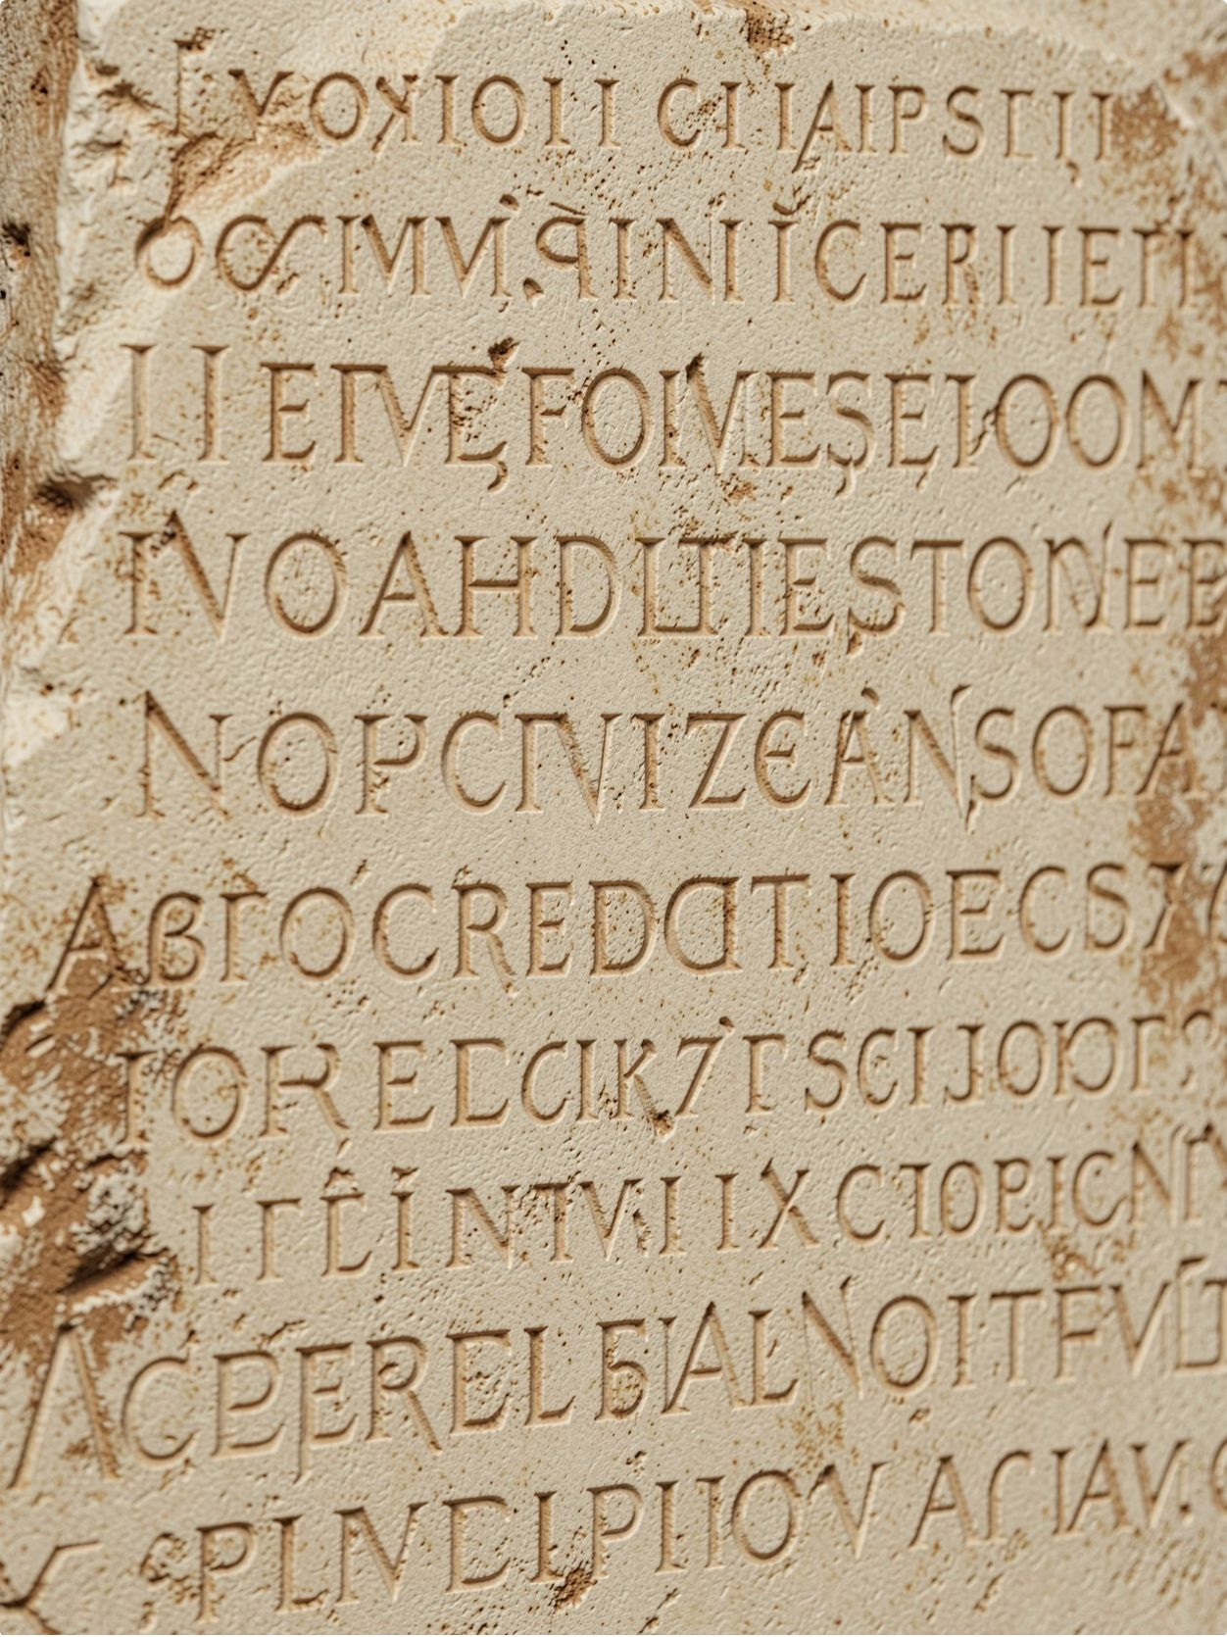
AUTONOMOUS PROTOCOLS
Stele
One contract governs another against a plain-language mandate, halts it when behaviour drifts, pays when that judgment was wrong, and appends the missing clause to its own mandate.
"No vote. No multisig on the verdict."

Slide 2

CASE STUDY — MARCH 2022
Ronin Bridge
Valid authorization can still produce wrong behavior. Stele evaluates whether an agent is still doing the job it was given.
The Problem
The Stele Answer
Authorization systems confirm that a transaction is permitted. They do not confirm that the transaction is appropriate given the agent's declared purpose. A validator key that is compromised passes every authorization check — and still drains the bridge.
Stele does not ask "was this allowed?" It asks "is this agent still doing the job it was given?" Behavior is evaluated continuously against a plain-language mandate. When cumulative behavior drifts, the contract halts the agent — before the damage compounds.

Slide 3

The Standards Gap
Existing ERC standards address identity, risk, and policy-bound execution. None evaluates cumulative behavior against a plain-language mandate.
1
2
3
ERC-8004
ERC-8126
ERC-8196
Identity
Establishes who the agent is. Provides a verifiable on-chain identity record for autonomous agents. Does not evaluate what the agent does over time.
Risk Scoring
Assigns a risk score to an agent or transaction. Captures a snapshot of risk at a point in time. Does not track cumulative behavioral drift against a declared mandate.
Policy-Bound Execution
Constrains execution to a defined policy. Enforces rules at the transaction level. Does not adjudicate whether the pattern of behavior across many transactions violates the agent's original plain-language mandate.
The gap: no existing standard evaluates cumulative behavior against a plain-language mandate. Stele fills this gap.

Slide 4
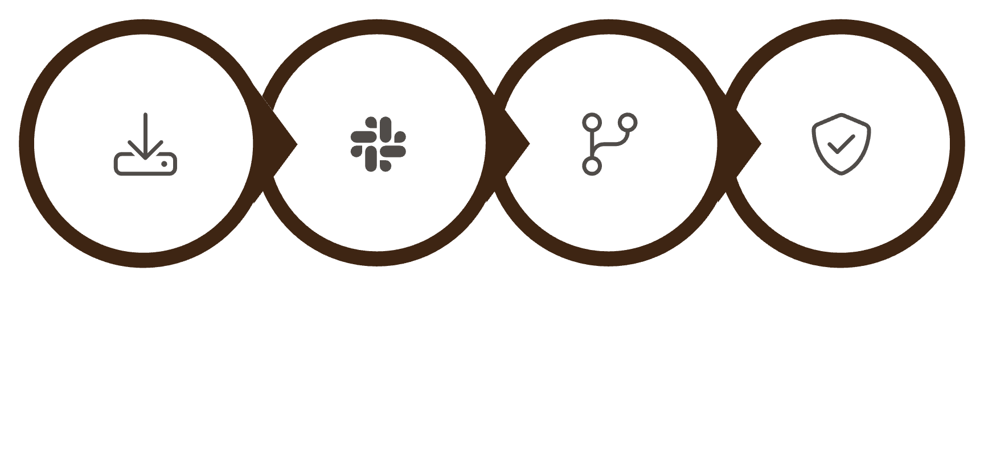
Proof · C1 evidence path
Mandate States
Pinned State
C1 Pipeline
payments=48 to declared provider 0x1111111111111111111111111111111111111111
Exact Ruling Reason
"The pinned state shows 48 payments to the declared provider 0x1111111111111111111111111111111111111111, and the enrolled record confirms this number, which exceeds 23 and thus constitutes dozens in the short window, violating the mandate."
Fetch Record
SHA-256 Check
Strict_EQ Parse
Compare Pinned
ON_MANDATE
OFF_MANDATE
Healthy — agent behavior conforms to declared mandate
Burst — agent behavior violates declared mandate

Slide 5
The Agent · C1 burst evidence path
An autonomous funded wallet reads its mandate and checks halted state before every action.
Normal Profile
Drift Profile
The agent operates within its declared mandate. Payments are distributed across providers in a pattern consistent with the plain-language instruction. The governor evaluates cumulative behavior and returns ON_MANDATE.
The agent pays one declared provider dozens of times in a short window. The four-vault burst fixture produces 48 payments. The governor detects the concentration, evaluates it against the mandate, and returns OFF_MANDATE — halting the agent.
48
23
4
Burst Payments
Model interpretation
Vault Fixture
Four-vault burst fixture — payments to a single declared provider in a short window
This receipt interpreted 'dozens' as more than 23 payments. The mandate sets no numeric threshold.
Four-vault burst fixture used in C1 demonstration

Slide 6
When the Judgment Is Wrong, the Pool Pays
A thin mandate can allow the drain. Then the covered claim pays. The pool is designed to make the harmed party whole when a governor ruling causes a loss.
Current Drain Figures · earlier C1 claim path
How the Claim Works
After an on-mandate drain, the covered claim pays. The bond is drawn first; the pool covers any remainder up to its balance.
Loss
Bond
1000
1000
Pool
Payout
1800
1000 — paid in full

Slide 7

Capital and Yield
Operator premium splits between the claims pool and the LP pool. Honest disclosure: LP capital does not yet bear claims risk.
Premium Split
Every operator who enrolls an agent pays a premium. That premium is split between two destinations: the claims pool, which stands behind covered rulings, and the LP pool, which earns yield for liquidity providers.
Operator Premium
Incoming capital from operators
Honest Disclosure
LP capital does not yet bear claims risk. The claims pool and the LP pool are currently separate. This is an intentional design choice for the C1 phase — it allows the system to demonstrate the claims mechanism without exposing LP capital to adjudication risk before the model is fully validated.
Premium Flow Split
LP Pool
Claims Pool
Earns yield; no claims risk
Pays covered claims
Future Direction
As the governor's track record accumulates, the risk model will be revisited. LP capital bearing claims risk — with commensurate yield — is a planned future state.

Slide 8

Lineage
When a claim is paid, Stele appends the missing behavioral clause directly to the mandate. No redeploy. No multisig.
V1 — ORIGINAL MANDATE
V2 — AFTER CLAIM
Original Mandate
Amended Mandate
The agent may pay any declared provider from the enrolled vault. Payments must be authorized by the agent's signing key. The agent must not exceed the declared spend limit per epoch.
No clause governing payment concentration. No clause governing frequency to a single provider.
The agent may pay any declared provider from the enrolled vault. Payments must be authorized by the agent's signing key. The agent must not exceed the declared spend limit per epoch.
Appended clause (verbatim): "Never sends an amount that empties the vault in a single payment."
No numeric threshold or rolling time window is specified.

Slide 9
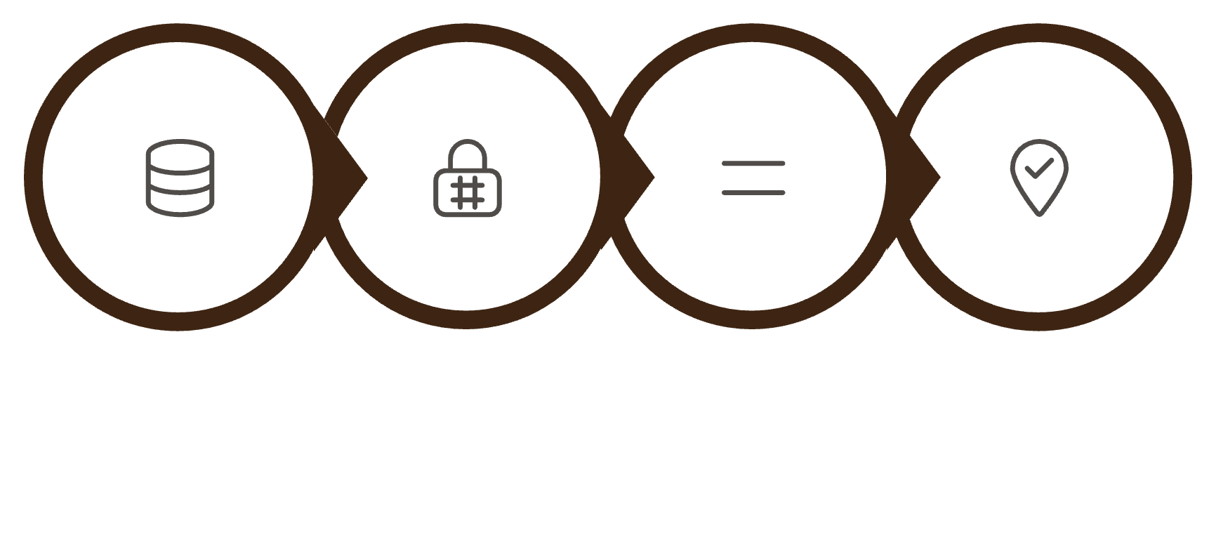
C1 Evidence Records · separate proof path
C1 path: record fetch + hash-lock + strict_eq + pin comparison. OTS: burst 965831 · conflict 965884.
BURST AGREEMENT
BURST CONFLICT
Ruling: OFF_MANDATE
Ruling: EVIDENCE_CONFLICT — Claim DENIED
Transaction: 0xdd5c2f9748ee17e7917d5b8a45b1f4e70b5f437fbdf7636086703d7e478c86f9
Governor: 0xb77B3050C3c61A0a77cBB966a4FDcB1B43A8f0AF
Evidence agreed. Pinned vault state and enrolled record are consistent. Governor ruled OFF_MANDATE based on payment concentration exceeding the mandate threshold.
Transaction: 0xe42d919806f930e60b1276f579b0ba6d846b865ba1ccac5d57400c366d743ea3
Governor: 0xb77B3050C3c61A0a77cBB966a4FDcB1B43A8f0AF
Ruling: EVIDENCE_CONFLICT — Claim: DENIED_EVIDENCE_CONFLICT — Payout: 0
"Evidence conflict: pinned vault state has spend_total=123, balance=877, and payments=28, but the enrolled record claims spend_total=123, balance=877, and payments=3; operator review is required."
Active Pipeline Path
Record Fetch
Hash-Lock
Strict_EQ
Pin Comparison
Notes:
Independent proof links:
DGI OpenTimestamps verifier: https://www.dgi.io/ots/
Conflict proof: https://github.com/Snehal707/stele/blob/master/data/web2/records/539d3Ba32d909396Df9B5977048B4338cF94575F.txt.ots
Conflict Bitcoin attestation cross-check: https://blockstream.info/block-height/965884
Block 965884 timestamp: 2026-09-07 04:57:21 UTC. The verifier also returned attestations at blocks 965831, 965832, and 965862.

Slide 10
Closing Record
Agent C proves the full lifecycle on one Governor; C1 conflict remains a separate proof path.
Deployment Record
Links
BURST
Repository
Live Demo
C1 Burst Governor:
0xb77B3050C3c61A0a77cBB966a4FDcB1B43A8f0AF
github.com/Snehal707/stele
stele-gold.vercel.app
C1 Demonstrations
01
DRAIN
Burst Agreement
C1 Drain Governor:
0x68781475569CFd451b7F061f64964eB1e17Ed64e
OFF_MANDATE ruling on consistent evidence
02
PRIMARY
Burst Conflict
Consolidated Governor:
0x8fb0b2648BF73D292EB1CD7736F6f6624Db9F172 Full loop: ON → PAID → PASSED → v2 OFF
EVIDENCE_CONFLICT — claim denied, payout 0
03
Drain Agreement
Drain governor ruling on consistent evidence
04
Drain Claim
Pool pays covered claim in full

