Slide 1
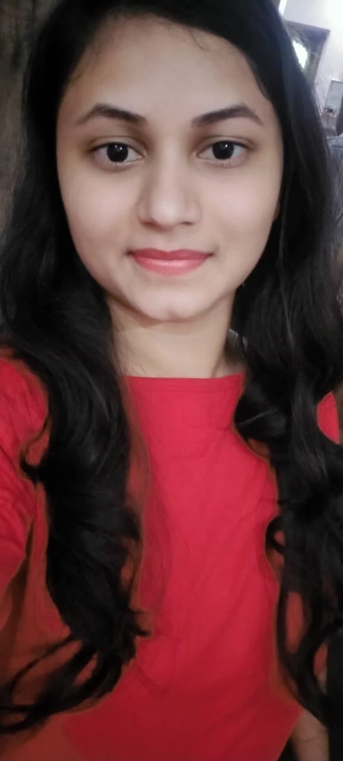

SNEHAL KOKATE
Analyst/Software Engineer
Diploma in Civil Engineering: 2015-2018
Bachelor of Engineering in
Civil : 2018-2021
MUMBAI
Skills
Snehal.kokate@capgemini.com
+91 7350025460
Java | Basics, OOPS, Exception Handling, Collections & Generics, Java 8 Features
Spring Framework | Spring MVC. Spring JDBC, Spring-ORM, Spring Boot
Angular | Basics, Directives, Services, Routing, Pipes, Forms
RDBMS | Postgres SQL, MySQL
UI Technology | HTML 5, CSS, JavaScript
Tools | Git ,GitHub, Swagger, Postman, Eclipse, Visual Studio code
Add On Skills | Communication , Team management
A4
EMP ID-46210203
Full Stack Developer
• Good Knowledge of java programming.
• Good with Spring Framework
• Good in developing web pages using HTML, CSS.
• Currently learning on iTransform: Full Stack Angular, Spring Boot MS & MongoDB
• Full Stack developer with Angular and Full Stack Java Developer
• Hands on experience in developing web pages using HTML5, CSS3, Typescript. Good understanding of Document Object Model (DOM) and DOM Functions.
• Proficient in creating Single page Web Application in Angular with routing.
LIBRARY MANAGEMENT SYSTEM
Case study of Library Management System along with Spring Boot, Swagger, HTML5, CSS and Angular used as User Interface.
Four layered architecture which includes a Presentation Layer, Business Layer, Persistence Layer and Database Layer. Exception Layer handled the exceptions.
Check out my work on GitHub

