Slide 1



Slide 2

P435 – Bankruptcy Prevention
GROUP MEMBERS – Group 2
MS. SNEHAL JAIN
MR. SUJITH KODURI
MR. KAUSHIK BHAKTA
MR. GAGAN KORI

Slide 3
Index
Introduction
Objective
Tools and technologies used
System Flowchart
EDA
Feature Engineering
Visualization
Model Building
Model Evaluation
Conclusion

Slide 4

Introduction
A Bankruptcy Prevention Engine uses data analysis and machine learning to monitor financial health, predict insolvency risks, and provide actionable insights, helping businesses take timely actions to avoid bankruptcy.
Approach to detect Fake News Articles
Detecting bankruptcy with machine learning involves using algorithms like logistic regression, decision trees, and neural networks to analyze financial data. These models identify patterns in key metrics such as cash flow, debt, and profitability, predicting insolvency risks early and enabling businesses to implement strategies to prevent bankruptcy.

Slide 5

Objective
The objective of bankruptcy is to provide a legal process for individuals or businesses unable to repay their debts, offering them relief by restructuring or discharging their obligations. It aims to protect creditors' interests while allowing debtors a fresh financial start, promoting economic stability and fairness.

Slide 6

Tools and Technologies/Libraries Used:
The programming language used in this project is Python . The following libraries were used for data analysis and data visualization and to build a Model to predict the clusters.
Pandas : For loading the dataset and performing data wrangling
Matplotlib: For data visualization.
Seaborn: For data visualization.
NumPy: For math operations in predictions.
Sklearn: For the purpose of analysis, prediction and evaluation.

Slide 7
Flowchart
Collectiong Data
Data Analysis
Data Preprocessing
Exploratory data analysis
Feature Engineering
Machine learning Algorithms
Creating and testing models

Slide 8
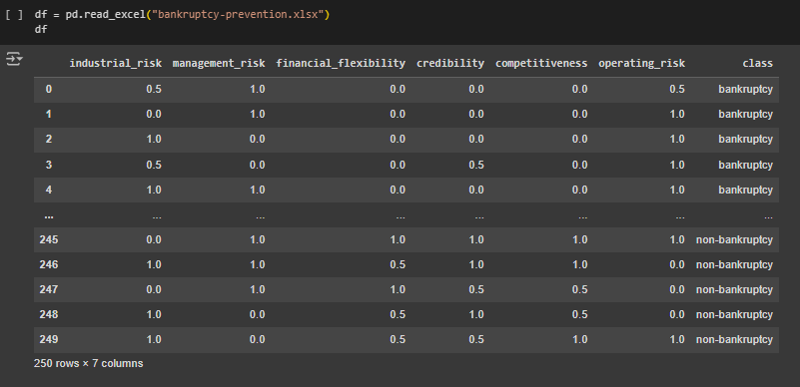
Collection Data
Here we have collected data and saved it into Dataframe named df

Slide 9
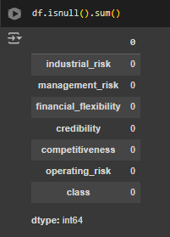
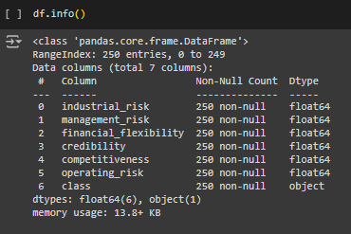
Exploratory Data Analysis(EDA)
Exploratory data analysis (EDA) is used to analyze and investigate data sets and summarize their main characteristics, often employing data visualization methods.
EDA is primarily about understanding the data, its underlying structure, patterns, and relationships, as well as identifying anomalies, missing values, and other characteristics
Checking for null values:
First we need to check for the null values from all the values , using isnull()
We can see there are no null values present in the data sets

Slide 10
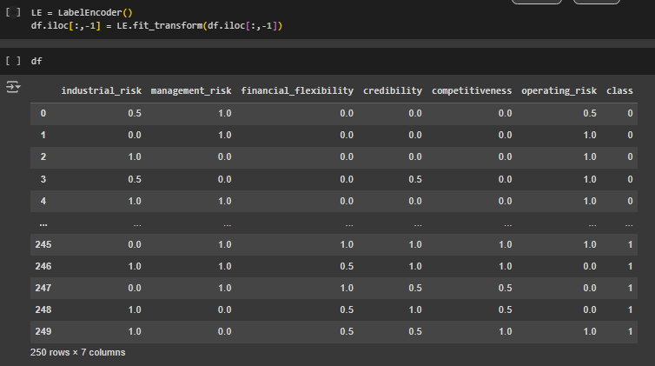
Label Encoding Target Variable
Here, bankruptcy = 0 and non-bankruptcy = 1

Slide 11
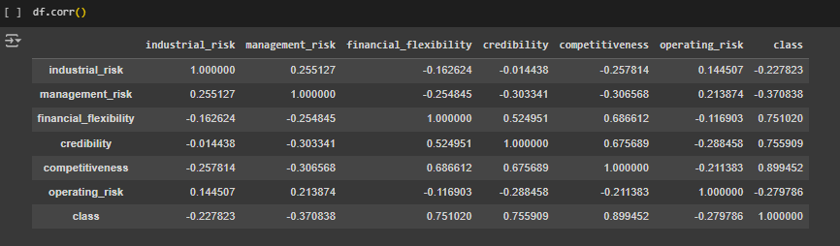
Calculating Correlation

Slide 12
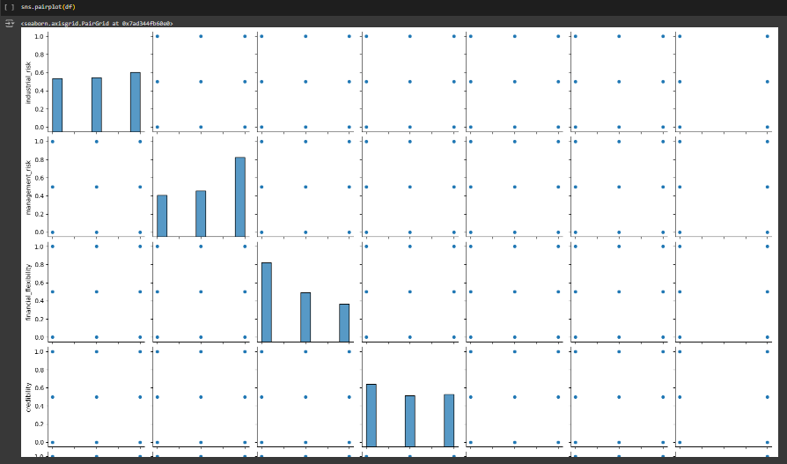
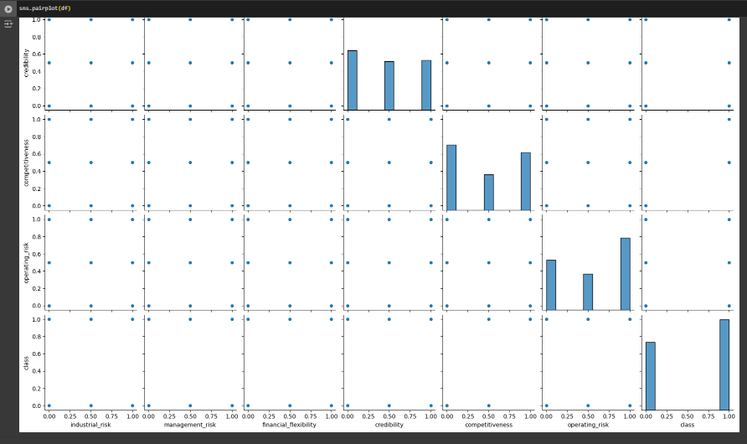
Visualization
Created Pair Plot of All Variables

Slide 13
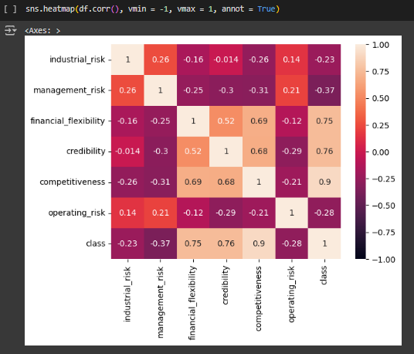
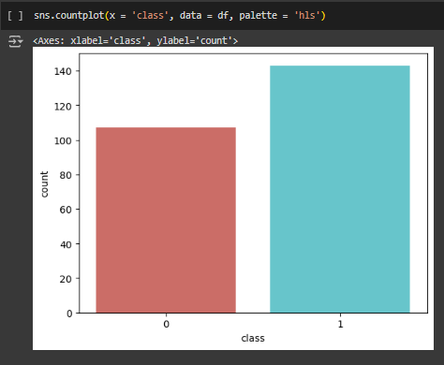
Heat Map
Count Plot between values of
Target Variable

Slide 14
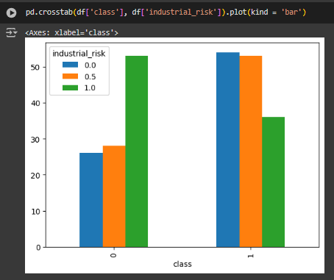
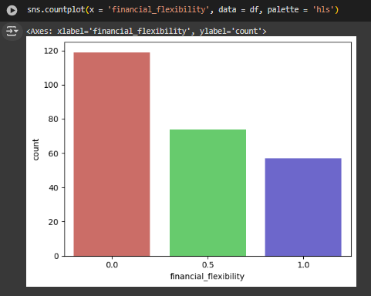
Created a Count Plot for financial_flexibility Variable
Creating Cross Tab using Bar-plot

Slide 15
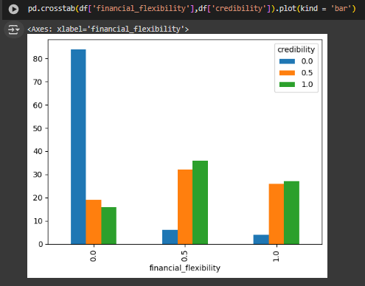
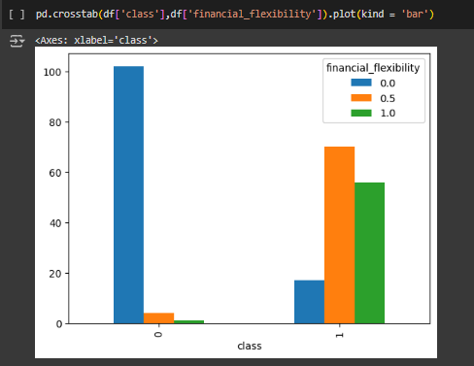
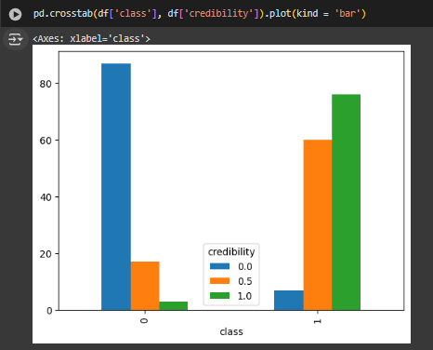
Created Cross Tab of
all variables respect to
The target variable

Slide 16
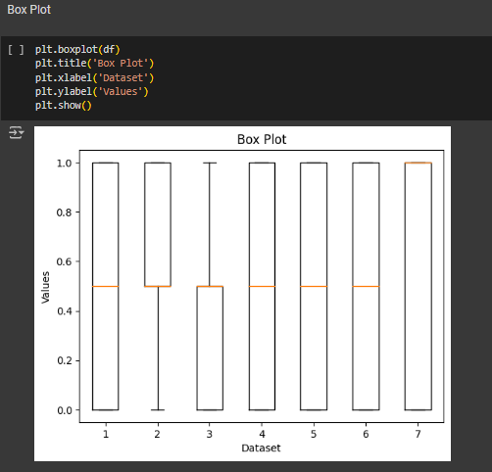
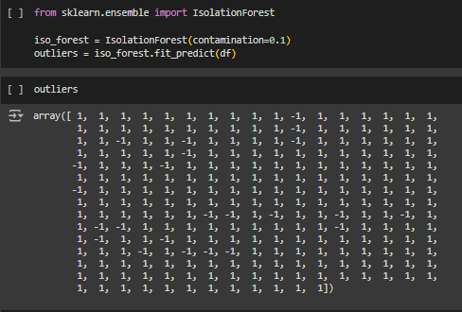
Detecting Outlier
Filtering outliers using Isolation Forest Technique
Created Box Plot of all the variables

Slide 17
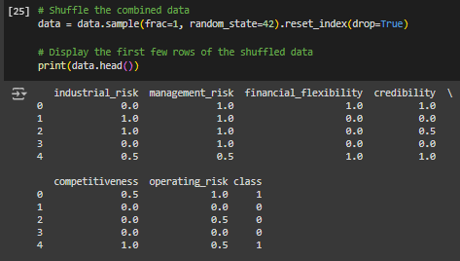
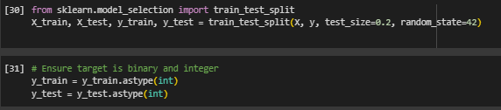

Shuffling the data
Splitting the data into training and test sets
Also ensuring that the target is binary
Standardize the data

Slide 18
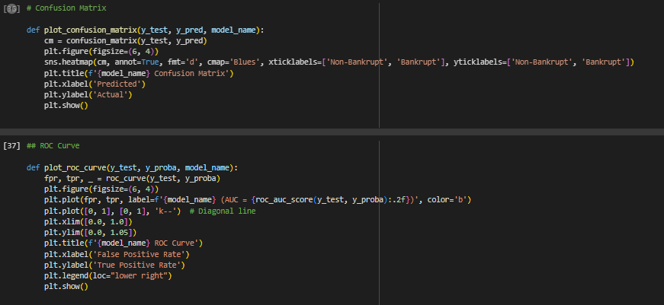
Created function for Confusion matrix and ROC Curve

Slide 19
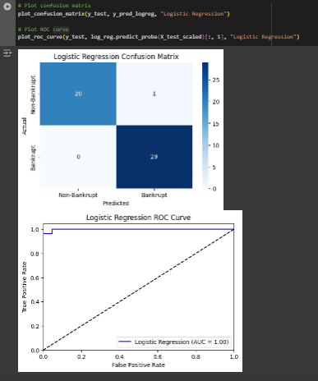
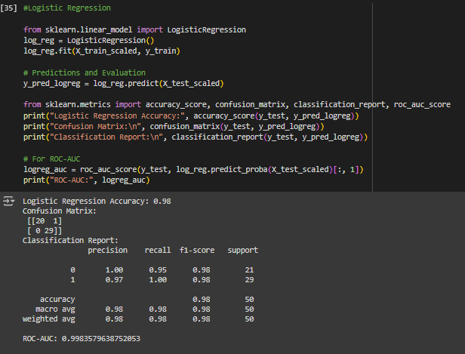
Model Building
Logistic Regression

Slide 20
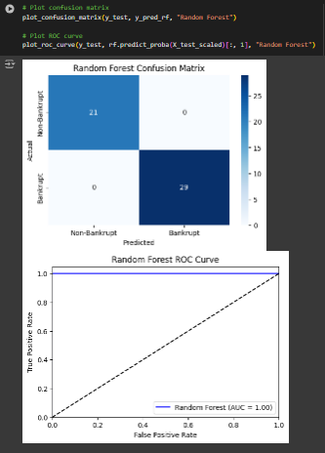
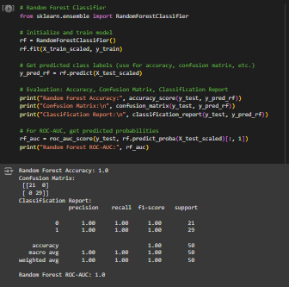
Random Forest Classifier

Slide 21
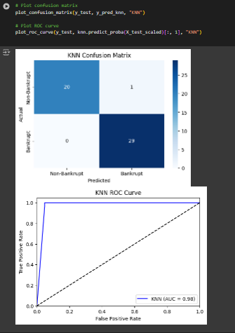
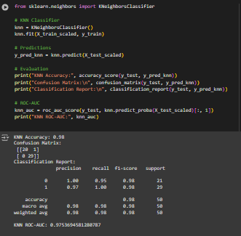
KNN Classifier

Slide 22
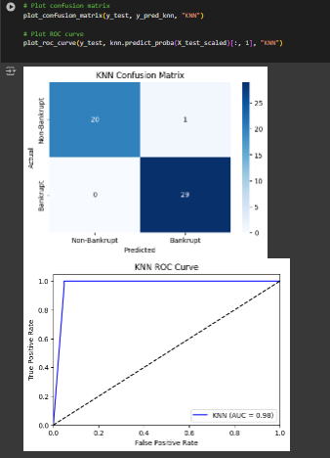
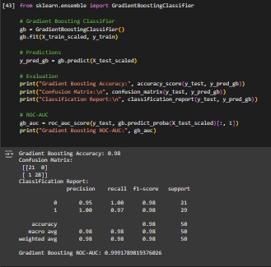
Gradient Boosting

Slide 23

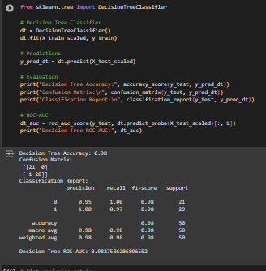
Decision Tree Classifier

Slide 24

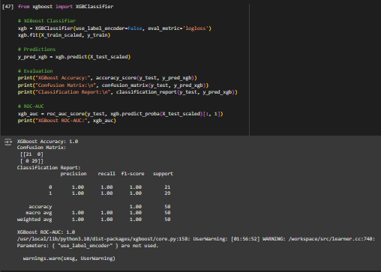
XG BoostClassifier

Slide 25
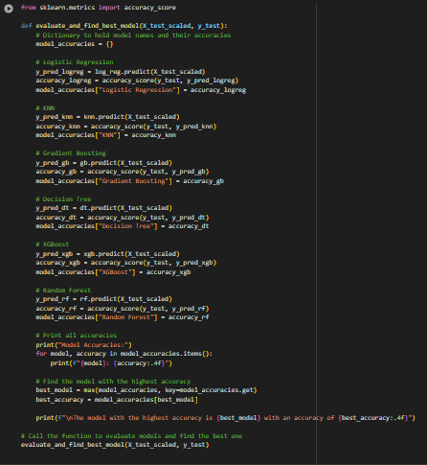

We tried to compare all the model’s accuracy, and we have an result that XGBoost Classifier is getting highest accuracy score of the highest rate of prediction, so We’ll go XGBoost Classifier Model for our Model Evaluation

Slide 26
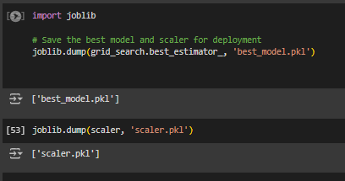
Creating pickle file of our model
In model building, a pickle file is used to save and serialize trained machine learning models, allowing them to be stored for later use without retraining. The Pickle module in Python converts the model object into a byte stream, which can then be saved as a file. This enables easy model reuse, sharing, and deployment

Slide 27
Model Deployment
Model deployment is the process of putting machine learning models into production. This makes the model's predictions available to users, developers or systems, so they can make business decisions based on data, interact with their application.
Model deployment can be a complex and time consuming process.
We make a model where we can input some parameters and analysis whether the news is real or fake
Using Streamlit to deploy our project.

Slide 28
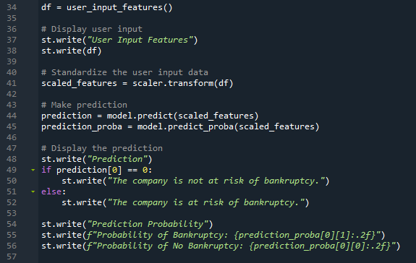
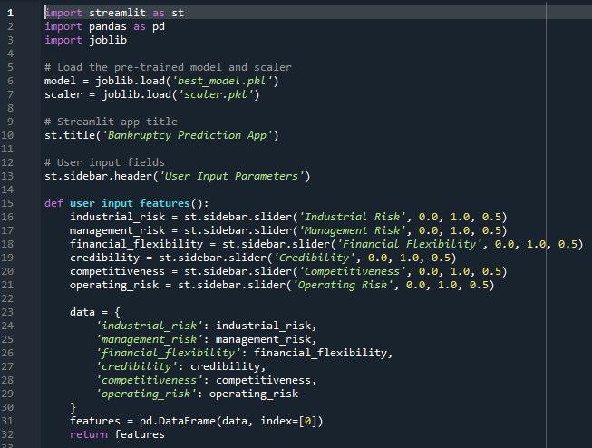
Code for Interface:
Reading all pickle files
user_input_features takes user input and will pass the argument and check for risk.

Slide 29
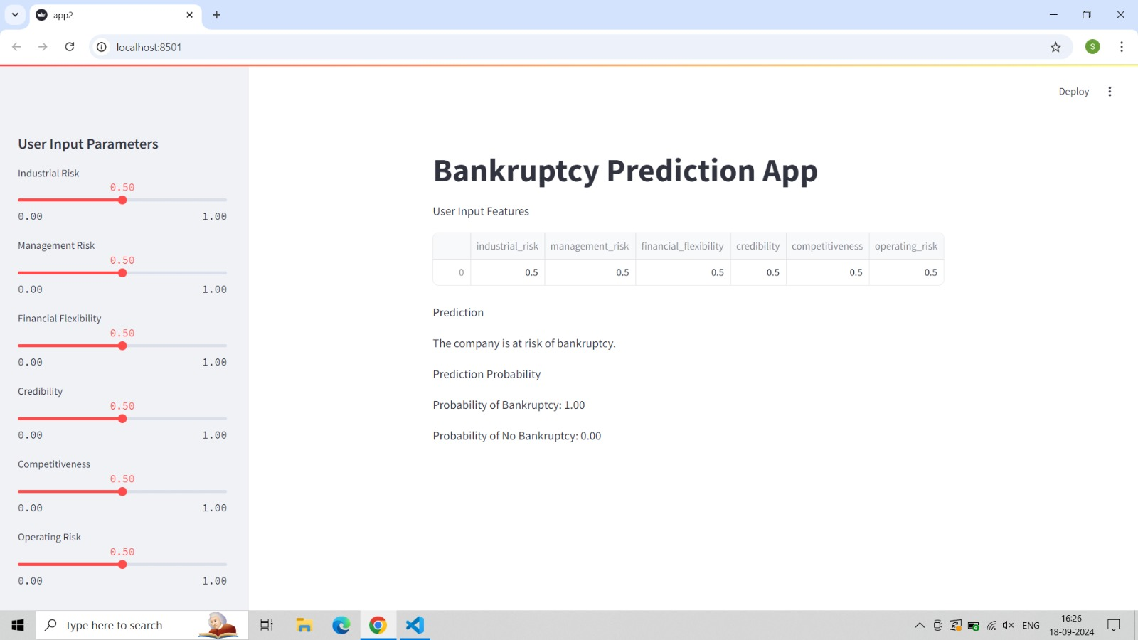
Interface of application

Slide 30
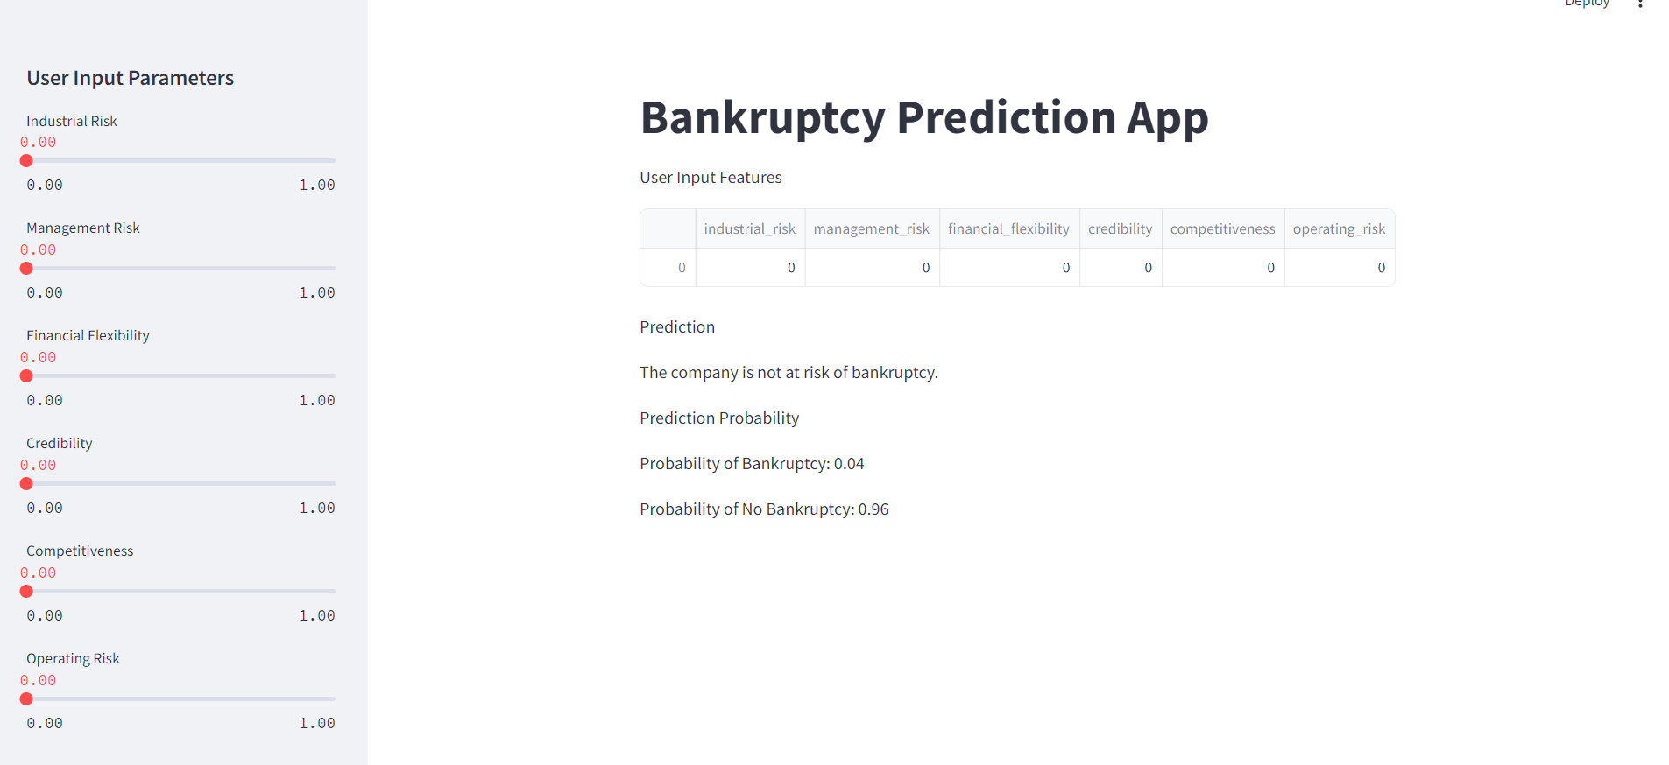
Testing of application
Low Risk Bankruptcy

Slide 31
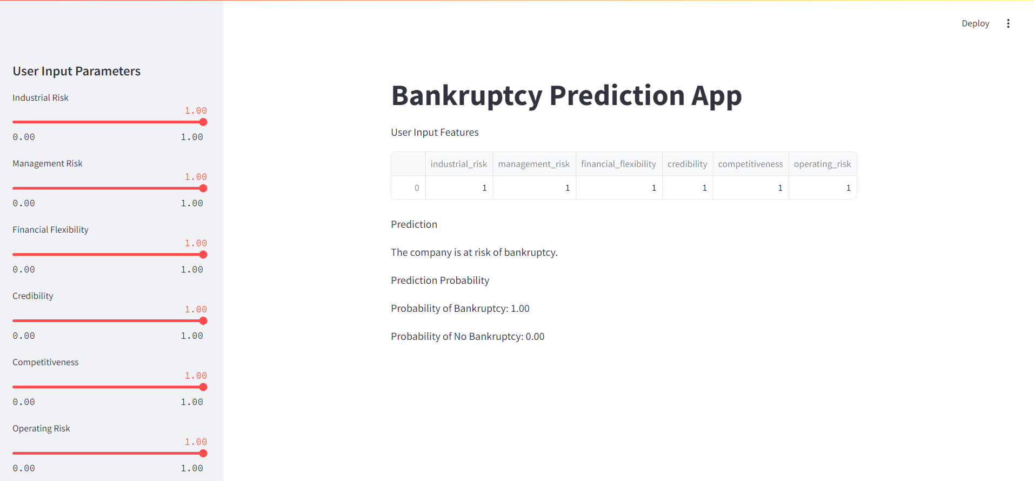
Testing of application
High Risk Bankruptcy

Slide 32
Conclusion
Effective Detection: The project successfully differentiates risk level with high accuracy rate, validating the effectiveness of the chosen machine learning models.
Key Features: Critical features like text patterns and keywords play a significant role in classification, proving essential for accurate risk analysis.
Ongoing Improvement: While the model performs well, continuous updates and refinements are necessary to handle emerging misinformation tactics and improve overall robustness.

Slide 33
Thank You!

