Slide 1
Fake real news detection
Team Members
PRATHAMESH CHANDRAKANT SATHE
MUBIN AHMAD TOKHI
MR. RAHUL Y R
SNEHAL JAIN

Slide 2

PROJECT OBJECTIVE:
"Fake Real News" Refers To Deliberately Fabricated Information Presented In A Format That Mimics Legitimate News. These Stories Are Designed To Deceive Readers By Appearing Credible, Often Exploiting The Trust Associated With Traditional News Outlets. The Intention Behind Such Content Can Range From Influencing Public Opinion To Generating Sensationalism For Profit, Ultimately Leading To Confusion And Misinformation. It Is Critical To Verify Sources And Cross-check Information To Avoid Falling Victim To These Misleading Narratives.

Slide 3


EXPLORATORY DATA ANALYSIS

Slide 4
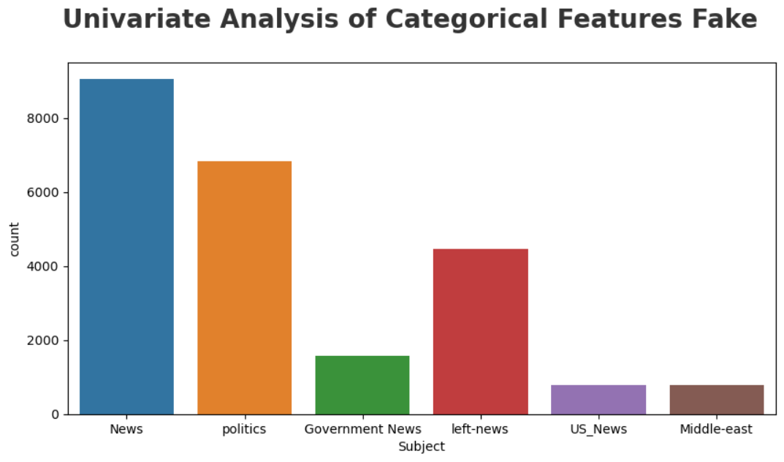
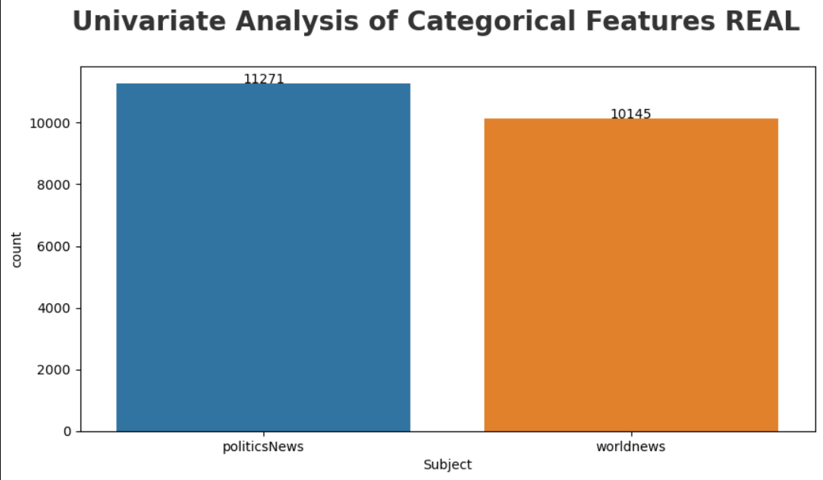
Univariate Analysis of Data
Real news data has only 2 subjects, where fake news includes 7 types of features.
In fake news data, most news are coming under news subject, and less news are coming under US_News.

Slide 5
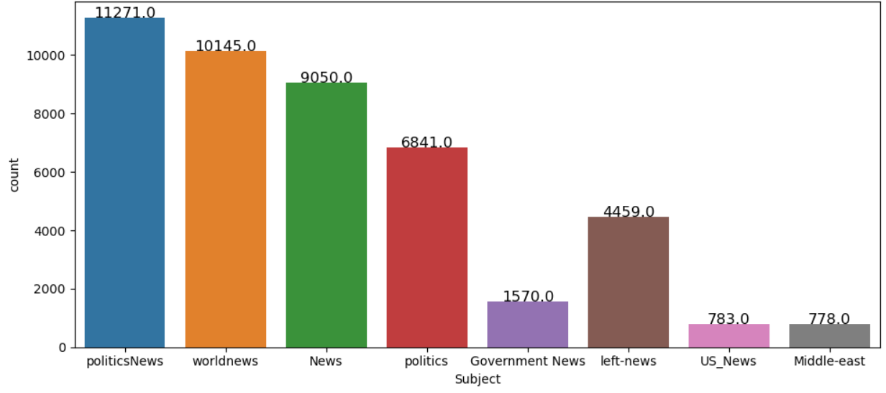
COMBINATION OF FAKE-REAL NEWS DATA

Slide 6
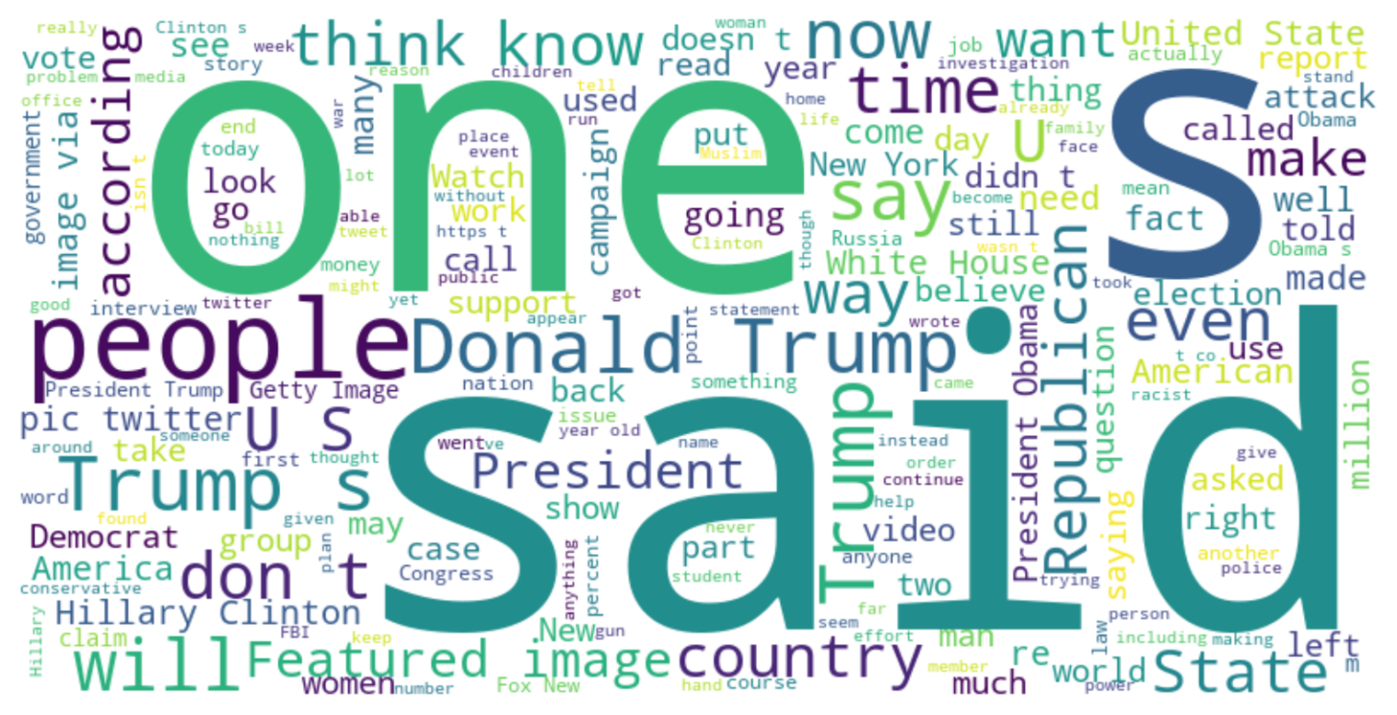
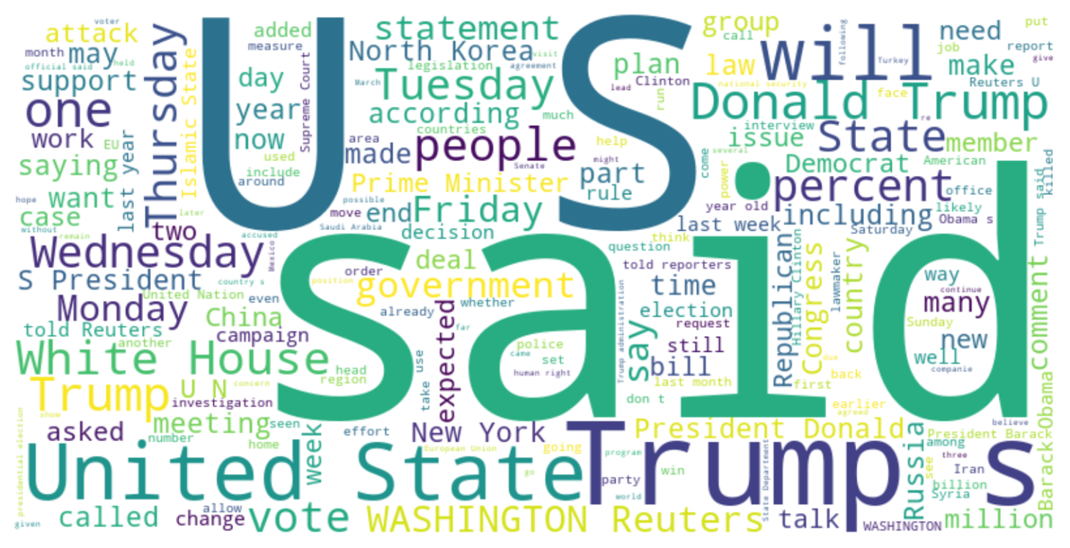
Word Cloud of Fake News
Word Cloud of
Fake News

Slide 7
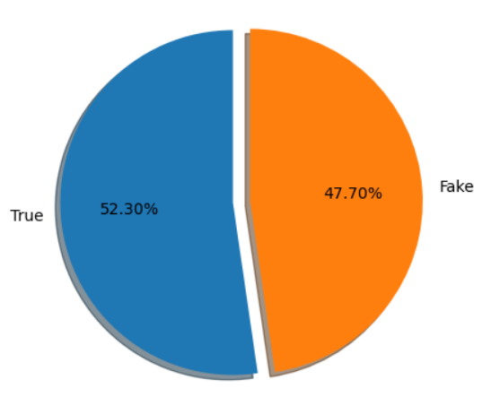
Checking balance of data

Slide 8
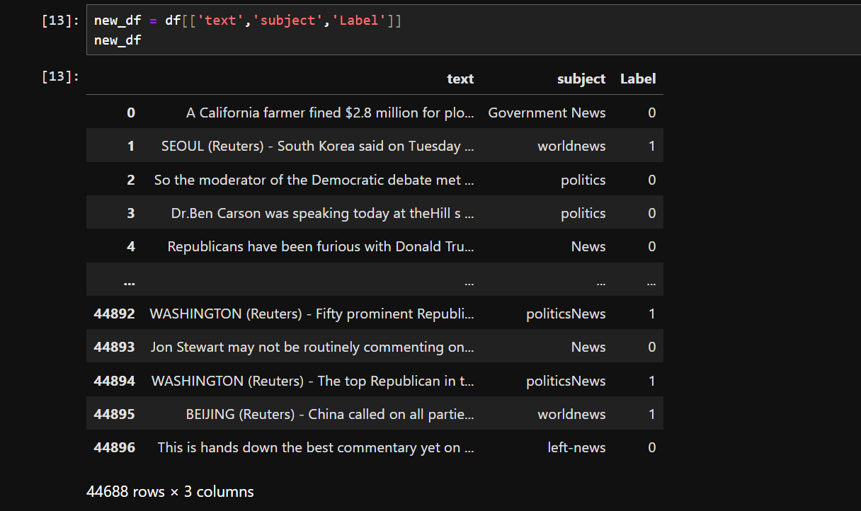
JOINING NECESSARY COLUNMS

Slide 9
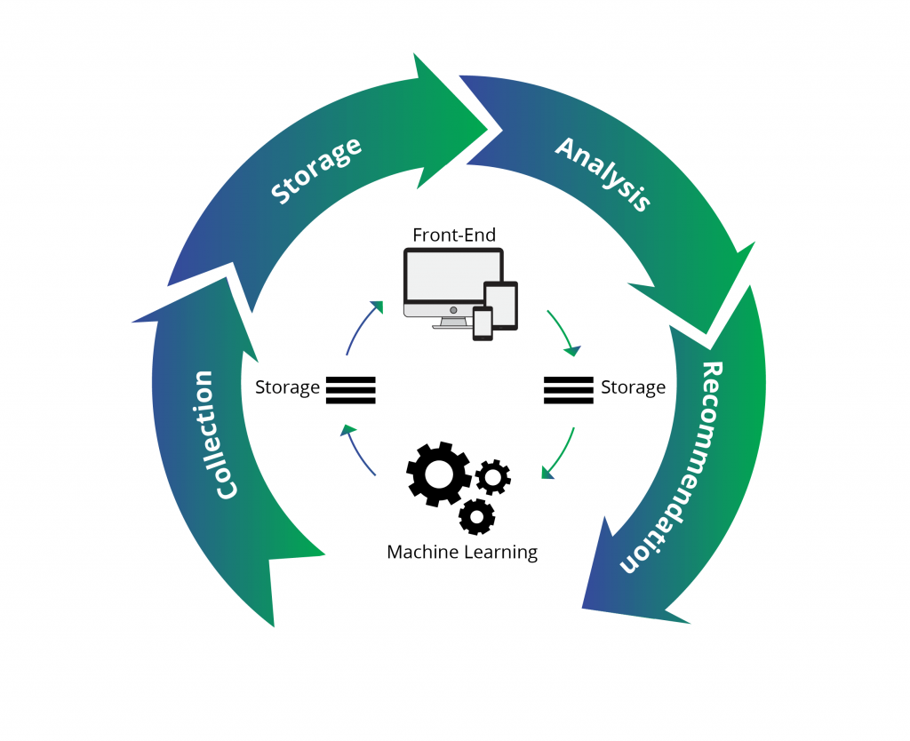
MODEL BUILDING

Slide 10
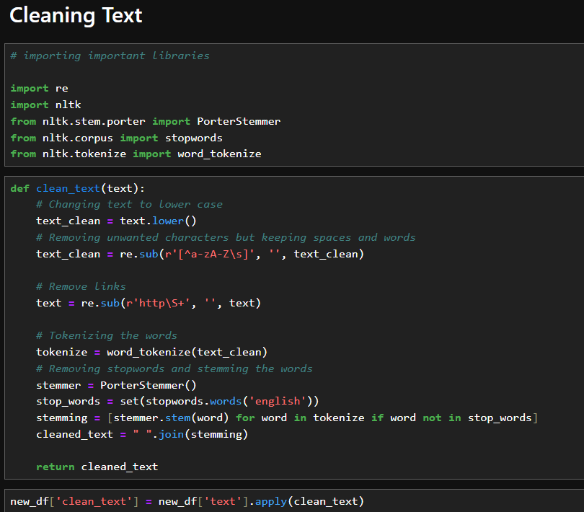
PRE-PROCESSING ON TEXT DATA

Slide 11
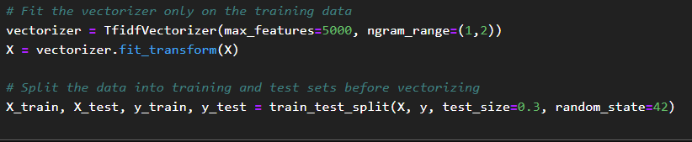
VECTORIZATION ON TEXT DATA

Slide 12
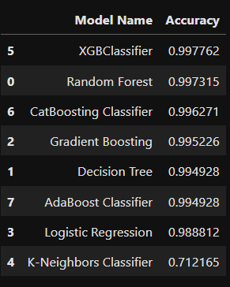
Model Accuracy Report

Slide 13
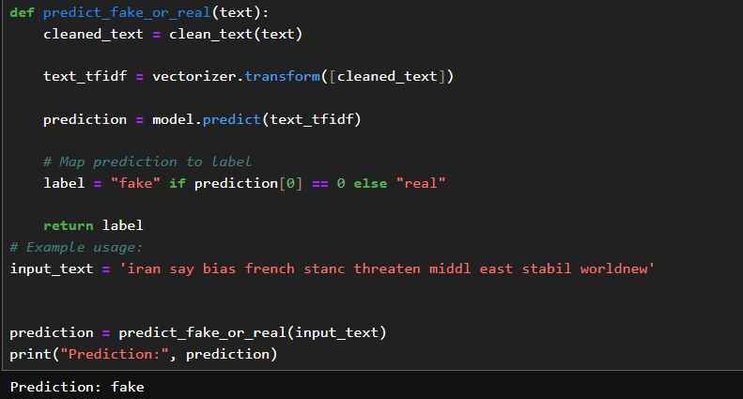
Model Prediction

Slide 14



Slide 15
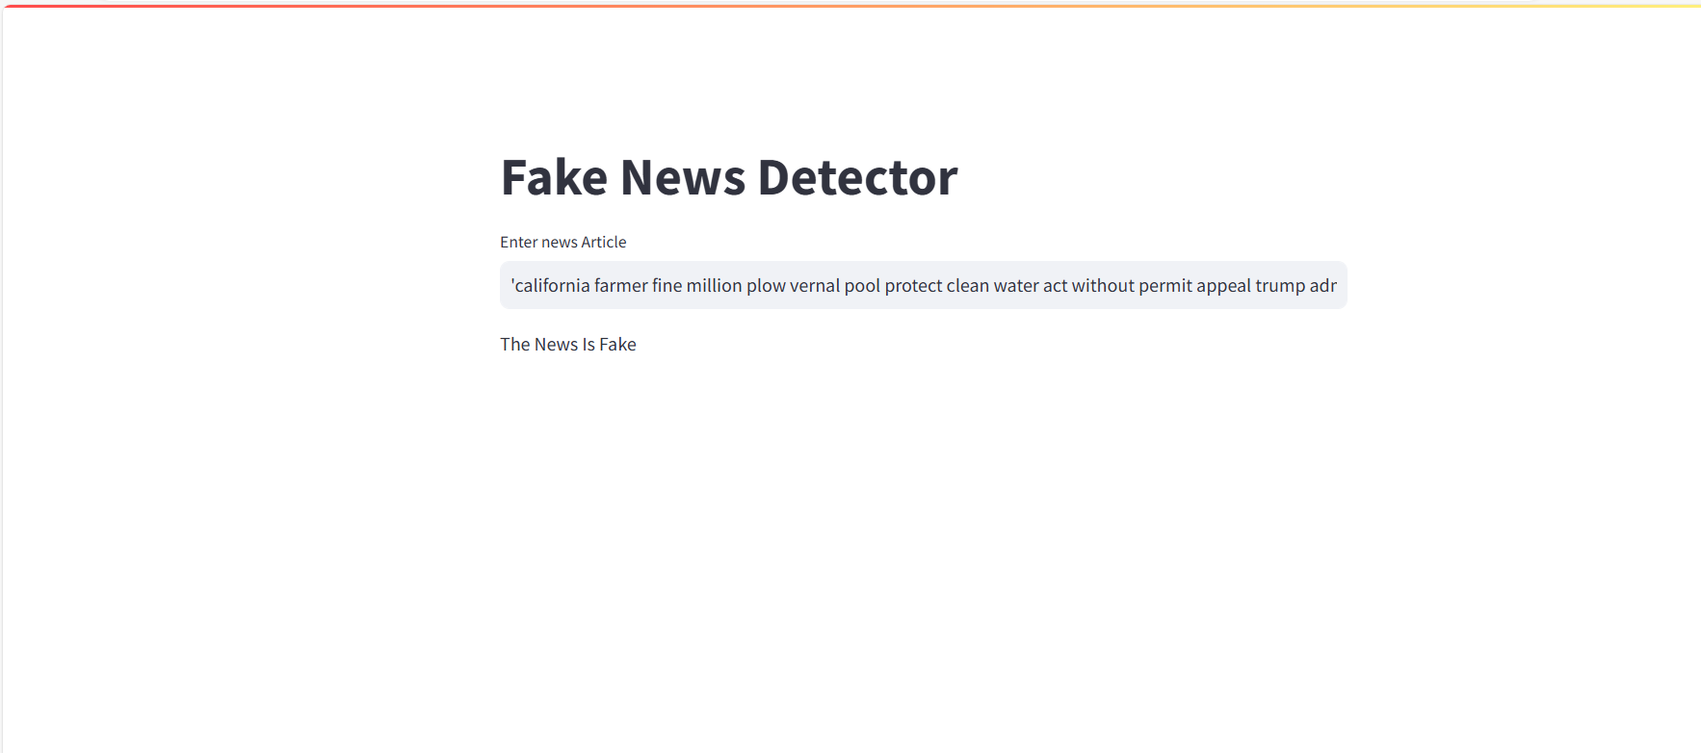
DEPLOYMENT

Slide 16
THANK YOU

