Slide 1
Forrelation
A problem admitting enormous quantum speedup,
which I and others have studied under various names over the years,
which is interesting complexity-theoretically and conceivably even practically,
and which probably deserves more attention
Scott Aaronson (MIT)

Slide 2
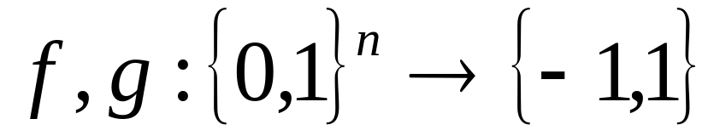
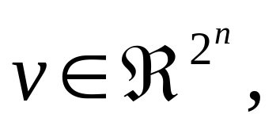
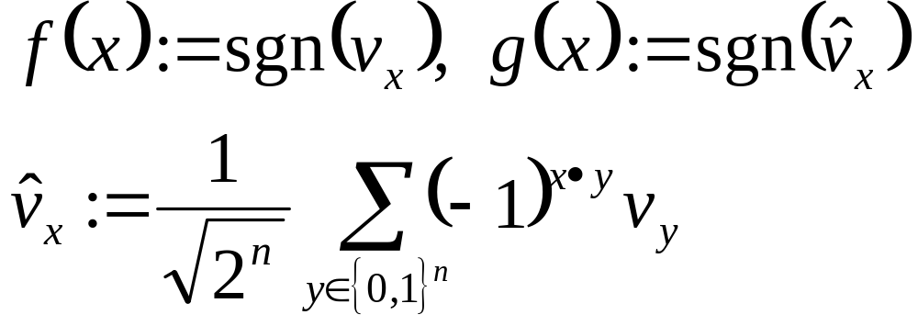
The Problem
Given oracle access to two Boolean functions
Decide whether
⟨f,g⟩ are drawn from the uniform distribution U, or
⟨f,g⟩ are drawn from the “forrelated” distribution: pick a random unit vector then let

Slide 3
Example
f(0000)=-1
f(0001)=+1
f(0010)=+1
f(0011)=+1
f(0100)=-1
f(0101)=+1
f(0110)=+1
f(0111)=-1
f(1000)=+1
f(1001)=-1
f(1010)=+1
f(1011)=-1
f(1100)=+1
f(1101)=-1
f(1110)=-1
f(1111)=+1
g(0000)=+1
g(0001)=+1
g(0010)=-1
g(0011)=-1
g(0100)=+1
g(0101)=+1
g(0110)=-1
g(0111)=-1
g(1000)=+1
g(1001)=-1
g(1010)=-1
g(1011)=-1
g(1100)=+1
g(1101)=-1
g(1110)=-1
g(1111)=+1

Slide 4
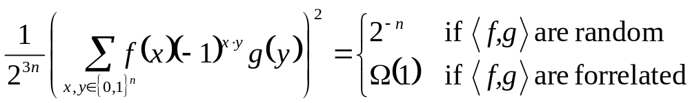
Trivial Quantum Algorithm!
|0⟩
H
H
H
|0⟩
H
f
H
g
H
|0⟩
H
H
H
Probability of observing |0⟩^{⊗n}:
Can even reduce from 2 queries to 1 using standard tricks

Slide 5
Classical Complexity of Forrelation
A. 2009: Classically, Ω(2^{n/4}) queries are needed to decide whether f and g are random or forrelated
Ambainis 2011: Improved to Ω(2^{n/2}/n)
Ambainis 2010: Any problem whatsoever that has a 1-query quantum algorithm—or more generally, is represented by a degree-2 polynomial—can also be solved using O(√N) classical randomized queries
N = total # of input bits (2^{n} in this case)
Putting Together: Among all partial Boolean functions computable with 1 quantum query, Forrelation is almost the hardest possible one classically!
de Beaudrap et al. 2000: Similar result but for nonstandard query model

Slide 6
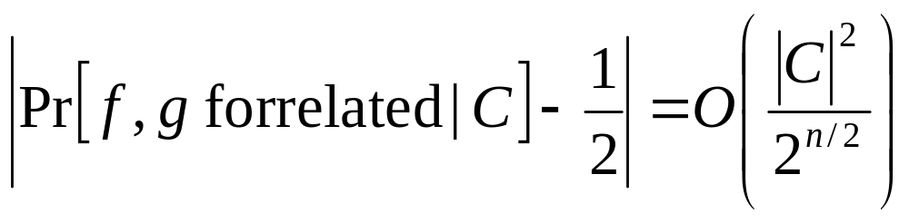
My Original Motivation for Forrelation
Candidate for an oracle separation between BQP and PH
Conjecture: No constant-depth circuit with 2^{poly(n)} gates can tell whether f,g are random or forrelated
A. 2009: For every conjunction C of f- and g-values,
I conjectured that this, by itself, implied the requisite circuit lower bound. (“Generalized Linial-Nisan Conjecture”) Alas, turned out to be false (A. 2011)
Still, the GLN might hold for depth-2 circuits
And in any case, Forrelation shouldn’t be in PH!

Slide 7
Different Motivation
This is another exponential quantum speedup!
Challenge: Can we find any “practical” application for it? I.e., is there any real situation where Boolean functions f,g arise that are forrelated, but non-obviously so?
Related Challenge: Is there any way (even a contrived one) to give someone polynomial-size circuits for f and g, so that deciding whether f and g are forrelated is a classically intractable problem?

Slide 8
k-Fold Forrelation
Given k Boolean functions f₁,…,f_{k}:{0,1}^{n}→{1,-1}, estimate
to additive error ±ε2^{(k+1)n/2}
Once again, there’s a trivial k-query quantum algorithm!
|0⟩
H
H
H
|0⟩
H
f₁
H
f_{k}
H
|0⟩
H
H
H
Can be improved to k/2 queries

Slide 9
Classical Query Complexity
Ambainis 2011: Any problem whatsoever that has a k-query quantum algorithm—or more generally, is represented by a degree-2k polynomial—can also be solved using O(N^{1-1/2k}) classical randomized queries
Conjecture: k-fold forrelation requires Ω(N^{1-1/2k}) randomized queries, where N=2^{n}
If the conjecture holds, k-fold forrelation yields all largest possible separations between quantum and randomized query complexities: 1 vs. Ω(√N) up to log(N) vs. Ω(N)
Right now, we only have the Ω(√N / log N) lower bound from restricting to k=2

Slide 10
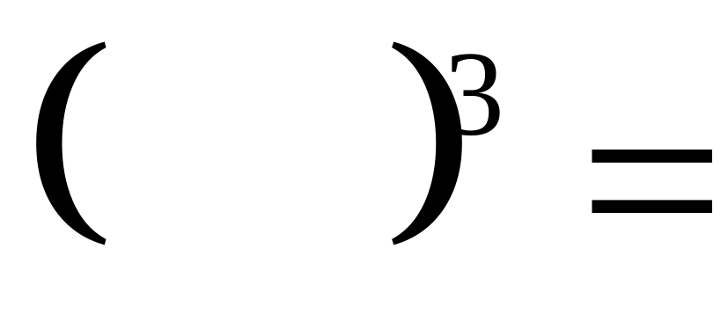
k-fold Forrelation is BQP-complete
|0⟩
H
H
H
|0⟩
H
f₁
H
f_{k}
H
|0⟩
H
H
H
Starting Point: Hadamard + Controlled-Controlled-SIGN is a universal gate set
Issue: Hadamards are constantly getting applied even when you don’t want them!
S
W
A
P
Solution:
H
C
P
H
A
S
E
H

Slide 11
Want to explain QC to a classical math/CS person?
What a quantum computer can do, is estimate sums of this form to within ±ε2^{(k+1)n/2} , for k=poly(n):
“Most self-contained” PromiseBQP-complete problem yet? Look ma, no knots!
k=polylog(n) ⇒ PromiseBQNC-complete problem

Slide 12
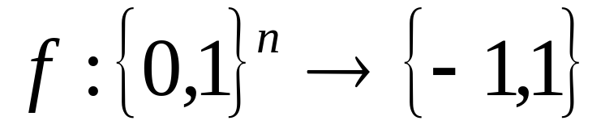
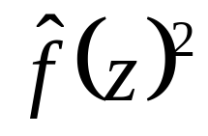
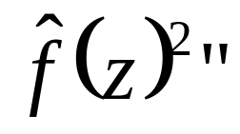
Fourier Sampling Problem
Given a Boolean function
output z∈{0,1}^{n} with probability
Also a search version: “Find z’s that mostly have large values of
A. 2009: If f is a random black-box function, then the search problem isn’t even in FBPP !
Trivial Quantum Algorithm:
|0⟩
H
H
|0⟩
H
f
H
|0⟩
H
H
PH^{f}

Slide 13


Bremner and Shepherd’s IQP Idea
arxiv:0809:0847
Classical verifier
Fourier Sampling oracle
Obfuscated circuit for f
Samples from f’s Fourier distribution
“Yes, those samples are good!”
Bremner and Shepherd propose a way to do this. Please look at their scheme and try to evaluate its security!

Slide 14
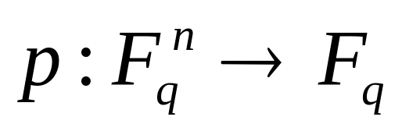
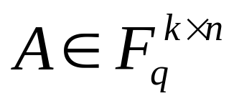
Instantiating Simon’s Black Box?
Given: A degree-d polynomial
specified by its O(n^{d}) coefficients
Goal: Find the smallest k such that p(x) can be rewritten as r(Ax), where r is another degree-d polynomial and
This problem is easily solved in quantum polynomial time, by Fourier sampling! (Indeed, ker A is just an abelian hidden subgroup)
Alas: By looking at the partial derivatives of p, it’s also solvable in classical polynomial time—at least when d<q

Slide 15
Summary
Forrelation: A problem that QCs can solve in 1 query, and that’s “maximally classically hard” among such problems
k-Fold Forrelation: A problem that QCs can solve in k queries, that we think is maximally classically hard among such problems, and that captures the power of BQP (when k=poly(n)) or BQNC (when k=polylog(n))
Fourier Sampling: A sampling problem, closely related to Bremner/Shepherd’s IQP (and to Simon’s algorithm), that yields extremely strong results about the power of QC relative to an oracle. Maybe even in the “real” world?

