Slide 1

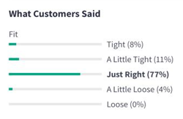
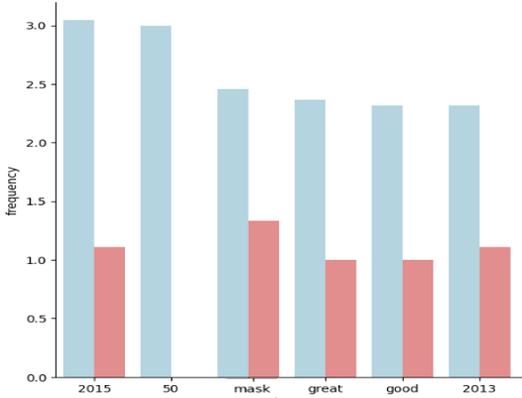

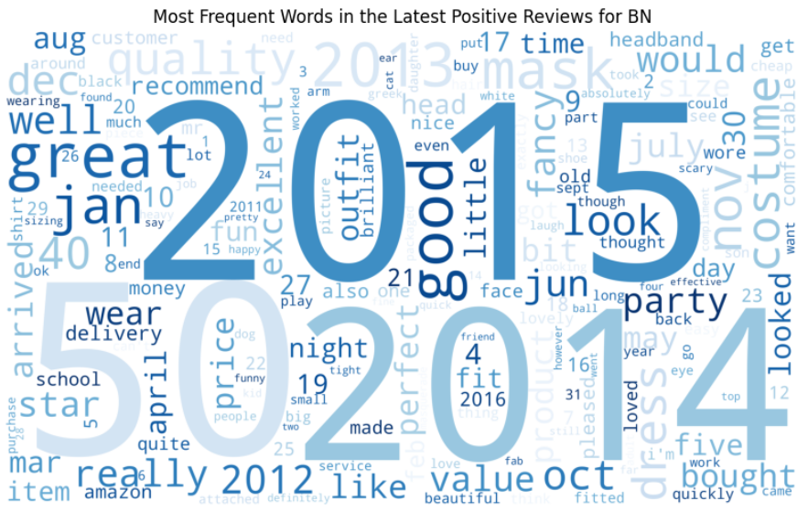
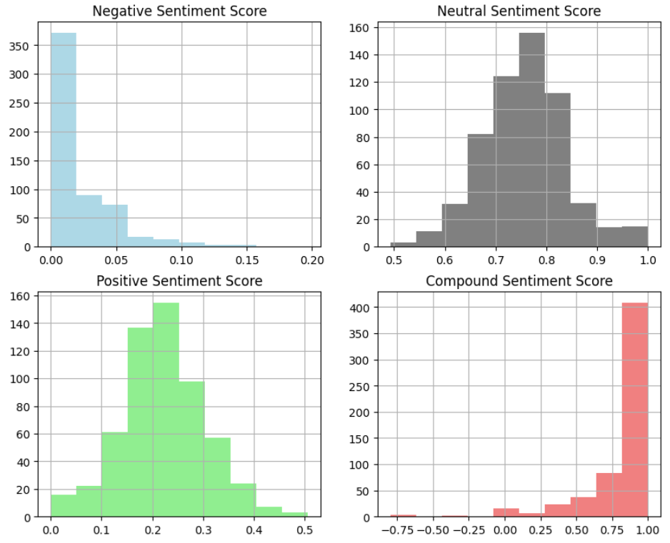
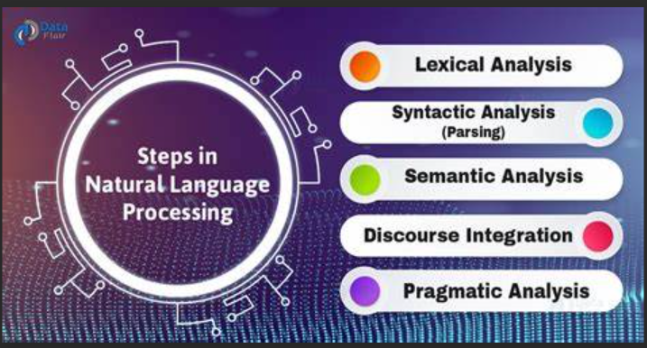
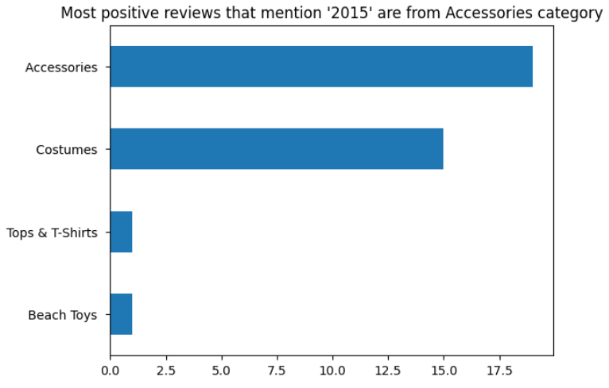
"Examining Fashion Products on Amazon.com to Provide Constructive Feedback to Manufacturers“
Snehal Rode
Mentor: Dr. Christelle Scharff
Pace University, Seidenberg School of CSIS
GitHub - https://bit.ly/3LIweg1
Notebook - https://bit.ly/3B6tg01
Abstract
Records – 10,000 with 898 features
Total Categories – 48
Duration – May 2020 – June 2021
2) In this research, Sentiment analysis considers ratings above 3 as positive else as negative.
3) Bristol Novelties emerges as the most purchased and preferred brand.
4) TF-IDF vectorization algorithm, Topic Modeling, Feature importance for sentiment classification, Sentiment analysis using VADER are performed
Natural Language Processing (NLP) is a crucial aspect of the AI world as it facilitates effective communication and interaction between humans and machines.
By utilizing NLP models like TF-IDF Vectorization, Topic Modeling, Feature importance for sentiment classification, VADER, and Text summarizing, insights and trends can be extracted to make strategic business decisions.
Related work
Recent study(Dec 2022) by Urvi Sharma focuses on personalized fashion recommendations using a page ranking recommender system.
Case study by V. R. Welgamage (2021) employs machine learning algorithms to conduct feature-level sentiment analysis of Amazon fashion product reviews. The methodology includes aspect extraction, topic modeling, and requirement revision. The results of these studies can be used to better understand consumer preferences and improve marketing strategies in the e-commerce fashion industry.
2015
dress
mask
great
On-time
party
Fig 4: Frequent words in positive and negative reviews
Result
Model | Accuracy
Sentiment analysis using VADER | 82.37%
TF- IDF vectorization | 74.56%
Identifying Named Entities | 67.36%
Introduction
The Covid-19 pandemic has changed buying behavior, where online purchases have increased and customer reviews have become crucial for manufacturers to improve product quality, customer satisfaction, and gain competitive advantage.
However, handling customer reviews using NLP algorithms can be challenging due to factors like large data volumes, varying data quality, language diversity
Methodology
Fig 2: Wordcloud for positive reviews
Research Question
How to build a NLP model utilizing customer reviews and ratings, allowing manufacturers to obtain valuable feedback on their products and make improvements accordingly?
Fig 5: Sentiment analysis using VADAR
Conclusions & Future Work
Fig 1: Different methodologies used in NLP
Reference : https://bit.ly/3HQRsHq
Successfully achieved the goal of giving suggestion to manufacturer for product improvement. Accuracy of NLP can be improved by working on advance technique of contextual understanding and resolving problem of language variation by converting all languages into a common or majorly used language.
Dataset
Experiments
Dataset URL – https://bit.ly/41XQ8tX
Source – Amazon.com reviews (United Kingdom)
Size – considered subset of 1 GB (Original 20 GB)
1) I have applied various NLP techniques such as tokenization, stop word removal, lemmatization, and text conversion to lowercase on the “Customer Reviews” feature.
Fig 3: Deciding Category based on frequency

