Slide 1
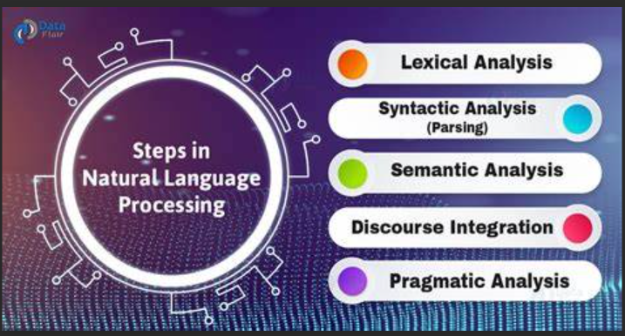
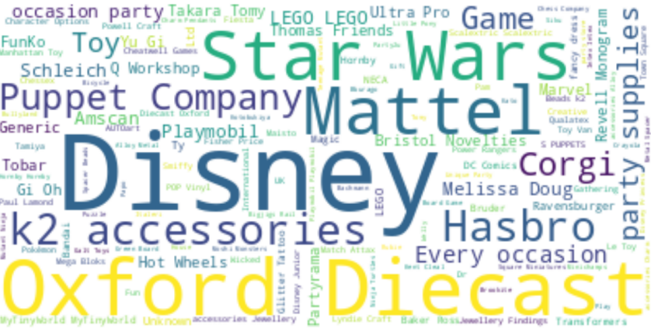
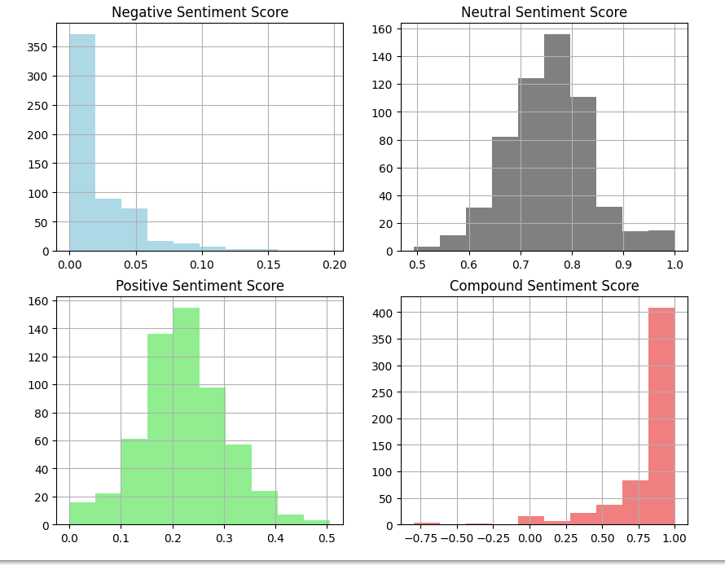
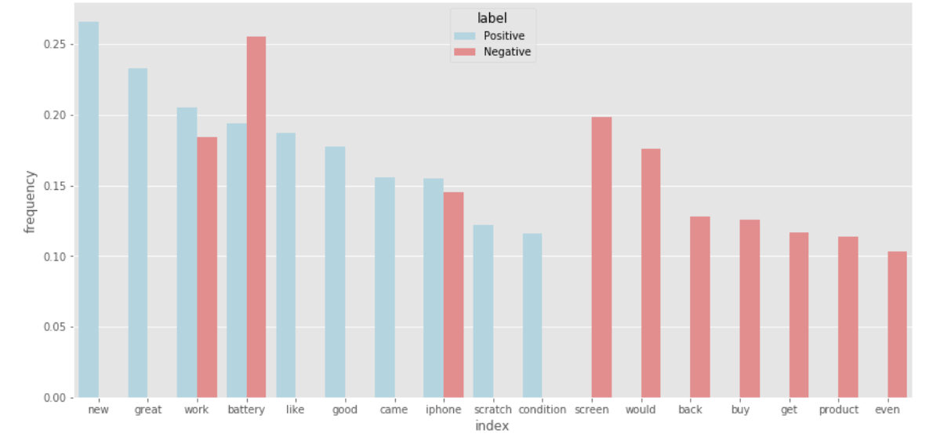
Fashion products on Amazon.com
Snehal Vilas Rode
PACE UNIVERSITY, NEW YORK
.
Abstract
Methods
Results
For a fashion dataset, develop a meaningful insight using natural language processing technique to predict area of improvement to the manufacturer from customer reviews, ratings and price
Introduction
This is a pre-crawled dataset, taken as subset of a bigger dataset (more than 7 million fashion products) that was created by extracting data from Amazon.
Experiments
conclusion & future work
TF-IDF Vectorization
Topic Modeling
Feature importance for sentiment classification
Sentiment analysis using VADER
Identifying named entities
Text summarizing
Related Work
Previous work was more focused with respect to marketing and product designers to comprehend consumer preferences in the e-commerce fashion business more clearly.

