Slide 1

PREDICTION OF PARKINSON'S DISEASE USING MACHINE LEARNING
Team Members
1. Rohan Varier - 1DS18CS107
2. Shruthi S Durgai - 1DS19CS154
3. Snehal H Chavan - 1DS19CS160
4. Narkedemilli Yasaswini - 1DS19CS102
Under the Guidance of
Name of the Guide : Prof. Muquitha Almas
Designation, Professor, Dept of Computer Science and Engineering

Slide 2

Contribution

Slide 3
Abstract
Parkinson's disease (PD) is a chronic neurodegenerative disorder characterized by motor impairments, including tremors, rigidity, and bradykinesia. Early and accurate detection of PD is crucial for effective disease management and intervention. This abstract presents a study focused on the prediction of Parkinson's disease using machine learning techniques. Several machine learning algorithms were evaluated for their performance in predicting Parkinson's disease. These algorithms included decision trees, support vector machines, random forests, and artificial neural networks. The dataset was divided into training and testing sets to assess the models' generalization capabilities and minimize overfitting. To enhance the predictive accuracy of the models, a feature selection process was employed to identify the most informative features. This step aimed to reduce the dimensionality of the dataset and improve the efficiency of the models without compromising their predictive power. The performance of the machine learning models was evaluated using various evaluation metrics, such as accuracy, precision, recall, and F1 score. Additionally, receiver operating characteristic (ROC) curves and area under the curve (AUC) values were calculated to assess the models' discriminatory power. This study highlights the potential of machine learning techniques in assisting clinicians and researchers in the early diagnosis and prediction of Parkinson's disease. The developed models and feature selection approach can aid in the development of robust and accurate predictive tools, facilitating early intervention and personalized treatment strategies for PD patients.

Slide 4
Introduction
NEURON or a nerve cell is the basic unit of the nervous system. There are different types of neurons. One such type is the motor neuron; these neurons receive signals from the brain and spinal cord and cause the muscles to contract or relax. Parkinson’s is a chronic and progressive disease. More than 10 million people worldwide are living with this disorder. It is also called the movement disorder. Parkinson’s is caused due to malfunctioning of some vital neurons located in the region called the substantia nigra of the midbrain. These neurons produce dopamine, a chemical responsible for transportation of signal from substantia nigra to the next location in the brain and further to the peripheral body parts. Along with dopamine another chemical called acetylcholine which is a neurotransmitter is produced in the brain. For smooth motor function, there should be a balance between the amount of dopamine and acetylcholine produced. When the neurons in the midbrain start degrading the balance between the amount of dopamine and acetylcholine is disturbed which in turn leads to improper muscle contraction and hence the patient experiences jerks or sometimes even rigidity. Based on the different techniques the come under ML, we have decided to use few of the techniques to overcome the disease well in advance to eradicate the disease

Slide 5
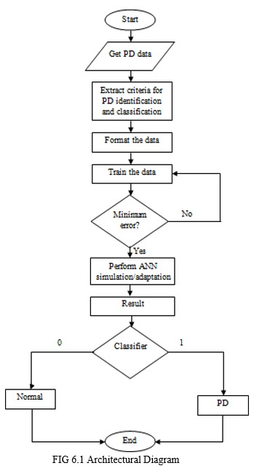
SYSTEM Architecture & Methodology
Get the Parkinson’s disease database that conatins training and testing data. The testing and training data is split. In Training Data the data is preprocessed and the features are selected. The training takes place and a predictive model is made. Data preprocessing and feature selection happens for the testing data too. The predictive model that is got from the training data is used in the prediction phase and the prediction is done.

Slide 6
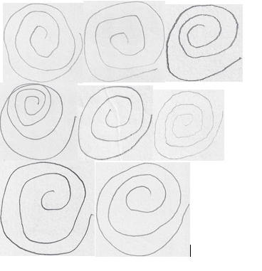
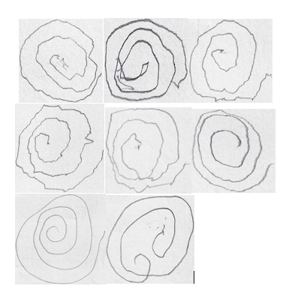
DATA SETS
The dataset that we would be using would be categorized into two parts; healthy people and people affected with Parkinson’s disease. The input that we would be using would be spiral and wave images that the PD patients would be drawing with their own hands. During this process of them drawing we can predict at what stage the PD patients are. Healthy Person Parkinson’s Person

Slide 7
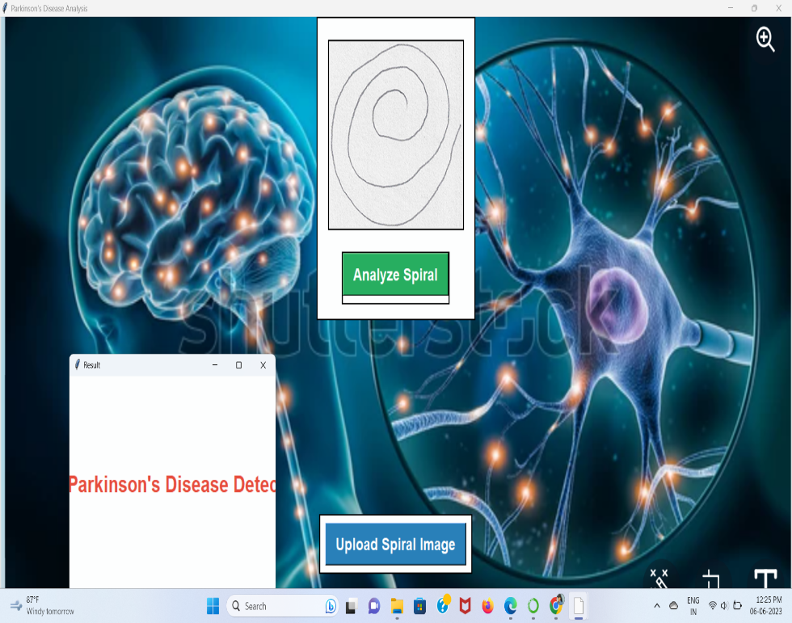
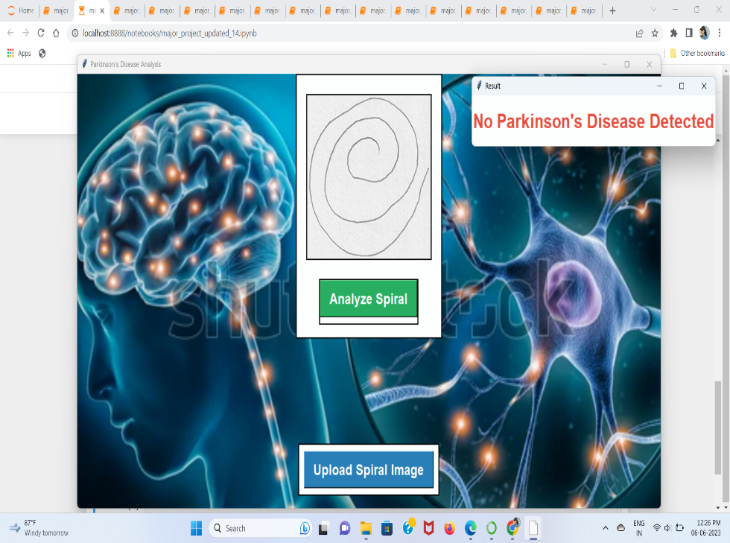
TESTING
Testing the Wave & Spiral Images We used different spiral images from two different kinds of people; healthy and Parkinson’s patient. After training the model we got an accuracy of 83% which would predict if the person had Parkinson’s disease or not.

Slide 8
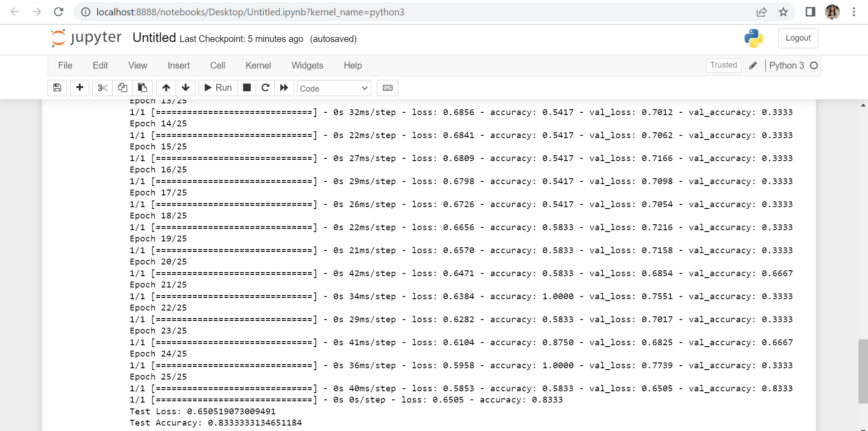
TESTING MODEL & ACCURACY
As seen below, the model is tested and trained to give an accuracy of 83% which can detect if the person had Parkinson’s disease or not.

Slide 9
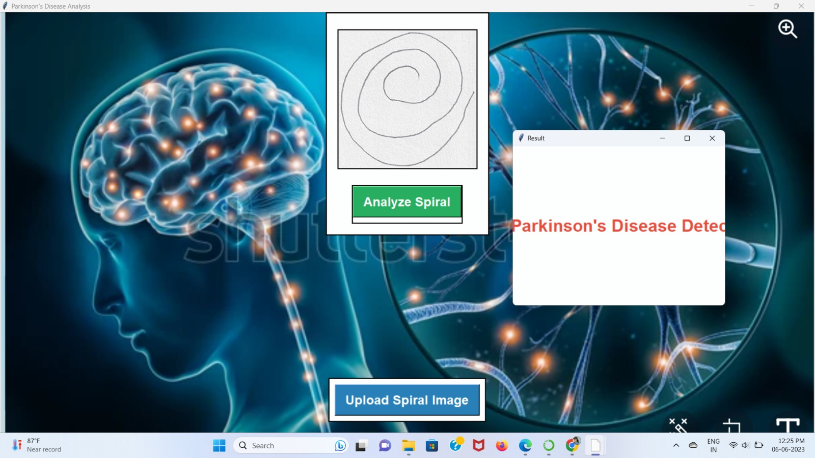

IMAGES AND RESULTS
As seen below the images are classified and show whether the person has Parkinson’s disease or is healthy with the help of this project. .

Slide 10
CONClusion
After testing the data sets of a spiral and wave images of a healthy and a PD person we got 83% accuracy to predict this disease However, there are several limitations and challenges that need to be addressed for the model to be more reliable and applicable in clinical setting These include the subjectivity of spiral drawings, limited representation of Parkinson’s symptoms, small and biased datasets, dependence on feature extraction techniques, external factors influencing the drawings, and the need for validation and comparison with other diagnostic methods. So finally by looking at these result’s we can’t conclude that whether it is PD or NOT ,so it can be used a supplementary tool in the medical field.

Slide 11
Thank You

