Slide 1
Name: Snehal kadam
Module: Fund’s SQL
Batch : 12pm-2pm
Batch Faculty: Nidhi Bhatt
Topic: Library Management System

Slide 2
Introduction
A library management system is software that is designed to manage all the functions of a library.
It helps librarian to maintain the database of new books and the books that are borrowed by members along with their due dates.
This system completely automates all your library's activities.
The best way to maintain, organize, and handle countless books systematically is to implement a library management system software.

Slide 3
Tables in DataBase.
Books
Members
Details

Slide 4
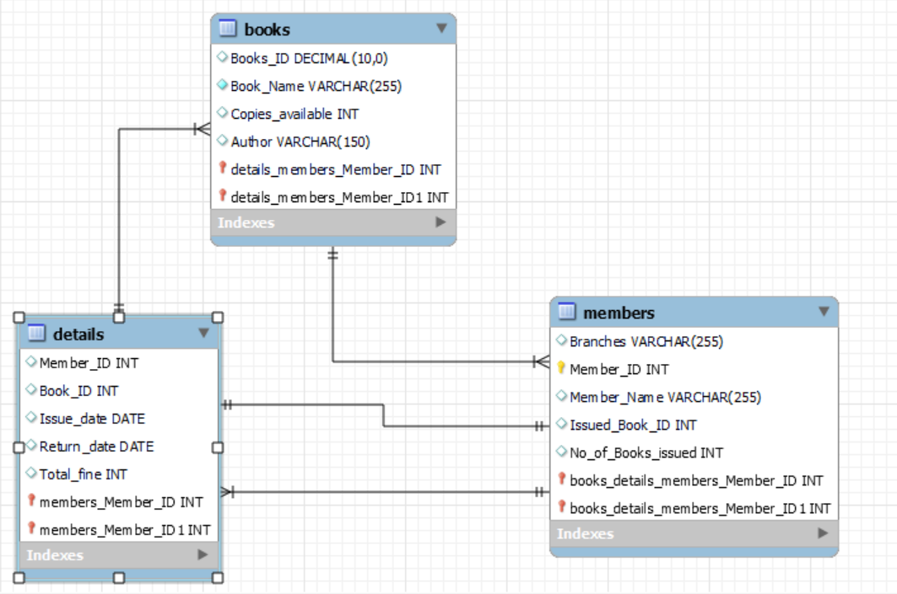
ER Diagram

Slide 5
To Create a DataBase.

Slide 6
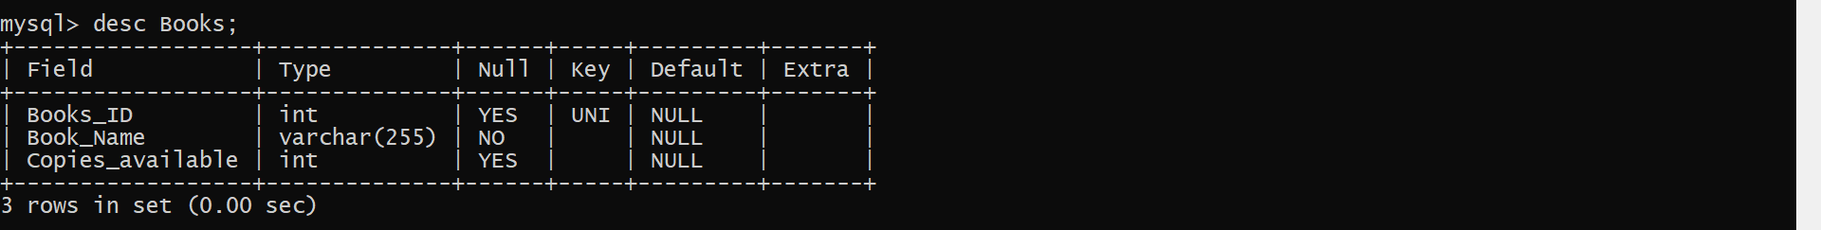
To Show the Structure of Table.

Slide 7
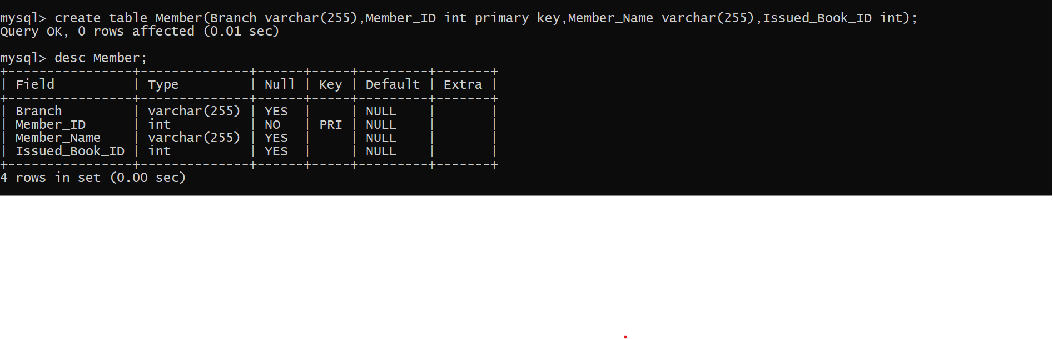
To Show the Structure of Table.

Slide 8
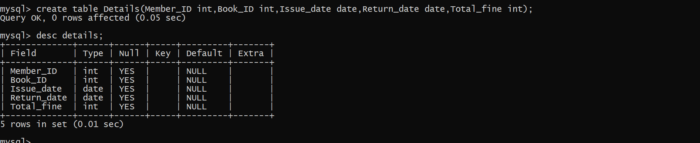
To Show & Create the Structure of Table.

Slide 9
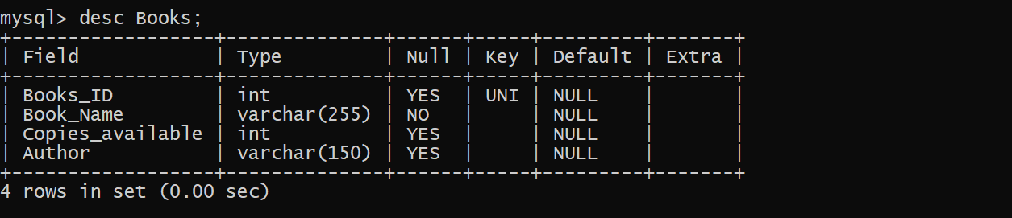
To Show the Structure of Table.

Slide 10
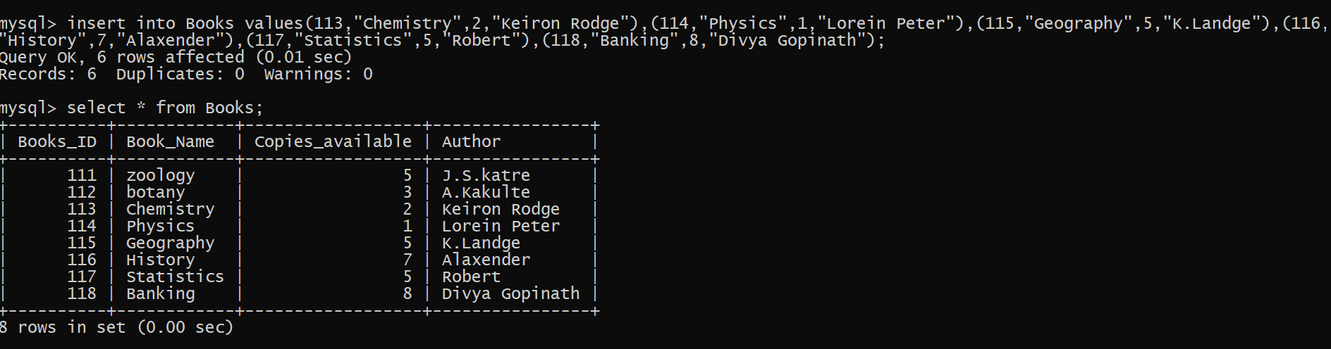
To Insert & Read Data in Table.

Slide 11
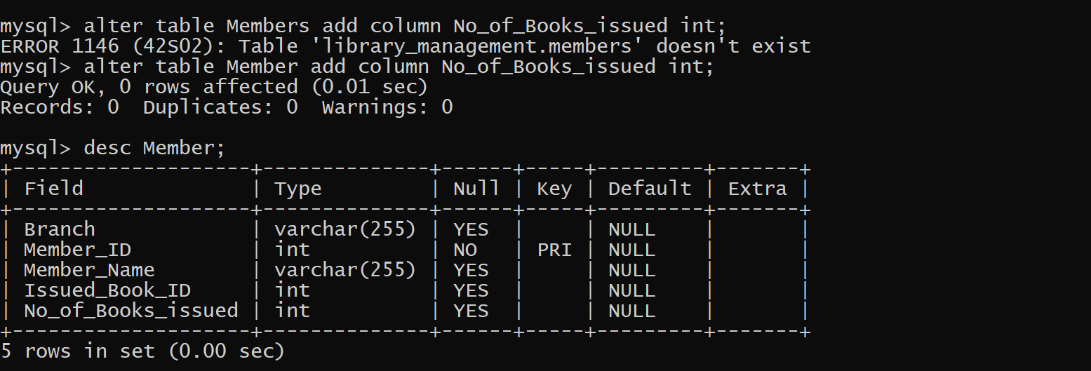
Alter Commands

Slide 12
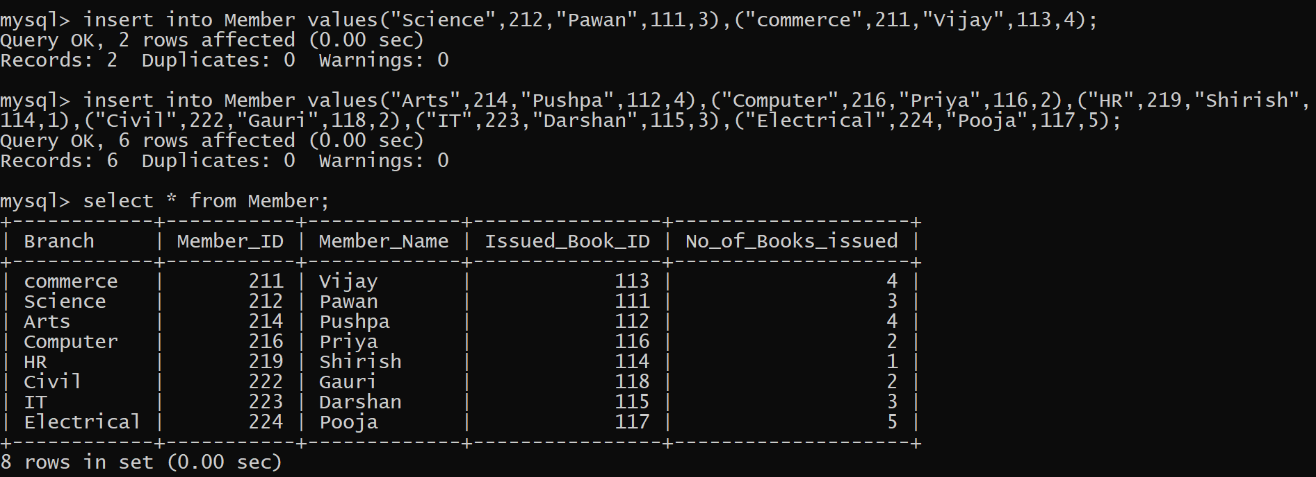
To Insert & Read Data in Table.

Slide 13
Delete Command

Slide 14
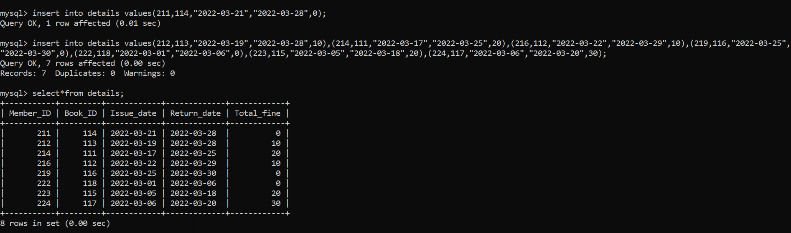
To Insert & Read Data in Table.

Slide 15
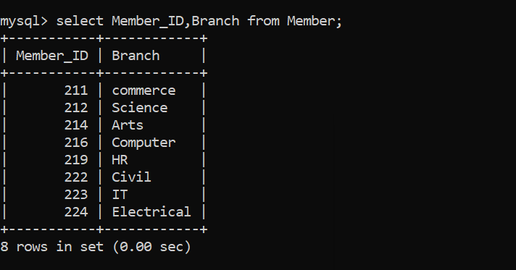
To Read the Data from the Table.

Slide 16
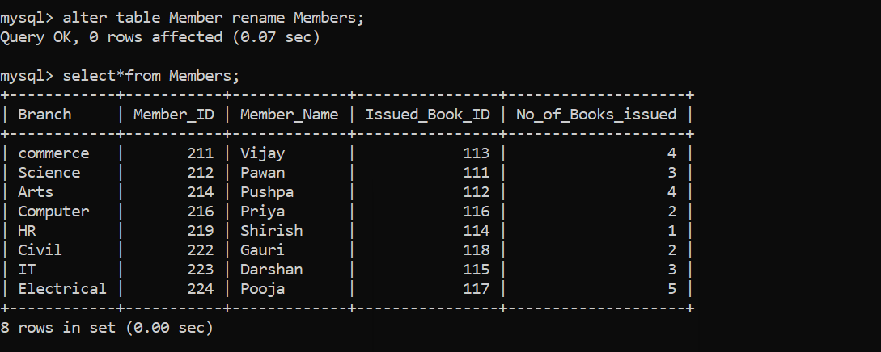
Alter Command & To Read The Data.

Slide 17
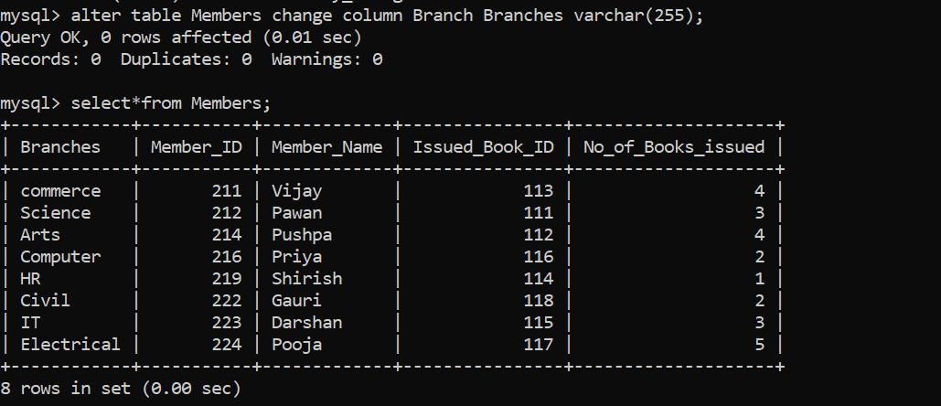
Alter Command & To Read The Data.

Slide 18
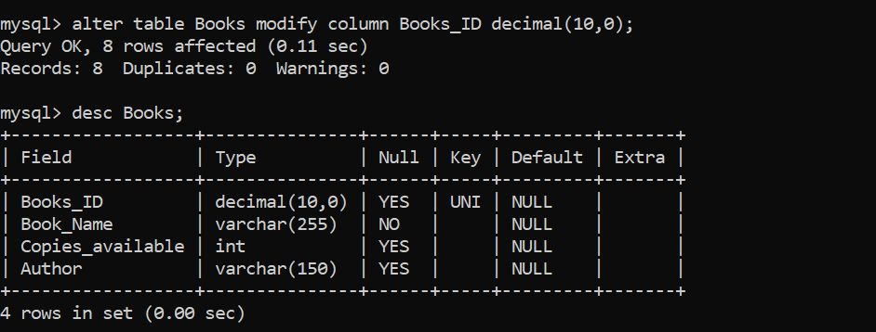
Alter Command & To Read Structure of the Table.

Slide 19
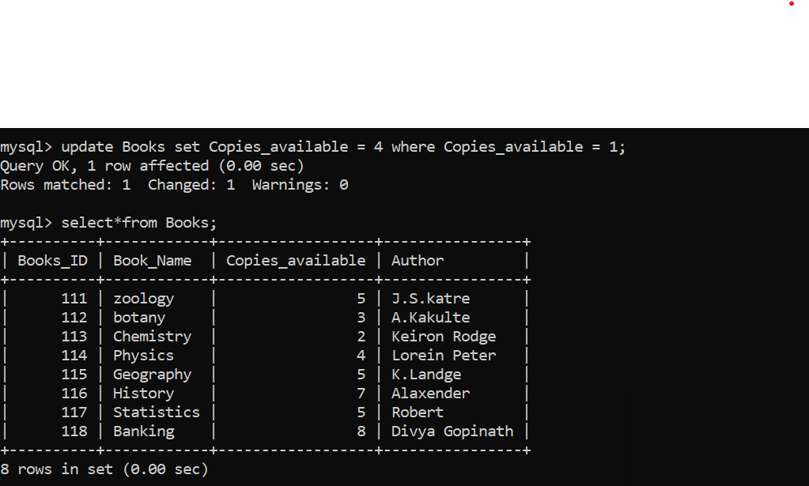
Update Command & To Read The Data.

Slide 20
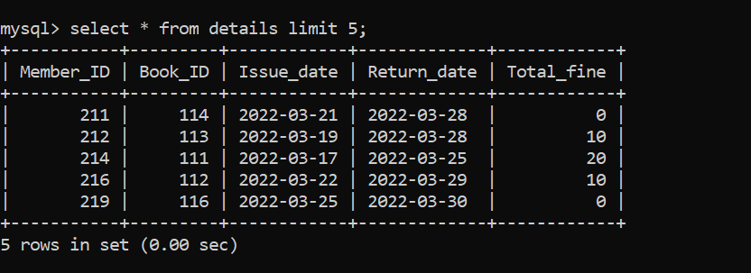
To Read the Data With Limit.

Slide 21
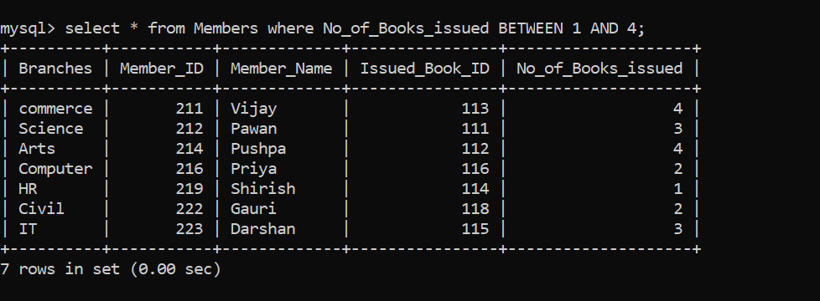
Where Clause with Between Operator.

Slide 22
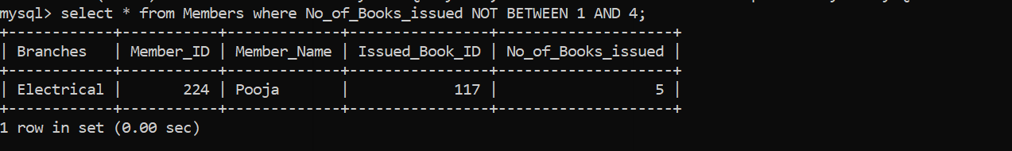
Where Clause with Not Between Operator.

Slide 23
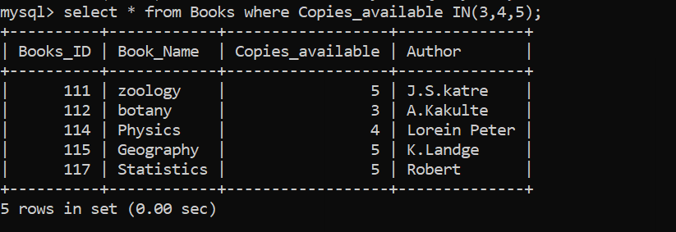
Where Clause with IN Operator.

Slide 24
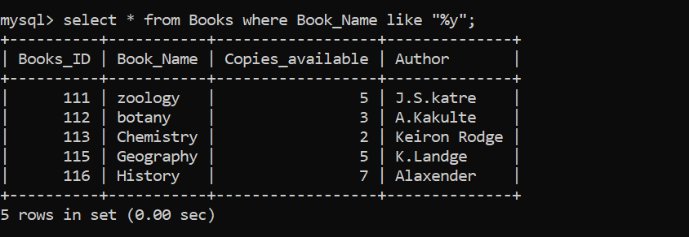
Where Clause with Like Operator.

Slide 25
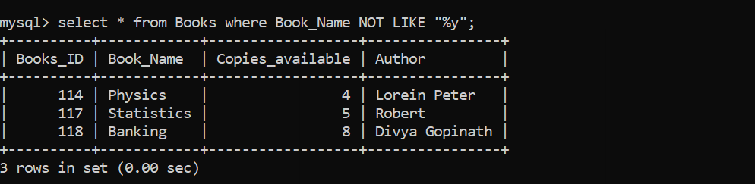
Where Clause with Not Like Operator.

Slide 26
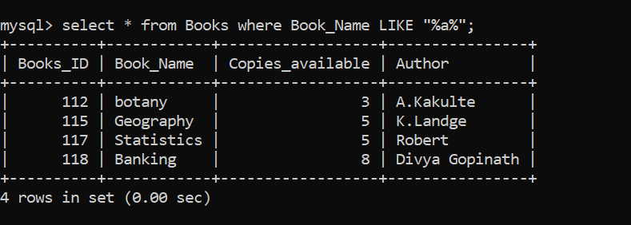
Where Clause with Like Operator.

Slide 27
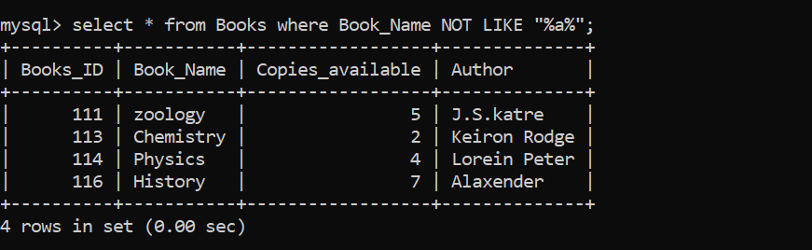
Where Clause with Not Like Operator.

Slide 28
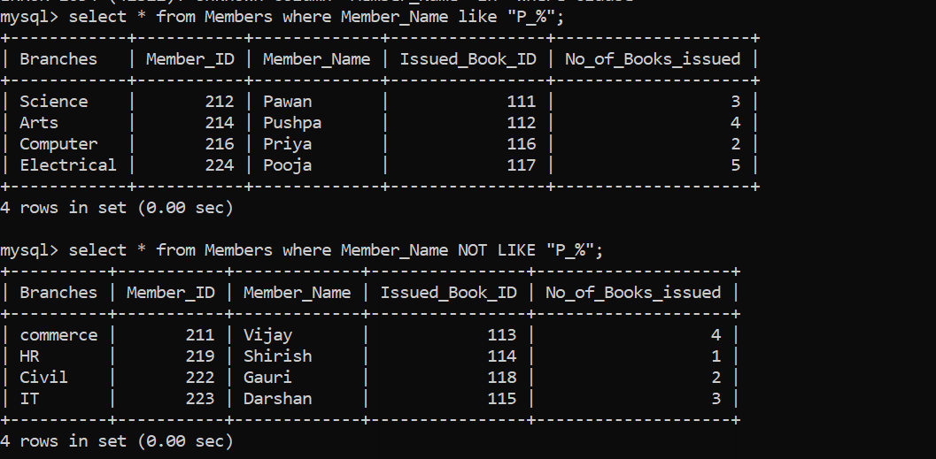
Where Clause with Like & Not Like Operator.

Slide 29
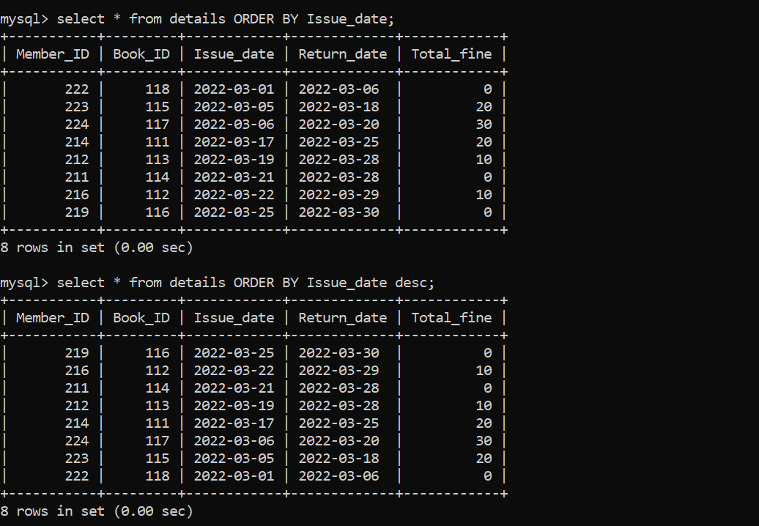
Using Order By Clause.

Slide 30
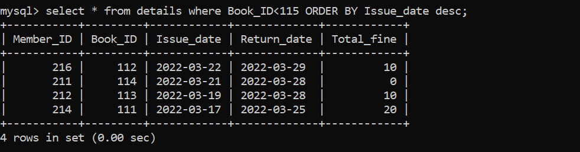
Using Order By Clause.

Slide 31
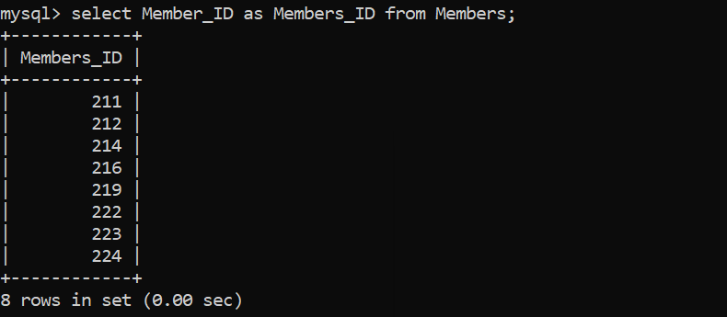
Using Alias.

Slide 32
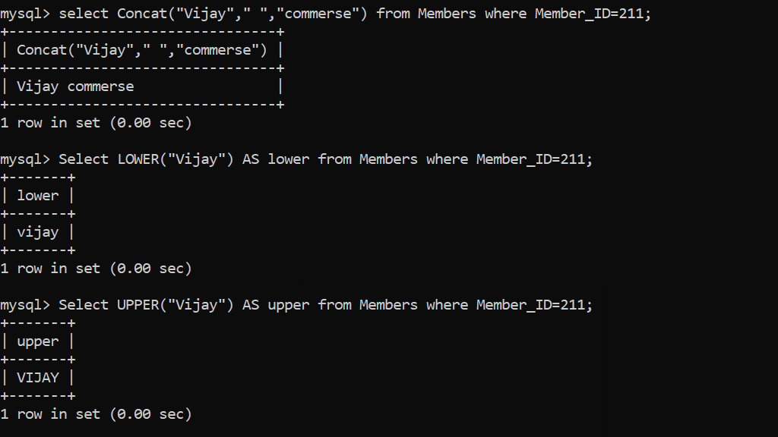
Using String() Function.

Slide 33
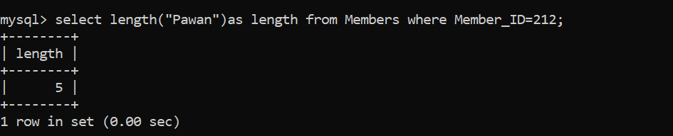
Using String() Function.

