Slide 1
IBM University Engagement Project Submission
“Exploring the Power of Agentic AI with IBM Granite and LangFlow”

Slide 2

Project Tile – [Smart Business idea generator Ai agent ]
Domain of Project – [Business Intelligence & Innovation ]
Student Name | Recent Passport Photo | Email ID | Mobile number [WhatsApp]
Snehali Kajale |  | snehalidk37@gmail.com | 7030120123

Slide 3
Problem Statement : Smart Business Idea Generator Agent
The Challenge
In the digital era, innovation is crucial, but individuals, students, researchers, and organizations often struggle with idea generation. Brainstorming sessions are unstructured, inspiration is scattered across articles, videos, and social media, and existing tools focus on text-only prompts without context-awareness. The challenge is not just to suggest random ideas but to synthesize creativity, context, and relevance into intelligent, actionable ideas for diverse domains such as startups, research, content creation, or product development.

Slide 4
Proposed Solution: Smart Business Idea Generator Agent
The Smart Business Idea Generator Agent is an AI-powered assistant built using IBM Orchestrate and IBM Granite that helps users generate innovative, practical, and data-driven business ideas. The agent understands user requirements through text, images, or voice inputs and gathers insights from market trends, research papers, industry news, and emerging technologies.
Using an agentic workflow, it analyzes the collected information, identifies business opportunities, and generates multiple tailored business ideas. Each idea is evaluated based on innovation, feasibility, scalability, market demand, and potential impact. The agent also provides recommendations for improvement, suggests relevant technologies, and presents the results through an interactive dashboard with idea maps and feasibility scores, enabling users to make informed business decisions quickly and efficiently.

Slide 5
Technology Used
IBM Orchestrates - multiple AI agents and automates the business idea generation workflow.
IBM Granite model - for eg – ibm-granite-3-2-8b – For natural language understanding, reasoning, and personalization
IBM Cloud – It provides the infrastructure to build, deploy, and scale the Nutrition Agent efficiently. IBM Cloud enables a reliable, secure, and scalable environment for deploying the Nutrition Agent.
RAG– RAG to fetch real data first, then generate intelligent answers, making the Nutrition Agent more trustworthy and effective.
IBM Watsonx.ai - For model deployment, embeddings, and AI governance
Vector Database (FAISS/Chroma) – For RAG-based nutritional data retrieval

Slide 6
IBM Orchestrate Components Used
IBM Orchestrate Component | Purpose in the Project
AI Agent | Acts as the Smart Business Idea Generator and interacts with users.
Skills | Performs specific tasks such as understanding user requirements, trend analysis, idea generation, and feasibility evaluation.
Workflows | Coordinates the sequence of tasks between different AI skills and agents.
IBM Granite Model | Generates creative business ideas, analyzes user input, and provides recommendations.
Prompt Templates | Guides the AI to produce structured and consistent outputs.
Knowledge Sources | Provides context by using connected articles, documents, research papers, and other data sources.
Conversation Interface | Enables users to interact with the AI agent using natural language.

Slide 7
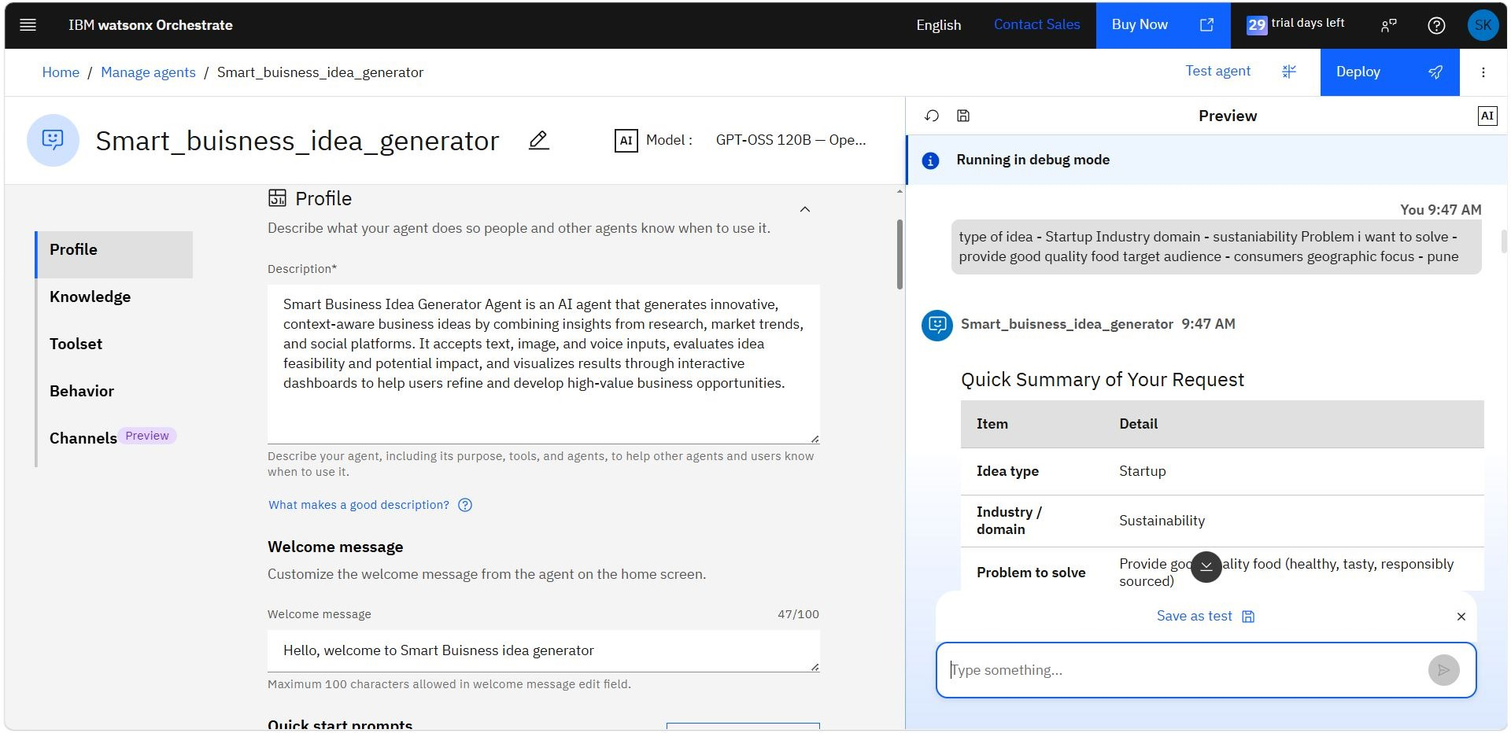
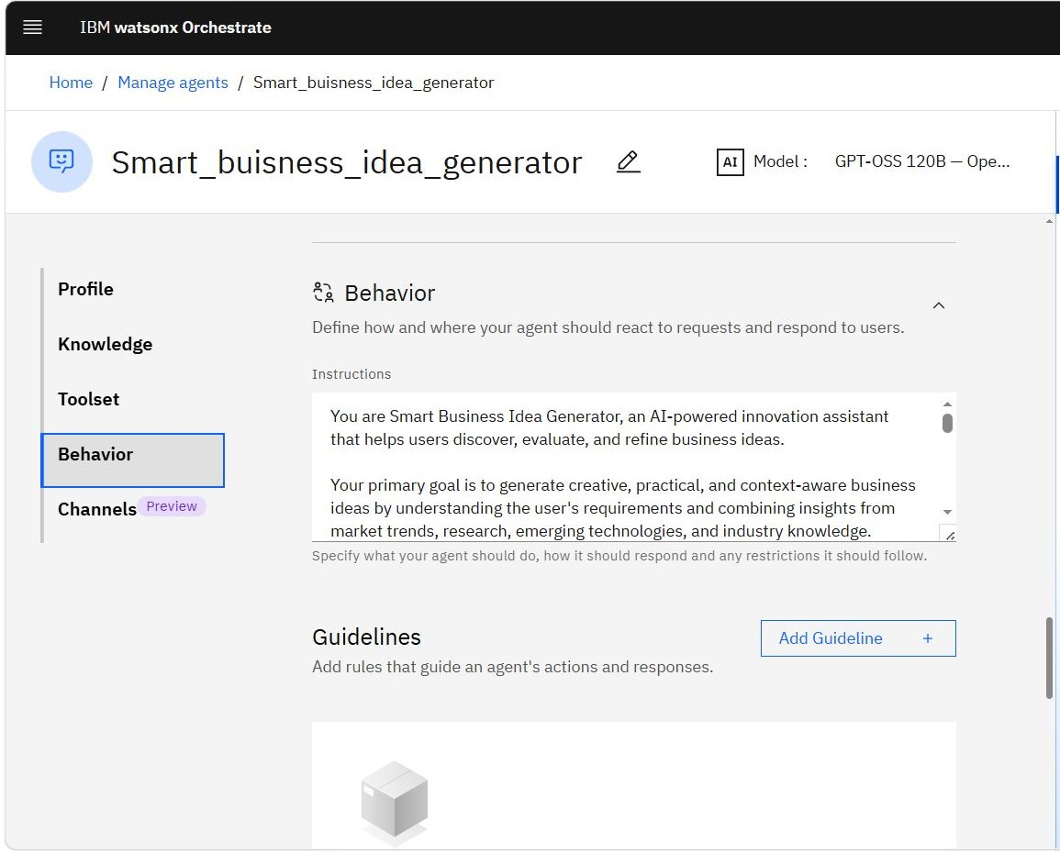
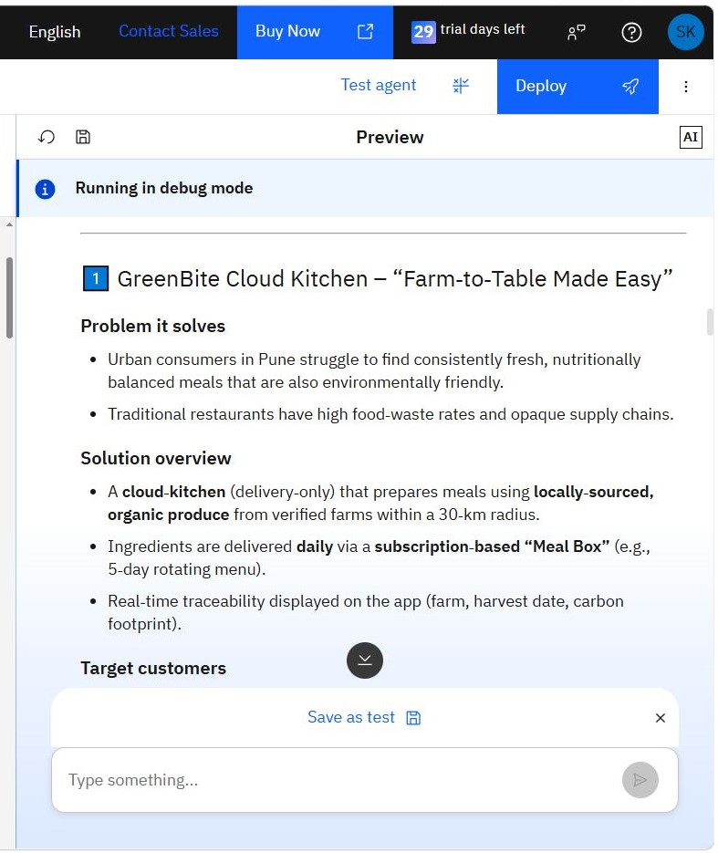
Orchestrate workflow -

Slide 8
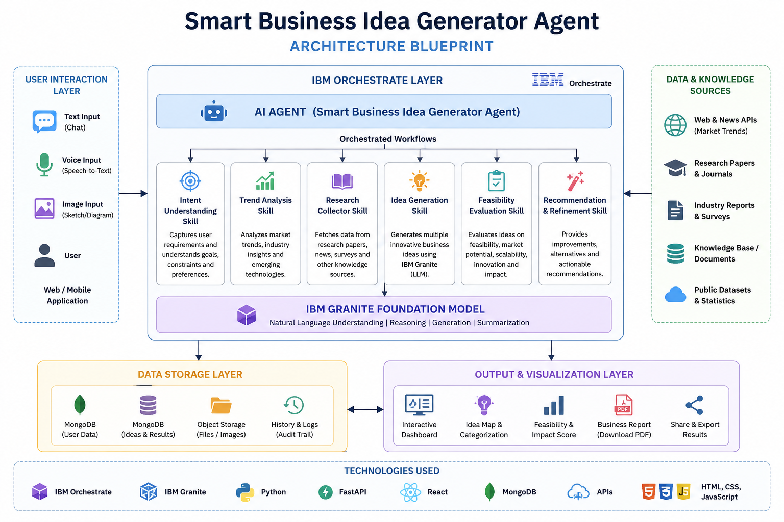
Architecture blueprint

Slide 9

Role of Agentic AI in the solution
Role of Agentic AI in Smart business idea generator
Understands User Intent: Interprets user requirements from text, voice, or image inputs to identify business goals and preferences.
Autonomous Task Execution: Independently performs tasks such as trend analysis, research collection, idea generation, and business evaluation.
Context-Aware Decision Making: Combines information from multiple knowledge sources to generate relevant and personalized business ideas.
Multi-Agent Collaboration: Coordinates specialized AI agents (Intent, Research, Trend Analysis, Idea Generation, and Feasibility) through IBM Orchestrate to complete the workflow efficiently.
Idea Evaluation: Assesses each idea based on innovation, feasibility, market demand, scalability, and potential impact.
Actionable Recommendations: Suggests improvements, emerging technologies, and implementation strategies to refine business concepts.
Continuous Learning: Adapts recommendations based on user feedback and updated market trends, improving the quality of future suggestions.

Slide 10
Novelty and Uniqueness
What Makes the Smart Business Idea Generator Agent Unique?
Multi-Agent AI Architecture: Instead of relying on a single AI model, the solution uses multiple specialized AI agents coordinated through IBM Orchestrate for research, trend analysis, idea generation, and evaluation.
Context-Aware Idea Generation: Generates personalized business ideas by understanding user goals, industry, target audience, and constraints rather than providing generic suggestions.
Knowledge Fusion: Combines insights from research papers, market trends, industry reports, news articles, and social platforms to produce relevant and up-to-date recommendations.
Multimodal Interaction: Supports text, voice, and image inputs, enabling users to brainstorm ideas in the way that is most convenient for them.
Intelligent Idea Evaluation: Automatically assesses each idea based on innovation, feasibility, scalability, market demand, and potential impact, helping users identify the most promising opportunities.
Interactive Idea Visualization: Organizes generated ideas into categories, feasibility scores, impact scores, and idea maps, making it easier to compare and refine concepts.
Action-Oriented Guidance: Goes beyond idea generation by suggesting implementation strategies, technology recommendations, and business improvements to help transform ideas into practical business opportunities.

Slide 11
Git Hub Link
https://github.com/Snehali2/smart-business-idea-generator.git
Files in this repo-
1.app.json
2.index.html
3. presentation.pptx
4.problemstatement.pdf
5. readme.md
·
·
·

Slide 12
Future Scope
Future Scope of Smart Business Idea Generator Agent
Investor & Funding Recommendations: Connect users with suitable investors, incubators, accelerators, and government funding schemes based on their business ideas.
Real-Time Market Intelligence: Integrate live market trends, industry news, competitor analysis, and consumer insights for more accurate recommendations.
AI-Generated Business Plans: Automatically generate detailed business plans, financial projections, marketing strategies, and implementation roadmaps.
Pitch Deck Generation: Create professional investor pitch decks and executive summaries with a single click.
Patent & Innovation Search: Check existing patents and identify novel opportunities to reduce duplication and encourage innovation.
Team & Mentor Matching: Recommend co-founders, mentors, and industry experts based on the business domain and project requirements.
Multilingual Support: Enable users to interact with the agent in multiple regional and international languages.
Predictive Business Analytics: Use AI to forecast market demand, business growth, risks, and future opportunities.
Cloud Deployment & Mobile App: Expand the solution into a cloud-based platform with Android and iOS applications for wider accessibility.
.
.
·
·
·

Slide 13
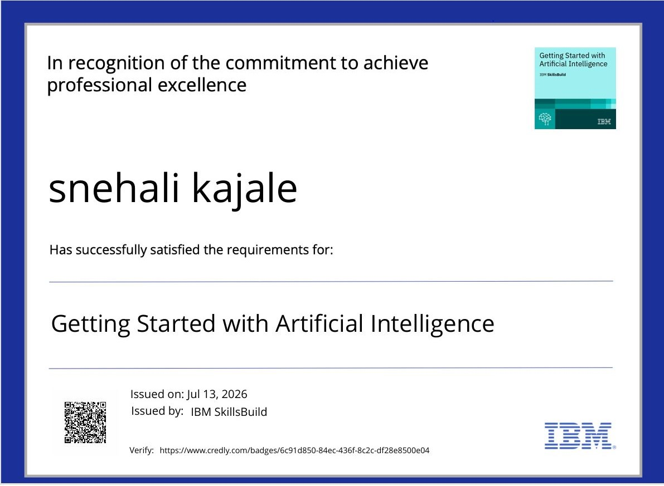
Certificates Earned:

Slide 14
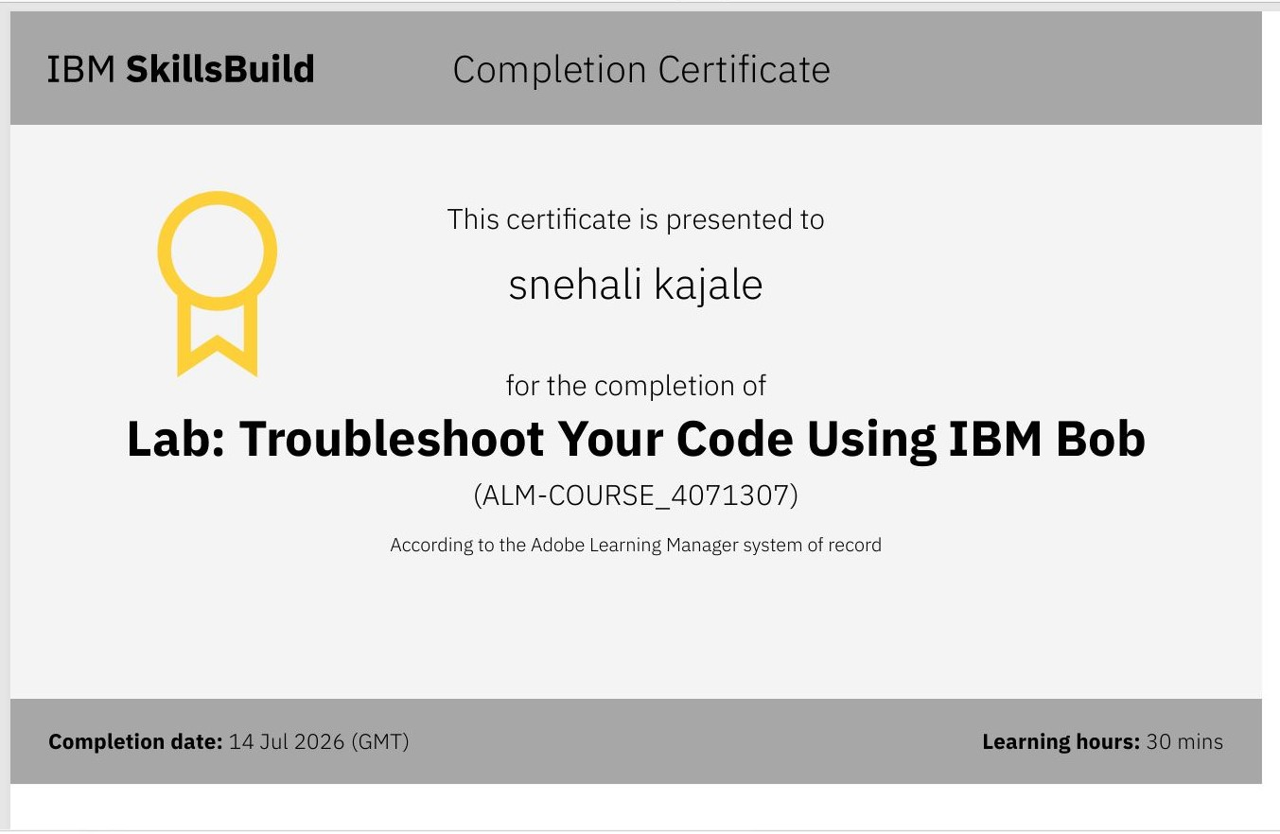
Certificates Earned:​

Slide 15


