Slide 1

Presented By :- Snehal Tawar

Slide 2

Content:
Introduction
Requirements
Architecture
Kerberos v4
Kerberos v5
Applications of Kerberos
Attacks on Kerberos
References

Slide 3
Introduction:
In Greek mythology, kerberos is a multi-headed dog (usually three) which guards the entrance of Hades.
Kerberos is an authentication protocol implemented on Project Athena at MIT
It uses symmetrical cryptographic algorithms (private key cryptosystems) i.e. same key is used for encryption as well as decryption.
The motivation was to create a secure, reliable, transparent and scalable architecture.

Slide 4
The first published report on Kerberos [STEI88] listed the following requirements :
• Secure: A network eavesdropper should not be able to obtain the necessary information to impersonate a user. More generally, Kerberos should be strong enough that a potential opponent does not find it to be the weak link.
• Reliable: For all services that rely on Kerberos for access control, lack of availability of the Kerberos service means lack of availability of the supported services. Hence, Kerberos should be highly reliable and should employ a distributed server architecture with one system able to back up another.
• Transparent: Ideally, the user should not be aware that authentication is taking place beyond the requirement to enter a password.
• Scalable: The system should be capable of supporting large numbers of clients and servers. This suggests a modular, distributed architecture.

Slide 5
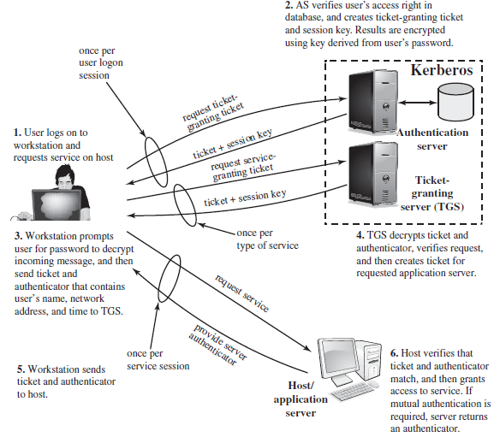
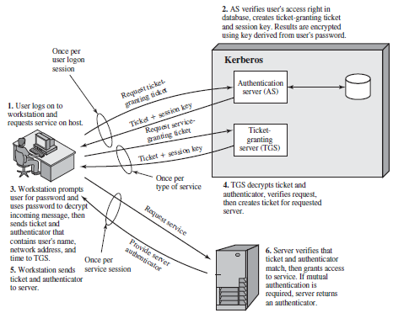
Overview Of Kerberos :

Slide 6
Difference between Kerberos version 4 and 5
Kerberos v4 :
Kerberos version 4 was launched in late 1980s. It provides ticket support.
It does not support transitive cross-realm authentication.
Kerberos version 4 works on the Receiver-makes-Right encoding system.
It uses Data Encryption Standard technique for encryption.
In Kerberos version 4, the ticket lifetime has to be specified in units for a lifetime of 5 minutes.

Slide 7
Kerberos v5 :
Kerberos version 5 was launched in 1993.
It provides ticket support with extra facilities for forwarding, renewing and postdating tickets.
Kerberos version 5 works on the ASN.1 encoding system.
It supports transitive cross-realm authentication. It uses any encryption techniques as the cipher text is tagged with an encryption identifier.
In Kerberos version 5, the ticket lifetime is specified with the freedom of arbitrary time.

Slide 8
APPLICATIONS OF KERBEROS
Windows servers use Kerberos as the primary authentication protocol.
Telnet/FTP uses Kerberos.
Authentication for web services.
Authenticating email client and servers.
ATTACKS ON KERBEROS
Brute-force attacks against the KDC (the initial ticketing service and the ticket-granting service)
Kerberos was designed for use with single-user client systems. In the more general case, where a client system may itself be a multi-user system, the Kerberos authentication scheme can fall prey to a variety of ticket-stealing and replay attacks
Password-guessing attacks

Slide 9
References :
https://web.mit.edu/kerberos/
https://www.simplilearn.com/what-is-kerberos-article
https://www.geeksforgeeks.org/difference-between-kerberos-version-4-and-kerberos-version-5/
https://access.redhat.com/documentation/en-us/red_hat_enterprise_linux/7/html/system-level_authentication_guide/using_trusts
http://people.duke.edu/~rob/kerberos/kerbasnds.html
CEH-v9-Certified-Ethical-Hacker-Version-9-Study-Guide-3rd-Edition-Technet24
Cryptography And Network Security Principles And Practice - Fifth Edition - William Stallings
Cryptography And Network Security Principles And Practice - Sixth Edition - William Stallings

Slide 10
THANK YOU !

