Slide 1
Basics Of SOAP
PRESENTED BY :- SNEHAL TAWAR

Slide 2
What is SOAP ?
A light-weight wire communication protocol
Used for communication between applications
SOAP is platform and language independent
XML based, simple and extensible.

Slide 3
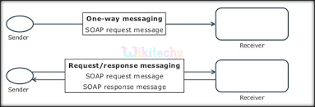
Two most popular forms of messaging used with SOAP are:
One way Messaging
Request/Response Messaging

Slide 4
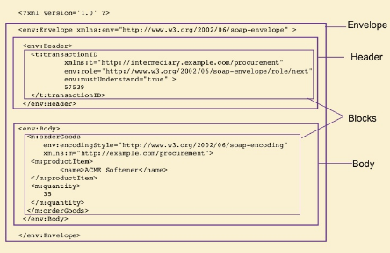
Elements of SOAP message :
The <Envelope> element
The <Header> element
The <Body> element

Slide 5
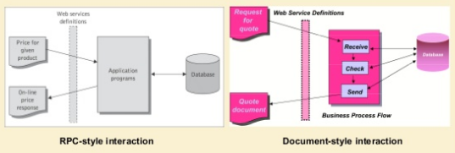
Two SOAP communication models :
Remote Procedure call
Document (or Message)

Slide 6
Advantages :
Simplicity
Portability
Firewall friendly
Use of open Standards
Interoperability
Universal Acceptance
Resilience to changes
Disadvantages :
Statelessness
Serialization by value and not by reference
Slow
WSDL Dependence

Slide 7
THANK YOU.

