Slide 1
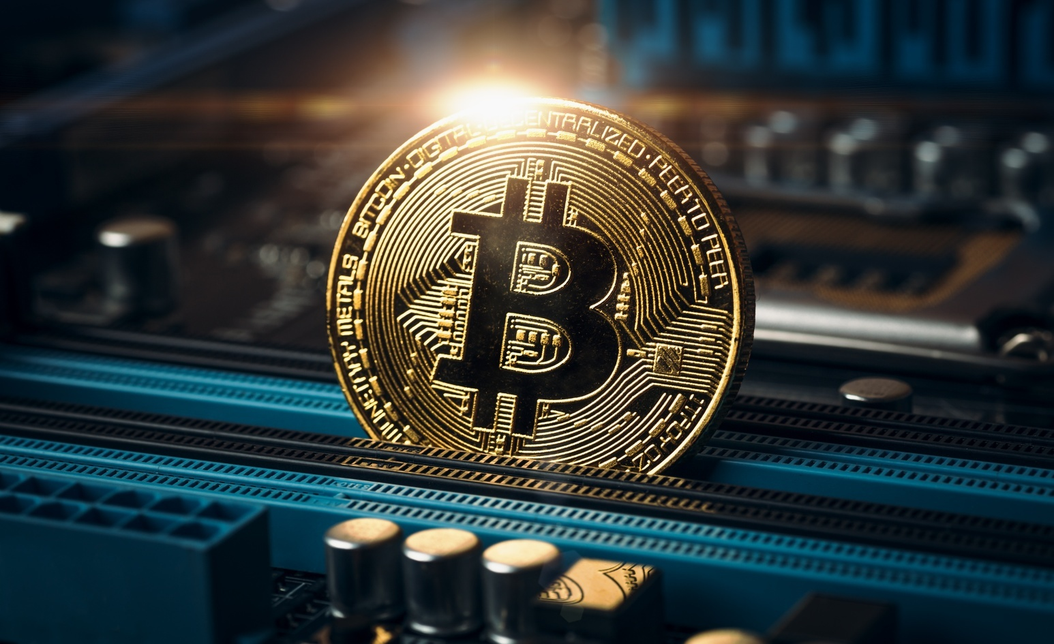
Cryptocurrency
PRESENTED BY :- SNEHAL TAWAR

Slide 2





What is Cryptocurrency?
Crypto- is short for “cryptography”, a computer technology used for securing and hiding information among other things. Currency means “money currently in use”.
Cryptocurrency is an electronic money created with technology controlling its creation and protecting transactions, while hiding the identities of its users.
Instead of trusting a bank with your money, users send money directly to each other while simultaneously recording their transactions. With so many records being maintained, transactions become efficient, permanent, secure and transparent.
The first cryptocurrency was bitcoin.

Slide 3
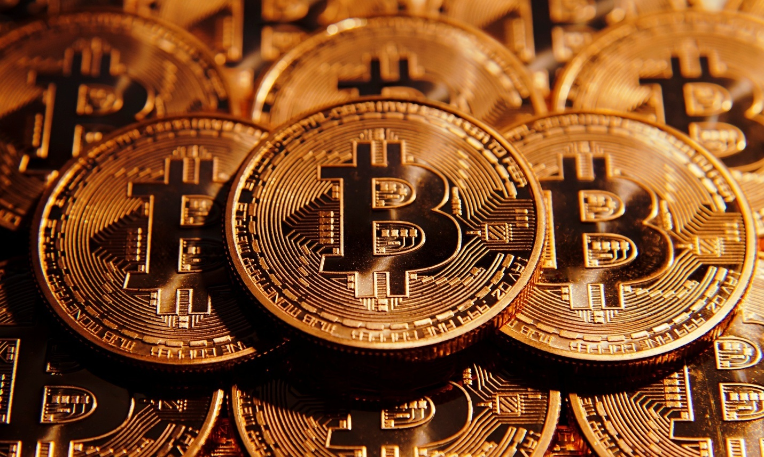
What is Bitcoin?
Bitcoin is the first digital cash created in 2009. It was made by an unknown person or group who went by the name, Satoshi Nakamoto.
Bitcoin is unique because it does not rely on government/bank created money
Each transaction is recorded on a digital record kept by many people across the world known as the “blockchain”. Because there are so many copies being simultaneously maintained, the banking data is very safe and virtually impossible to manipulate.

Slide 4
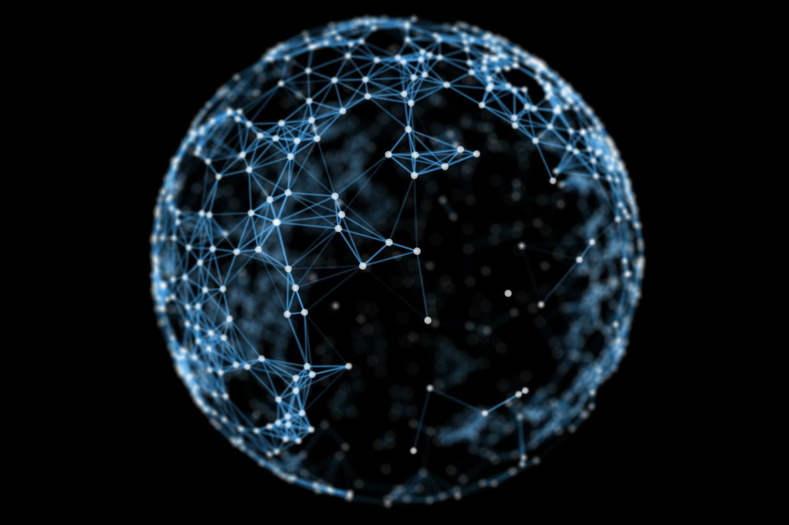
What is Blockchain?
Blockchain is technology for creating permanent, secure digital recordings that don’t rely on any single person or group.
Imagine the blockchain as a book of records. Each page in that book, is a block, and can record anything. Blocks are created one after the other, chained to each other creating what we know as the blockchain.
Multiple blockchain records are maintained simultaneously by a large group of unrelated individuals and their computers, making it cloud storage on steroids. Updates are seen immediately and manipulation is extremely difficult/impossible.

Slide 5
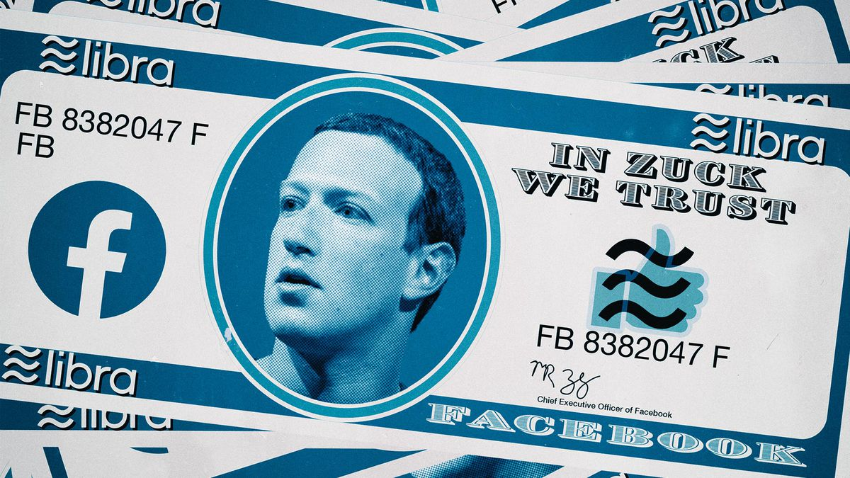
LIBRA
Transaction processing by the members of Libra Association
Abides International laws , aims global financial inclusion
“Moving money around the globe should be as easy and secure than –sending a text message ,or sharing a photo , no matter where you live, what you do or what you earn.”

Slide 6
THANK YOU.

