Slide 1

Morris worm attack
Presented By :- Snehal Tawar

Slide 2
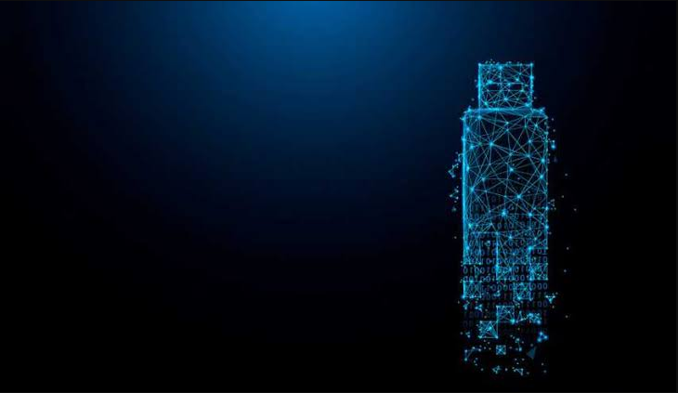
Contents:
What is Cyber Forensics?
Background
The Attack
Investigation
Current Status
References

Slide 3
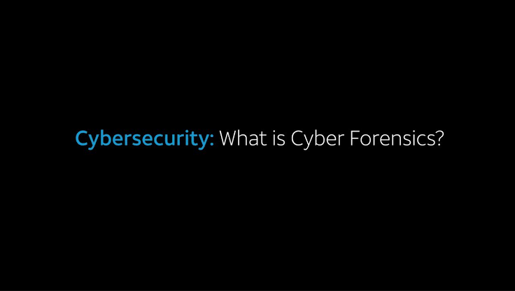
What is Cyber Forensics?
Cyber Forensics is the scientific processes of identification, seizure, acquisition, authentication, analysis, documentation and preservation of digital evidence in a way that is suitable for presentation in a court of law. Also known as Computer Forensics or Digital Forensics.
The stages of a computer forensics examination:
1. Readiness
2. Evaluation
3. Collection
4. Analysis
5. Presentation
6. Review

Slide 4
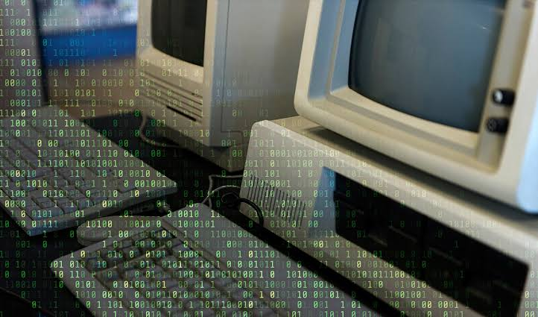
Background :
Morris was a talented computer scientist who had graduated from Harvard in June 1988.
ARPANET was the network that became the basis for the Internet.
According to Morris, the purpose of the worm was to measure the size of the “Internet” i.e ARPANET - although it unintentionally caused denial-of-service (DoS) for around 10% of the 60,000 machines connected to ARPANET in 1988.
The cyber worms unlike viruses don’t need software host but can exist and propagate on their own.

Slide 5
The Attack:
At around 8:30 pm on November 2 1988, a maliciously clever program was unleashed on the internet from a computer at Massachusetts Institute of Technology.
Vital Military and University functions slowed to a crawl. Morris designed the worm to ask systems whether they already had a local copy of the worm. The worm would skip systems that replied "yes." In theory, this would prevent the worm from copying itself endlessly and bogging down the Internet.
Big Mistake Morris seven-to-one ratio turned out to be a fatal design flaw. The ratio wasn’t high enough to slow the programs reproduction. The worm quickly spread from systems.

Slide 6
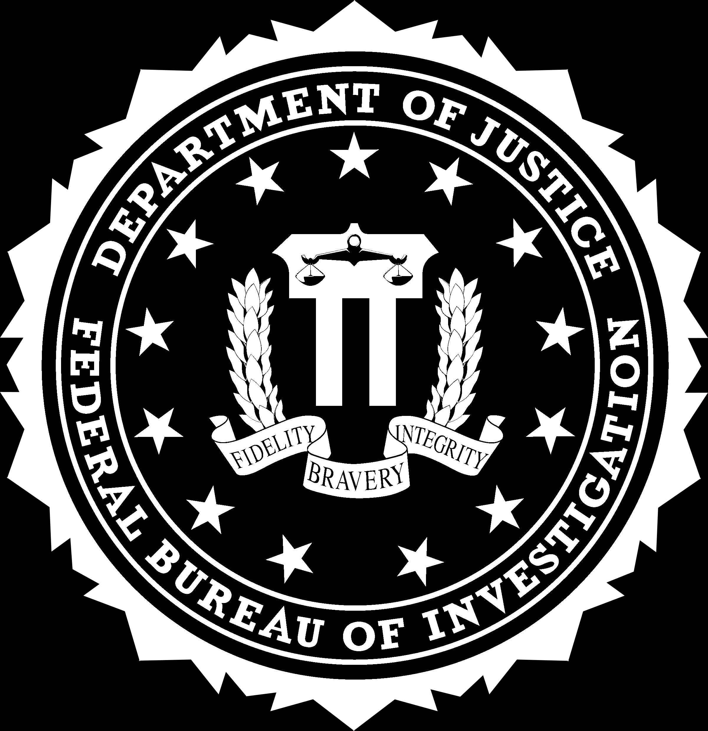
Investigation :
After the incident became public the FBI launched an investigation.
Agents quickly confirmed that Morris was behind the attack and began interviewing him and his associates and decrypting his computer files which yielded plenty of indiscriminating evidences.
This was a year before the invention of the World Wide Web. Among the many casualties were Harvard, Princeton, Stanford, Johns Hopkins, NASA, and the Lawrence Livermore National Laboratory.
Robert Morris was tried and convicted of violating United States Code: Title 18 , the Computer Fraud and Abuse Act[11] in United States v. Morris. After appeals, he was sentenced to three years' probation, 400 hours of community service, and a fine of $10,050 plus the costs of his supervision.

Slide 7
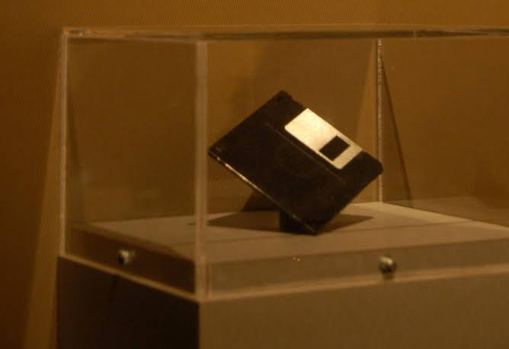
Current Status :
The episode had a huge impact on a nation just coming to grips with how important and vulnerable computers had become at that time.
The idea of cybersecurity became something computer users began to take more seriously.
Just days after the attack, for example, the country’s first computer emergency response team was created in Pittsburgh at the direction of the Department of Defense. Developers also began creating much-needed computer intrusion detection software.
The Morris Worm inspired a new generation of hackers and a wave of Internet-driven assaults that continue to plague our digital systems to this day. Whether accidental or not, the first Internet attack was a wake-up call for the country and the cyber age to come.

Slide 8
References:
https://www.fbi.gov/history/famous-cases/morris-worm
https://www.inverse.com
https://www.wikipedia.com
https://www.forensiccontrol.com
https://searchsecurity.techtarget.com

Slide 9
Thank You

