Slide 1

MOVIE RECOMMENDATION SYSTEM
PRESENTED BY :- SNEHAL TAWAR

Slide 2

Contents:
Introduction
Project Implementation
Output
Conclusion
Future Scope References

Slide 3
Introduction
A recommendation system is a type of information filtering system which attempts to predict the preferences of a user, and make suggests based on these preferences.
These systems are able to collect information about a user’s choices, and can use this information to improve their suggestions in the future.
The main approaches are widely used for recommender systems is content-based filtering, where we try to profile the user’s interests using information collected, and recommend items based on that profile. The other is collaborative filtering, where we try to group similar users together and use information about the group to make recommendations to the user.
Cosine similarity is one of the simplest unsupervised learning algorithms that solve the well- known clustering problem. The procedure follows a simple and easy way to classify a given data set through a certain number of clusters.
This filtering method matches content resources to user characteristics, base their predictions on user’s information. It relies heavily on the ratings of different users.

Slide 4
Project Implementation
A Web Base user-item Movie Recommendation Engine using Collaborative Filtering By matrix factorizations algorithm and The recommendation based on the underlying idea that is if two persons both liked certain common movies, then the movies that one person has liked that the other person has not yet watched can be recommended to him.
Commonly used language to develop this web application is HTML, CSS and Python.
Later on we’ve used Cosine similarity algorithm on a movie dataset to derive various desired results and analysis.

Slide 5
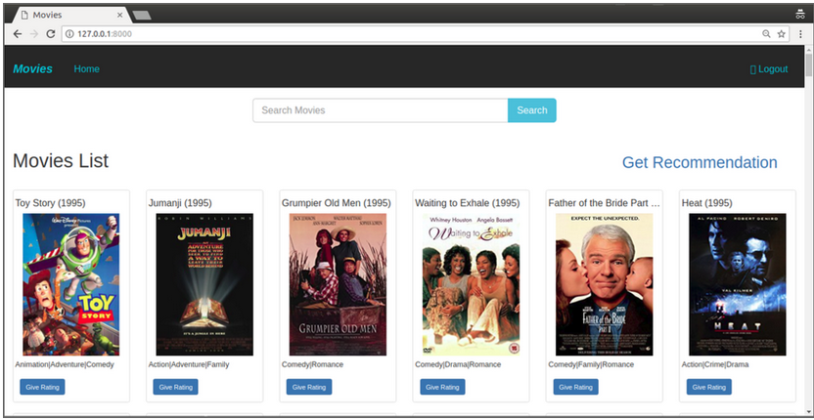
Output
Home page:

Slide 6
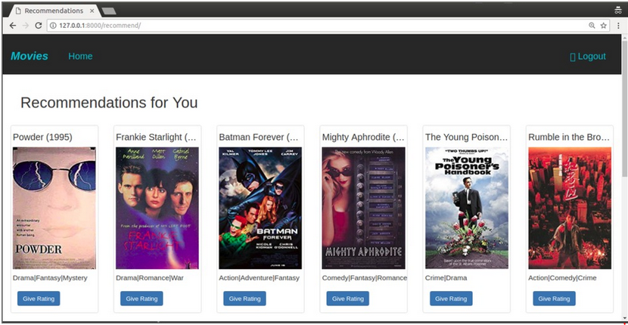
Recommendation Page:

Slide 7
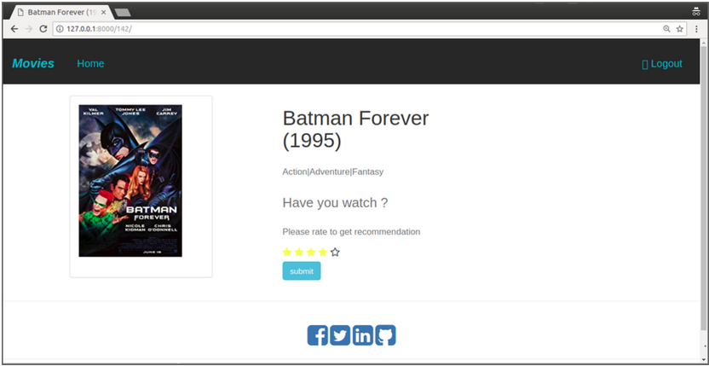
Rating Page:

Slide 8
Conclusion
Recommender systems are a powerful new technology for extracting additional value for a business from its user databases. These systems help users find items they want to buy from a business. Recommender systems benefit users by enabling them to find items they like. Conversely, they help the business by generating more sales. Recommender systems are rapidly becoming a crucial tool in E-commerce on the Web. Recommender systems are being stressed by the huge volume of user data in existing corporate databases, and will be stressed even more by the increasing volume of user data available on the Web. New technologies are needed that can dramatically improve the scalability of recommender systems

Slide 9
Future Scope
The website can be further enhanced by adding sentiment analysis to it.
Various algorithms can be used to analyze the dataset to get varied results and ROC curve can be used to comparison.

Slide 10
References
[1] G. Adomavicius, A. Tuzhilin, “Toward the next generation of recommender system: A survey of the state-of-the-art and possible extensions,” IEEE Trans on Knowledge and Data Engineering, vol. 17, no. 6, pp. 734–749, 2005.
[2] G. Linden, B. Smith and J. York, “Amazon.com recommendations: Item to item collaborative filtering,” IEEE Internet Computing, vol.7, no.1, pp. 76–80, 2003.
[3] B. M. Sarwar, G. Karypis, J. Konstan and J. Riedl, “Recommender systems for large-scale e-commerce: Scalable neighborhood formation using clustering,” in Proceedings of the international conference on computer and information technology, 2002
[4] https://raco.cat/index.php/ELCVIA/article/download/373942/467477/
A Review of Movie Recommendation System: Limitations, Survey and Challenges
Mahesh Goyani _ and Neha Chaurasiya
[5]https://ieeexplore.ieee.org/ielx7/5971803/8821508/08821512.pdf?tp=&amp;arnumber=8821512&amp;isnumber=8821508&amp;ref=aHR0cHM6Ly9zY2hvbGFyLmdvb2dsZS5jby5pbi8=
Personalized Real-Time Movie Recommendation System: Practical Prototype and Evaluation
Jiang Zhang, Yufeng Wang_, Zhiyuan Yuan, and Qun Jin
[6] https://easychair.org/publications/preprint_download/Qqsp
Collaborative Filtering Based Movie Recommendation System
Yasir Riaz, Ujjwal Deep and Ankit Darad
[7]https://discovery.dundee.ac.uk/ws/files/39285097/Recommendation_system_for_cold_start_items.pdf
Collaborative filtering and deep learning based recommendation system for cold start items
Wei, Jian; He, Jianhua; Chen, Kai; Zhou, Yi; Tang, Zuoyin
[8] https://d1wqtxts1xzle7.cloudfront.net/33554940/V3I4201494-with-cover-page-v2.pdf?Expires=1639150383&Signature=cxy41T~cOaGpwwv9~B7JArwCR9OBBcMQR66pCCMaColRC59BwcaLdxUSOVAVxlenI8RWnicJiZzUJlv0dO2y4gdVpoO9qIkAZFettEjuU1iMTB82aZZyCwlJZvOG~XpwYz-Nd5ntFixmDc8GzZ1PbD3r8U7Ccdhnl5EW007Lry1zWBM6cmSEJR80RVtdIwJre6BpMB57SMCI6vN5bFXZiGiI1I7-AwGaMNP3yASZllHu8689ENNlh7yYJa1UtR2G9MtySdWGwLkbyV8LFJNEZlob-8tpeVKgPa557UhNRo9AfjpDEvR91Lhfoy1Xjz1KAGjuX7yuReSUeDSvEgfpgw__&Key-Pair-Id=APKAJLOHF5GGSLRBV4ZA
MOVIE RECOMMENDATION SYSTEM BASED ON USERS’ SIMILARITY
Gaurav Arora1, Ashish Kumar2, Gitanjali Sanjay Devre3, Prof. Amit Ghumare4

Slide 11
THANK YOU !

