Slide 1
WEP and WPA
PRESENTED BY :- SNEHAL TAWAR

Slide 2
Contents:
Wired Equivalent Privacy (WEP)
WEP Architecture
Wi-Fi Protected Access(WPA)
WPA Architecture
Advantages/Disadvantages of WEP
Advantages/Disadvantages of WPA
References

Slide 3


Wired Equivalent Privacy (WEP)
Wired Equivalent Privacy (WEP) is a security protocol for wireless networks which provides data confidentiality comparable to a traditional wired network.
It was introduced in 1999. It provides wireless security through the use of an encryption key.
It uses an old encryption method that is Rivest Cipher 4 (RC4). It uses 40 bit key and 24 bit random number
Authentication method in WEP is Open system authentication or shared key authentication
In WEP no protection against reply attacks. It is possible to deploy on current hardware infrastructure

Slide 4
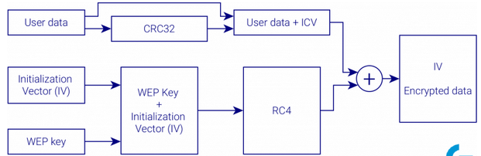
WEP Architecture :
In WEP, for data integrity 32-bit cyclic redundancy check (CRC32) is used. Integrity Check Vector (ICV) is appended to the user data and forwarded to encryption. This is where first flaw of WEP shows up. CRC32 intention was to detect errors during transmission. This method is not very reliable in message integrity check.
On the other hand, RC4 is used for encryption. This is a stream encryption algorithm, which uses a pair of WEP key (a password) and an Initialization Vector (IV) as a seed. WEP key might either have 40 or 104 bits and IV is always 24 bits long. This makes the seed either 64 or 128 bits long. IV is appended to the encrypted message and its purpose is to avoid using the same seed for encrypting different messages.
As it turns out within few minutes so many packets can be captured, that IV collision reaches a probability of 50%. This makes WEP key easy to be compromised.
It is strongly advised not to use WEP anymore in any circumstances

Slide 5


Wi-Fi Protected Access (WPA)
Wi-Fi Protected Access (WPA) is a security protocol which is used in securing wireless networks and designed to replace the WEP protocol.
It was developed by the Wi-Fi Alliance in 2003. It was designed to replace the WEP protocol and it uses Rivest Cipher 4 (RC4) and Temporal Key Integrity Protocol (TKIP) for encryption.
WPA key is 256 bit key. Authentication method in WPA is WPA-PSK and WPA-Enterprise.
In WPA sequence counter is implemented for reply protection.
It is possible to deploy on both previous and current hardware infrastructure.

Slide 6
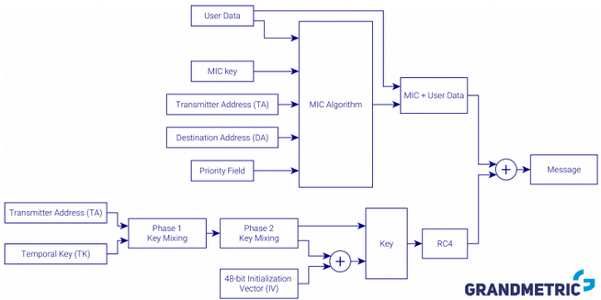
WPA Architecture :

Slide 7
Encryption was still based on RC4, since it was hardware implementation and couldn’t be updated, but IV was extended to 48 bits. Moreover a master key (so a password you enter in access point and station) is not directly used, but rather it is mixed and encryption key is derived from master key. This makes the main key hard to compromise.
Output message is, as in case of WEP, xor operation of the user data and pseudorandom stream from RC4, but this time the key is much better protected and collision is less likely.
WPA also improved message integrity. It introduced Message Integrity Check (MIC) algorithm, which by design was better suited to this task than CRC32 used in WEP. Algorithm is based not only on the data, but also additional input, such as Transmitter Address, Destination Address, etc. so it is much harder to forge message with correct MIC vector.
It is important to remember, that WPA protects well enough only against those who don’t have a key. If a malicious user is legitimately connected to some network protected with WPA it can capture packets destined for others and decrypt them.

Slide 8

Advantages/Disadvantages of using WEP
One advantage to using WEP is that when users happen to see your network during wireless detection, they will most likely be discouraged since it will require a key. This makes it clear to the user that they are not welcome.
Another advantage that WEP offers is interoperability, since all wireless devices support basic WEP encryption.
WEP encryption uses a shared key authentication and sends the same key with data packets being transmitted across the wireless network. If malicious users have enough time and gather enough data they can eventually piece together their own key.
If the master key needs to be changed, it will have to be manually changed on all devices connected to the network. This can be a tedious task if you have many devices connected to your network.

Slide 9


Advantages/Disadvantages of using WPA
WPA uses a Temporary Key Integrity Protocol (TKIP), which dynamically changes the key as data packets are sent across the network.
Since the key is constantly changing, it makes cracking the key much more difficult than that of WEP. If the need arises to change the global key, WPA will automatically advertise the new key to all devices on the network without having to manually change them
Disadvantages to using WPA are few, with the biggest issue being incompatibility with legacy hardware and older operating systems. WPA also has a larger performance overhead and increases data packet size leading to longer transmission.

Slide 10


References :
https://www.brighthub.com/computing/smb-security/articles/78216/
https://www.geeksforgeeks.org/difference-between-wep-and-wpa/
https://www.grandmetric.com/2018/07/06/ended-wpa3-wi-fi-security-evolution/
https://www.wi-fi.org/discover-wi-fi/security

Slide 11
THANK YOU !

