Slide 1



SAVE SMART
Title :
AI-Based Expense Tracker with Smart Financial Insights
An Intelligent Financial Management Solution.

Slide 2


Problem Statement:
Many individuals struggle to track their daily expenses and understand their spending habits. Manual tracking is time-consuming and lacks insights, leading to poor budgeting and financial planning.

Slide 3

Objective:
To develop an AI-powered expense tracker that automatically records expenses, analyzes spending patterns, and provides personalized financial insights to help users manage money effectively.

Slide 4

Proposed Solution:
An intelligent expense tracking application that uses AI to categorize expenses, monitor income, predict future spending, and provide smart alerts and recommendations for better financial decisions.

Slide 5
Key Features:
A
Automatic expense categorization
AI-based spending analysis
B
C
Personalized budgeting suggestions
Smart alerts for overspending
Future expense prediction
Goal-based savings planning

Slide 6

Innovative Features:
  AI Financial Health Score
  Emotion-aware spending insights
  Scenario-based financial simulations
  AI Financial Coach (Chat-based)
  Subscription usage analysis

Slide 7
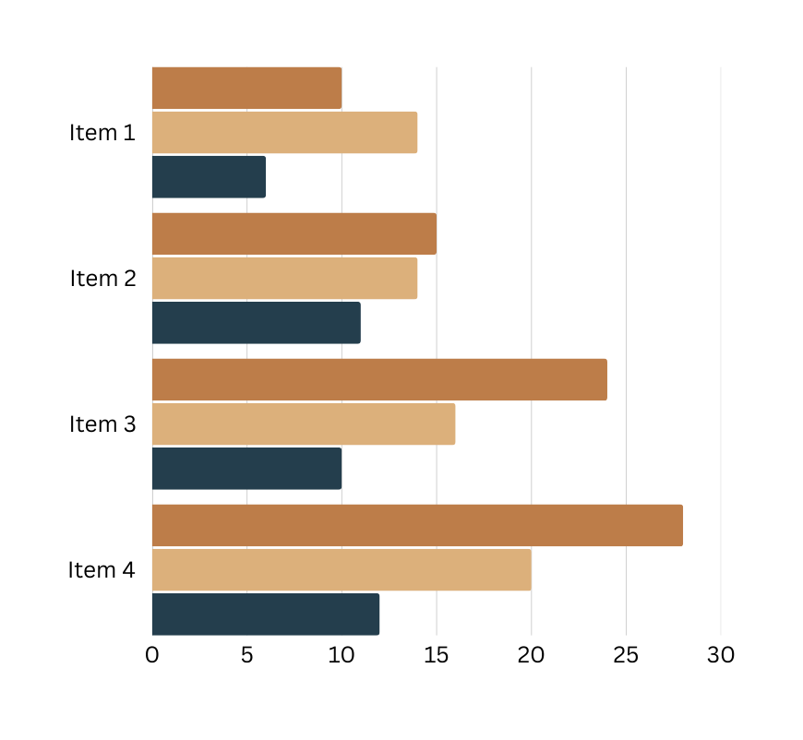
Technologies Used:
  Frontend: Web / Mobile Application
  AI Tools: Replit ,Gemini ,Deepseek
  Security: Encrypted data storage

Slide 8

Use Cases:
  Students managing monthly expenses.
  Working professionals tracking income & savings.
  Families planning budgets.
  Individuals aiming for financial goals.

Slide 9

Advantages:
  Easy and automated expense tracking
  Better control over finances
  Smart decision-making using AI insights
  Improved savings and financial discipline

Slide 10

Conclusion:
T
  The AI-Based Expense Tracker simplifies money management by combining automation and intelligence. It empowers users with actionable insights, helping them build better financial habits and achieve long-term financial stability.
~Thank you

