Slide 1

Capstone-Project
Capstone Project – Credit Score Dataset
Submitted by :Group 2
PGP DSE JUN-2023 BATCH

Slide 2
Problem Definition
Dataset:
Credit Score Dataset(real Credit Score data taken from Kaggle.com)
Problem Statement :
To prepare a base model that can predict the credit score of a person based on his bank and other essential details.
Business Importance of Problem
Investment decisions can be made
Used to create reports
Regulation evaluation and new strategy development
Risk Assessment
Loan Approval and Interest Rates
Automation of Decision Processes
Market Competitiveness

Slide 3
Data Set Description
Customer_ID | Unique ID of customer | Delay_from_due_date | Delay from due date
Month | Months | Num_of_Delayed_Payment | Number of delayed payments
Name | Name of the customer | Changed_Credit_Limit | changed credit limit
Age | Age of the customer | Num_Credit_Inquiries | Number of loan inquries
SSN | Social security number | Credit_Mix | different credit accounts
Occupation | Occupation of the customer | Outstanding_Debt | Total ammount to be paid
Annual_Income | Annual income of that person | Credit_Utilization_Ratio | credit utilization ratio
Monthly_Inhand_Salary | Monthly salary | Credit_History_Age | credit history age
Num_Bank_Accounts | Number of bank accounts | Payment_of_Min_Amount | payment of min amount
Num_Credit_Card | Number of credit cards | Total_EMI_per_month | Total emi per month
Interest_Rate | Rate of intrest on the lone taken | Amount_invested_monthly | Amount invested monthly
Num_of_Loan | Number of loans taken | Payment_Behaviour | Amount spent
Type_of_Loan | Type of loan | Monthly_Balance | Monthly balance
 |  | Credit_Score | Credit score/ The Target

Slide 4
Data Exploration
There are total 1,00,000 rows and 28 columns.
We can observe that the data contains null values.
In which 8 columns are numeric and other 20 columns are categorical columns.
Columns like Name, Monthly In Hand Salary, Total Of Loan, Changed Credit Limit, Number of delayed payments, Number of credit enquires, Credit History Age, Amount invested Monthly, Monthly Balance have null values.
And there many columns with special characters.
Some columns has non-related values to that columns.
The presence of the special characters has changed the data type of the columns to categorical.
There are some columns like Customer ID, Type Of Loan columns which are not important for the model building.

Slide 5
Data cleaning
As we discussed in the previous slide there are lot of noise, missing values and special characters in the data.
The columns with the special characters such as Underscore and negative values and some un-ambiguous data were removed and were made null. So, that filling them with proper imputing method becomes easy.
Other columns like Age, Number of bank account, Number of credit card has greater values than usual. For the greater or negative values also we removed the data and fill it with null values .
There are some columns like Customer ID, Name, SSN, Month and Type Of Loan columns which are not important for the model building.

Slide 6
Filling Missing values
For the categoric columns null values are filled Using group by function with CustomerID column and finding mode values for each group and imputing them in null places.
For the numeric columns null values are filled with mean using KNN imputing method.
Credit_Mix had the highest percentage of null values.

Slide 7
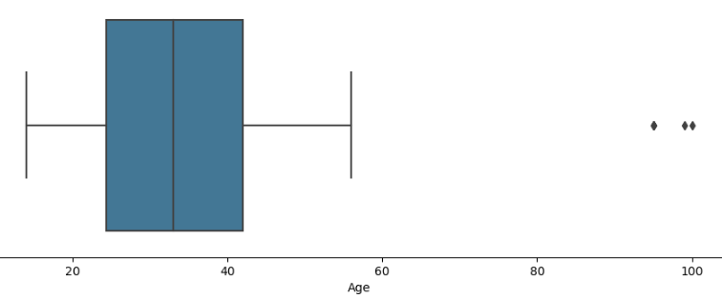
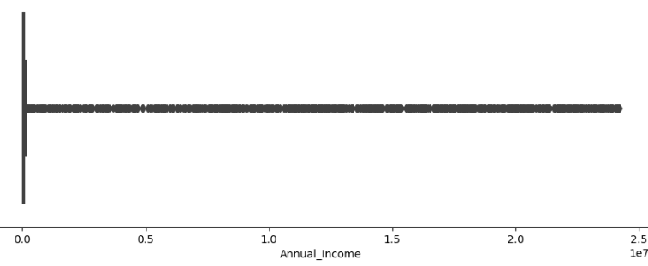
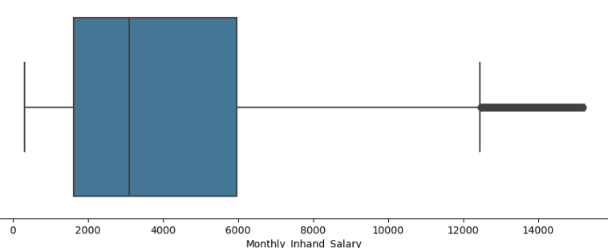
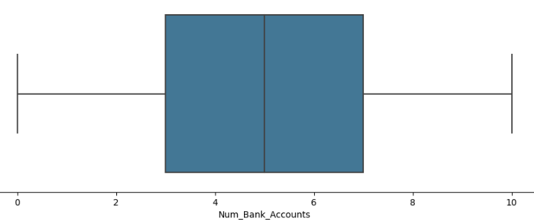
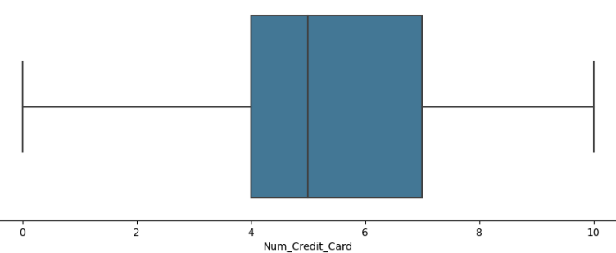
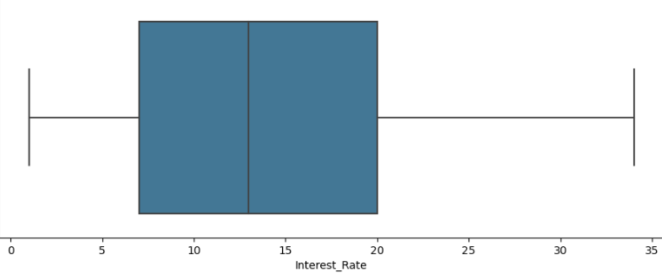
Data Visualization
Uni - Variant - Analysis

Slide 8
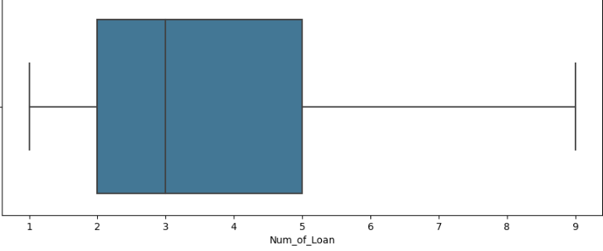
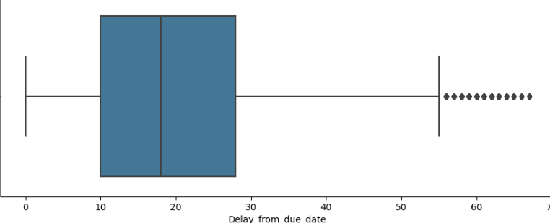
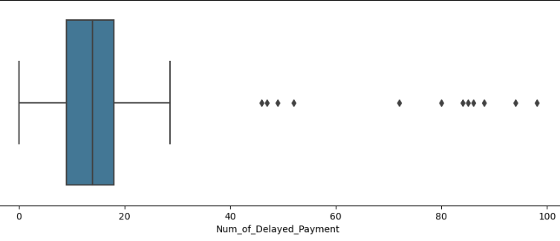
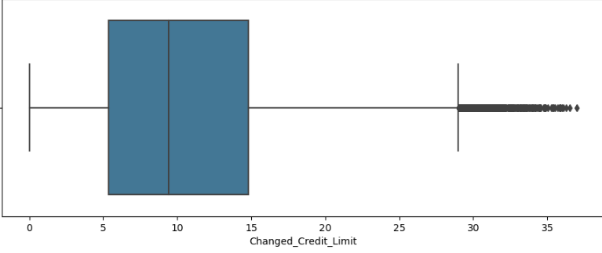
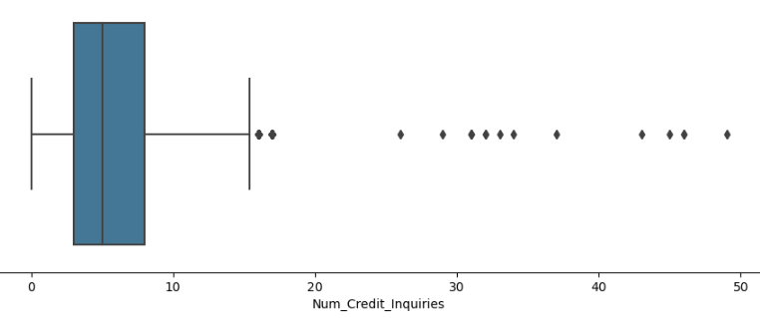
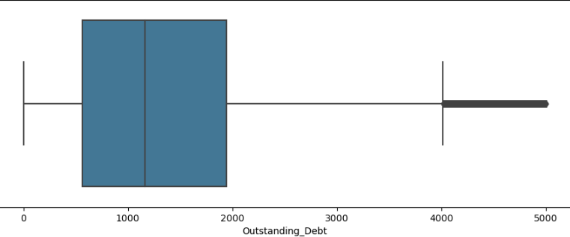
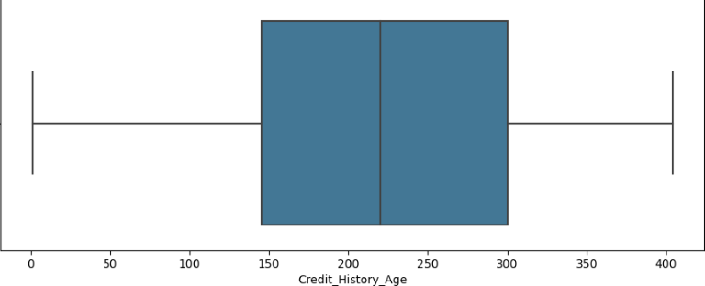
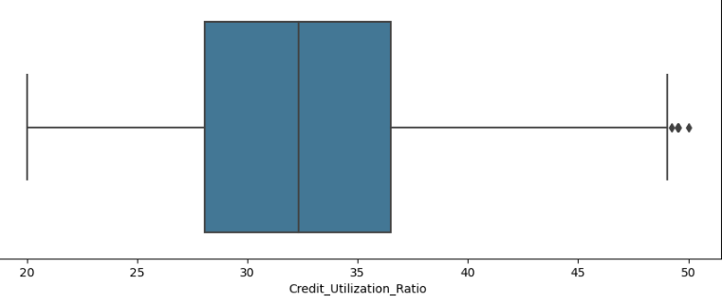

Slide 9
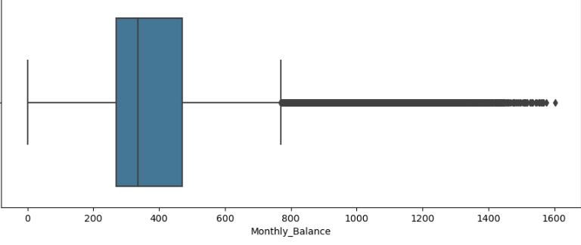
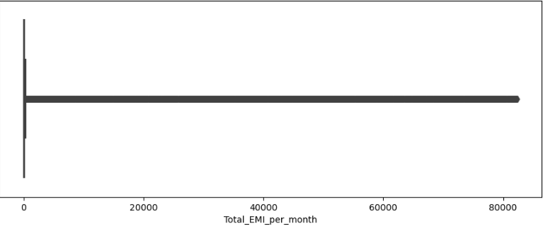
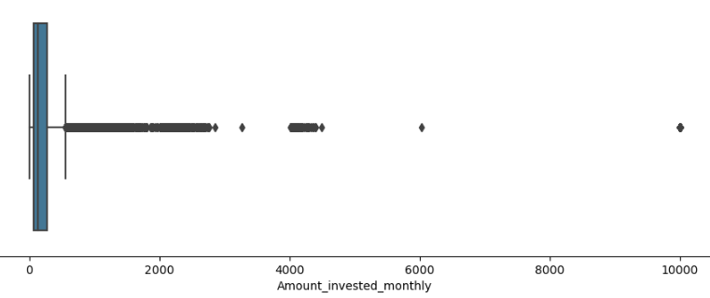
Features that have positive skew are Age, Annual_Income, Monthly_Inhand_Salary, Num_Credit_Card, Interest_Rate, Num_of_Loan, Delay_from_due_date, Changed_Credit_Limit, Num_Credit_Inquiries, Outstanding_Debt, Total_EMI_per_month, Amount_invested_monthly, Monthly_Balance
Features that have negetive skew is Num_Bank_Accounts
Features that have normal distribution are Num_of_Delayed_Payment, Credit_Utilization_Ratio, Credit_History_Age
Total_EMI_per_month and annual_income have extreme values.

Slide 10
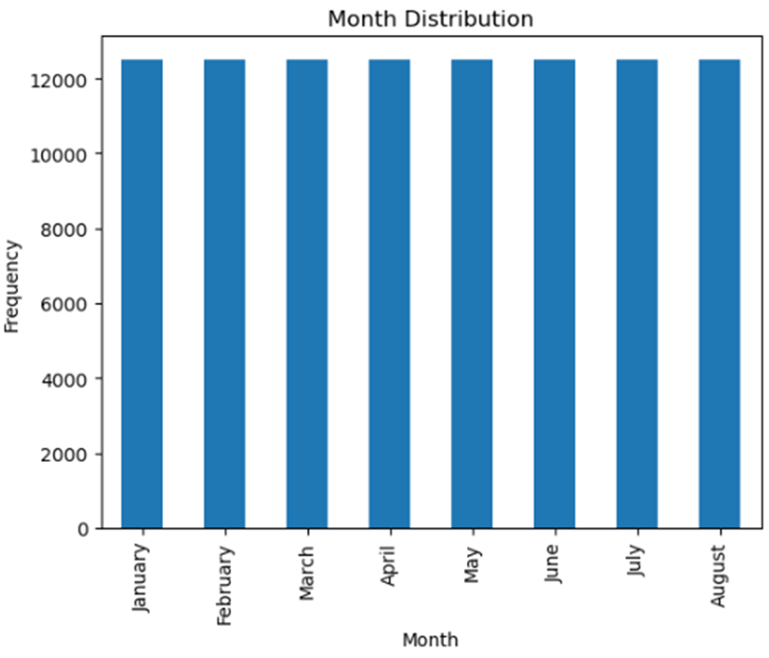
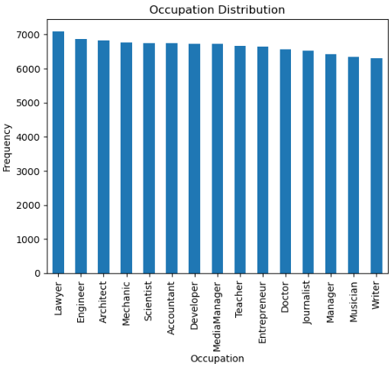
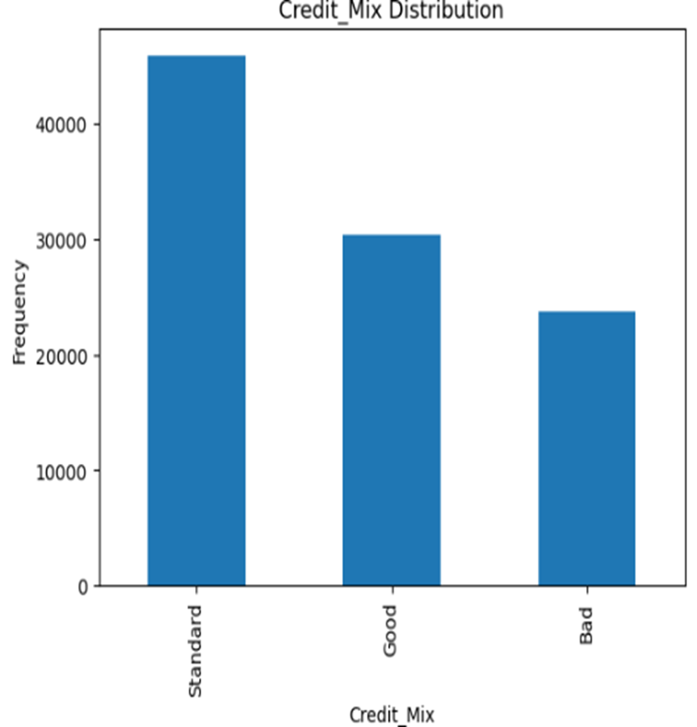
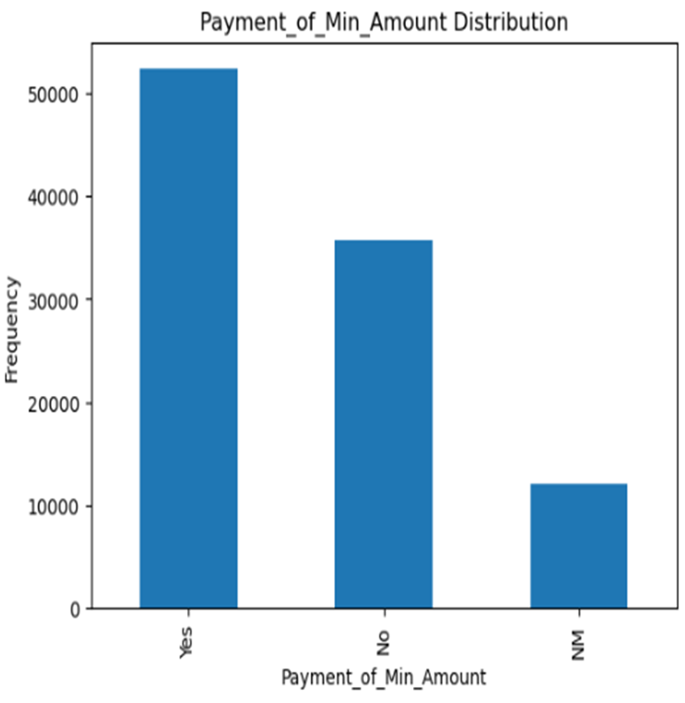

Slide 11
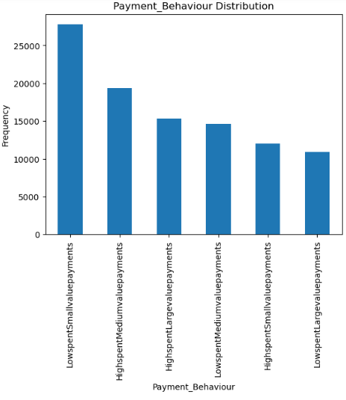
The data of each customer for all the 6 months are available.
The data of lawyers are most in the data and the data of musicians and writers are least.
The people with credit score as Standard is the most and Bad is the least.
Most of them have done the minimum payment and less number of people have not mentioned whether they did or not.
Most of the people have the behavior of Low_spent_small_value_payments and very less people does low_spent_large _value_payments.

Slide 12
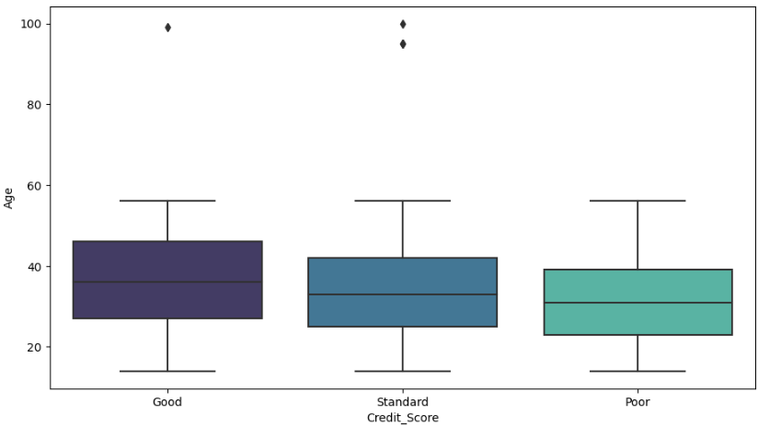
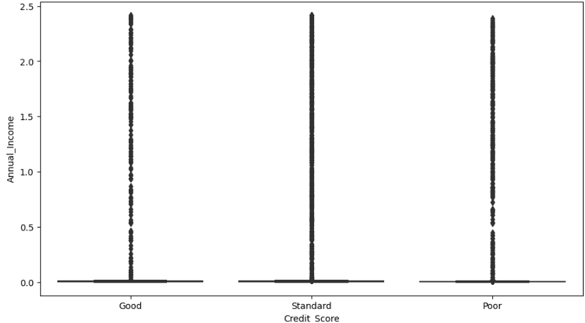
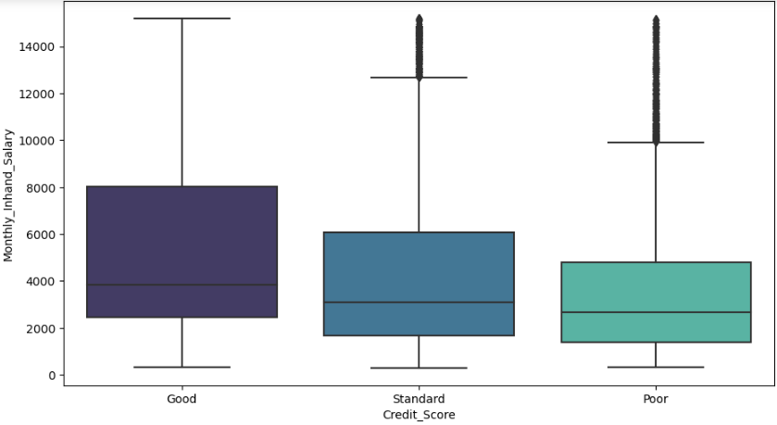
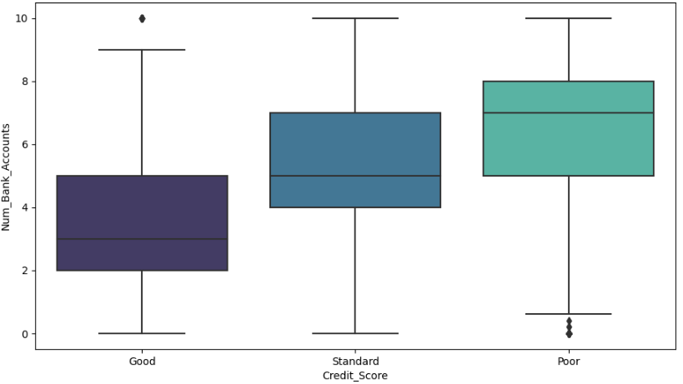
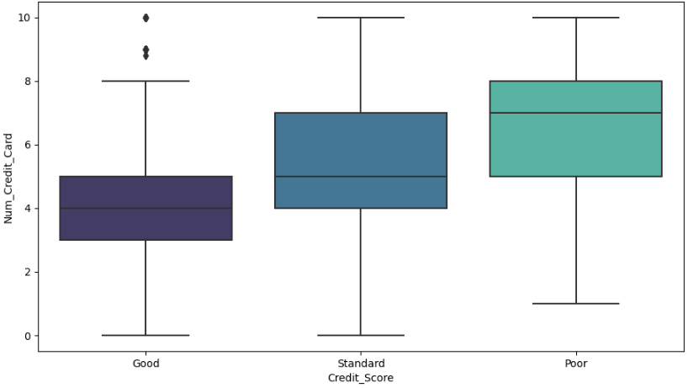
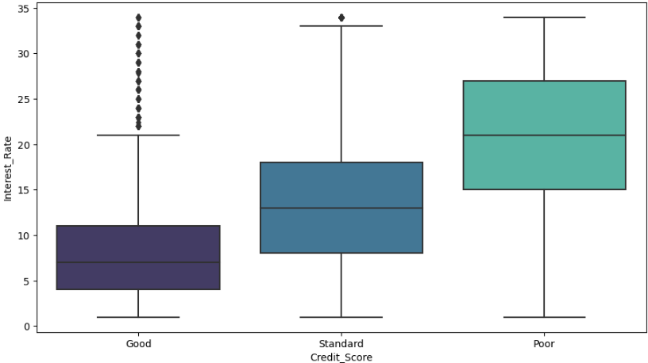
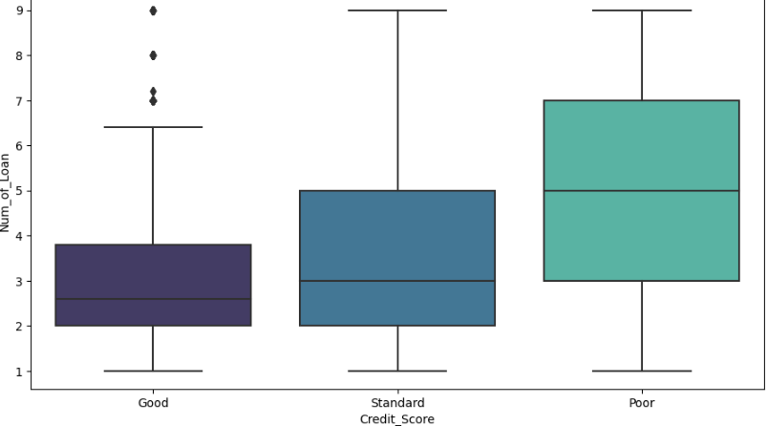
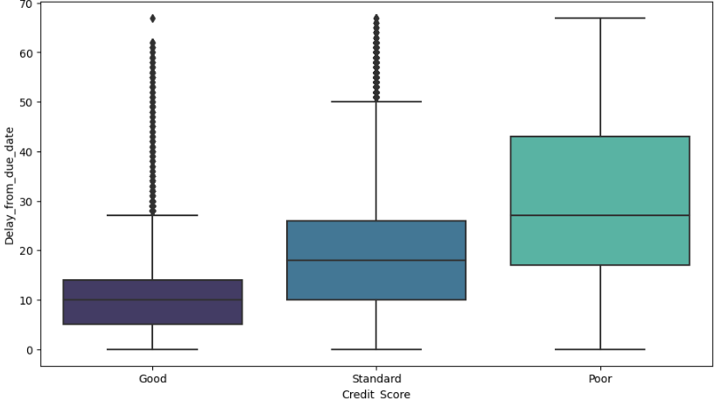
Bi - Variante - Analysis

Slide 13
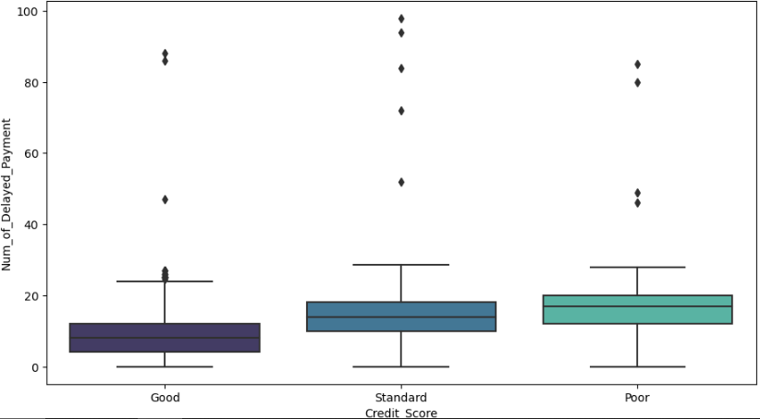
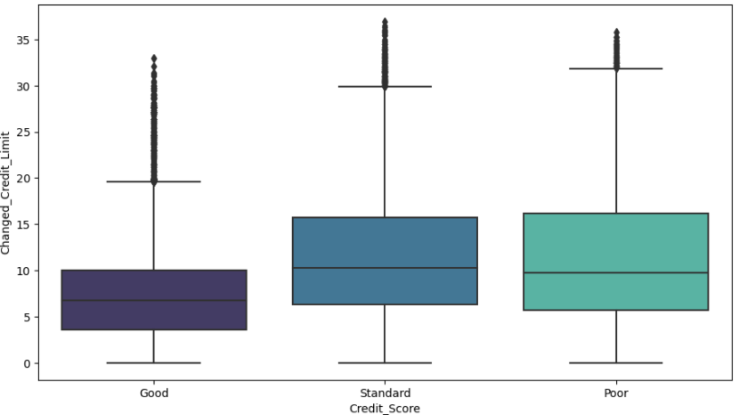
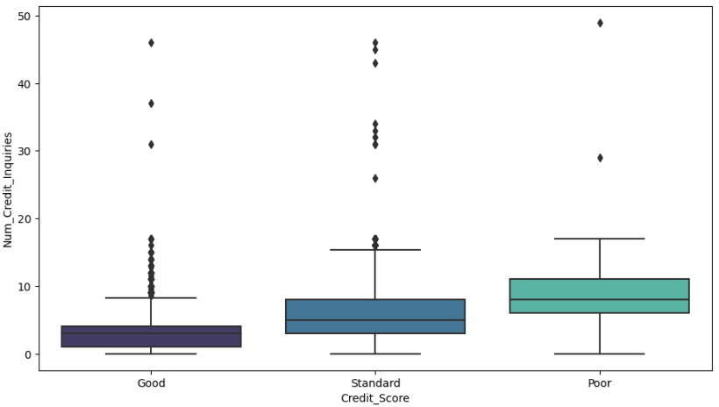
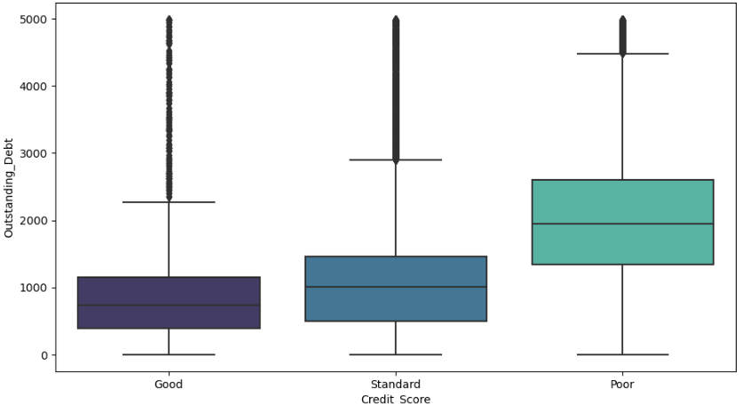
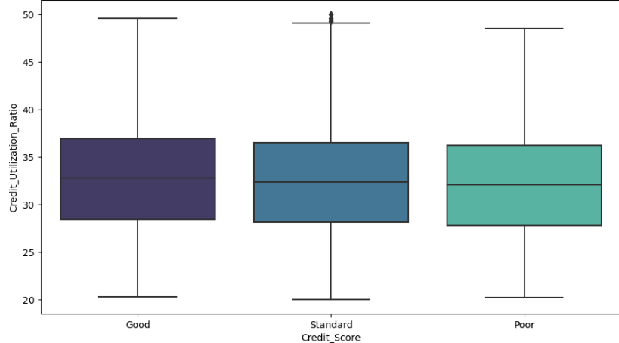
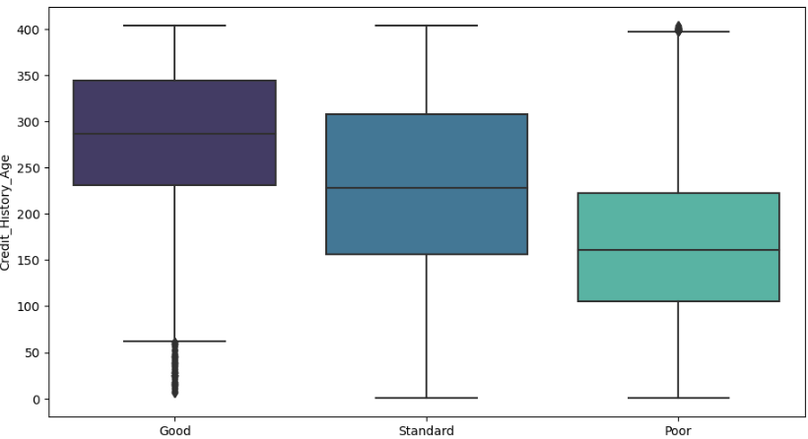
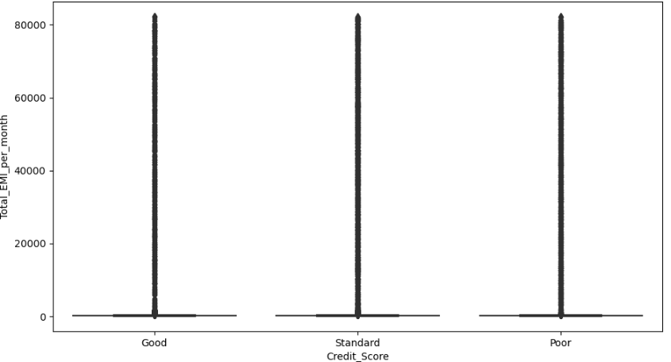
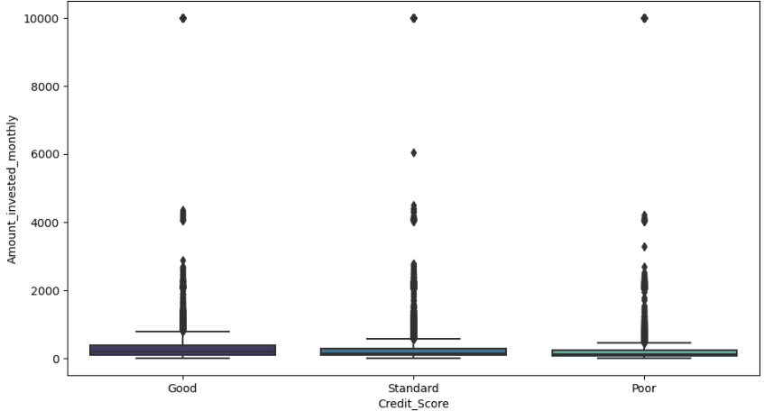

Slide 14
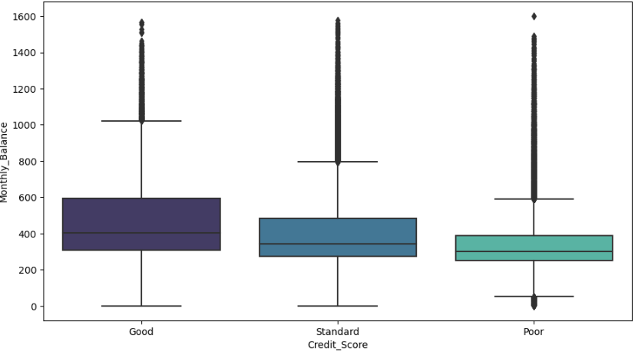
All the credit score features are equally shown by the people who comes under the age group of 10 – 60.
Those having the tree types of credit score have annual incomes in very different ranges.
The standard and poor credit score have outliers in monthly inhand salary.
Those having good credit score have more number of bank account, number of credit cards, number of loans, interest rate, interest rate, delay from due date, compare to others.
Number of delay payment is almost similar for all the credit score.
The median of changed credit limit is almost same for standard and poor credit score and all of those have positive outliers.
The maximum and minimum value of number of credit inquiries are same for each credit score.
The minimum, maximum and median of credit utilization ratio for credit score types are same.
Age has negative outliers in good credit score and poor have positive outliers.
Total EMI per month have a large number of outliers in each category.

Slide 15
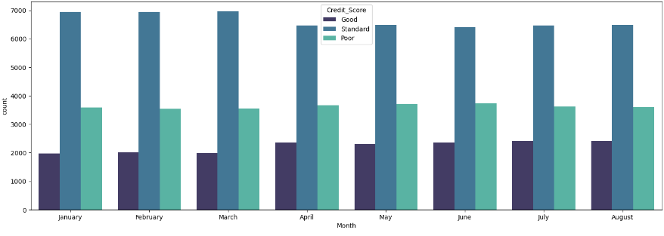
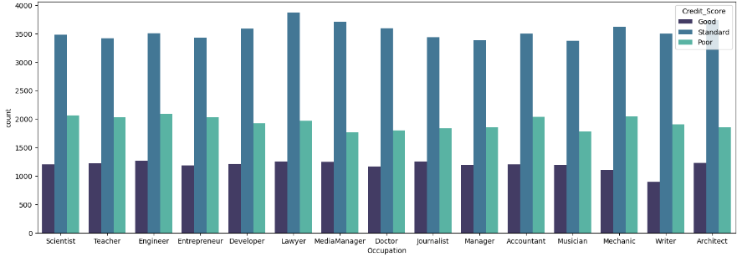
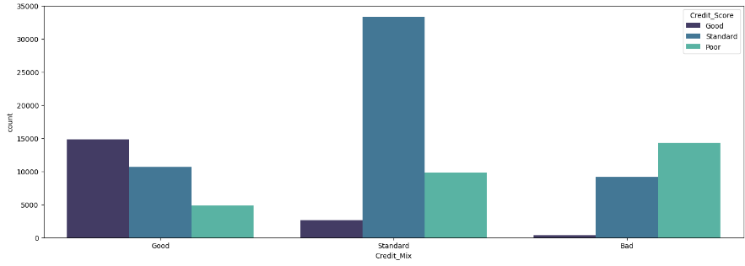
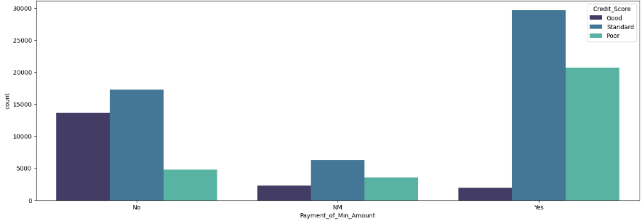
Count Plot

Slide 16
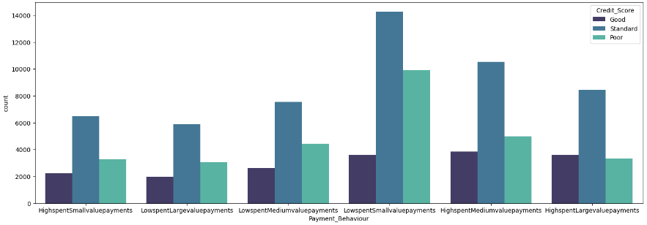
Scientists, teachers, engineers, developers, lawyers, media manager, doctors, journalists, architects have a chance to get good credit score.
Lawyers, mechanics, architects, writers have a average or standard credit score.
Mechanics, accountants, entrepreneurs have bad credit score.
Those who have not done minimum amount payment have a good credit score.
People who did minimum payment amount have a poor credit score.
Those whose behavior is High spending medium value payments have a good credit score.

Slide 17
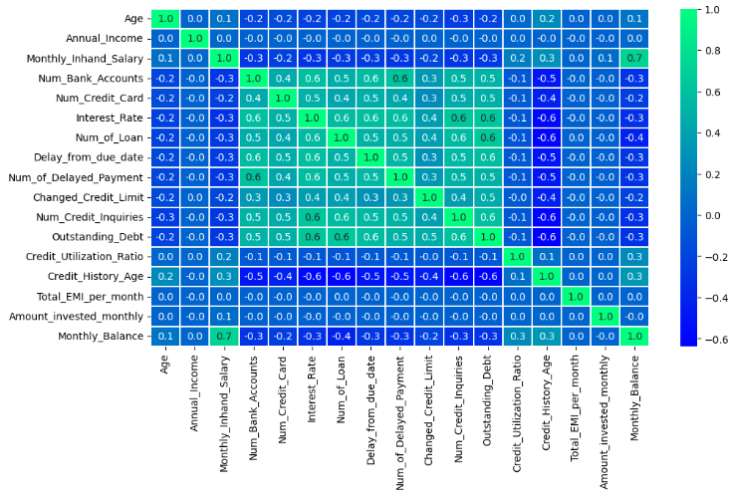
Multi - Variante - Analysi

Slide 18
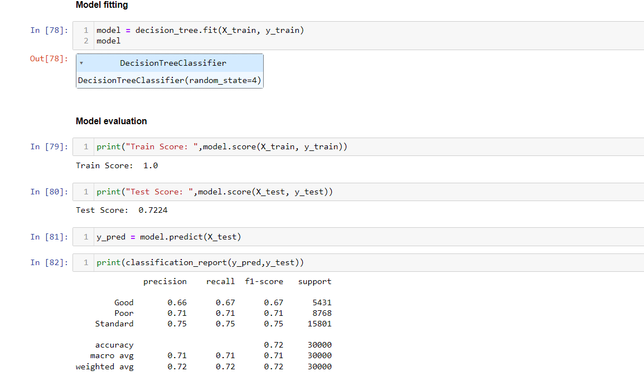
Modelling and Evaluation

Slide 19
Conclusion
We followed following 7 steps for base modeling :
Reading Data
Data Exploration
Data cleaning
Data Preprocessing
Data Visualization
Data Transformation
Modeling & Evaluation
We got 72 percent accuracy from our base model for 3 classes i.e Good , Poor , Standard.
We will be trying Different Models along with Feature engineering , PCA , Advanced EDA and smote for future improvement of out modeling Process

Slide 20
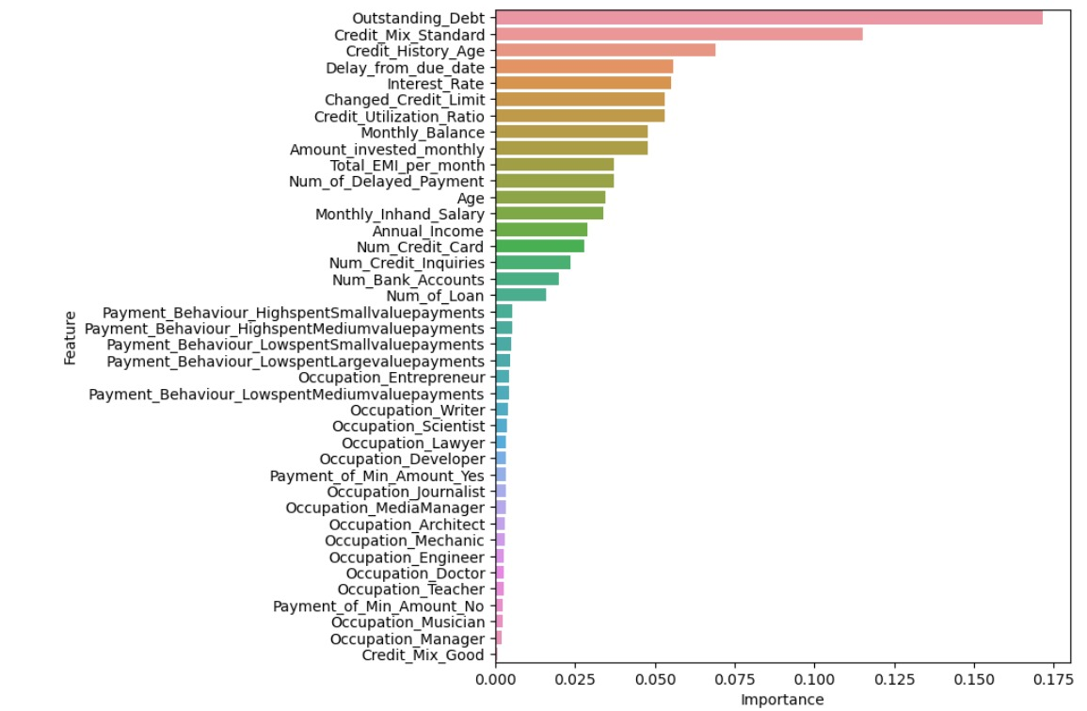
Feature Importance

Slide 21
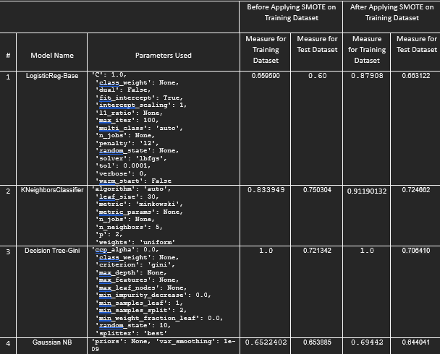
Performance Measure : Weighted Average F1

Slide 22
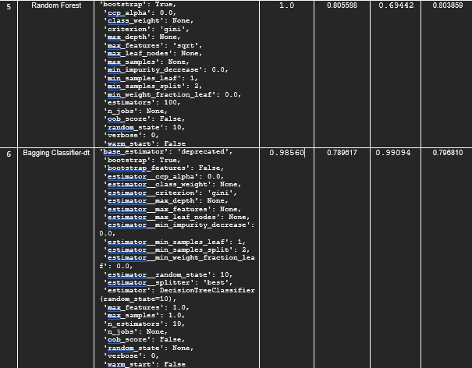

Slide 23
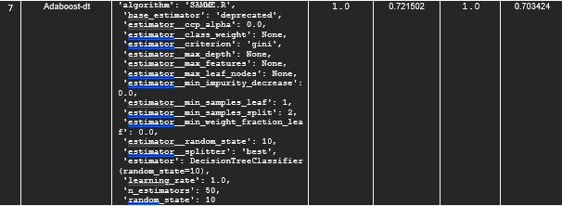

Slide 24


Slide 25


Slide 26
Conclusion
Outstanding_Debt, Credit_Mix_Standard and Credit_History_Age has more influence on the target.
As our data is imbalanced we are not considering accuracy.
Also we have 3 classes so we cannot rely on precision and recall. So, we will be looking at F1 score for selection of best model.
After analyzing all the models build, XGBoost Is the best model.
Choosing XGBoost as the best model before SMOTE. We got weighted F1 score 76% in test dataset and 83% in training dataset.
To improve the model performance we tuned the model and performed SMOTE, But the model performance did not improve.
So, We are going with the base model.

Slide 27
Thank you!!!

