Slide 1

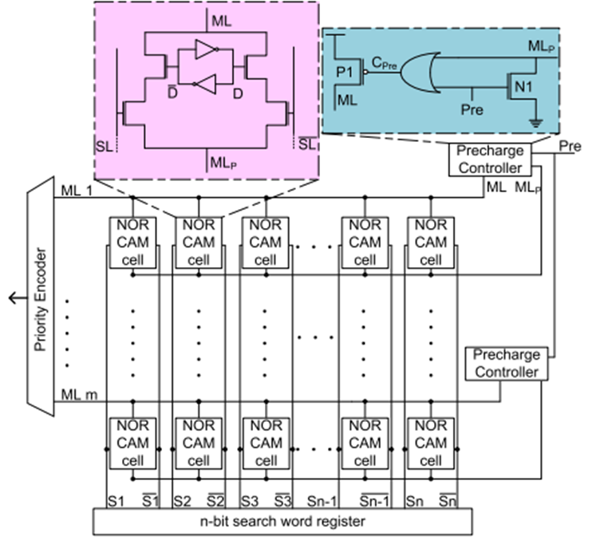
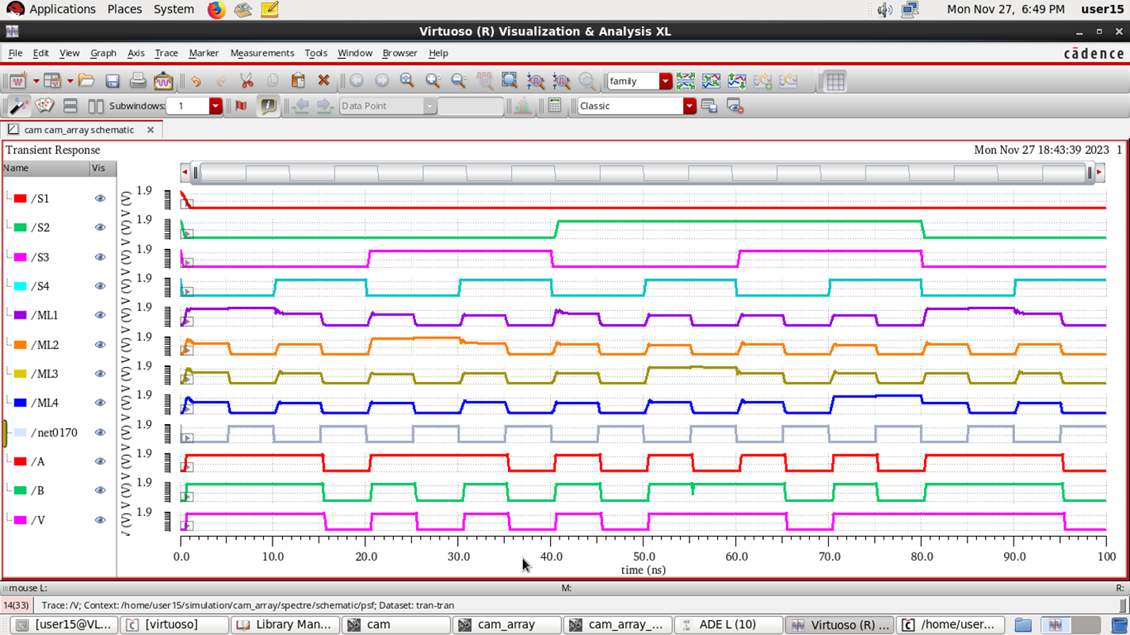
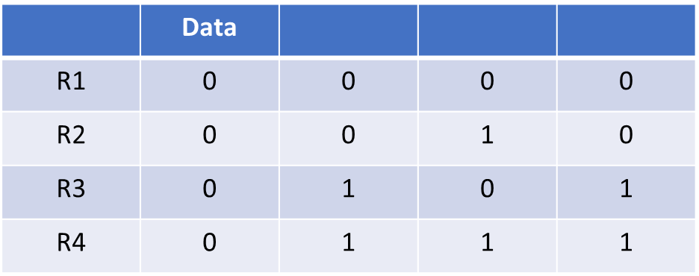
Project Title: Single Event Upset on CAM
Students Team members list : Harsha Hiregoudar, Kiran Hanamagoudar, Sneha Kumari, Sneha Anchekar
School of Electronics and Communication
Email id for correspondence:01fe20bec183@kletech.ac.in, 01fe20bec214@kletech.ac.in,01fe20bec272@kletech.ac.in, 01fe20bec291@kletech.ac.in
Senior Design Project-2023-24
Problem statement
Proposed Methodology
The proposed CAM architecture enhances performance by dynamically adjusting the precharge time for mismatching Memory Lines (MLs). Unlike traditional CAMs that precharge all MLs to full swing level during the precharge phase, this design predicts and selectively limits the charge on MLs that would mismatch. The NOR CAM cells in this architecture create a path between ML and MLP nodes when a mismatch occurs, enabling dynamic charge control This optimized precharging improves search speed by minimizing the voltage swing required to drain mismatching MLs during the evaluation phase, enhancing overall CAM efficiency. Consider 4x4 array data stored in array as shown below.
Results and inferences
This Project aims to implement and simulate content addressable memory(CAM) and CAM array. Also Study the Impact of Single Event Upset(SEU) in CAM array
Objectives
Analyse different CAM architecture
To model the double exponential current pulse(DECP) in Cadence.
To study the impact of single-event upset on CAM.
To determine the threshold of DECP which causes single-event upset
Literature survey
Design and Optimization details
1)Low Energy Metric Content Addressable Memory (CAM) with Multi Voltage Matchline Segments
2)Content Addressable Memory—Early Predict and Terminate Precharge of Match-Line Mohammed Zackriya V and Harish M. Kittur.
3) Precharge-Free, Low-Power Content-Addressable Memory
Identifying the current threshold value in a Double Exponential Current Pulse (DECP) is critical for determining the circuit's resiliency. It gives critical information about the maximum current that the circuit can handle without failing. This understanding drives the careful design of real-time memory systems, preventing potential problems such as malfunctions or data corruption. Designers can build safety margins and guarantee the memory performs consistently within its specified parameters by understanding the circuit's limits.
Contributions
The project contributes to advancing semiconductor reliability by developing a radiation-hardened Content Addressable Memory (CAM) design in Cadence. This includes the creation of error-resilient CAM schematics, mitigating Single-Event Upsets (SEUs) and enhancing overall system dependability in critical applications.
Conclusions
This project systematically designed and simulated various CAM cells using Cadence. Emphasizing array-level performance, we evaluated the CAM array's functionality and modeled Single-Event Upsets to assess vulnerabilities under external radiation.
Semester: VII Under the guidance of: Dr. Vijay H M

