Slide 1

ShipmentSure: Predicting On-Time Delivery Using Supplier Data
A machine learning solution for accurate delivery prediction and enhanced logistics planning

Slide 2
About the Project
Project Overview
Our Approach
ShipmentSure leverages machine learning to predict whether shipments will arrive on time or face delays, enabling logistics companies to proactively manage delivery expectations and optimise operational efficiency.
We developed a robust predictive model through systematic data preprocessing, intelligent feature engineering, comprehensive model evaluation, and strategic regularisation techniques to ensure reliable deployment.
Data Preprocessing
Model Building
Deployment
Clean and prepare raw data
Train and compare algorithms
Implement production solution
1
2
3
4
5
Feature Engineering
Evaluation
Create meaningful variables
Validate performance metrics

Slide 3
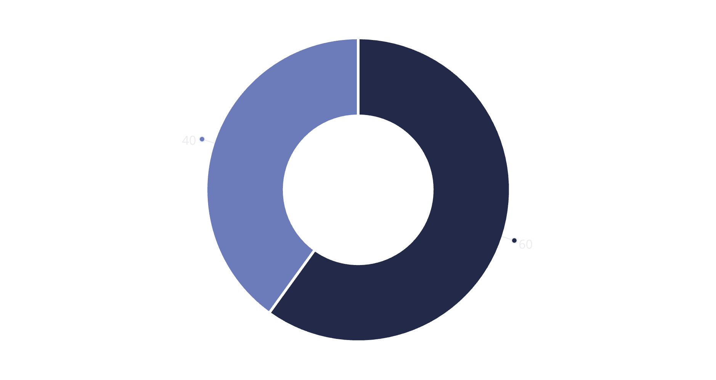
Dataset Overview
Data Collection & Loading
Source: Train_new.csv dataset
Volume: 10,999 shipment records
Features: 12 comprehensive columns
Target Variable: Reached.on.Time_Y.N
1 = On-Time Delivery
0 = Delayed Shipment
Key Features:
Warehouse Block
Cost_of_the_product
On-Time
Delayed
Mode_of_Shipment
Target Variable Class distribution
weight_in_gms
The dataset exhibits a moderate class imbalance, with 60% of shipments arriving on time and 40% experiencing delays. This distribution required careful handling through SMOTE balancing techniques.
Prior purchase
Product importance

Slide 4





Data Preprocessing Pipeline
Data Cleaning
Categorical Encoding
Feature Scaling
Removed missing values and duplicate records to ensure data integrity and reliability
Applied LabelEncoder for ordinal data and OneHotEncoder for nominal features
Normalised numerical columns using StandardScaler for consistent model training
Outlier Detection
Class Balancing
Identified and removed statistical outliers using Interquartile Range (IQR) method
Implemented SMOTE to address class imbalance and improve model performance
Our comprehensive preprocessing pipeline transformed raw shipment data into clean, balanced, and normalised inputs optimised for machine learning model training and evaluation.

Slide 5
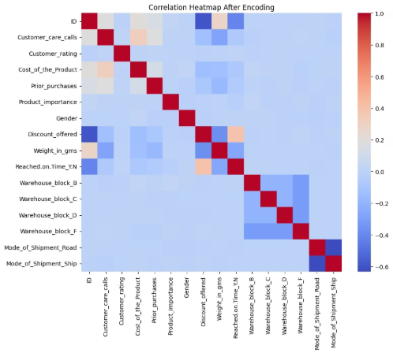
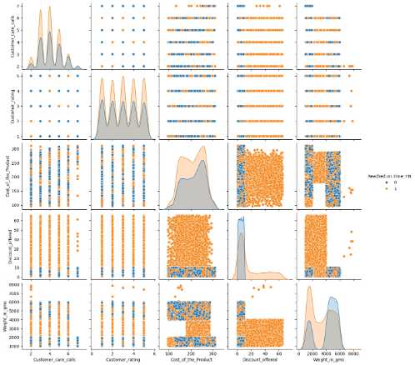
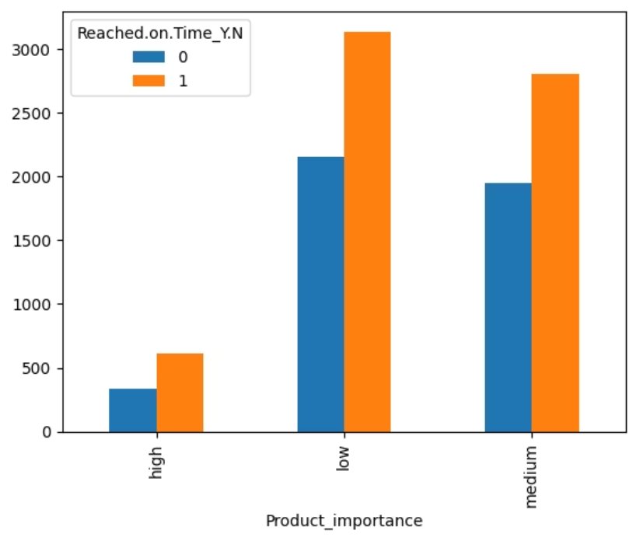
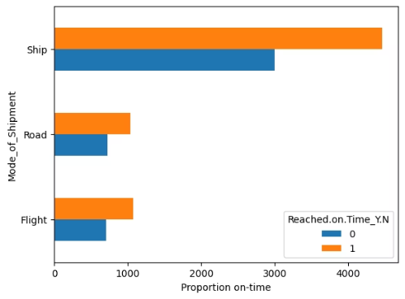
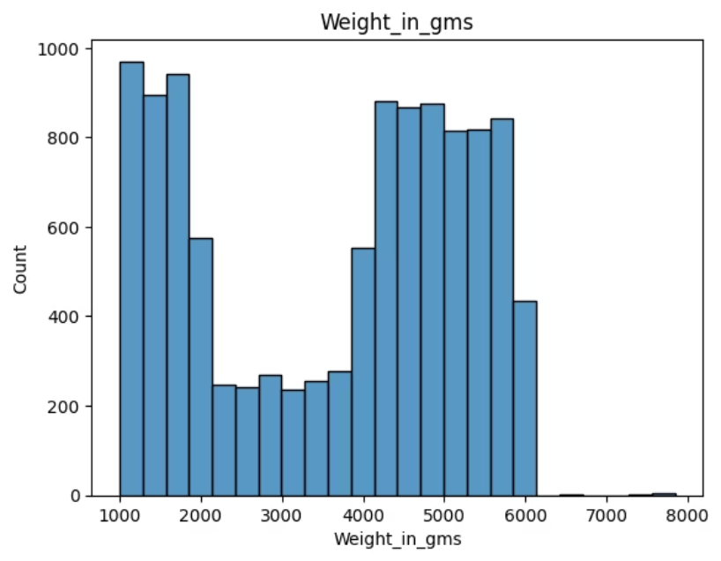
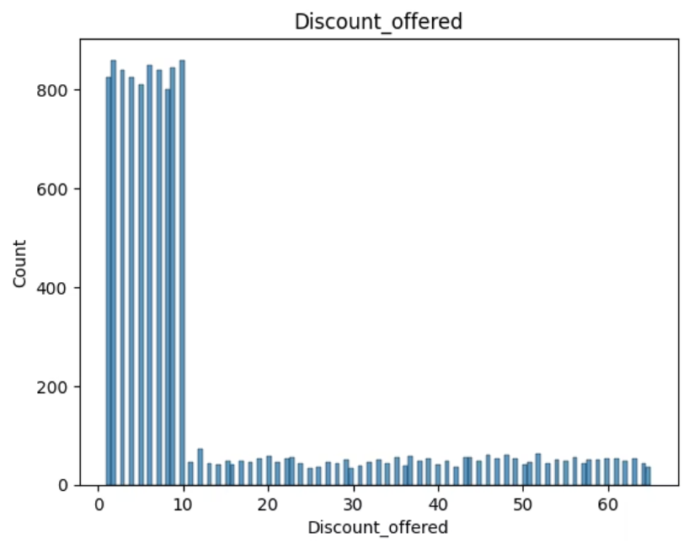
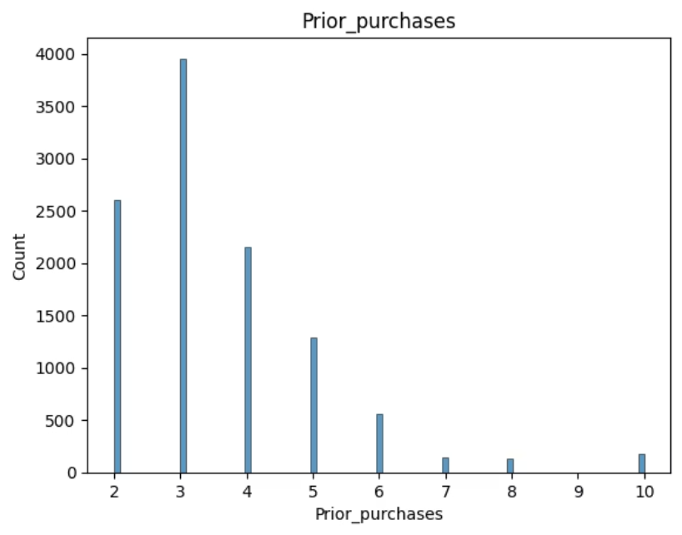
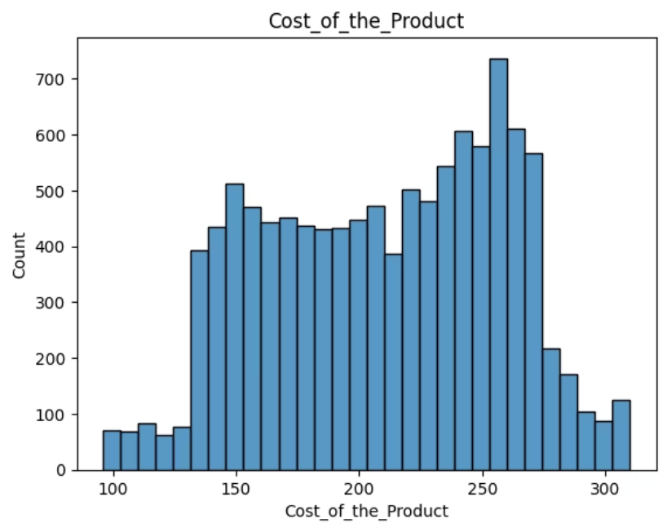
Visualisation Techniques
Bar plots, heatmaps, pairplot(scatter plots & histograms) revealed critical insights into delivery performance drivers.

Slide 6
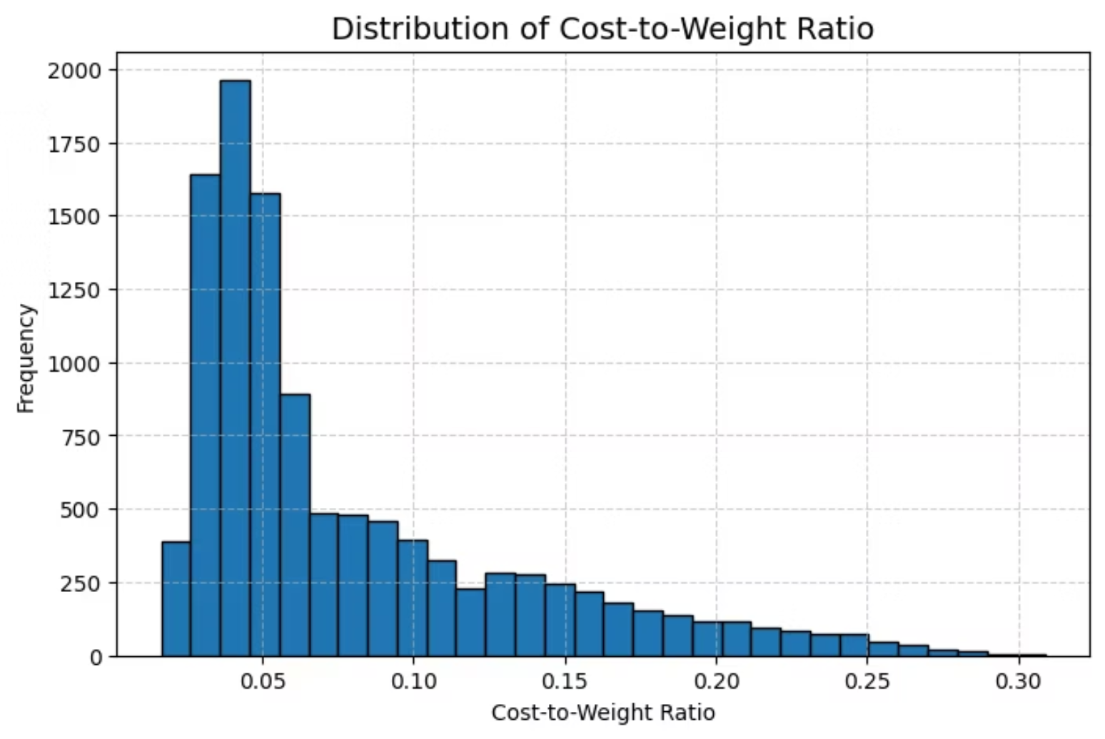
Feature Engineering: Cost-to-Weight Ratio
The Engineered Feature
Formula: Cost_to_Weight = Cost ÷ Weight
This derived metric captures the economic density of shipments, revealing critical relationships between product value, weight, and chosen logistics methods.
Impact on Model Performance: This feature significantly improved the model's ability to distinguish between shipment types by encoding business-meaningful relationships between price, weight, and delivery logistics, ultimately enhancing prediction accuracy.

Slide 7
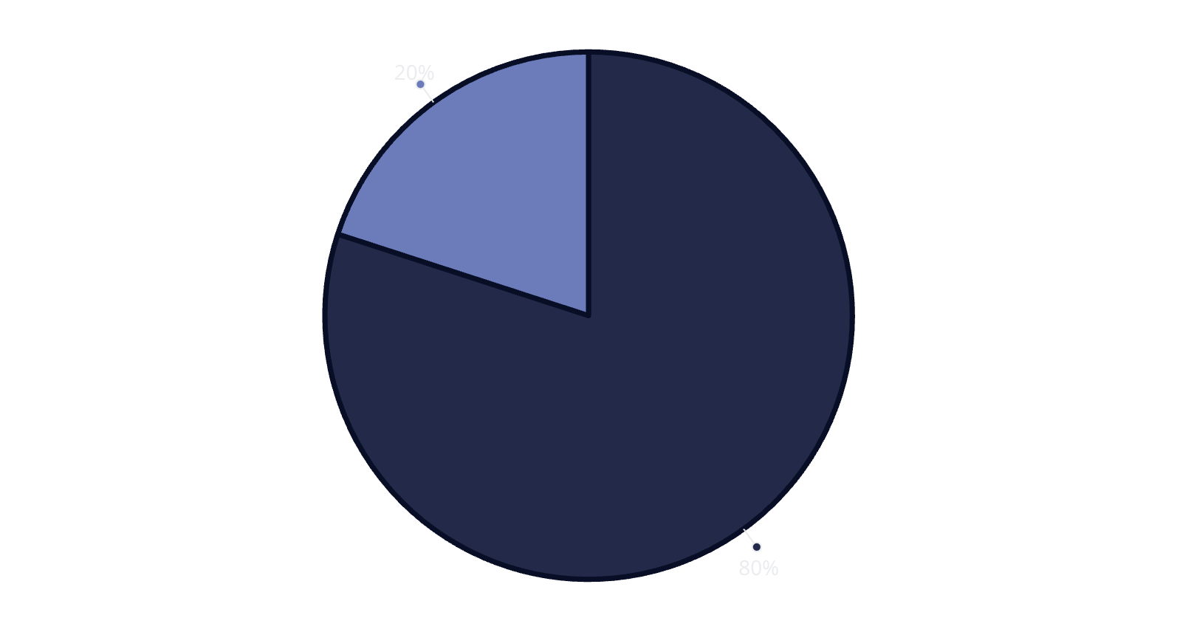
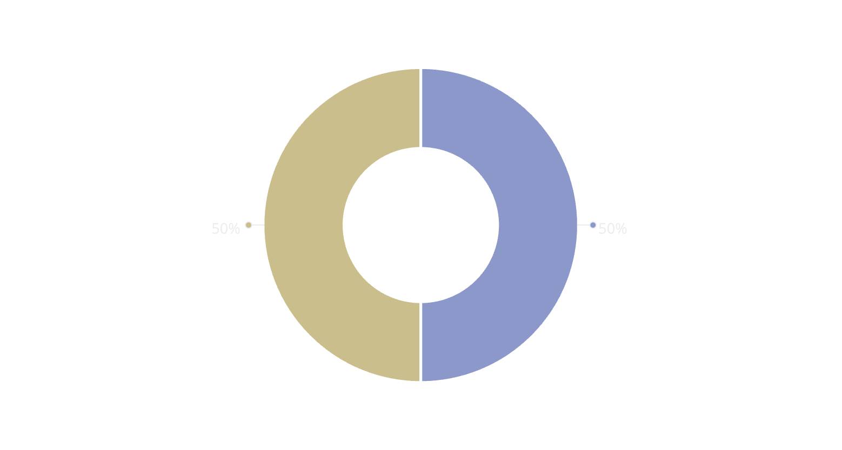
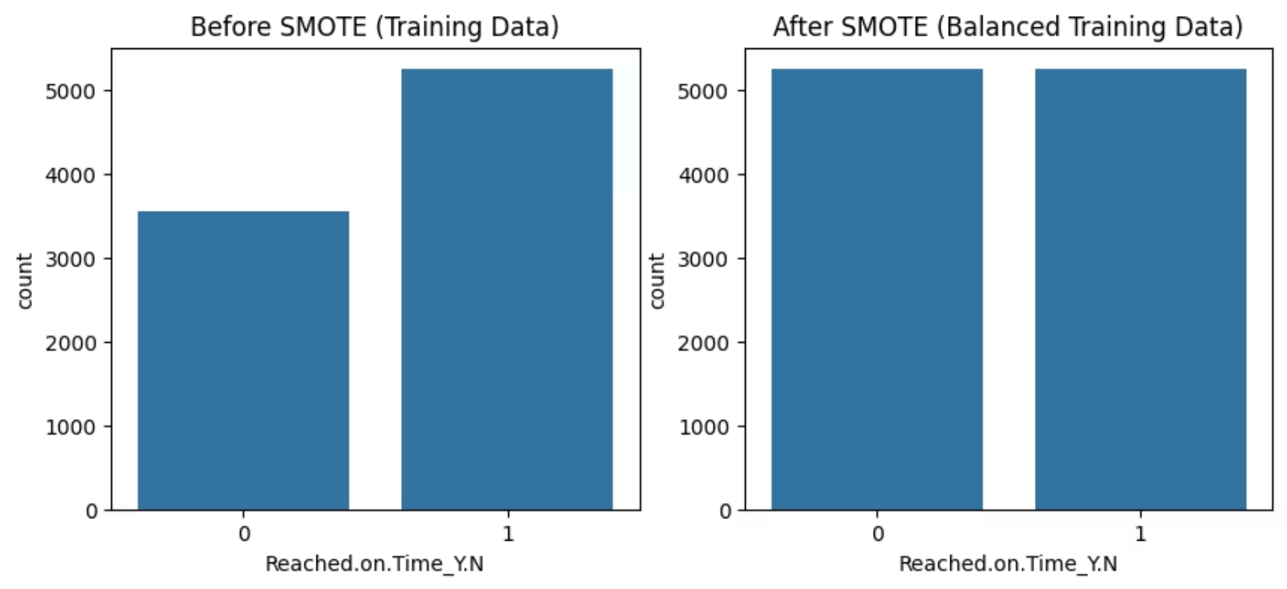
Data Splitting & Class Balancing Strategy
Train-Test Split
We implemented an 80-20 split strategy to ensure robust model training whilst maintaining sufficient data for comprehensive testing and validation.
80%
20%
Training Set
Testing Set
Used for model learning and pattern recognition
Reserved for performance evaluation
SMOTE Balancing Technique
Synthetic Minority Over-sampling Technique (SMOTE) was applied to address the class imbalance between on-time and delayed deliveries. This sophisticated resampling method generates synthetic examples of the minority class, ensuring the model learns both delivery outcomes equally.
On-Time
Delayed
Result: Perfectly balanced classes enable the model to learn patterns from both delivery outcomes without bias towards the majority class.

Slide 8
Model Building & Regularisation Techniques
Algorithm Comparison
We evaluated eight distinct machine learning algorithms to identify the optimal predictor for delivery outcomes:
1
Logistic Regression
2
Decision Tree
3
Random Forest
4
Support Vector Machine
5
K-Nearest Neighbours
6
Naive Bayes
7
Gradient Boosting
8
XGBoost ✓
Regularisation Strategy
Regularisation techniques prevent overfitting by adding penalty terms to the loss function, constraining model complexity and improving generalisation.
L1 Regularisation (Lasso)
L2 Regularisation (Ridge)
Forces irrelevant feature weights to zero, enabling automatic feature selection and model simplification
Penalises large weights to promote smooth generalisation and reduce sensitivity to individual features
The regularisation parameter λ controls the trade-off between fitting the training data and maintaining model simplicity.

Slide 9


Model Training & Validation Process
Stratified K-Fold Cross Validation
Balanced Class Distribution
Implemented k=10 folds to ensure robust performance estimation across multiple data partitions
Maintained consistent class ratios across all validation folds for unbiased evaluation
L2 Regularisation
Hyperparameter Optimisation
Applied Ridge regularisation with λ=1 to prevent overfitting and enhance generalisation
Utilised RandomizedSearchCV to tune learning rate, n_estimators, and max_depth parameters
Hyperparameters Tuned
Learning Rate
N_Estimators
Max_Depth
Controls the step size during gradient descent optimisation
Determines the number of boosting rounds in the ensemble
Limits tree complexity to prevent overfitting
Outcome: Achieved stable accuracy with minimal variance across validation folds, confirming robust model performance and reliable generalisation to unseen data.

Slide 10
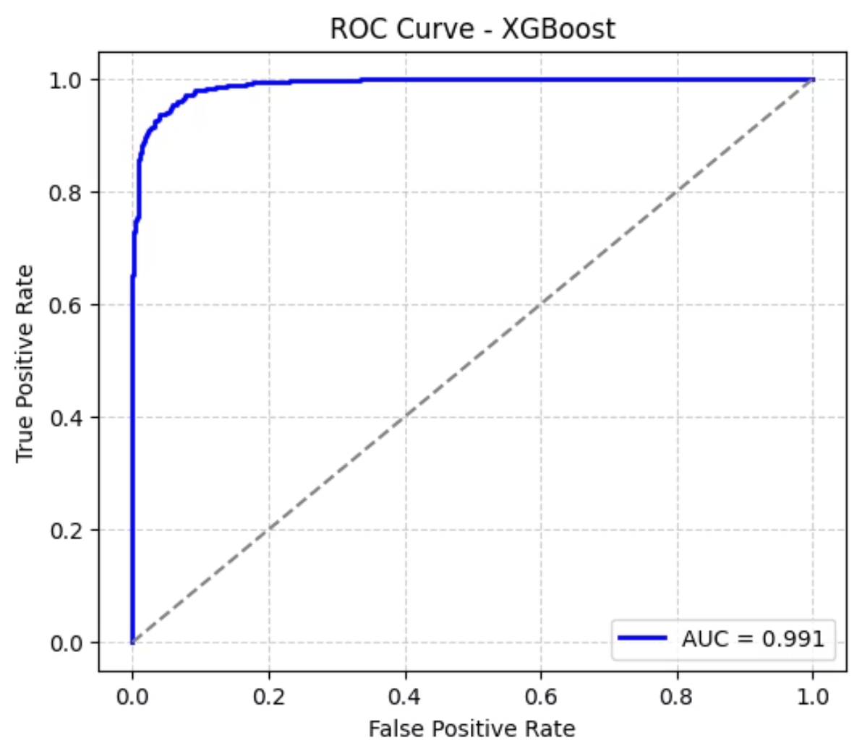
Model Evaluation Results
Performance Metrics
Comprehensive evaluation across multiple metrics confirms XGBoost as the optimal solution for delivery prediction:
Metric
Score
Accuracy
0.9428
Precision
0.9713
Recall
0.9114
F1-Score
0.9404
Exceptional Accuracy
Balanced Metrics
94% overall prediction accuracy demonstrates strong performance across both delivery outcome classes
High precision and recall scores indicate reliable prediction of both on-time and delayed shipments
Best Model: XGBoost Classifier outperformed all competing algorithms through superior handling of complex feature interactions, robust regularisation control, and optimised hyperparameter configuration. The confusion matrix and ROC curve validate consistent performance across all evaluation criteria.

Slide 11
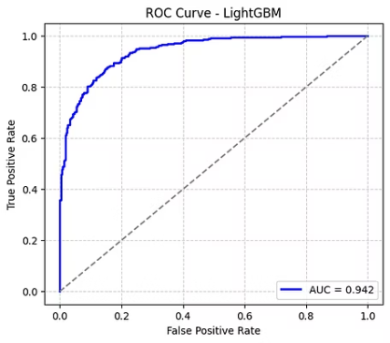
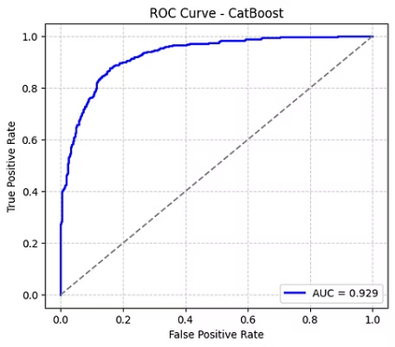
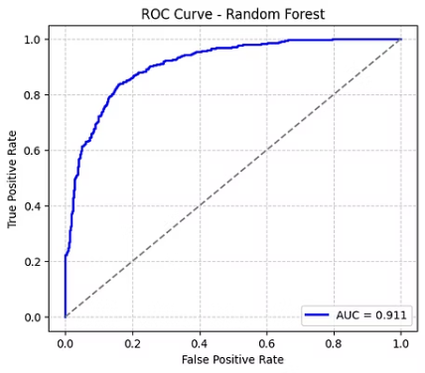
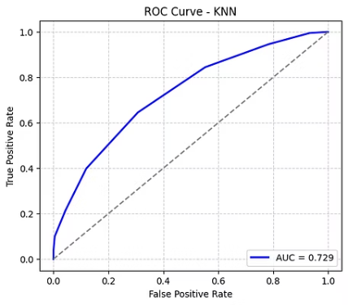
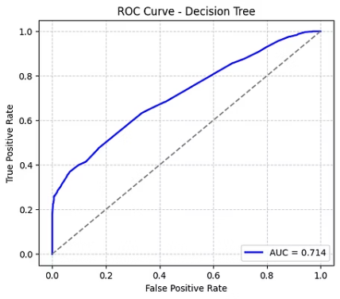
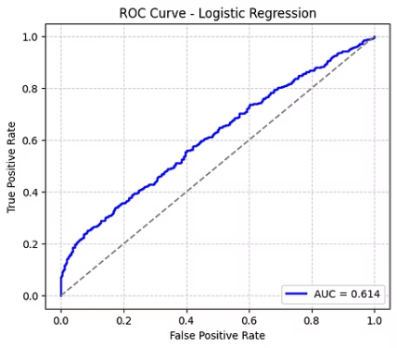
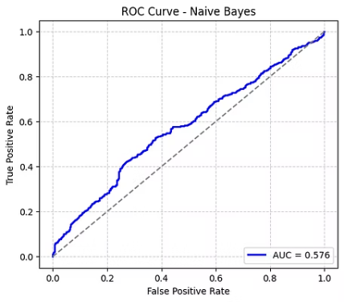
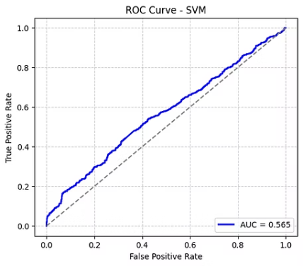
Model Evaluation Results
Model
Accuracy
Precision
Recall
F1=score
ROC-AUC
LightGBM
0.8378
0.9242
0.7326
0.8173
0.9420
CatBoost
0.8111
0.9151
0.6820
0.7815
0.9289
Random Forest
0.7367
0.9458
0.4968
0.6515
0.9114
KNN
0.6693
0.6733
0.6456
0.6591
0.7292
Decision Tree
0.6528
0.7981
0.4003
0.5332
0.7137
Logistic Regression
0.5690
0.5697
0.5301
0.5492
0.6137
Naive Bayes
0.5768
0.6045
0.4209
0.4963
0.5761
SVM
0.5517
0.5673
0.4003
0.4694
0.5647

Slide 12



Model Optimisation
Fine-tuning our XGBoost classifier involved comprehensive hyperparameter optimisation and rigorous validation strategies to maximise predictive accuracy whilst preventing overfitting.
Hyperparameter Tuning
Regularisation Control
Deployed RandomizedSearchCV to efficiently explore parameter space and identify optimal configurations
Fine-tuned lambda (λ=1) and alpha (α) parameters to balance model complexity with generalisation
Stratified K-Fold
Feature Analysis
Applied stratified cross-validation to ensure robust performance across class distributions
Conducted importance analysis to identify key predictors driving model decisions

Slide 13

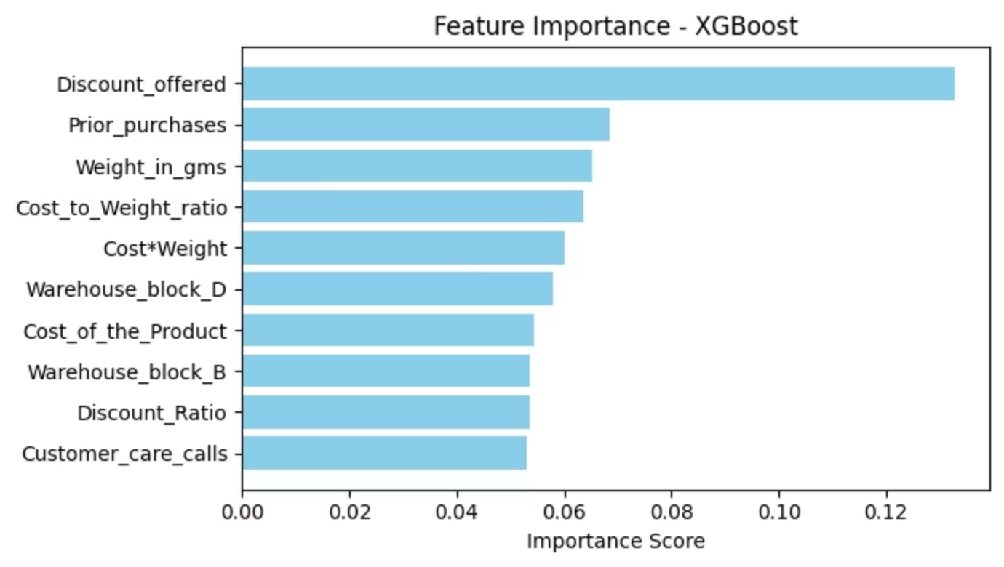
Feature Importance
Feature importance tells us how much each input feature contributes to the model’s prediction.In other words, it shows which features influence the outcome the most.
used the feature_importances_ attribute of the trained XGBoost model to identify top features.
Discount_offered is the most important feature in the XGBoost.
Prior_purchases, weight_in_gms, cost_to_weight_ratio has acquired 0.08 important score.
cost*weight, warehouse_block_d are the third highest features.
Least important features are Cost_of_the_product, warehouse_block_b, discount_ratio, customer_care_calls.

Slide 14
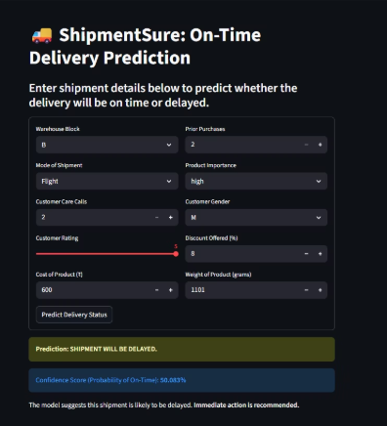
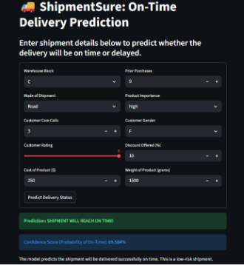
Model Deployment
Streamlit Framework
01
Our production deployment leverages Streamlit to create an intuitive, real-time prediction interface that connects end-users directly to the trained XGBoost model.
Load Model
Import trained classifier (.pkl)
Core Libraries
02
pandas & numpy for data manipulation
Capture Inputs
scikit-learn for preprocessing pipelines
xgboost for model inference
Collect user parameters via UI
pickle for model serialisation
03
streamlit for web application framework
Transform Data
Apply encoding & scaling
04
Generate Prediction
Execute XGBoost inference
05
Display Results
Show classification & probability

Slide 15









End-to-End ML Pipeline
Our complete machine learning workflow encompasses data ingestion through production deployment, ensuring reproducibility and scalability at every stage.
Data Collection
Dataset loading & initial exploration
Preprocessing
Handling missing values & outliers
Feature Engineering
Creating derived features
SMOTE
Addressing class imbalance
Train/Test Split
Stratified data partitioning
Model Building
Training 8 candidate algorithms
Optimisation
Hyperparameter tuning
Evaluation
Performance metrics analysis
Deployment
Production release

Slide 16
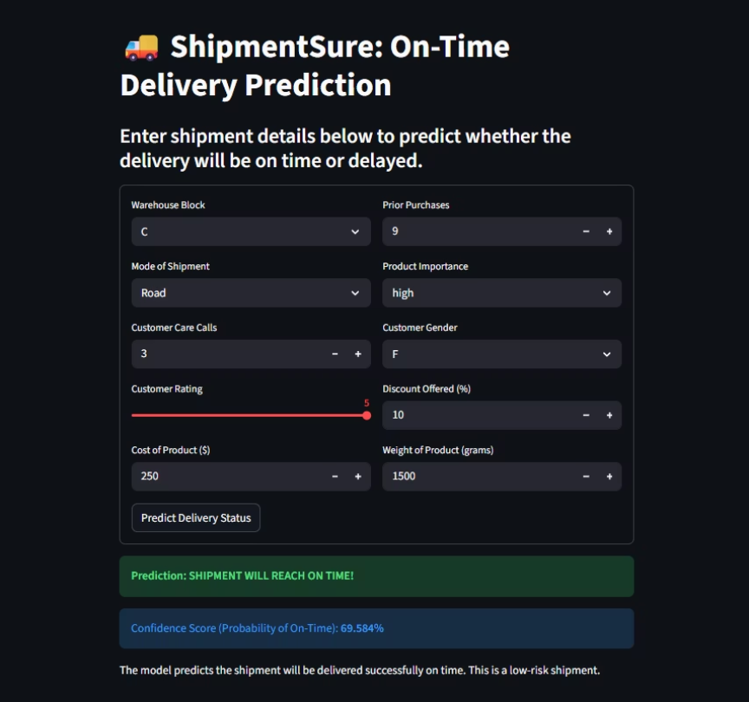
Application Workflow
The Streamlit application bridges our machine learning model with end-users through an elegant, responsive interface that delivers real-time shipment predictions with confidence scores.
Real-World Example: "Shipment will reach on time!" (Probability: 0.93)
This production-ready system enables logistics teams to make proactive decisions based on predictive insights, ultimately reducing delays and improving customer satisfaction.
User Input
1
Customer enters shipment parameters via web form
2
DataFrame Creation
Input values structured into pandas DataFrame
Preprocessing
3
Categorical encoding & feature scaling applied
4
Model Inference
XGBoost generates classification & probability
Results Display
5
Output rendered: On-Time or Delayed status

