Slide 1

Blockchain-Based Shipment Tracking Management System
Exploring the advantages of decentralized tracking for improved transparency, security, and efficiency in shipment management.
Presenter -
Snehashisa Subudhiratna
A124013

Slide 2
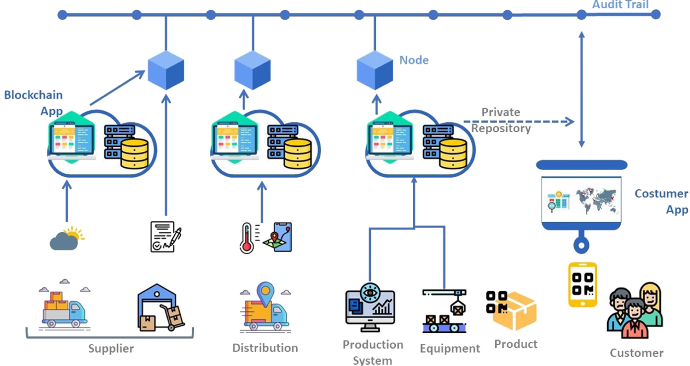
Introduction
The Blockchain-Based Shipment Tracking System is a decentralized solution to improve traditional shipment tracking system. It uses blockchain technology to provide secure, transparent, and tamper-proof tracking . Smart contracts automate updates, and decentralized storage (IPFS) ensures data is always accessible and reliable. The system offers a user-friendly interface for real-time tracking, making shipment management easier and more efficient. By enhancing trust and reducing reliance on intermediaries, it is well-suited for modern supply chains.

Slide 3
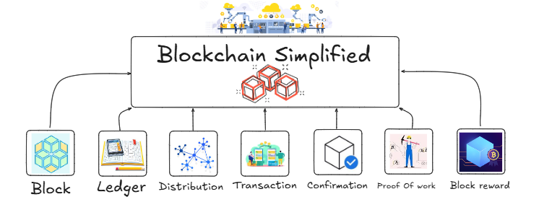
Motivation
OUR VISION
WHO WE ARE
Challenges in Traditional Systems:
Lack of transparency: Information silos among stakeholders result in incomplete or inconsistent shipment data.
Inefficiency: Manual processes and paperwork lead to delays, errors, and increased operational costs.
Susceptibility to fraud: Centralized systems are vulnerable to data tampering and unauthorized modifications.
Limited real-time visibility: Many systems fail to provide accurate, up-to-date shipment status and location.
Blockchain Advantages:
Immutability: Ensures tamper-proof and reliable data.
Decentralization: Reduces reliance on central authorities.
Transparency: Enables real-time, shared access to information.
Efficiency: Automates processes, minimizing errors and costs.

Slide 4

Objective
PROBLEM & SOLUTION
WHO WE ARE
Primary Goal:
To develop a blockchain-based shipment tracking system that ensures transparency, security, and efficiency in managing shipments.
Key Contributions:
Implementation of smart contracts for secure and automated shipment updates.
Integration of a blockchain-powered frontend for real-time shipment tracking and interaction.
Use of decentralized storage (IPFS) to ensure data availability, persistence, and fault tolerance.

Slide 5
Preliminaries
Technologies Used:
Blockchain Platform: Ethereum, chosen for its decentralized, open-source nature and support for smart contracts.
Decentralized Storage: IPFS (InterPlanetary File System) ensures distributed and persistent storage.
Programming: Solidity is used for writing smart contracts.
Frontend Tools: React is employed for user interface development, and MetaMask serves as the wallet for blockchain interaction.
Key Concepts:
Smart Contracts: These automate shipment updates, ensuring secure and tamper-proof execution of predefined business logic.
Consensus Mechanism: Ethereum's Proof of Stake (PoS) validates and secures shipment data efficiently, ensuring trust and decentralization

Slide 6
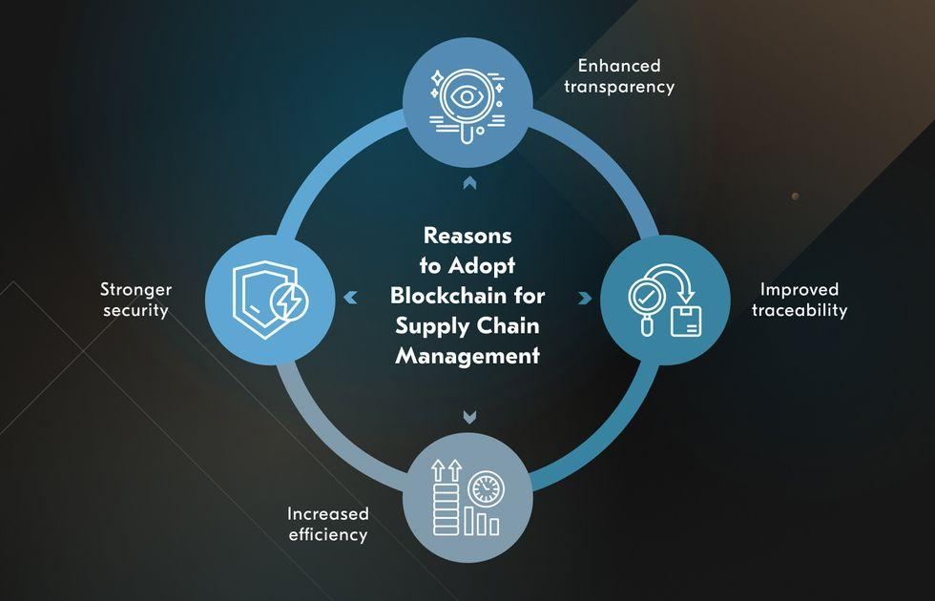
Literature Survey
Existing Systems:
Centralized systems depend on manual processes and intermediaries, making them inefficient and prone to fraud.
Examples like TradeLens (by IBM and Maersk) show promise but struggle with issues like data ownership and limited adoption.
Research Gap:
Limited adoption of blockchain for real-time shipment tracking, with most existing systems lacking robust integration of IoT devices.
Challenges in combining blockchain's immutability with automated IoT-based data collection and processing.

Slide 7
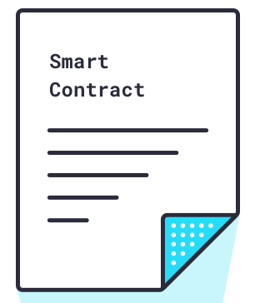
Smart Contarct
The primary purpose of this contract is to allow users to create shipments, track their status and location, and retrieve shipment information. Below is a breakdown of its functionalities:
Creating a Shipment :
The sender calls (createShipment) with the recipient’s address and a unique tracking number.
The contract initializes and stores the shipment data.
Tracking a Shipment :
The sender updates the shipment status and location using (trackShipment).
The updates are logged on the blockchain for transparency.
Viewing Shipment Details :
Any user can call (getShipmentInfo) with a tracking number to retrieve the latest details about a shipment.

Slide 8
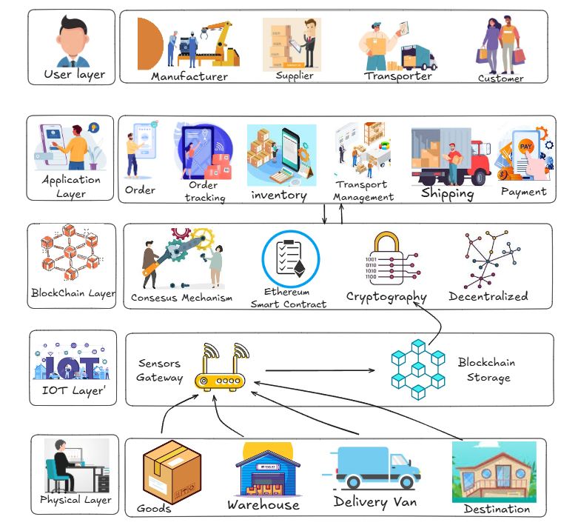
Proposed System
PRODUCT OVERVIEW
System Architecture:
Overview of the system: IoT, Blockchain, IPFS, and Frontend.
Diagram: A visual flow of the system components and their interactions.
Workflow:
Shipment Creation: User inputs shipment details.
Data Tracking: Updates stored immutably on the blockchain.
User Interaction: Real-time updates accessible via the frontend.
By generating an unchangeable record of all transactions and movements,this blockchain-IoT collaboration improves efficiency, security and traceability.
Advantages:
Transparency, security, traceability and automation of shipment processes.

Slide 9
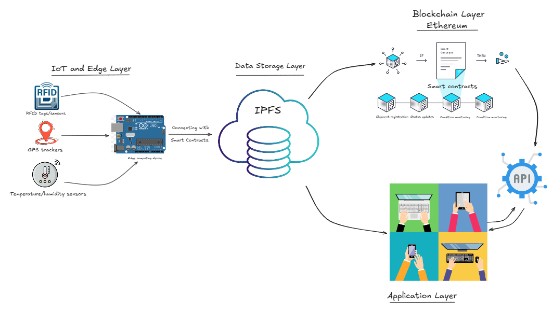
System Architecture:

Slide 10
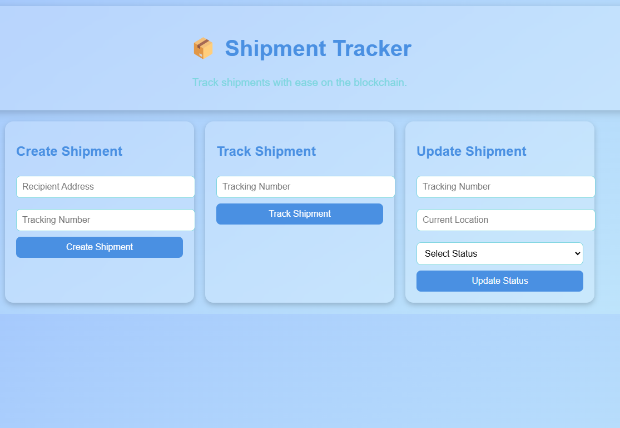
Frontend-Dapp

Slide 11

Conclusion
Summary: The proposed blockchain-based shipment tracking system effectively addresses inefficiencies in traditional shipment management by enhancing transparency, security, and reliability. By leveraging blockchain technology, it ensures tamper-proof and immutable data management while providing real-time tracking through IoT integration and decentralized storage.
Future Scope:
Integration with advanced IoT devices for automated data collection and monitoring.
Scalability to support global supply chain networks and diverse industries.

Slide 12

THANK YOU

