Slide 1
PRISMA Protocol for Systematic Reviews
[Preferred Reporting Items for Systematic reviews and Meta-Analyses]

Slide 2
Survey vs Review
Literature Survey | Literature Review
Surface-level view of existing literature of a field/domain | Extensive analysis of research work done in a field
Presentable as either a short article or part of a longer article | Often presented as an article of its own
Mostly summarization of work done in the concerned field | Detailed description of the progress of research done in the concerned field
Usually aimed at pinpointing the problem to be tackled | Usually aimed at finding out concepts and flaws in previous research and how to proceed on them, as a guide for future researchers

Slide 3
Arbitrary Review vs Systematic Review
Arbitrary Review | Systematic Review
No specific reviewing method adopted | Specific/systematic reviewing protocol/procedure adopted
Thematic approach | Question-based approach
No criteria defined on the inclusion/exclusion of studied articles | Regulated criteria and conditions followed for limiting the number and content of studied articles
No specific question is answered | Specific research questions are answered
Biasing of authors may be present | Minimal bias is attempted to be ensured
Review conclusions may/may not be reproducible | Review conclusions should be reproducible as far as possible

Slide 4
Systematic Review vs Meta Analysis
Systematic Review | Meta Analysis
Qualitative review of articles (analysis of content, methodology, techniques) | Quantitative review of articles (analysis of data, results, and reproduction of results)
Dissimilar articles may be included if they satisfy the inclusion criteria | Similar articles are included only, since the results need to be compared
Concept explanation | Statistical summarization of results
May contain a meta-analysis in itself | May be independent or part of a systematic review

Slide 5
PRISMA Protocol
PRISMA – Preferred Reporting Items for Systematic Reviews and Meta Analyses
“evidence-based minimum set of items aimed at helping authors to report a wide array of systematic reviews and meta-analyses, primarily used to assess the benefits and harms of a health care intervention”*
Users:
Authors: improving the reporting of systematic reviews and meta-analyses.
Journal Peer reviewers and editors: useful for critical appraisal of published systematic reviews
*The PRISMA Statement: http://www.prisma-statement.org/

Slide 6
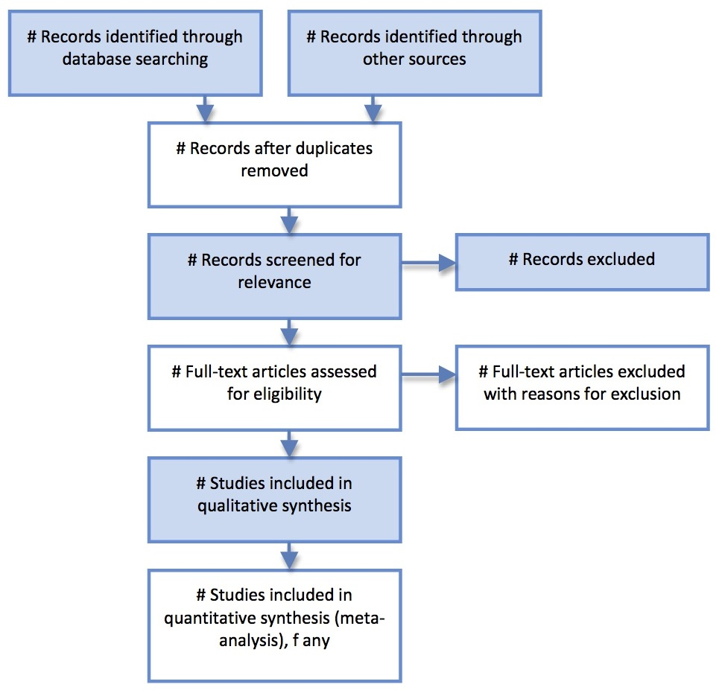
PRISMA process of paper-screening

Slide 7
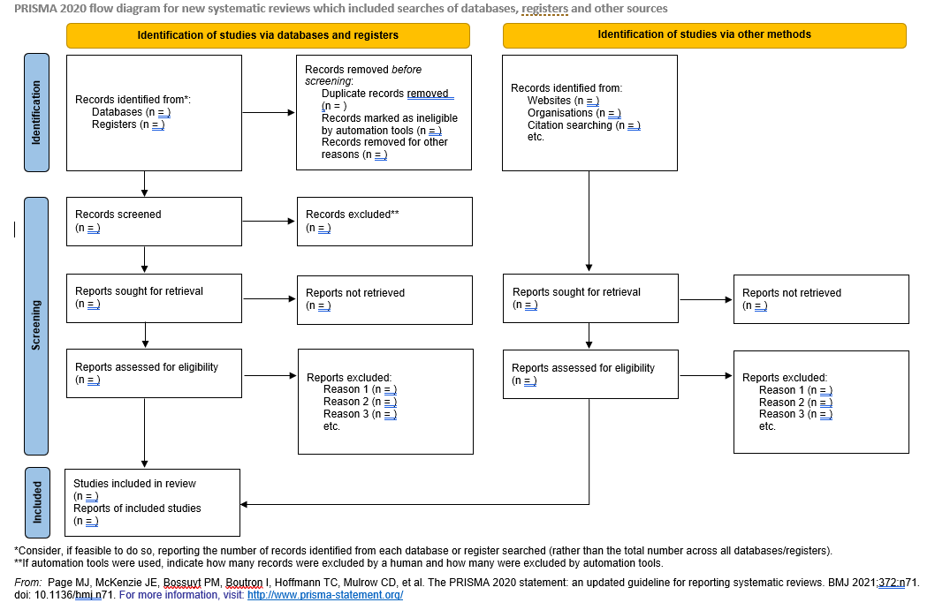
PRISMA flowchart for new reviews

Slide 8
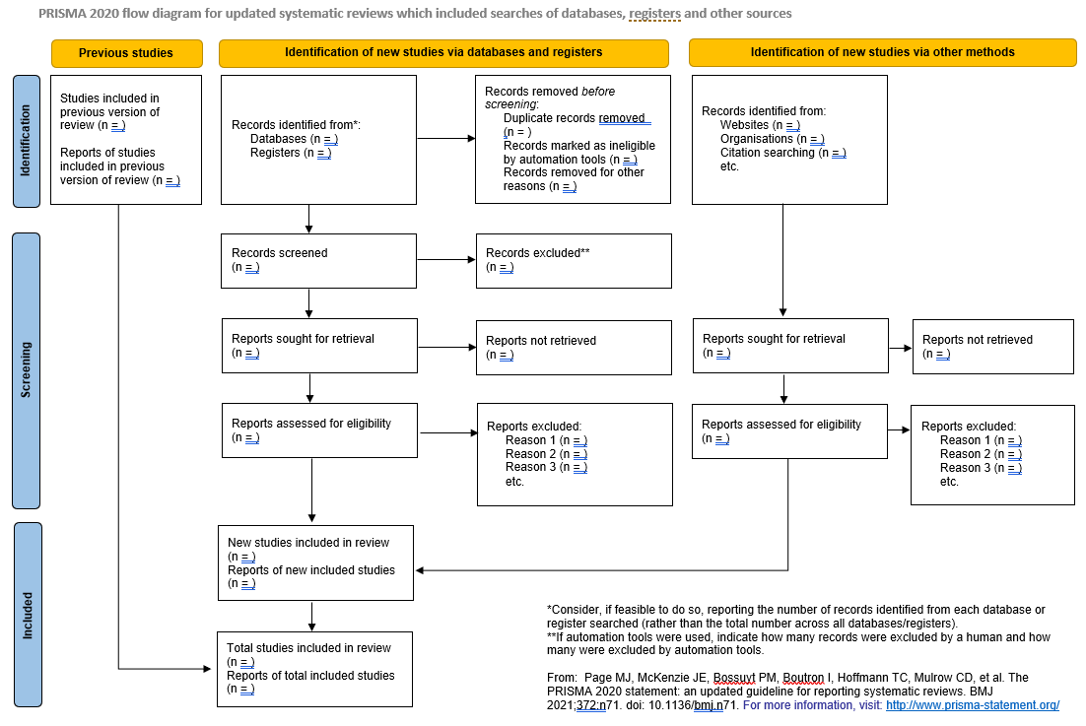
PRISMA flowchart for updated reviews

Slide 9
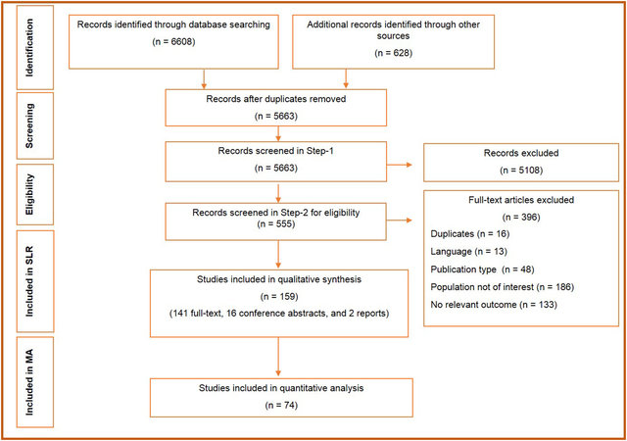
Example

Slide 10
Examples and Documents related to PRISMA
The PRISMA Statement
http://www.prisma-statement.org/
Contains:
Official statement
Flowchart of literature selection
Checklist of reporting items
Citations
Examples using PRISMA:
Accuracy of Machine Learning Algorithms for the Classification of Molecular Features of Gliomas on MRI: A Systematic Literature Review and Meta-Analysis. https://www.mdpi.com/2072-6694/13/11/2606
Convolutional Extreme Learning Machines: A Systematic Review. https://www.mdpi.com/2227-9709/8/2/33

