Slide 1
Research Methodology

Slide 2
Research Methodology
Research Methodology
Research methodology is the specific procedures or techniques used to identify, select, process, and analyze information about a topic.
Research
According to John W. Creswell who states that “Research is a process of steps used to collect and analyze information to increase our understanding of a topic or issue".
It consists of three steps: pose a question, collect data to answer the question, and present an answer to the question.

Slide 3
Research
“If we knew what we were doing, it wouldn’t be called research, would it?”
Albert Einstein

Slide 4
Developing Your Question
Start with a clear purpose
Know your literature
Be iterative in your approach
Try to specify the who, what, where and when of your purpose
Ask yourself “What would the answer to this question add to the literature?” and…

Slide 5
Difference Between Research Methods and Research Methodology
Research Methods:
The various ways and means conducting a research that involve the conduct of experiments , tests, surveys, and the like
Aims at finding solutions to research problem
Research Methodology:
The science of systematically solving a research problem
The learning of various techniques we can use in the conduct of research

Slide 6
Types of Research
Criteria | Types
On the basis of objectives | Fundamental research, applied research, action research
On the basis of nature of data | Qualitative research, Quantitative research
On the basis of nature of findings | Explanatory research, exploratory research, descriptive research
On the basis of experimental manipulations | Experimental research
On the basis of approach involved | Longitudinal research, cross sectional research

Slide 7
Explanatory research is a research method that explores why something occurs when limited information is available. It can help you increase your understanding of a given topic, ascertain how or why a particular phenomenon is occurring, and predict future occurrences
Exploratory research aims to explore the main aspects of an under-researched problem, while explanatory research aims to explain the causes and consequences of a well-defined problem
Action research is a philosophy and methodology of research generally applied in the social sciences. It seeks transformative change through the simultaneous process of taking action and doing research

Slide 8
Longitudinal studies differ from one-off, or cross-sectional, studies. The main difference is that cross-sectional studies interview a fresh sample of people each time they are carried out, whereas longitudinal studies follow the same sample of people over time

Slide 9
6 Steps of Research Process
Define Research Problem
Review of literature
Formulate hypothesis
Preparing the research design
Data collection
Data Analysis
Interpretation and report writing

Slide 10
Effective Literature Review
Objective of literature search
Advantages of literature search
What to look for
Identifying and deciding alternate ways for search

Slide 11
Effective Literature Review
Where to look for
Organization and keeping track of important literature
Am I Done?
Time-line: Too-long vs Too-short
Is it ongoing and continuos process?

Slide 12
Where to look for?
What should be my strategy?

Slide 13
Strategy for search
Exploratory
Refining
Focused
Assessing the important and relevant articles

Slide 14
Where to look for
Google or other usual search engines
How about specialized and domain-dependent search engines
Google-scholar
Web-of-knowledge, scirus
Citeseer, DBLP
Digital Libraries, like ACM-digital, IEEE-Explore
Journal and conference web-sites

Slide 15
Lets start with Google-scholar
Objective:
Start with few keywords
Find important and relevant articles (based on citation history, year published etc)
Refine your keywords
Identify key journals, conferences and research groups

Slide 16
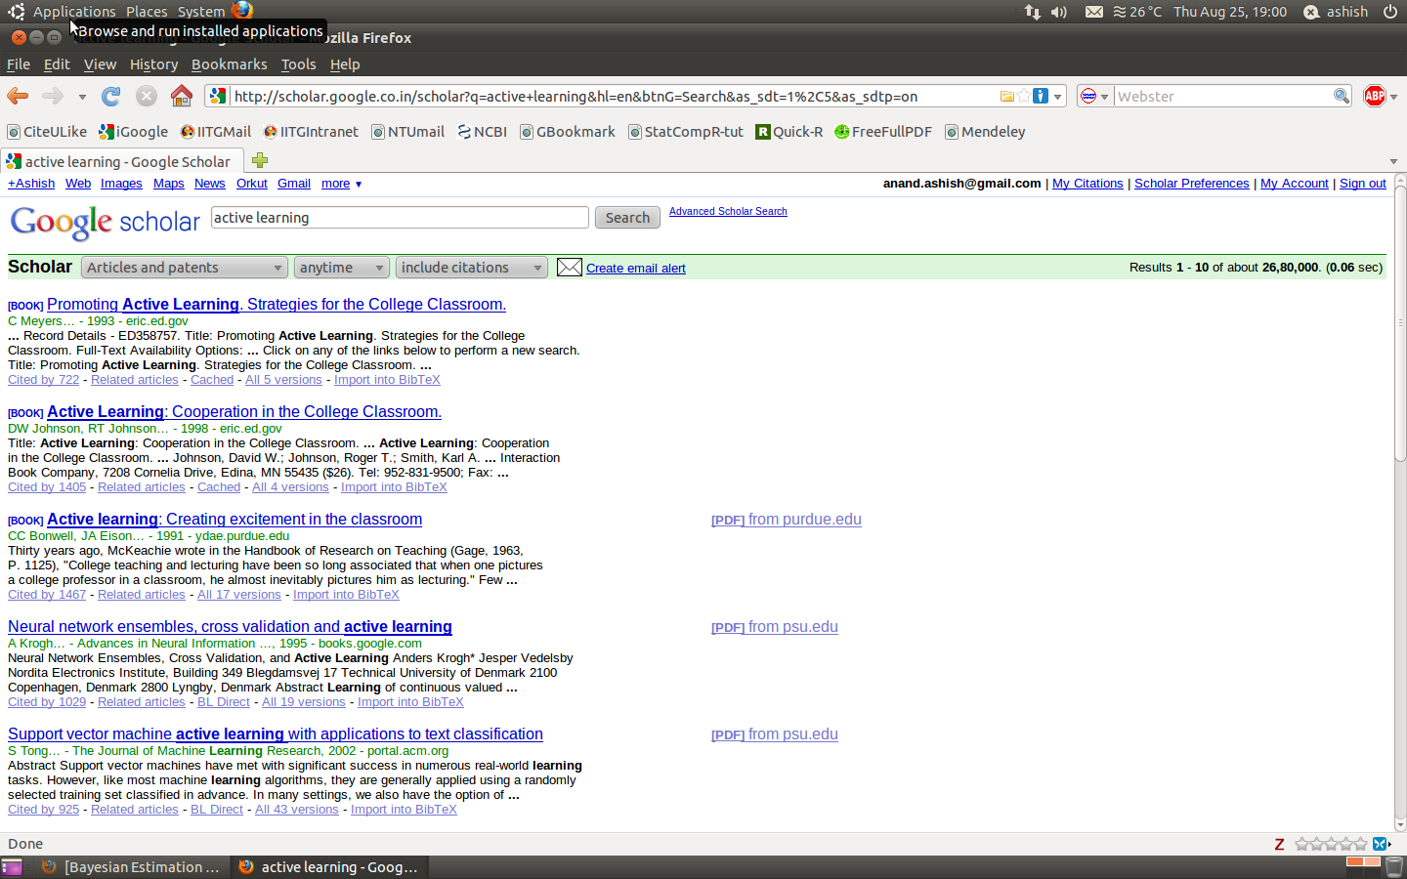
Continuing with Google-Scholar

Slide 17
What I observe ?
Many articles look out-of-place compared to my intented meaning
However, some of them do look what I actually meant
What else I see ?
Related articles
Cited by

Slide 18
What I still able to do ?
Refine my keywords
Get hold of some key papers
Where they got published
Basically, more pointers

Slide 19
Could I have done even better than this ?
OR
Can I further refine or be more focused ?

Slide 20
Dedicated literature databases
Ever checked E-resources provided at our central library ?
Several of them are focused and some of them are generic but perhaps better than google-scholar

Slide 21
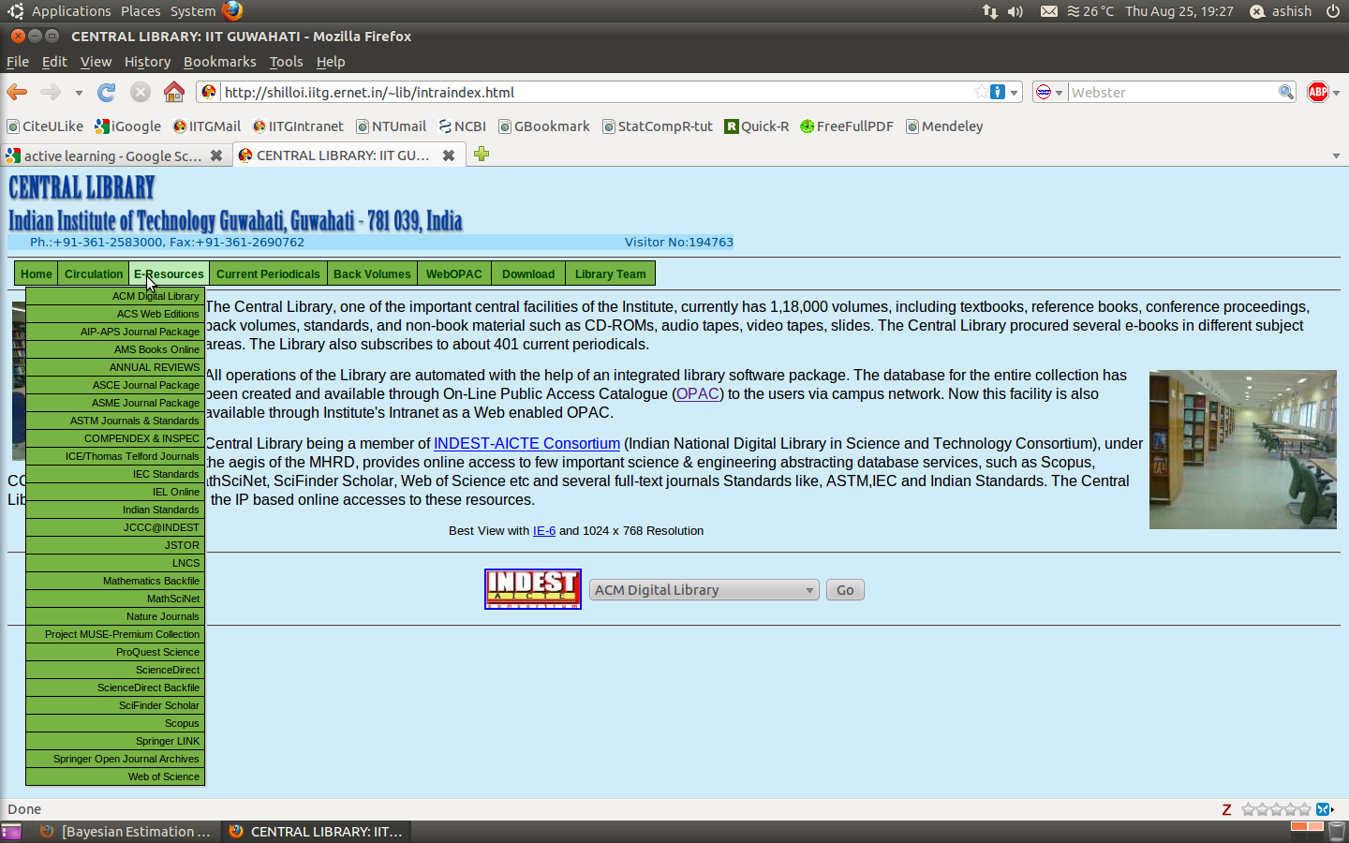
E-Resources at Central Library

Slide 22
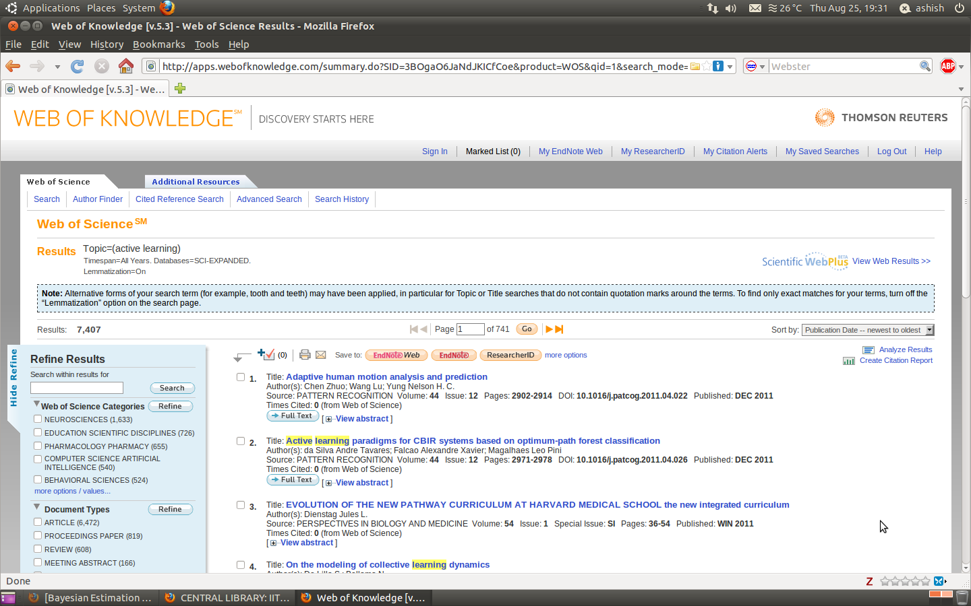
Web of Knowledge

Slide 23
Advantage of using Web of Knowledge
Refine results options
Various options
Can identify important groups working on similar topic, journals and conferences
Managing your searches and important papers
Citation alert for Tracking citations
My Saved Searches

