Slide 1
2-3 Tree

Slide 2
Balanced search tree
Many search tree operations take time proportional to the height of the tree.
Keep the height small: make the tree balanced.
2-3 trees are one kind of balanced search trees.

Slide 3
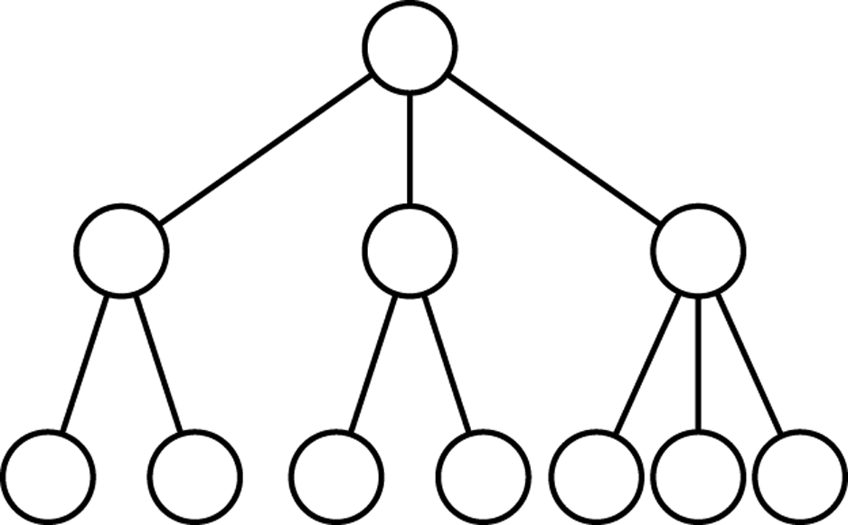
2-3 Trees
each node holds 1 or 2 keys
each non-leaf node has either 2 or 3 children
all leaves are at the same level

Slide 4
2-3 Trees Properties
Nodes with two children are called 2-nodes. The 2-nodes have one data value and two children
Nodes with three children are called 3-nodes. The 3-nodes have two data values and three children.
Data is stored in sorted order.
It is a balanced tree.
All the leaf nodes are at same level.
Each node can either be leaf, 2 node, or 3 node.
Always insertion is done at leaf.

Slide 5
2-3 Trees: Search
Base cases:
If T is empty, return False (key cannot be found in the tree).
If current node contains data value which is equal to K, return True.
If we reach the leaf-node and it doesn’t contain the required key value K, return False.
Recursive Calls:
If K < currentNode.leftVal, we explore the left subtree of the current node.
Else if currentNode.leftVal < K < currentNode.rightVal, we explore the middle subtree of the current node.
Else if K > currentNode.rightVal, we explore the right subtree of the current node.

Slide 6
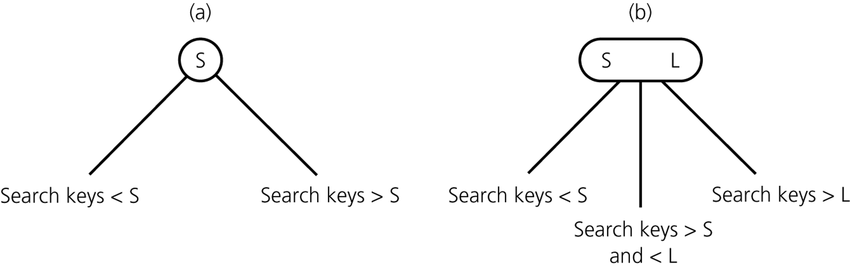
Search tree property in 2-3 Trees
1 key, 2-node
2 keys, 3-node
leaf node can be either a 2-node or a 3-node

Slide 7
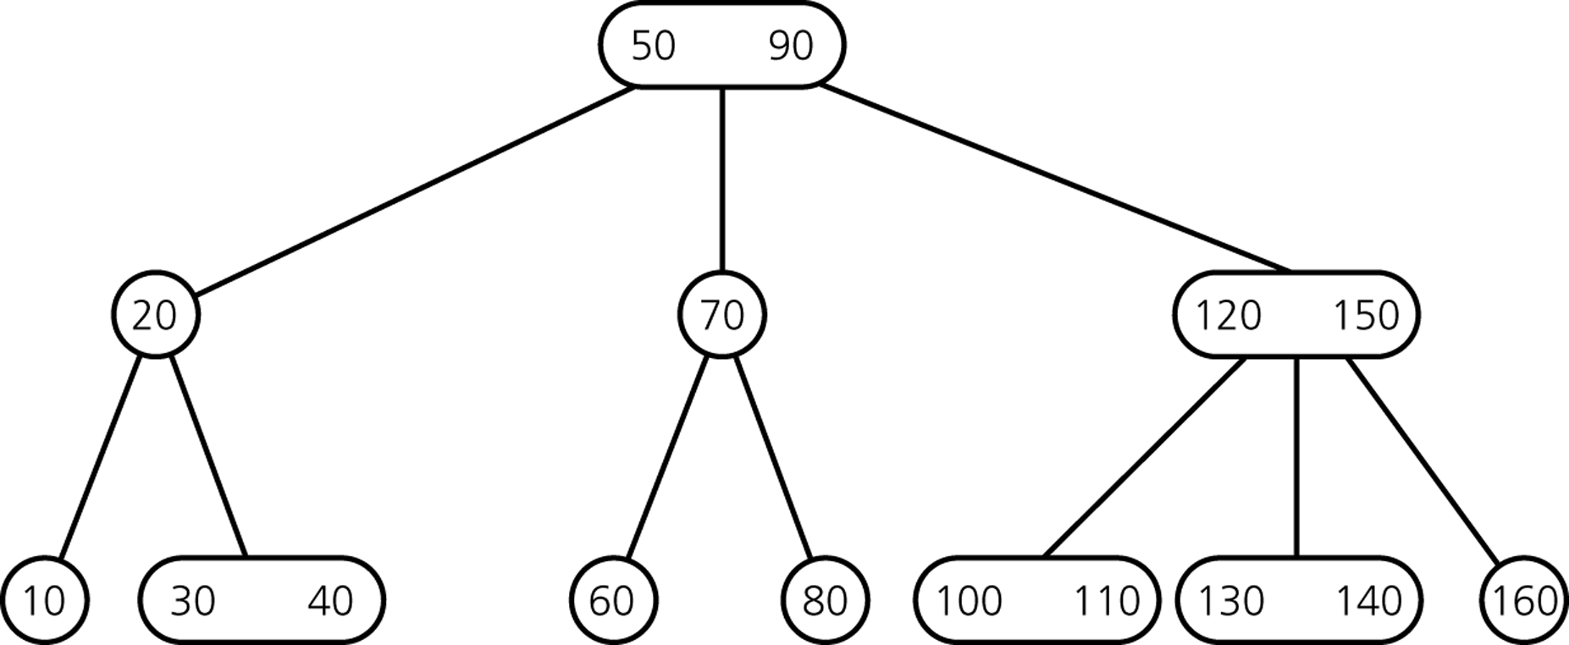
Example of 2-3 Tree

Slide 8
Height of a 2-3 tree
Number of leaves ≥ 2^{h} where h is tree height
So h ≤ log (number of leaves)
number of leaves < number of nodes
number of nodes ≤ number of stored keys = n
So h < log n.
Soon: search, insert, delete can be done in time O(h) = O(log n).

Slide 9
Searching in a 2-3 tree
Start at the root to search for any key x.
If x < first key, recurse on first subtree.
Else if x = first key, return “found”.
Else if there is only 1 key or x < second key, recurse on second subtree.
Else if x = second key, return ”found”.
Else recurse on third subtree.

Slide 10
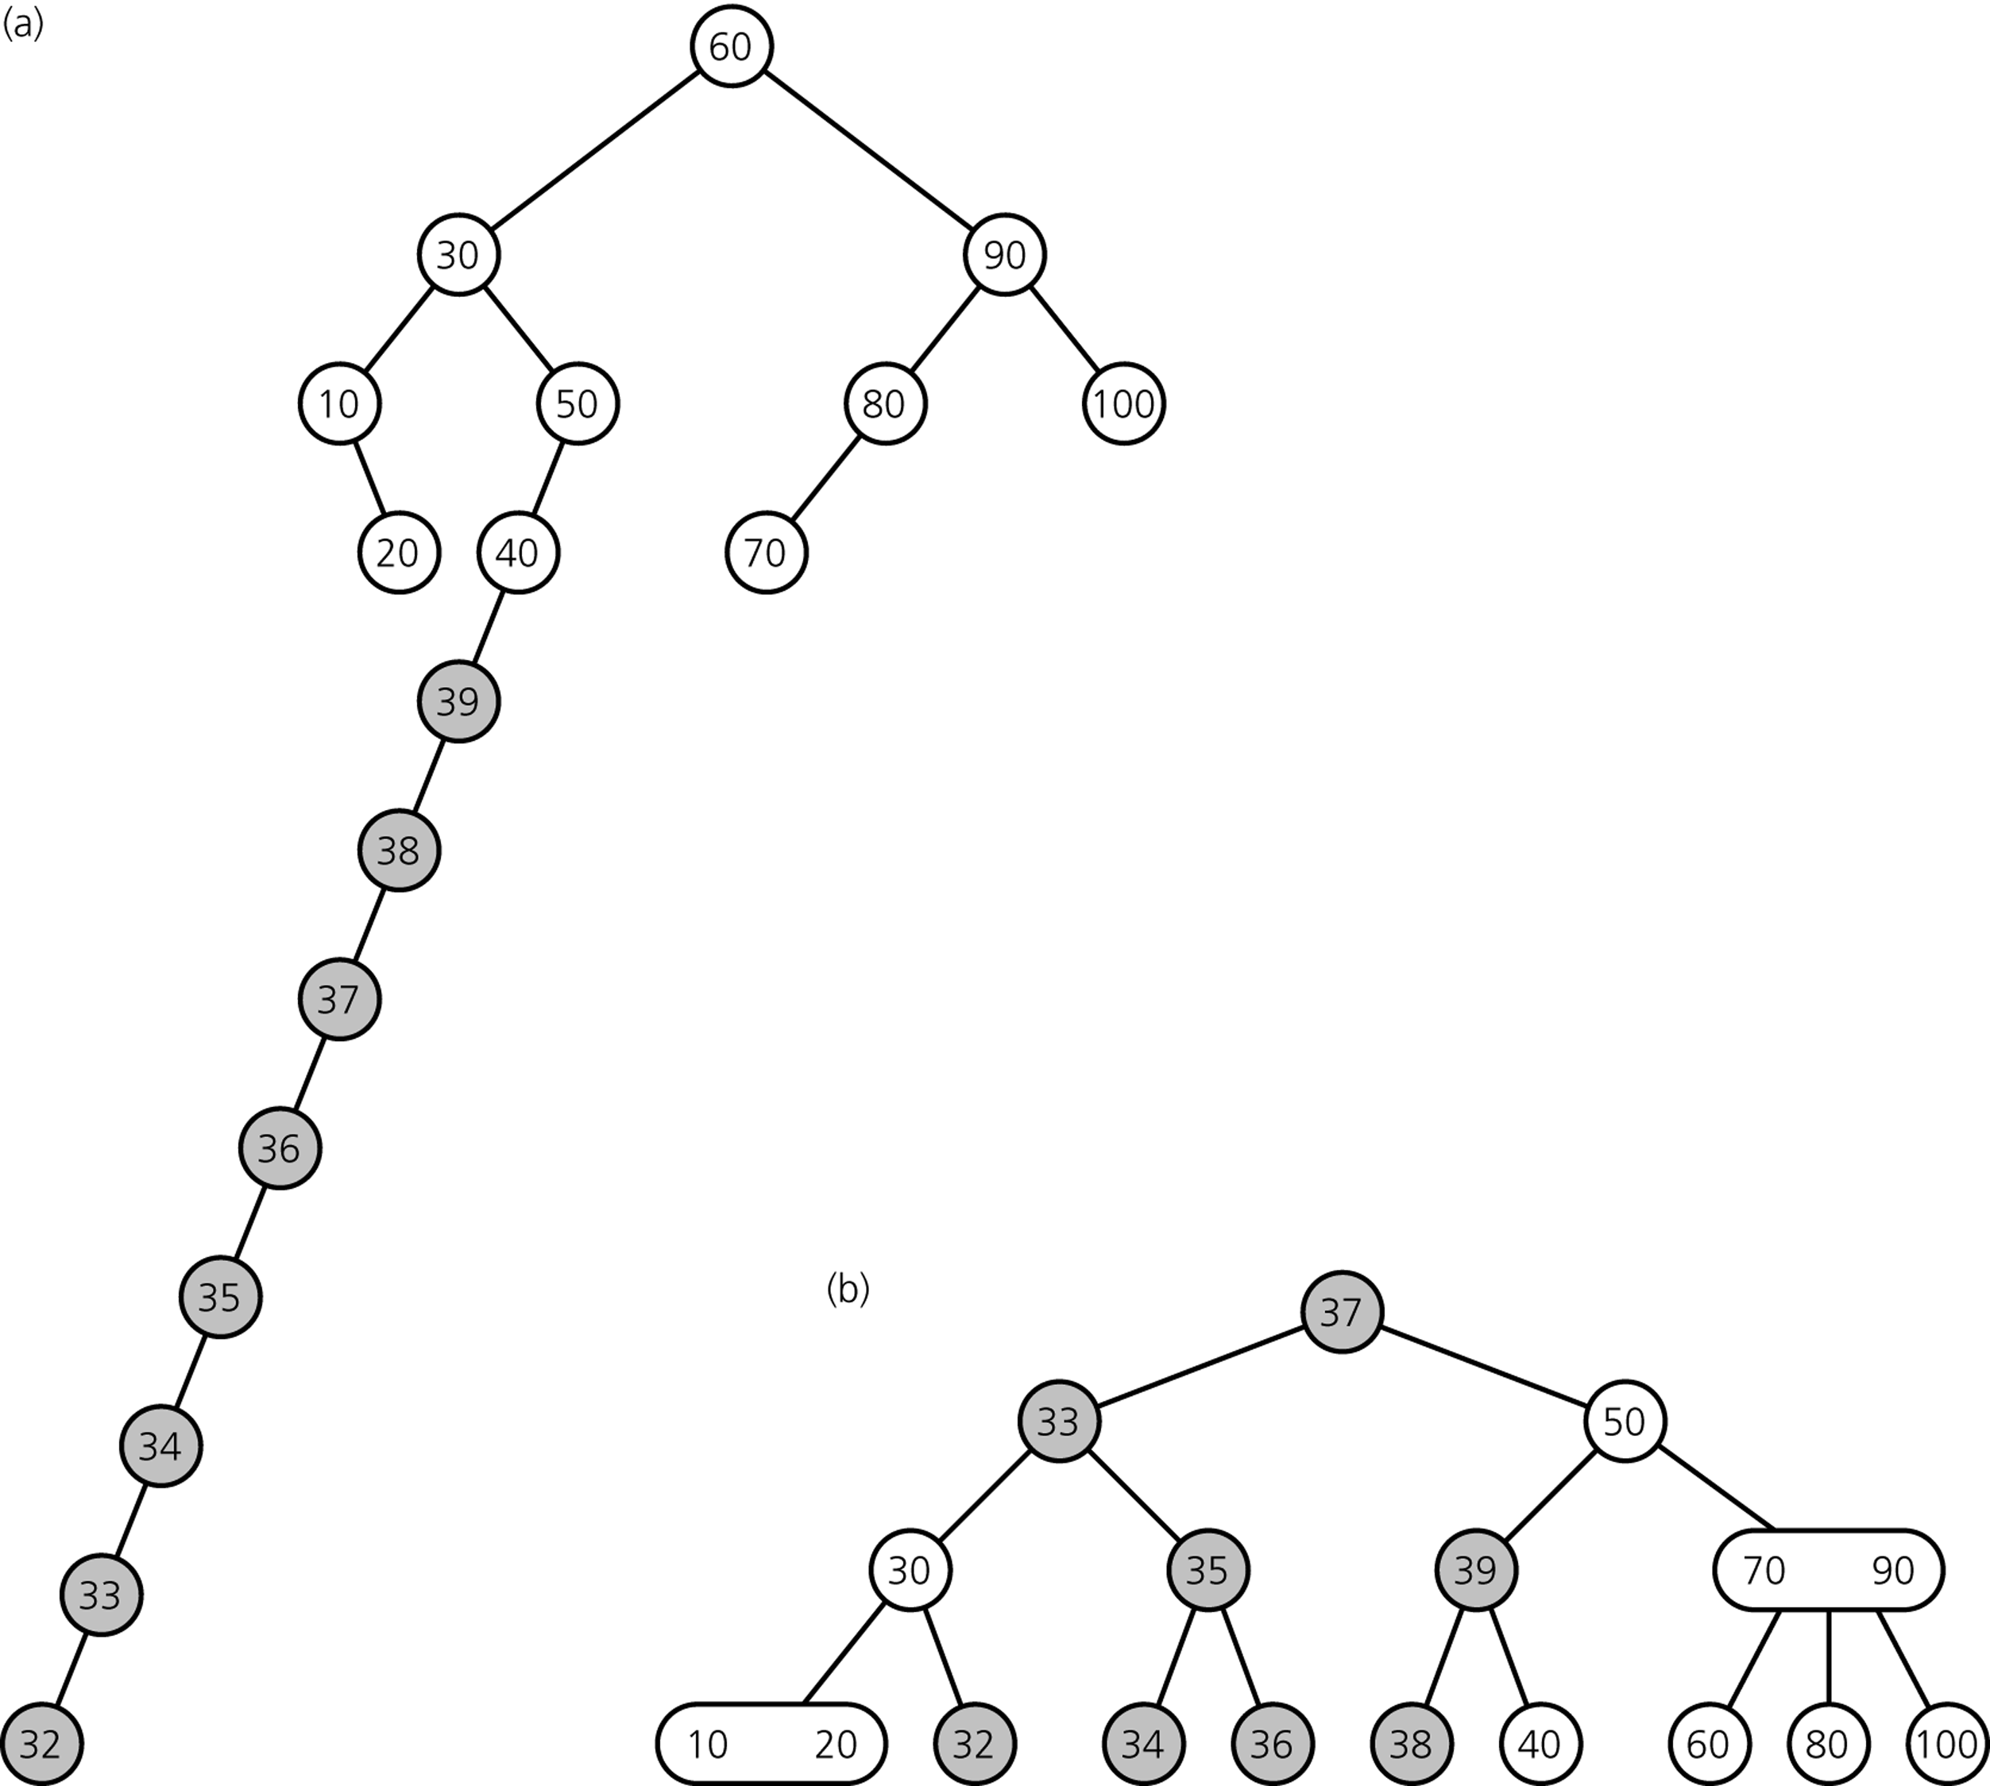
Can maintain balance much better in insertion
Binary Search
Tree
both trees after
inserting items
39, 38, ... 32
2-3 Tree

Slide 11
Inserting an item
Search for the key and locate the leaf in which the search stops.
Insert the key into the leaf.
Leaf holds 2 keys: done!
Leaf holds 3 keys: Needs more work!

Slide 12
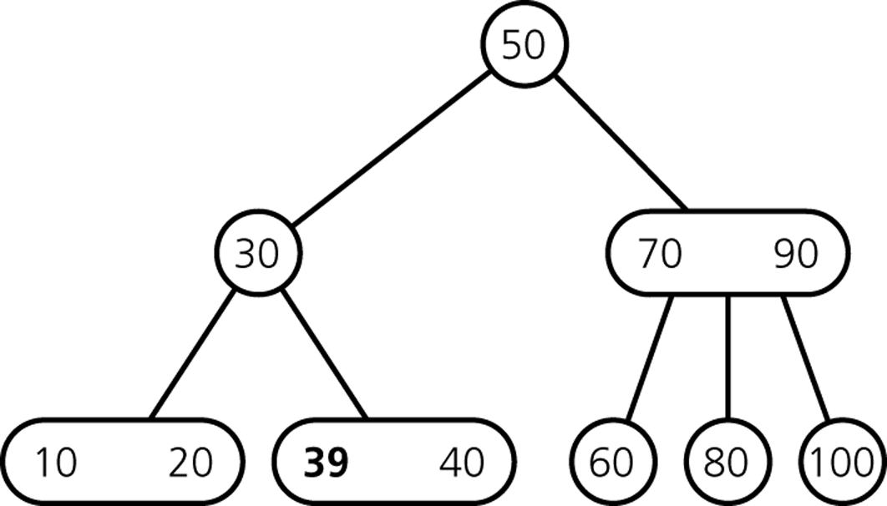
Inserting Items
Insert 39

Slide 13
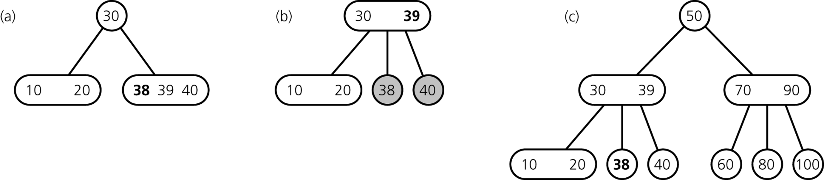
Inserting Items
Insert 38
divide leaf
and move middle
value up to parent
insert in leaf
result

Slide 14
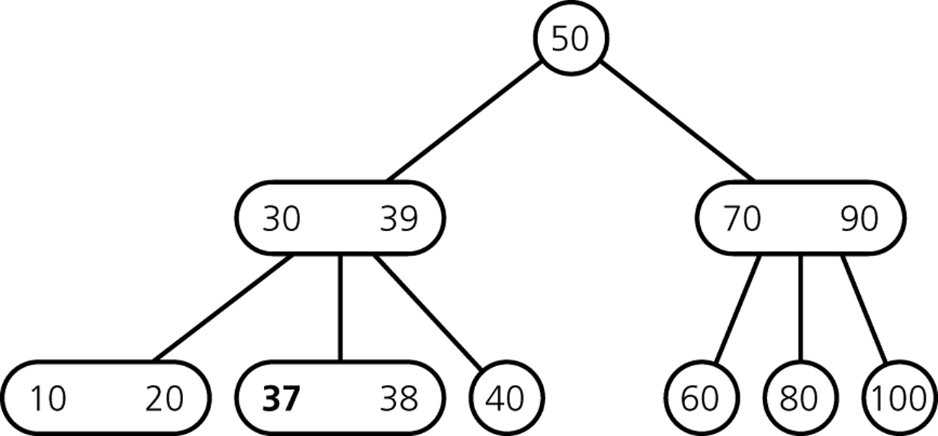
Inserting Items
Insert 37

Slide 15
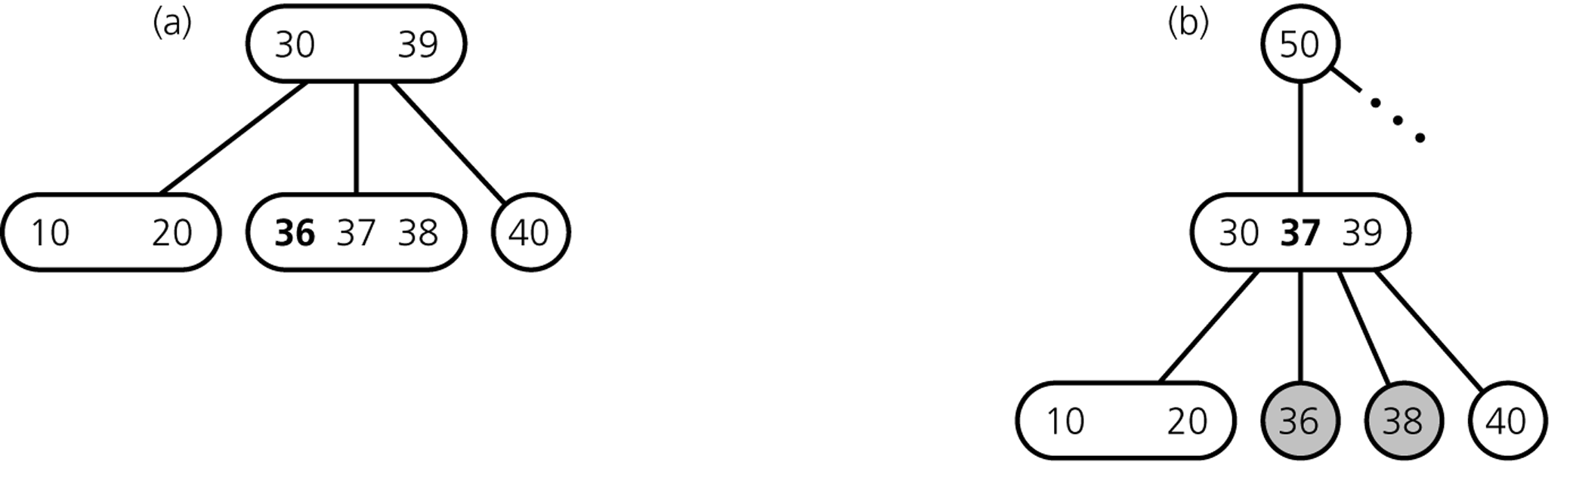
Inserting Items
Insert 36
divide leaf
and move middle
value up to parent
insert in leaf
overcrowded
node

Slide 16
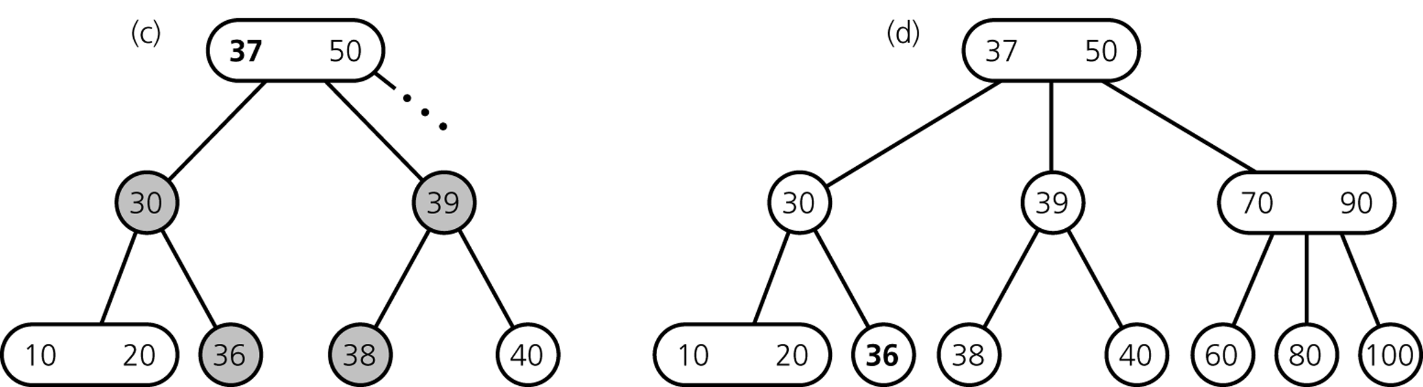
Inserting Items
... still inserting 36
divide overcrowded node,
move middle value up to parent,
attach children to smallest and largest
result

Slide 17
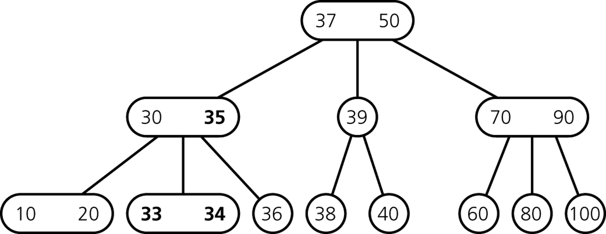
Inserting Items
After Insertion of 35, 34, 33

Slide 18
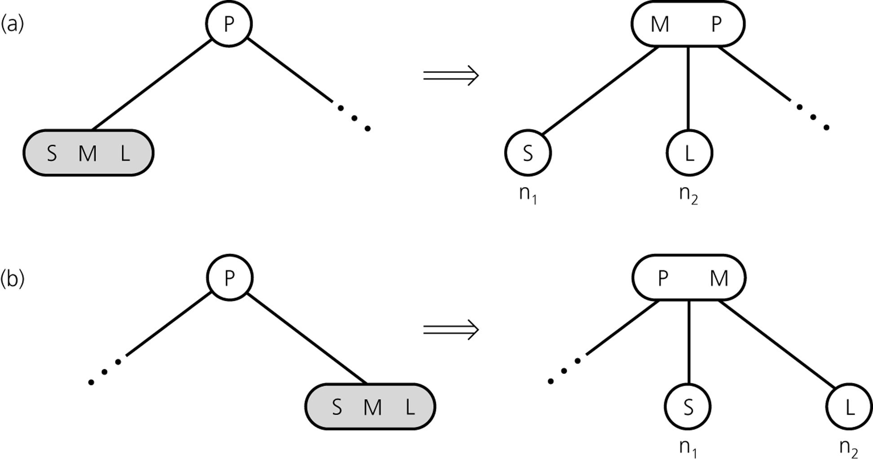
Inserting so far

Slide 19
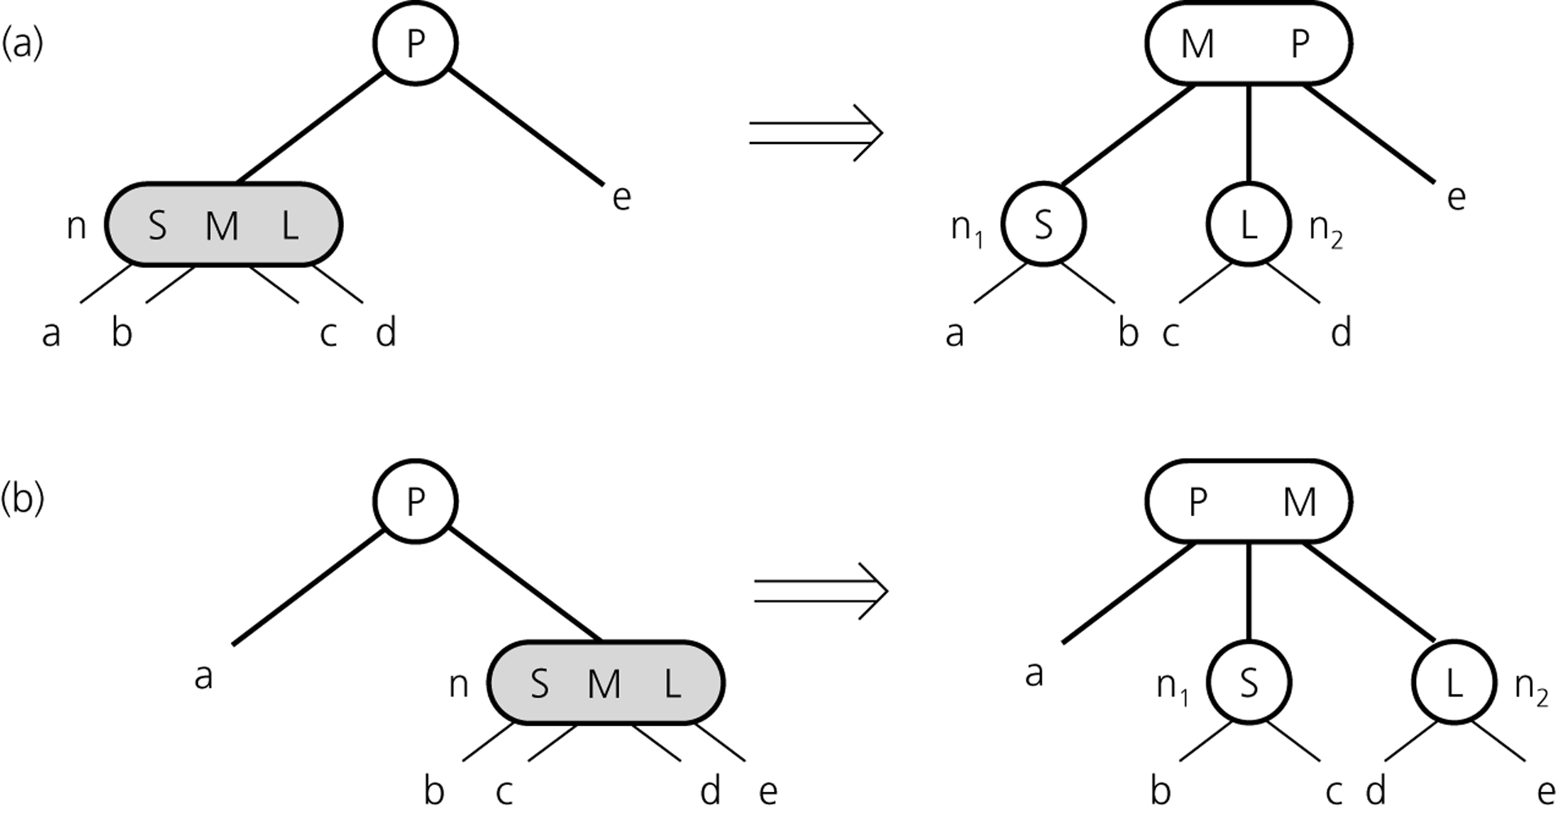
Inserting so far

Slide 20
Inserting Items
How do we insert 32?

Slide 21
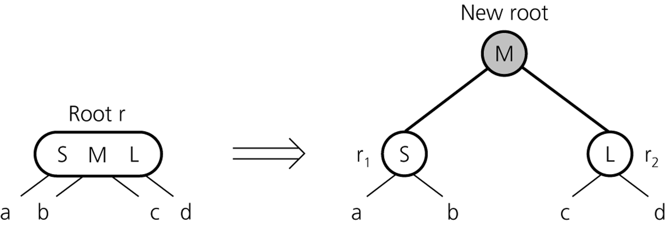
Inserting Items
creating a new root if necessary
tree grows at the root

Slide 22
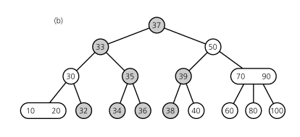
Inserting Items
Final Result

Slide 23
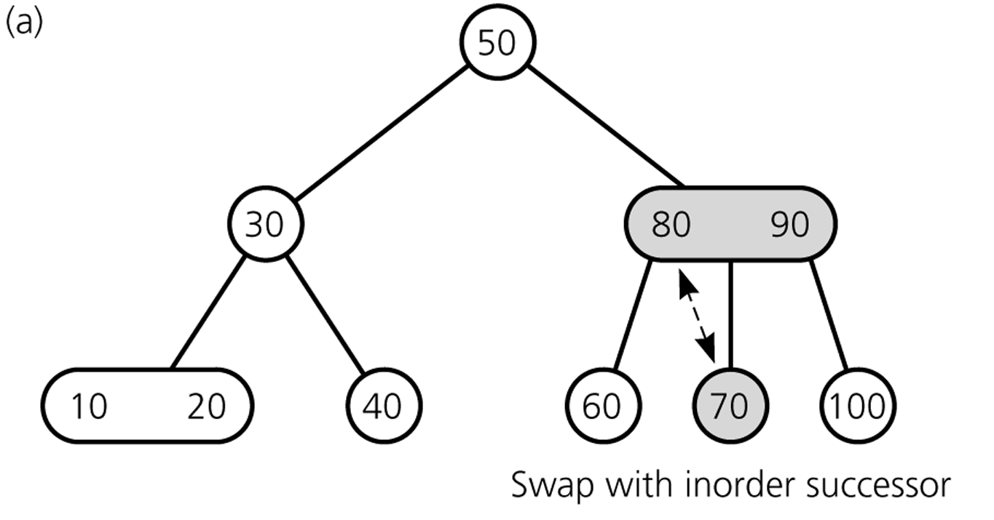
Deleting Items
Delete 70
70
80

Slide 24
Note
In-order successor: node holding the next largest key
In-order successor of any node is a leaf
Proof?
Because of this we can assume that any delete operation get converted to a delete operation at a leaf.

Slide 25
Deleting Items
Deleting 70: swap 70 with inorder successor (80)

Slide 26
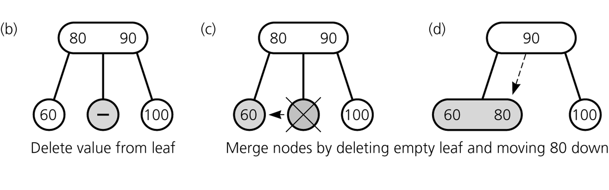
Deleting Items
Deleting 70: ... get rid of 70

Slide 27
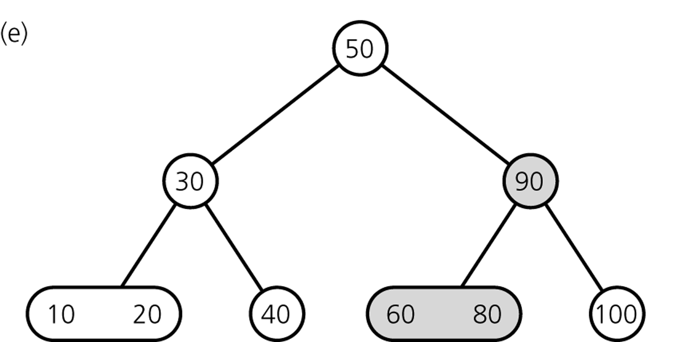
Deleting Items
Result

Slide 28
Deleting Items
Delete 100

Slide 29
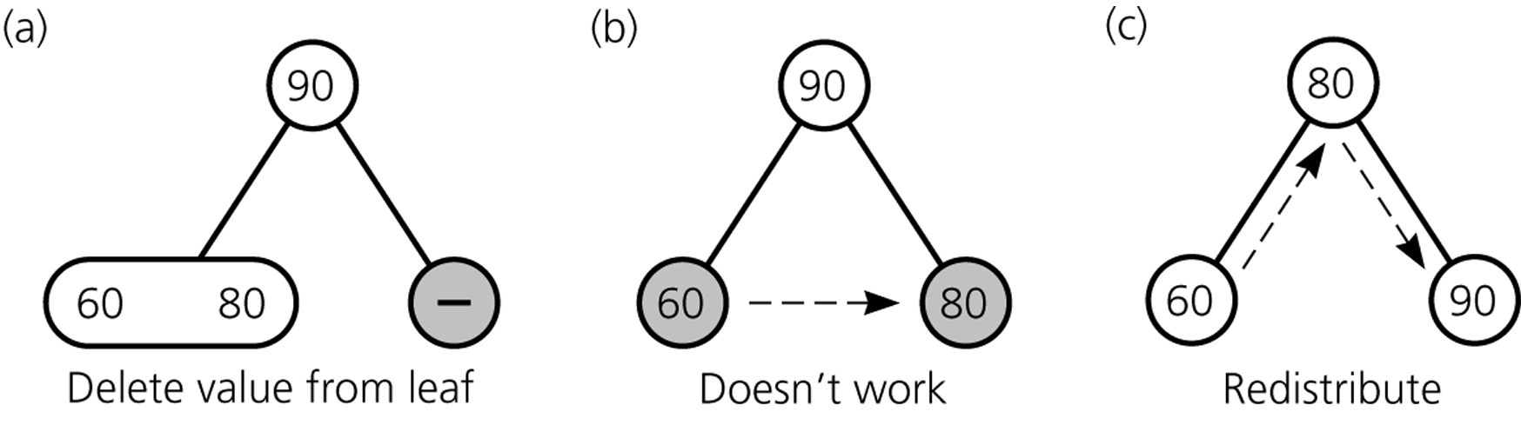
Deleting Items
Deleting 100

Slide 30
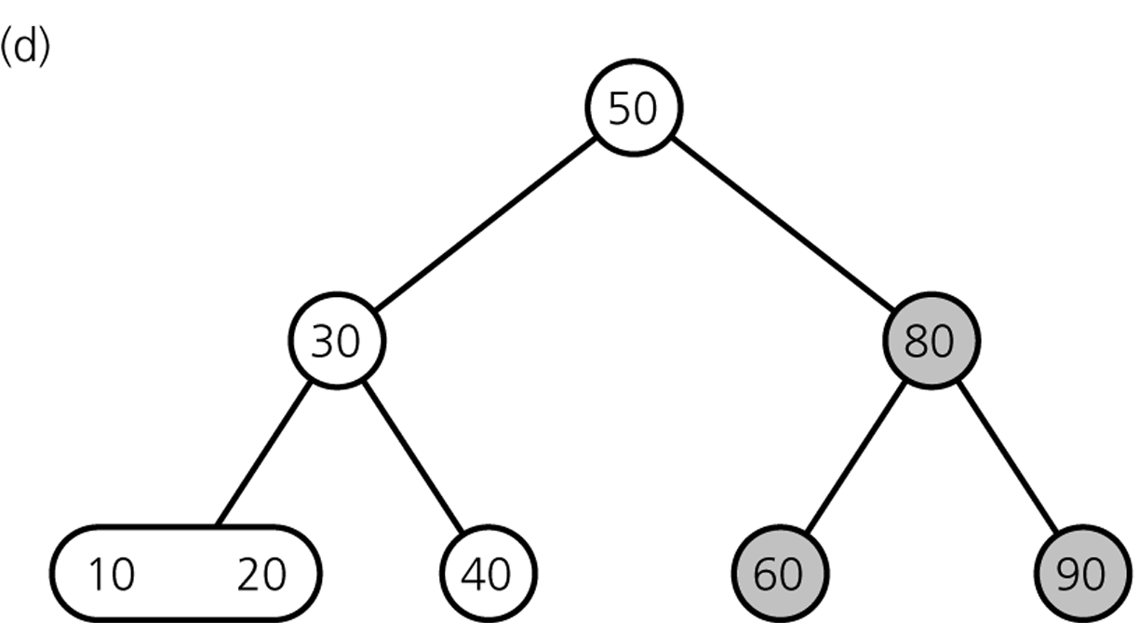
Deleting Items
Result

Slide 31
Deleting Items
Delete 80

Slide 32
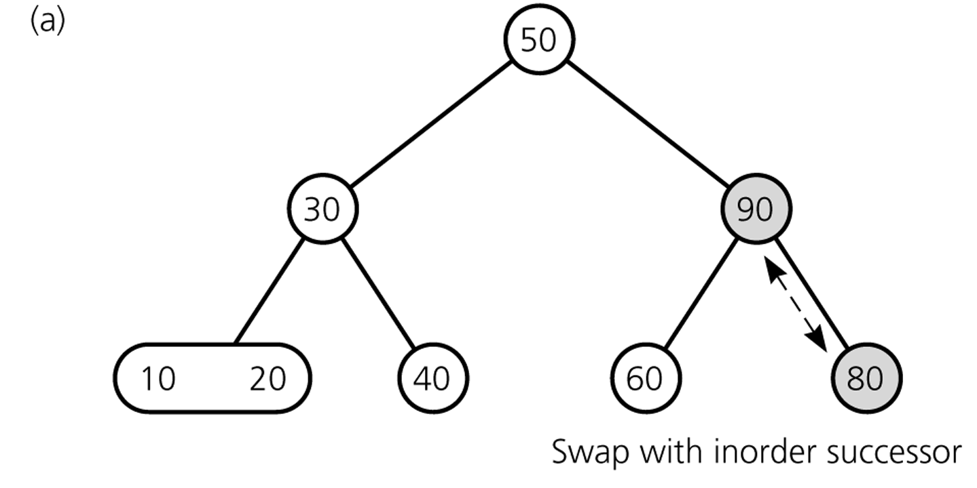
Deleting Items
Deleting 80 ...

Slide 33
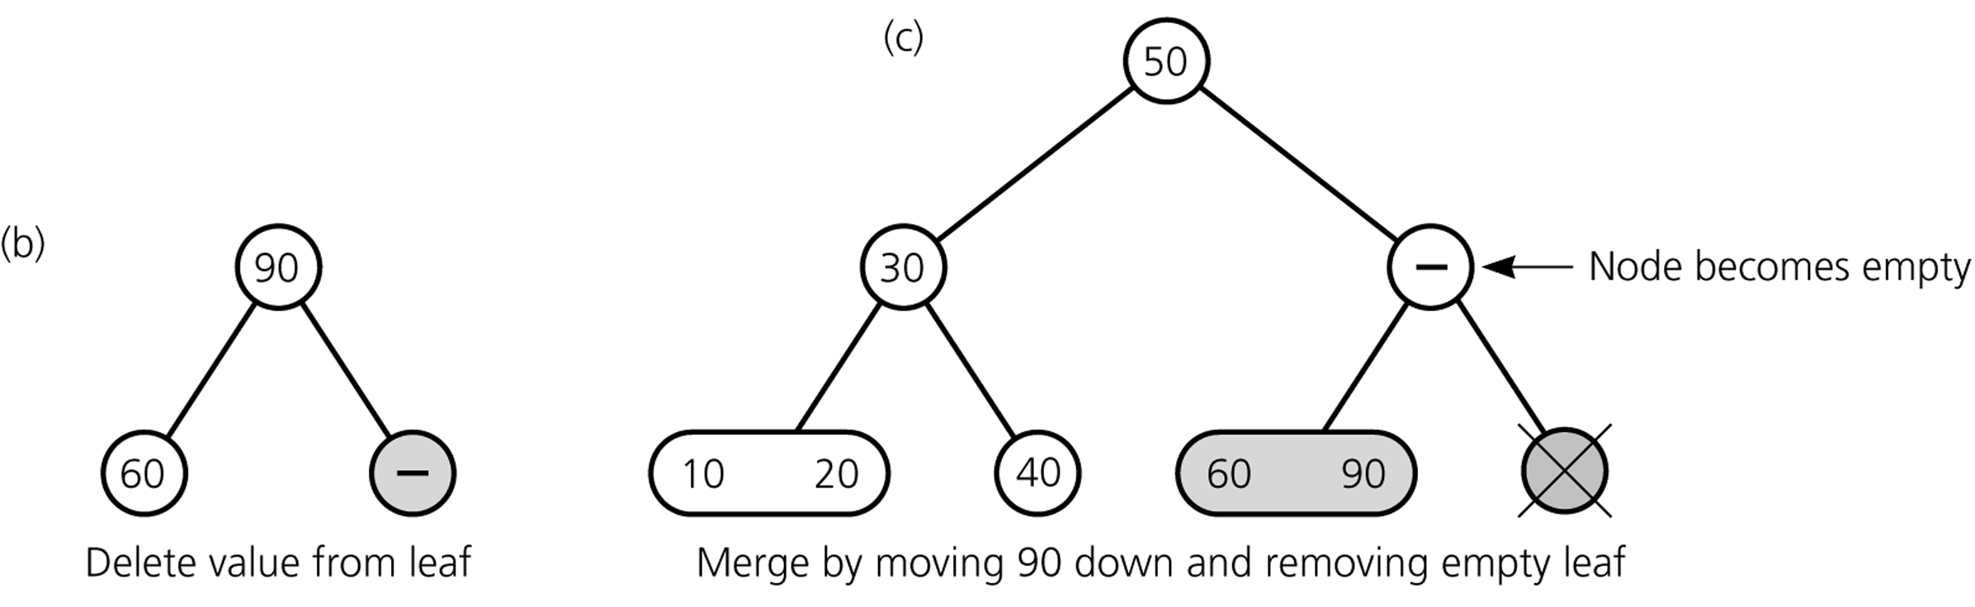
Deleting Items
Deleting 80 ...

Slide 34
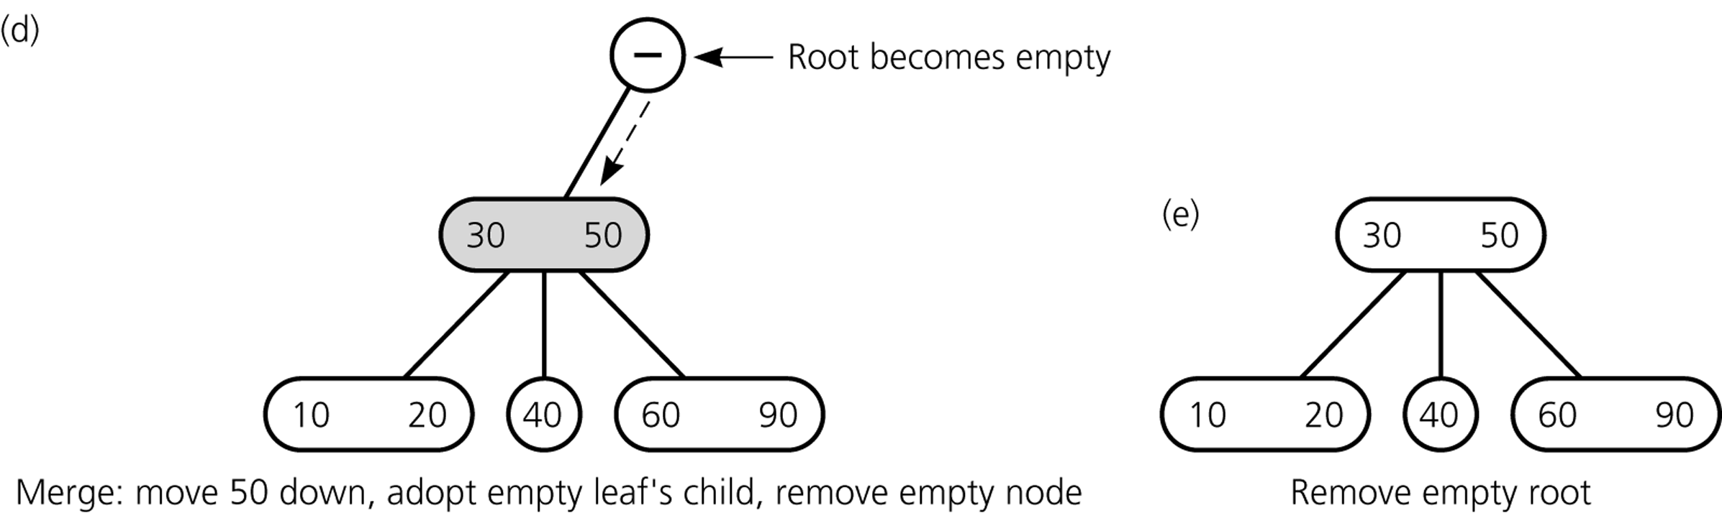
Deleting Items
Deleting 80 ...

Slide 35
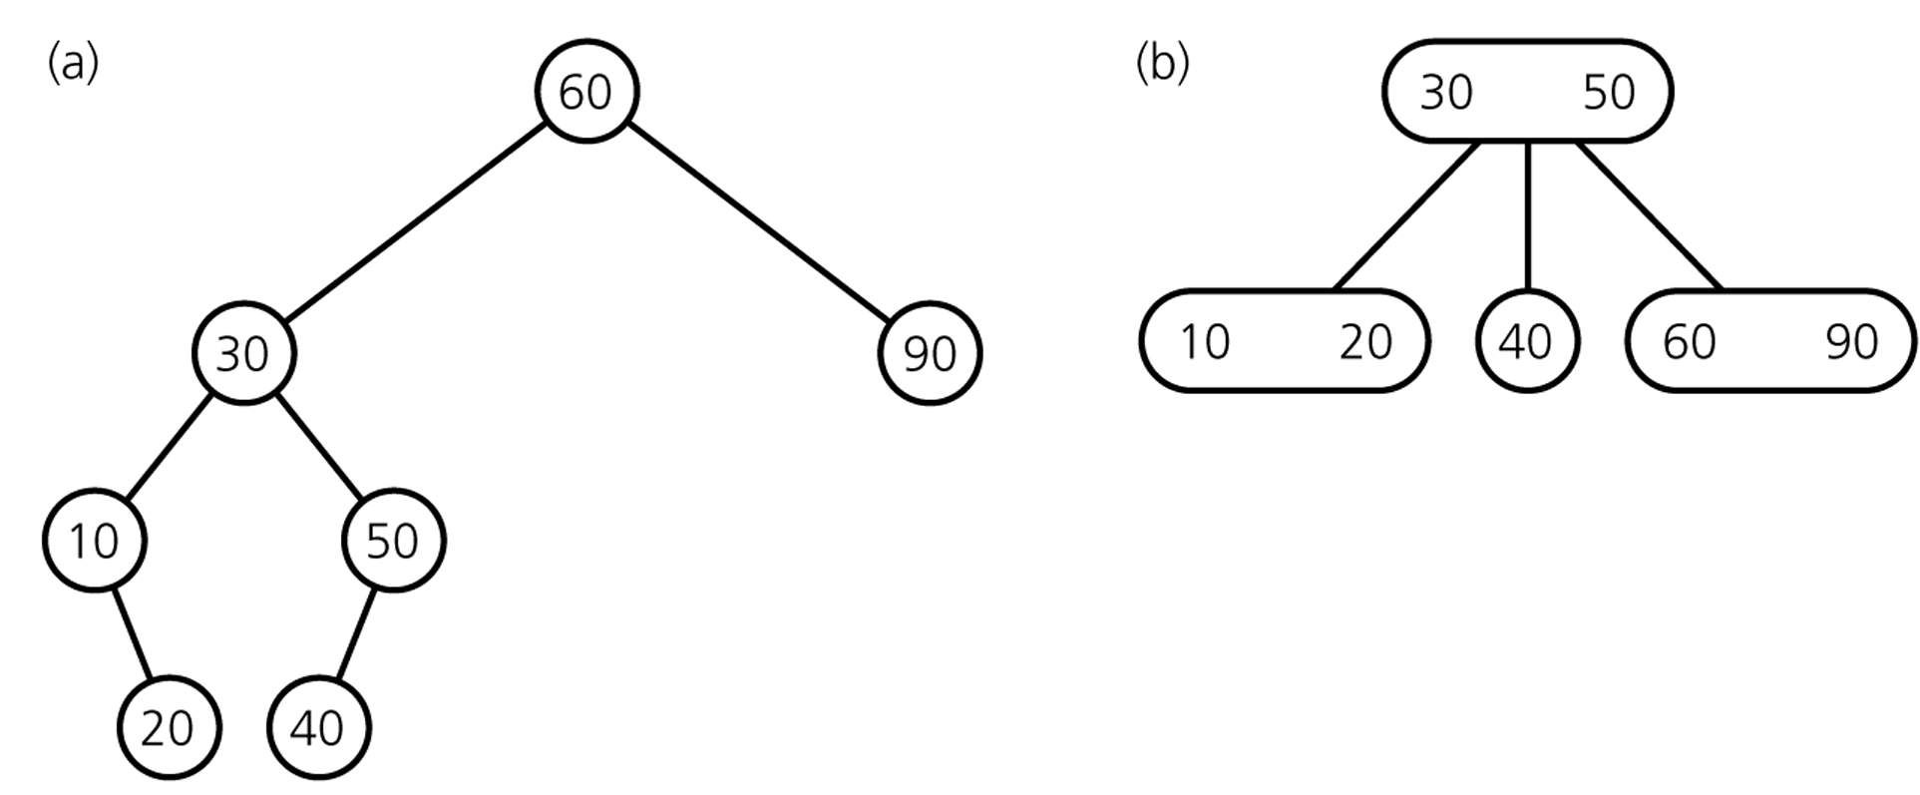
Deleting Items
Final Result
comparison with
binary search tree

Slide 36
Deletion Algorithm I
Deleting item I:
Locate node n, which contains item I
If node n is not a leaf → swap I with inorder successor
deletion always begins at a leaf
If leaf node n contains another item, just delete item I
else
try to redistribute nodes from siblings (see next slide)
if not possible, merge node (see next slide)

Slide 37
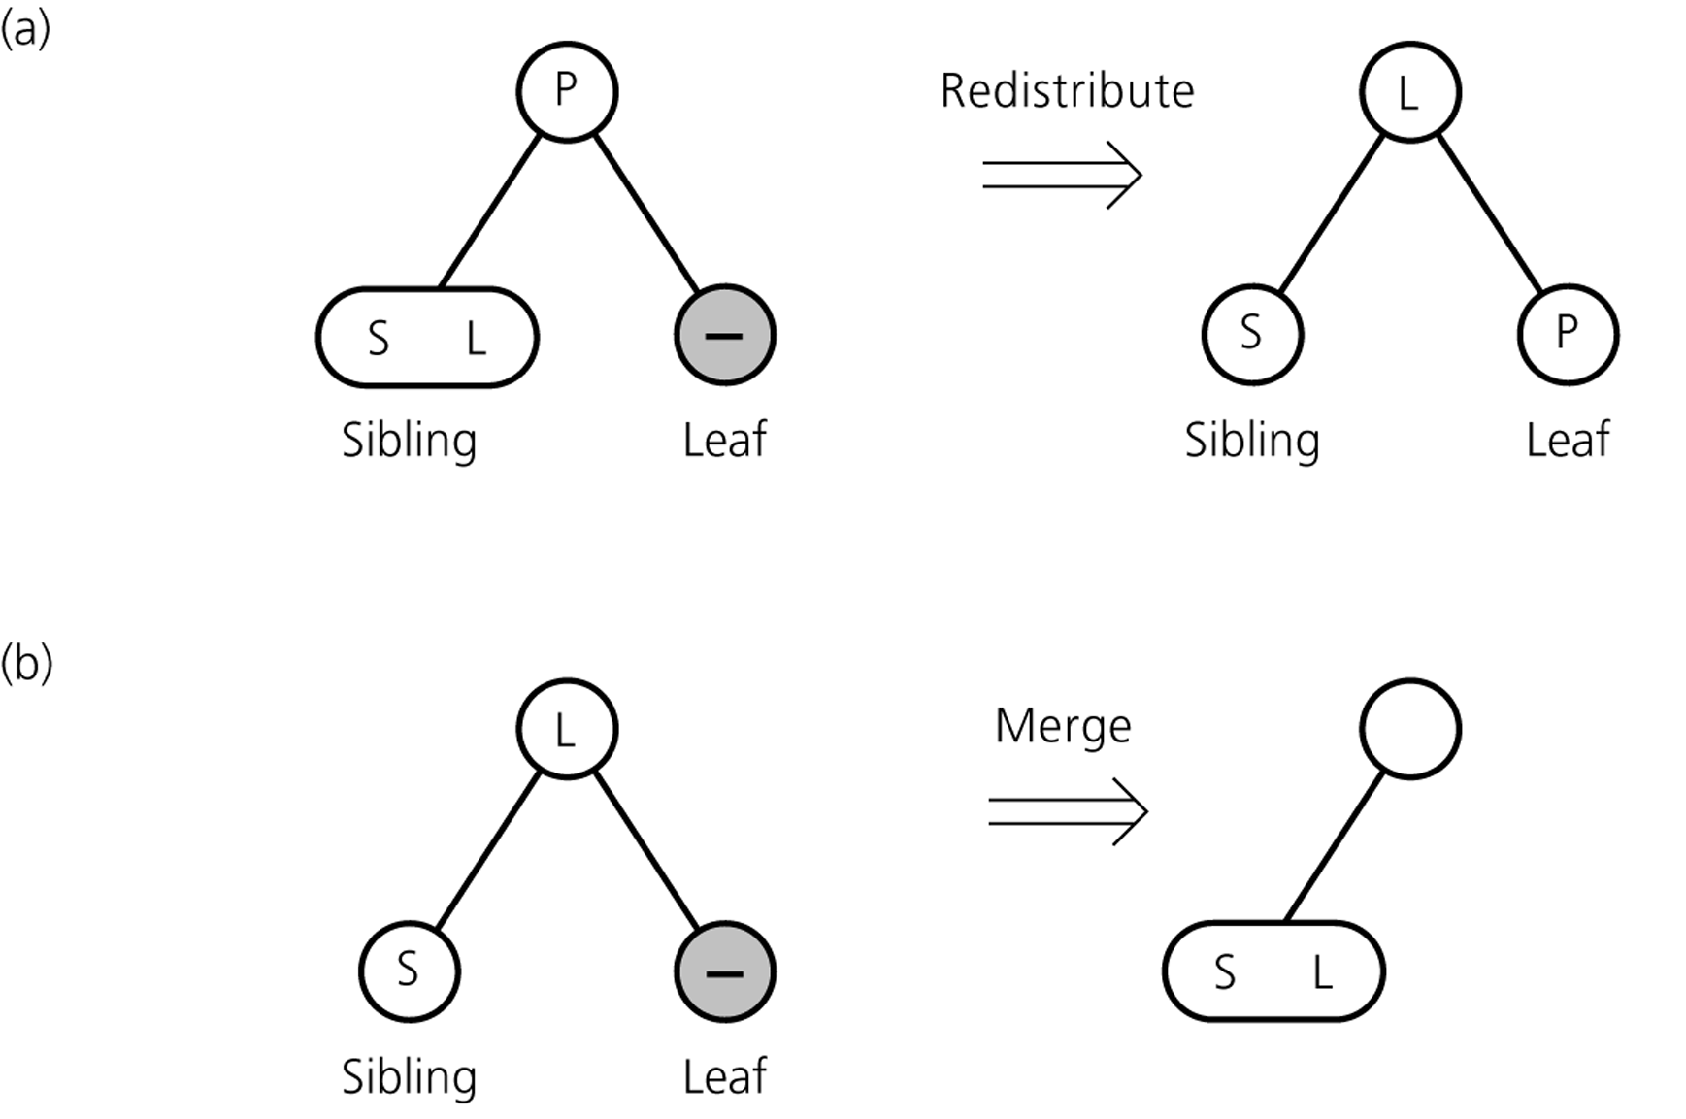
Deletion Algorithm II
Redistribution
A sibling has 2 items:
redistribute item
between siblings and
parent
Merging
No sibling has 2 items:
merge node
move item from parent
to sibling

Slide 38
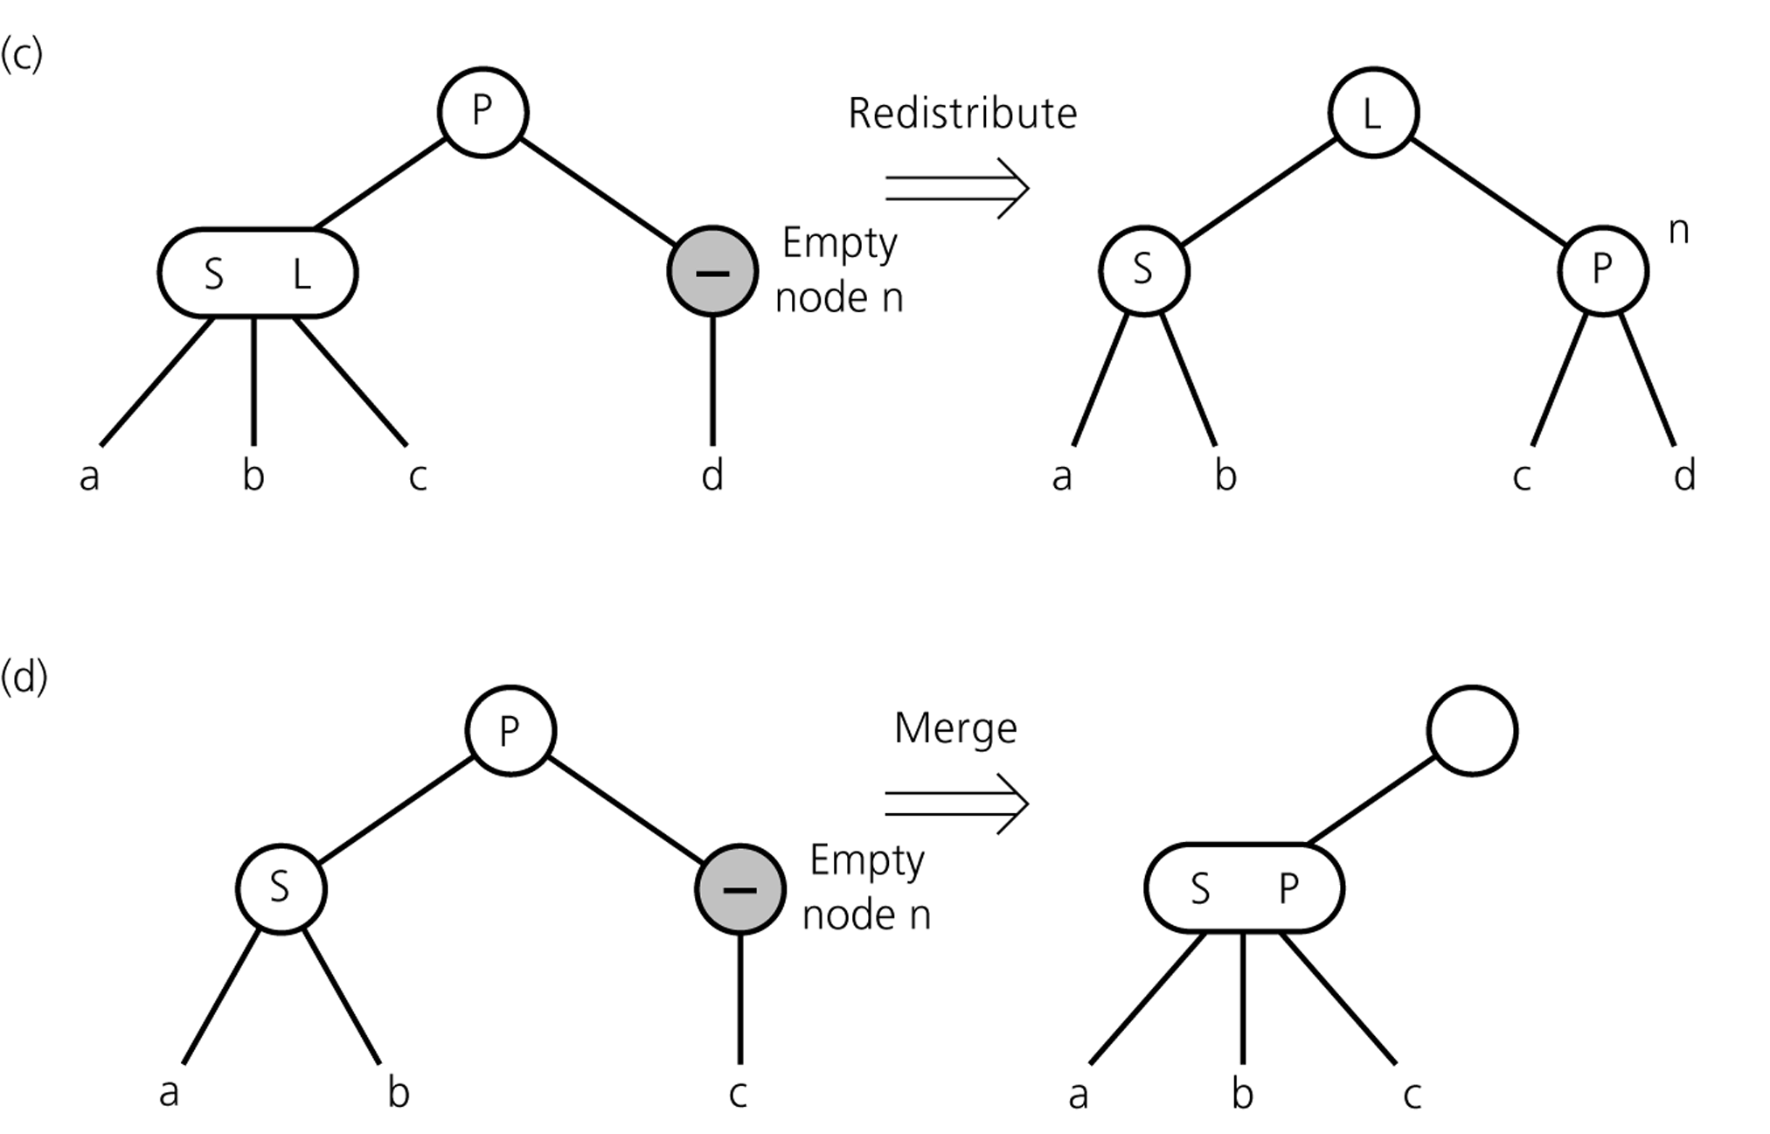
Deletion Algorithm III
Redistribution
Internal node n has no item left
redistribute
Merging
Redistribution not possible:
merge node
move item from parent
to sibling
adopt child of n
If n's parent ends up without item, apply process recursively

Slide 39
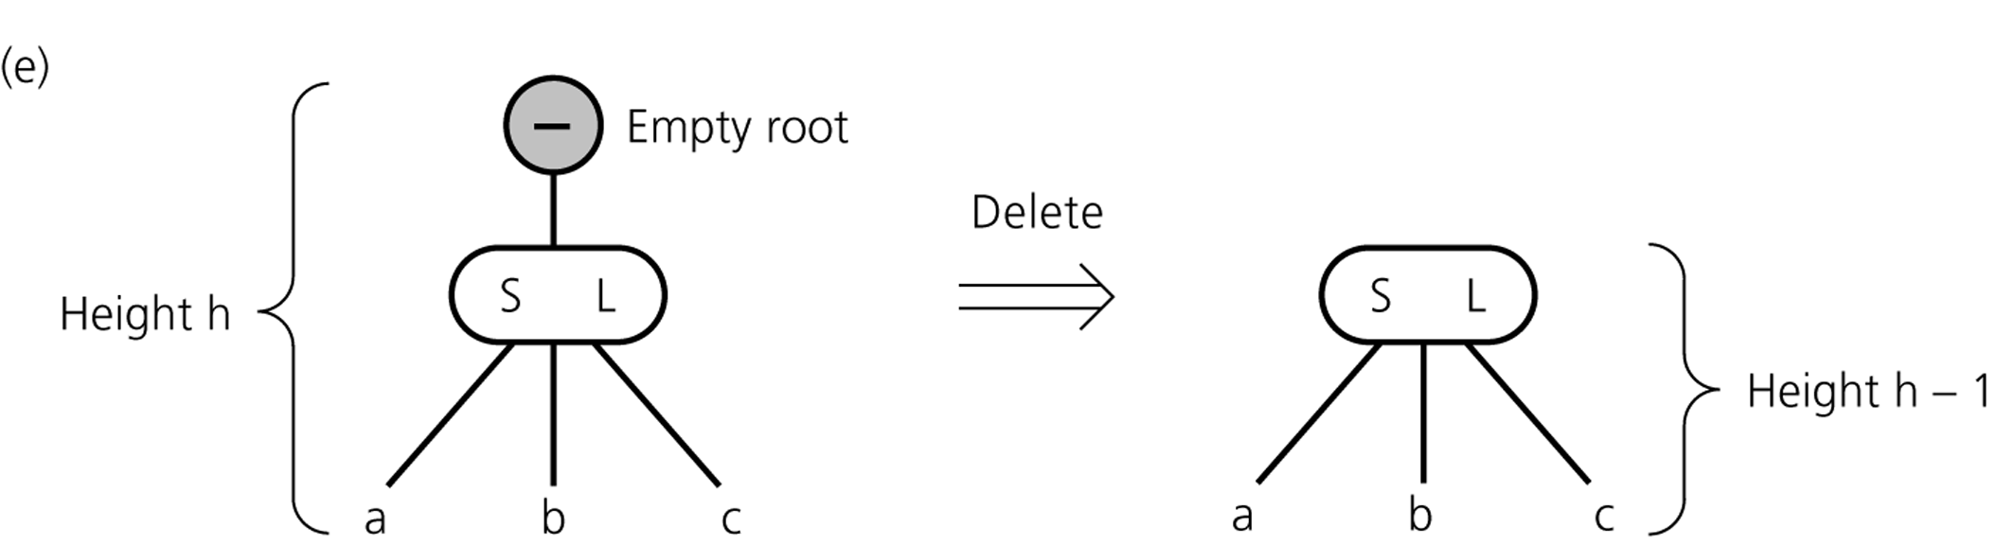
Deletion Algorithm IV
If merging process reaches the root and root is without item
→ delete root

Slide 40
Remarks
Search, insert, delete take time proportional to height, and hence to log n, where n is the number of keys.
Other balanced tree organizations are also possible, e.g. AVL trees, Red-Black trees
AVL and Red-Black are both binary.
Red-Black trees are obtaining by converting a 3 node to two 2 nodes.

