Slide 1
Global life expectancy and %gda invested in healthcare vs %1y/o vaccinated by tnap
Project Group 2 Snehashish Srivastava

Slide 2
Why and How
The viz hope to explore vaccination , life expectancy and uncover some possible insights about the data and draw a solid conclusion in the correlation of these data sets.
Methods used :
D3.js for viz development
Python for feature engineering and exploration

Slide 3
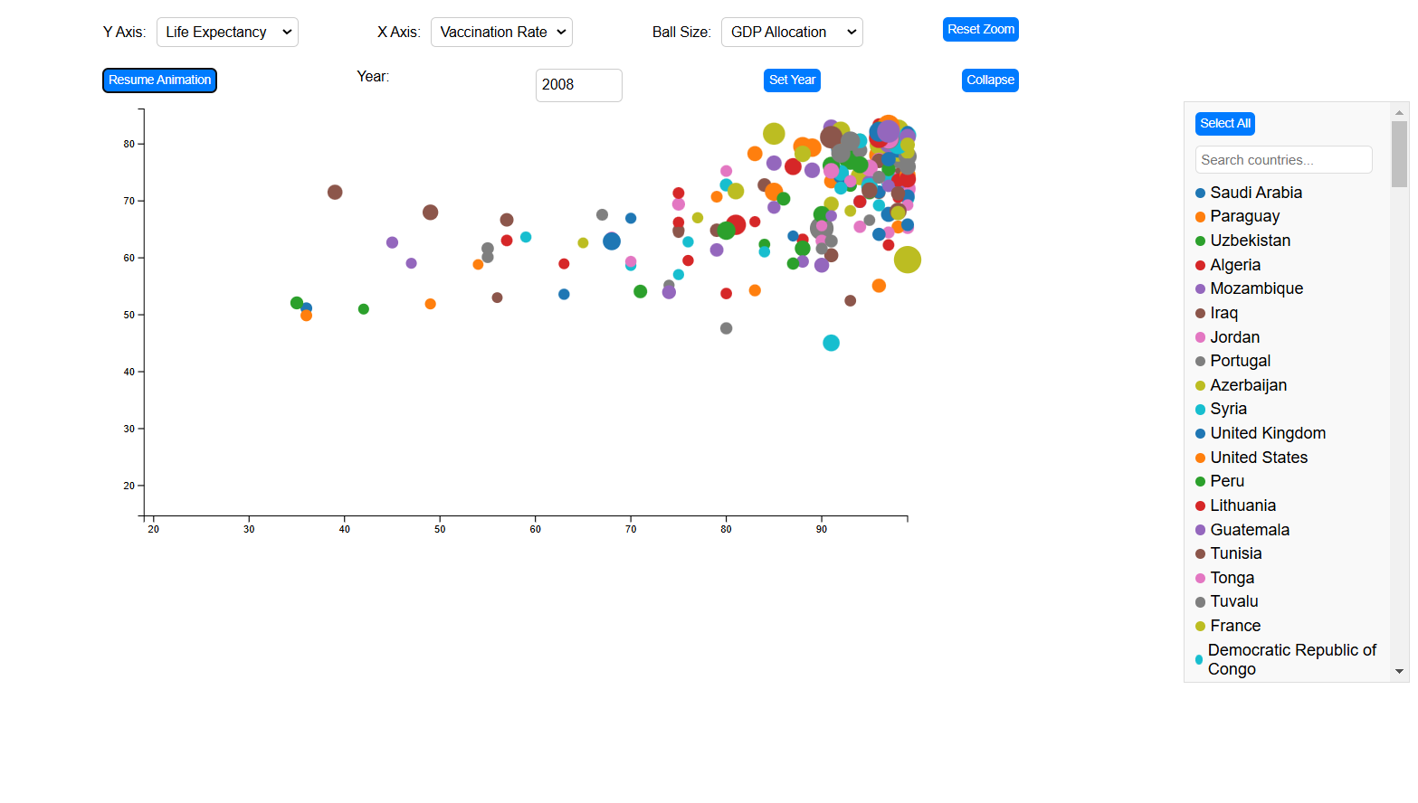

Slide 4
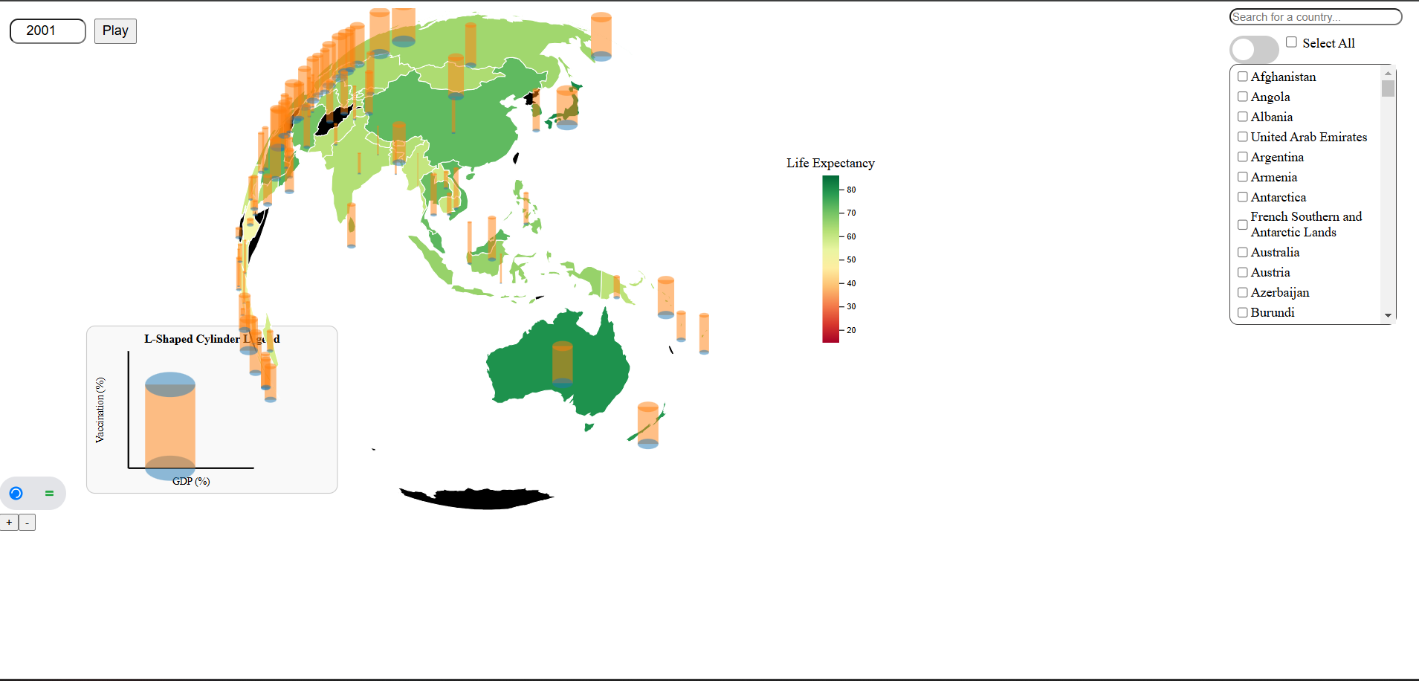

Slide 5
Discussion
Goals achieved: uncovered some insights using globe vizulization
See correlation pattern in the scatter plot viz

Slide 6
Obstacle
Animation sync
Loading SVG
Transition between maps

