Slide 1
CSE442
Section : 2
Instructor : Md. Nawab Yousuf Ali

Slide 2
Presented by:
Name :
Tithir Mahmud Bakshi
Snehashis Ghosh Pial
Noshin Samiha Prova
ID :
2016-1-60-095
2017-2-60-163
2018-1-60-58

Slide 3
IOT Based Smart Garden Irrigation System

Slide 4
Introduction
Monsoon dependent Bangladeshi Agriculture.
Automatic Irrigation.
Soil moisture, air humidity, temperature and water level in the soil are wirelessly transmitted using wireless technology for better production

Slide 5
Problem Statement:
Design a prototype of a web-based smart garden for monitoring and controlling water for soil-based plant.

Slide 6
Objectives:
Construct a web-based garden water system using instruments and write codes for the system to be online
Use the system to control watering of the garden
Continuously monitoring the status of sensors and provide signal for taking necessary action.
To get the output of soil water sensor and provide water to crop.

Slide 7
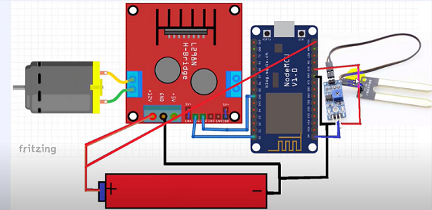
Figure 1 : System Architecture of IOT Backyard

Slide 8
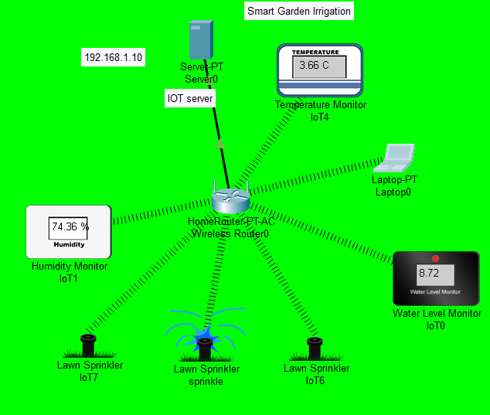
Figure 2: Simulation scenario of irrigation

Slide 9
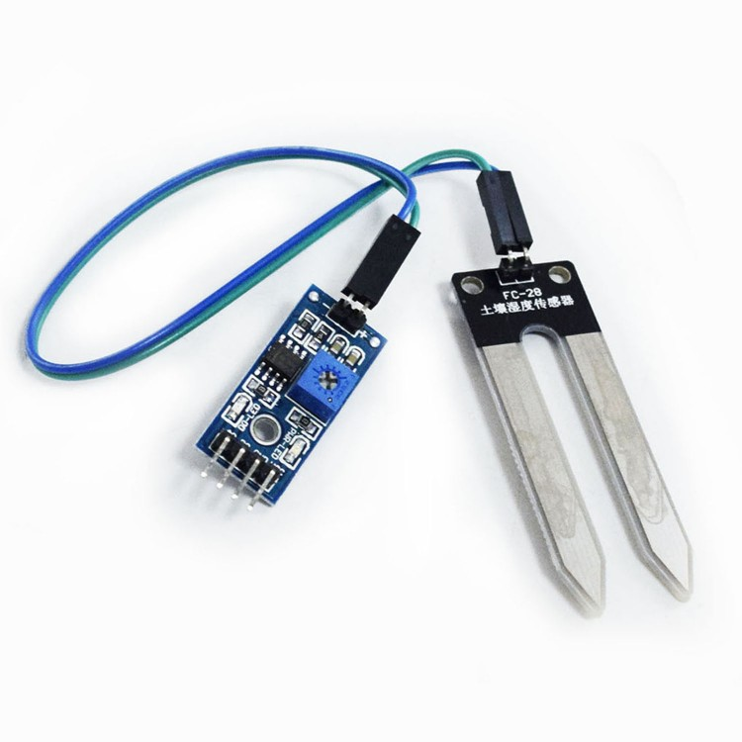
Soil Moisture Sensor:
The Soil Moisture Sensor is used to measure the volumetric water content of soil
Measures the loss of moisture over time due to evaporation and plant uptake
Evaluate optimum soil moisture contents for various species of plants

Slide 10
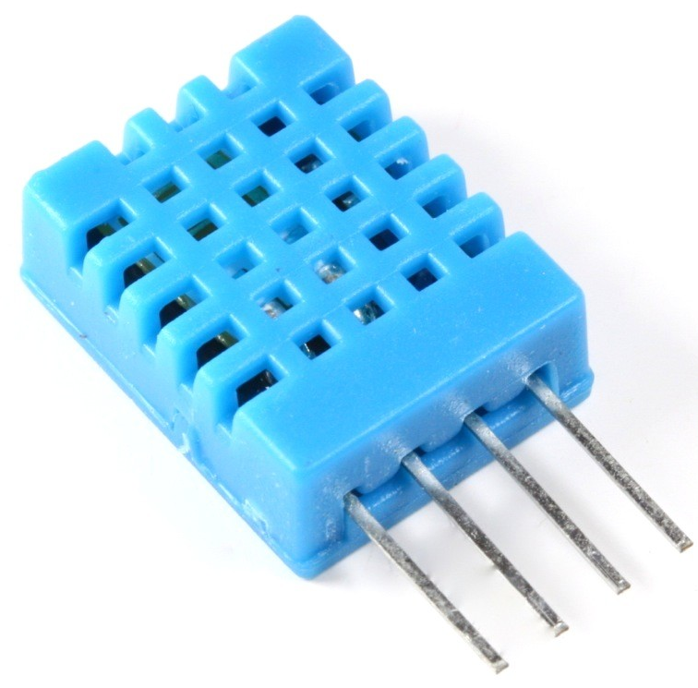
Temperature and Humidity Sensor:
Measures humidity and temperature
Relays the data back to controller

Slide 11
Design Structure:
The microcontroller senses the soil moisture and connects with the internet to send and receive data
The soil moisture sensor provides integer values between 0 and 1024. 0 is 100% humidity and 1024 represents 0% moisture in the soil.
The water level indicator works to monitor the water level in the reserve and to refill when necessary

Slide 12
[contd.]
The temperature sensor provides us with integer values between 0°C and 50 °C. If the temperature is less than 26°C, watering is allowed. Otherwise, sprinkler irrigation can burn leaves when water evaporates. The system waits for the temperature to go down.
Two types of irrigation is used.
Drip Irrigation.
Sprinkle Irrigation.

Slide 13
Connecting Hardware Elements:
We need a 12v battery for this project. Firstly, connect the battery with the NODE MCU wifi module. Then make a common ground for the battery [5]. Though, moisture sensor generate analog data, connect the wire to the Node Mcu A0 port. Connect another wire to the gound and other to the 3.3v port. Motor driver need 1 input pin to run motor. So, connect motor driver in1 pin to NODE MCU D0 port or 16 pin and another port connect to the ground. Connect motor driver to the 12v battery. Connect motor to the motor driver output pin. Then, we are done with the circuit connection.

Slide 14
Analysis and Calculations:
We Calculated the flow rate using the following formula :
Q = v/t
Where Q = flow rate of water, v = volume of water, t = time interval of each flow
So the time interval is :
t = V/Q

Slide 15
Design Analysis:
Microcontroller:
Two segments, Arduino UNO and NodeMCU V3
Arduino UNO senses the soil moisture via its sensors and sends data to NodeMCU V3
NodeMCU V3 has a Wi-Fi interface to connect with the Internet to send data to the system
It also receives the watering thresholds from the sensor and forwards them to Arduino UNO.
Water Level Monitoring Sensor:
Relays information back to a control panel to indicate if a body of water has a high or low water level
Maintains water level in the reserve
Fills up the reserve if the water is below the threshold
IoT Based Application:
A wifi-module was used to connect the garden with user
A sprinkler was used to water the pump

Slide 16
Advantages:
Increase in productivity
Reduced water consumption
Safe
No manpower required
Reduce soil erosion and nutrient leeching
Require small water sources

Slide 17
Conclusion and Future Work:
The deployed system presented in this document accomplishes the objective of taking data from different sensors and calculating irrigation needs for a given type of crop. Communication between the Arduino module and the cloud environment fulfilled the requirements. However, improvements can be done in order to reduce the amount of water that is wasted. This solution is scalable, which means that it can be used for different types of cloud services and can be used with many other sensors with other purposes. So that in the future other types of sensors could be integrated to monitor plant growth, amount of fertilizer used, harvest time, etc.

Slide 18
THANKS!
Any questions?

