Slide 1
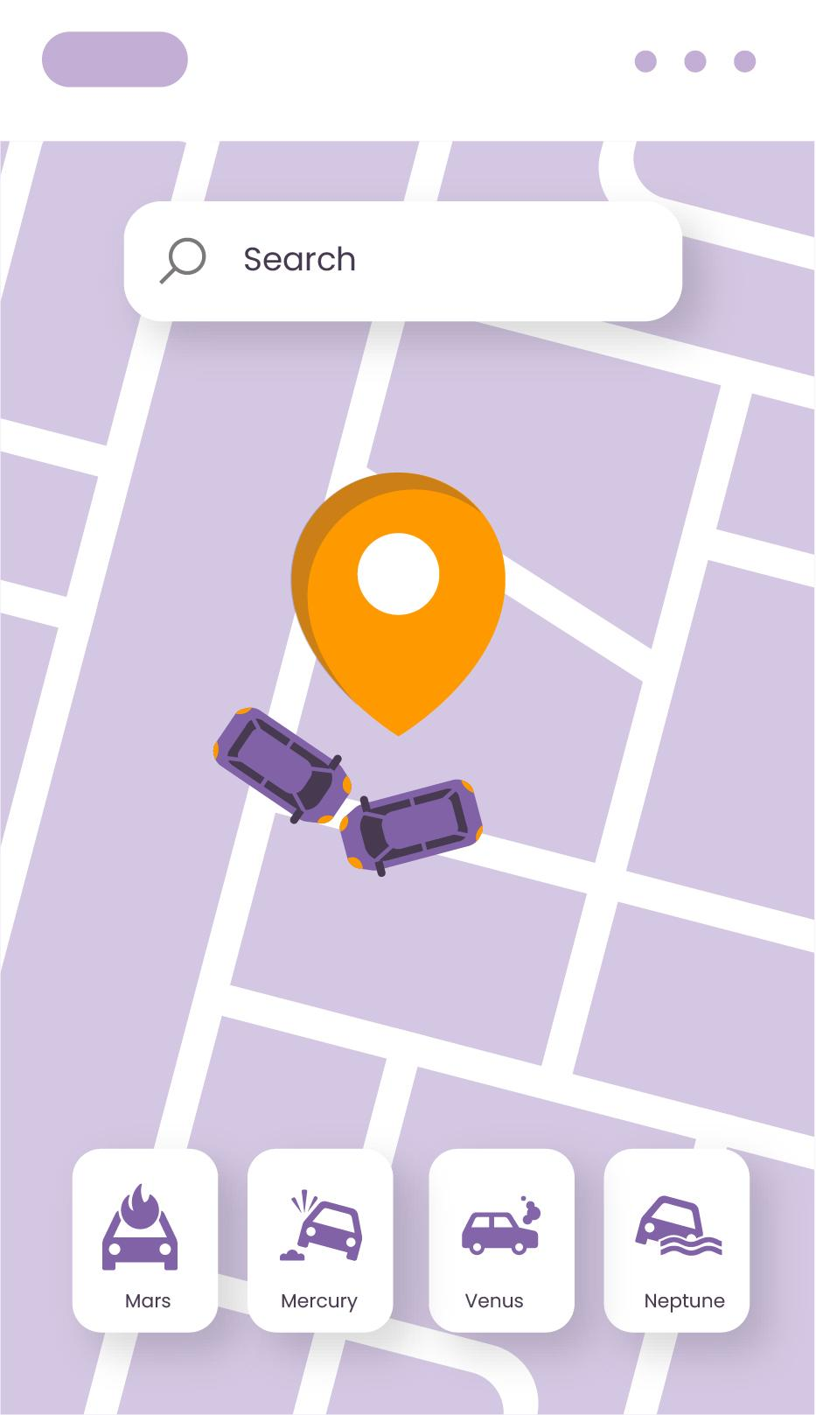
Traffic/Route Optimization

Slide 2
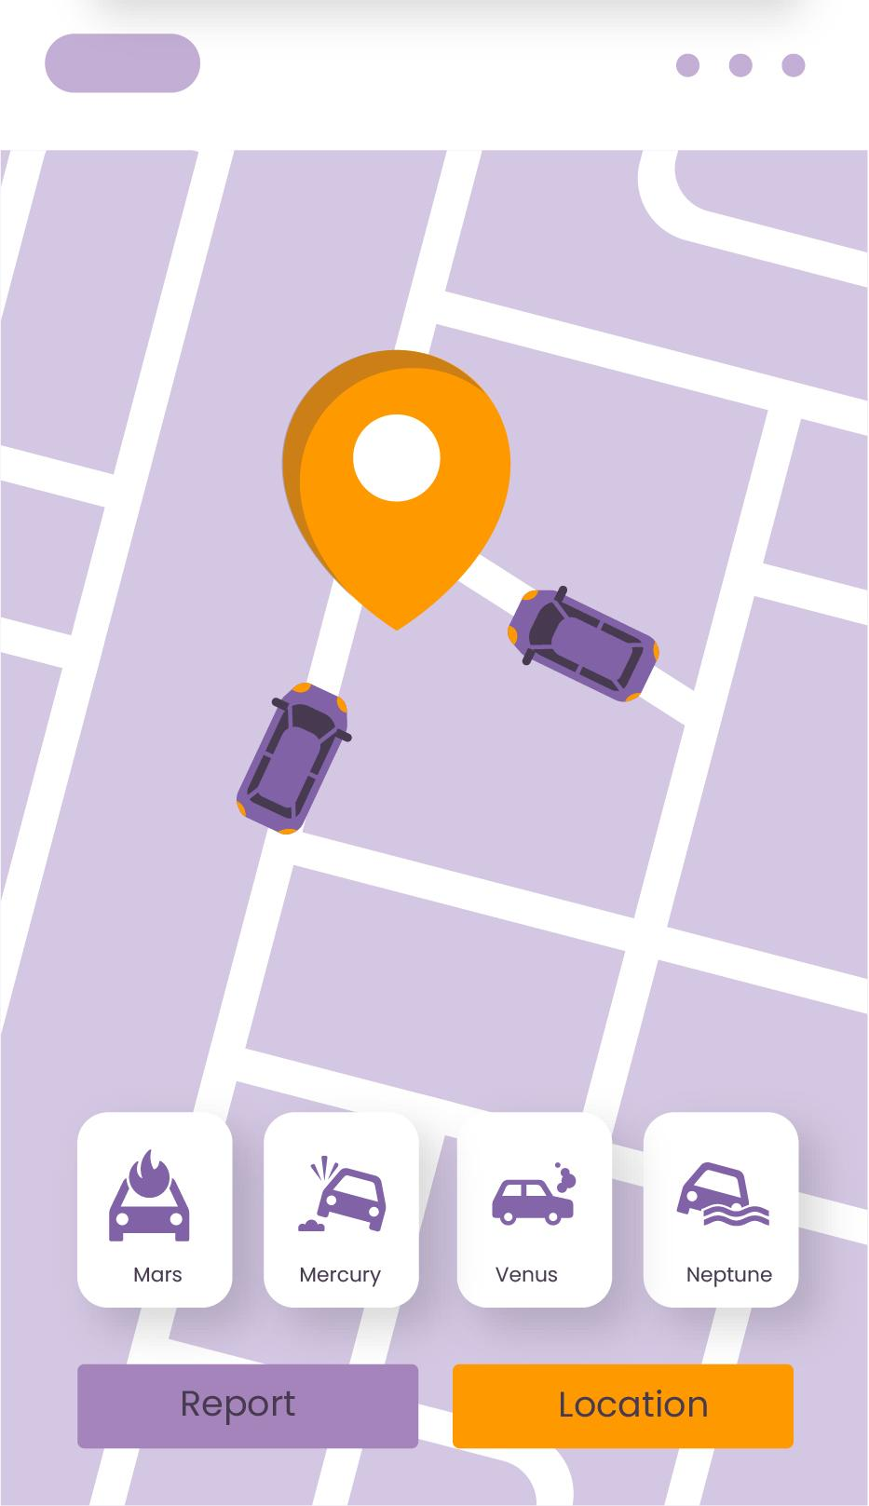
Data Structures used
Arrays
Priority Queue using min-heaps
Linked List
Graphs

Slide 3
Algorithms used and their Time Complexity
CreateGraph() | O(V)
GetWeight() | O(1)
Dijkstra() | O((V+E)logV)
BuildHeap() | O(V)
ExtractMin() | O(logV)
RelaxEdge() | O(logV)

Slide 4
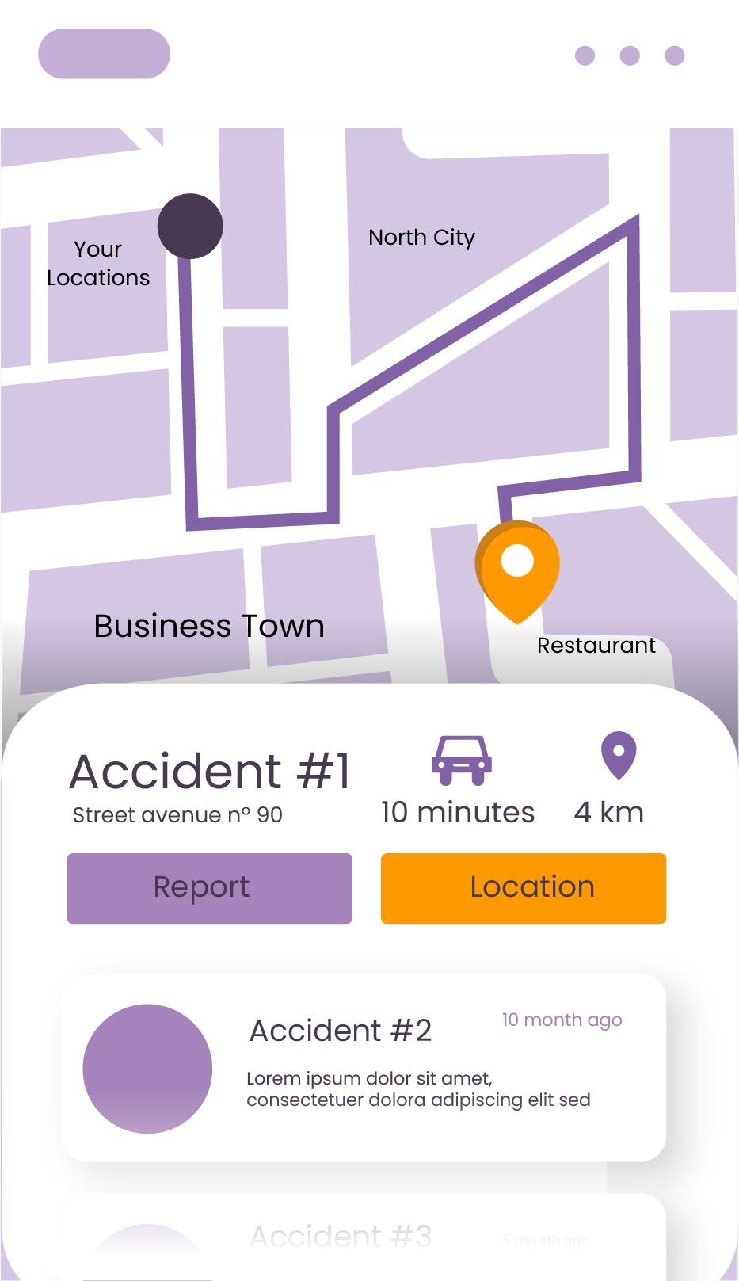
Datasets:
Intersections (nodes)
Roads (edges)
Marriage hall data at each node
Length of the road
Traffic Density of the road
Speed limits (maximum speed to travel on a particular road)

Slide 5
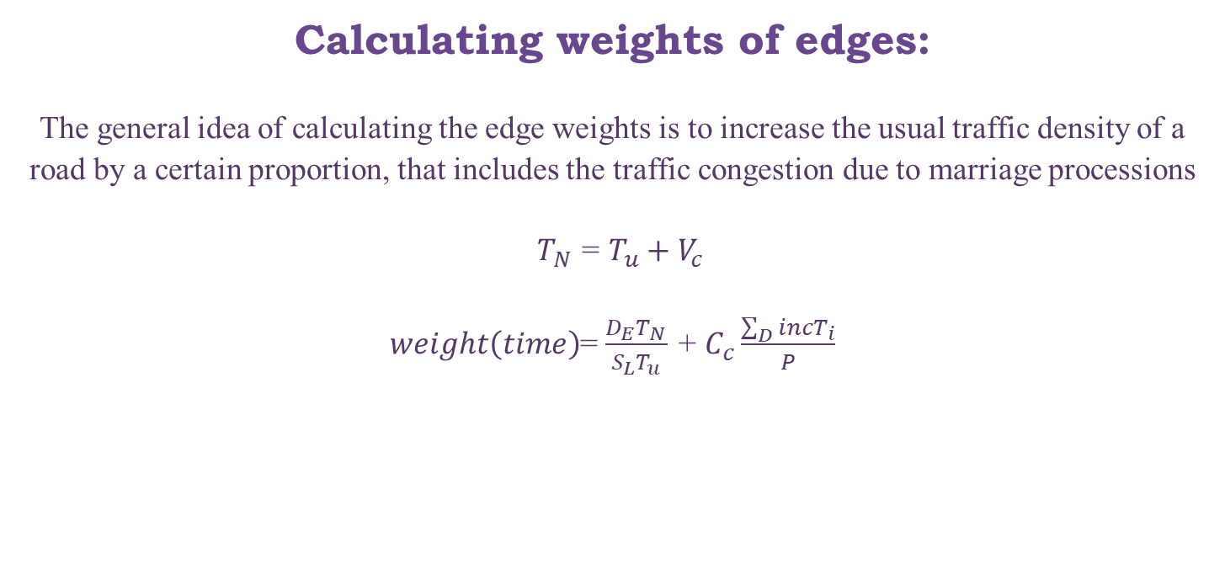
Calculating weights of edges:
The general idea of calculating the edge weights is to increase the usual traffic density of a road by a certain proportion, that includes the traffic congestion due to marriage processions
$T_{N}$ = $T_{u}+V_{c}$
$weight\left(time\right)$= $\frac{D_{E}T_{N}}{S_{L}T_{u}}$ + $C_{c}\frac{\sum_{D}{incT_{i}}}{P}$

Slide 6
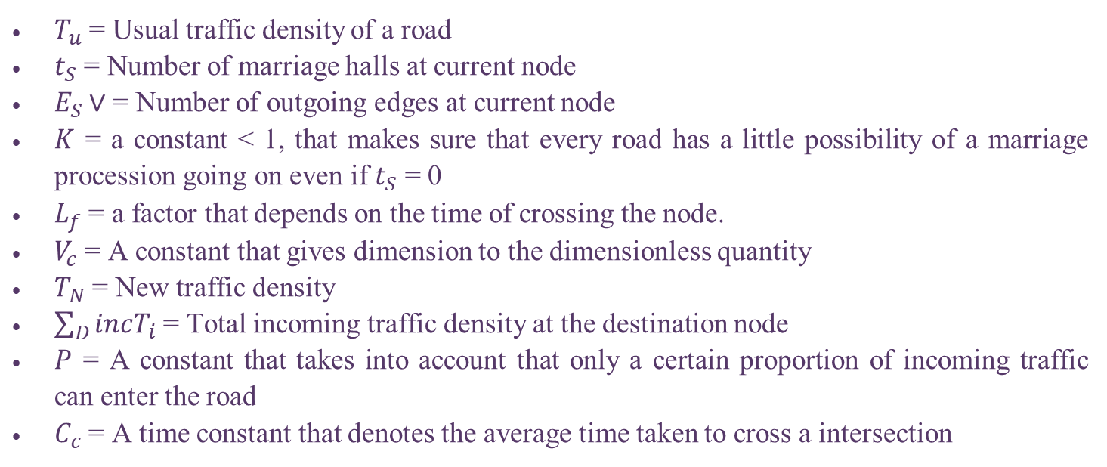
$T_{u}$ = Usual traffic density of a road
$t_{S}$ = Number of marriage halls at current node
$E_{S}∨$ = Number of outgoing edges at current node
$K$ = a constant < 1, that makes sure that every road has a little possibility of a marriage procession going on even if $t_{S}$ = 0
$L_{f}$ = a factor that depends on the time of crossing the node.
$V_{c}$ = A constant that gives dimension to the dimensionless quantity
$T_{N}$ = New traffic density
$\sum_{D}{incT_{i}}$ = Total incoming traffic density at the destination node
$P$ = A constant that takes into account that only a certain proportion of incoming traffic can enter the road
$C_{c}$ = A time constant that denotes the average time taken to cross a intersection

Slide 7
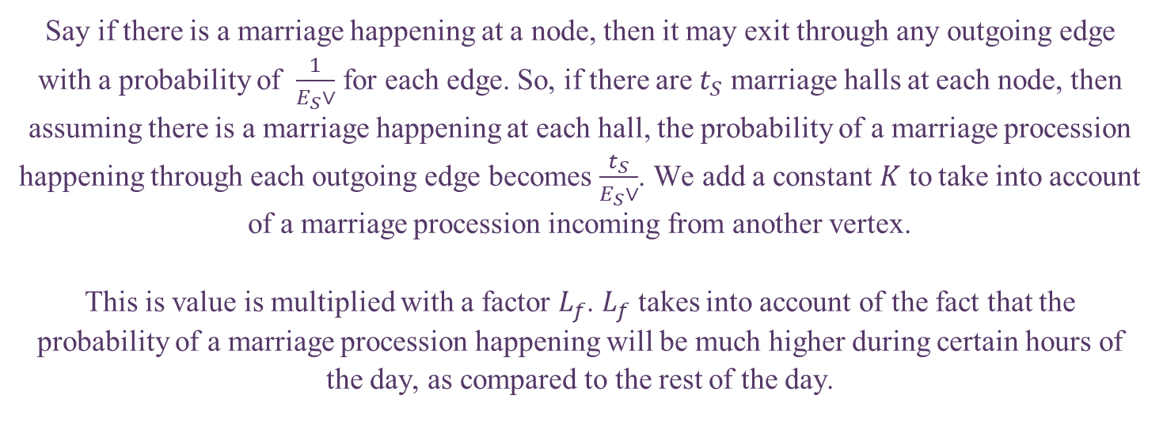
Explanation
Say if there is a marriage happening at a node, then it may exit through any outgoing edge with a probability of $\frac{1}{E_{S}∨}$ for each edge. So, if there are $t_{S}$ marriage halls at each node, then assuming there is a marriage happening at each hall, the probability of a marriage procession happening through each outgoing edge becomes $\frac{t_{S}}{E_{S}∨}$. We add a constant $K$ to take into account of a marriage procession incoming from another vertex.
This is value is multiplied with a factor $L_{f}$. $L_{f}$ takes into account of the fact that the probability of a marriage procession happening will be much higher during certain hours of the day, as compared to the rest of the day.

Slide 8
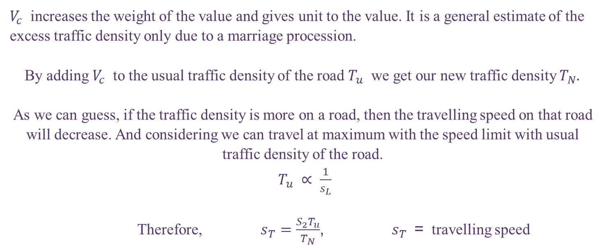
$V_{c}$ increases the weight of the value and gives unit to the value. It is a general estimate of the excess traffic density only due to a marriage procession.
By adding $V_{c}$ to the usual traffic density of the road $T_{u}$ we get our new traffic density $T_{N}$.
As we can guess, if the traffic density is more on a road, then the travelling speed on that road will decrease. And considering we can travel at maximum with the speed limit with usual traffic density of the road.
$T_{u}$ $∝$ $\frac{1}{s_{L}}$
Therefore, $s_{T}=\frac{S_{2}T_{u}}{T_{N}}$, $s_{T}$ = travelling speed

Slide 9
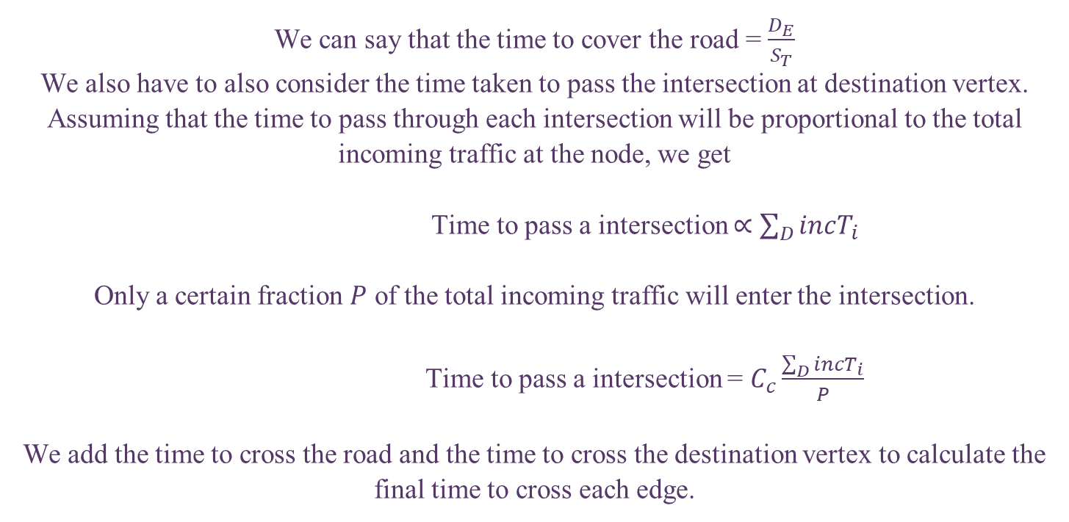
We can say that the time to cover the road = $\frac{D_{E}}{S_{T}}$
We also have to also consider the time taken to pass the intersection at destination vertex. Assuming that the time to pass through each intersection will be proportional to the total incoming traffic at the node, we get
Time to pass a intersection $∝$ $\sum_{D}{incT_{i}}$
Only a certain fraction $P$ of the total incoming traffic will enter the intersection.
Time to pass a intersection = $C_{c}\frac{\sum_{D}{incT_{i}}}{P}$
We add the time to cross the road and the time to cross the destination vertex to calculate the final time to cross each edge.

Slide 10
Inspiration…
We took inspiration from the research paper “Intelligent Traffic Control System Based on Density and Time Delay in Vehicle Networks” By Q.Liu, H.Gao and Z.cai:-
As in it a vague idea was presented that we could factor in various factors happening in our day-to-day life like processions(in Indian context the most relatable one was Marriage processions),as well as Traffic Density to formulate a way to give the most efficient path for travel that would the least amount of time.

Slide 11
Novelty:-Formulated a method to factor in the traffic density as well as solved a major reason of slow traffic/road blockages in India…processions much more in Indian context..(Marriage Processions).
Future Scope:- Could be integrated in Navigation platforms like google Maps, Apple Maps etc. Also in food delivery apps such as Swiggy, Zomato etc. as they have to deliver food within a very short interval of time and this could give them the most efficient path bypassing the processions which could otherwise slow them down. Also we could map it to a UI like that of Google Maps where we could display the shortest path we get by formulating.

Slide 12
Salient Features
Modularity :- We have ensured code Modularity by making separate .h and
.c files.
Readability :- We have made our project readable for others by adding
comments and also made a readme file for configuring out
the input method.
Graphics :- We are also showing graphically all our nodes and as well as
the shortest path taken for better visualization of the user.

Slide 13
Contributions:
Snehasish Bose
Implemented the Dijkstra’s algorithm(Dijkstra.h & Dijkstra.c),brainstormed over our novelty(formulating the path),debugging.
Ananta Hatwar
Implemented the Heap(Heap.h & Heap.c),brainstormed over our novelty(formulating the path),debugging.
Gaurish Dodke
Aryan Thakre
Implemented the Graph(graph.h & graph.c),brainstormed over our novelty(formulating the path),debugging.
Implemented the graphics and integration amongst the C and python code of our project, brainstormed over our novelty(formulating the path),debugging.

