Slide 1
🏏 IPL AUCTION
PERFORMANCE ANALYTICS
2013 – 2022 IPL Auction Data
543
10
13
₹2.04K Cr
Players
Seasons
Franchises
Total Spend

Slide 2
PROJECT OVERVIEW
Problem Statement
The IPL is one of cricket's biggest sporting events, with franchises spending crores on player auctions. This project analyzes auction data from 2013–2022 to uncover spending patterns, player value, and franchise strategies using interactive Power BI dashboards.
Key Objectives
Analyze total franchise spending across 10 IPL auction seasons
Identify top players by auction price and their role distribution
Compare Indian vs. Overseas player spending and representation
Visualize team-wise role-based spending (Batsman, Bowler, All-Rounder, WK)
Examine price bracket distribution and year-over-year spend trends

Slide 3
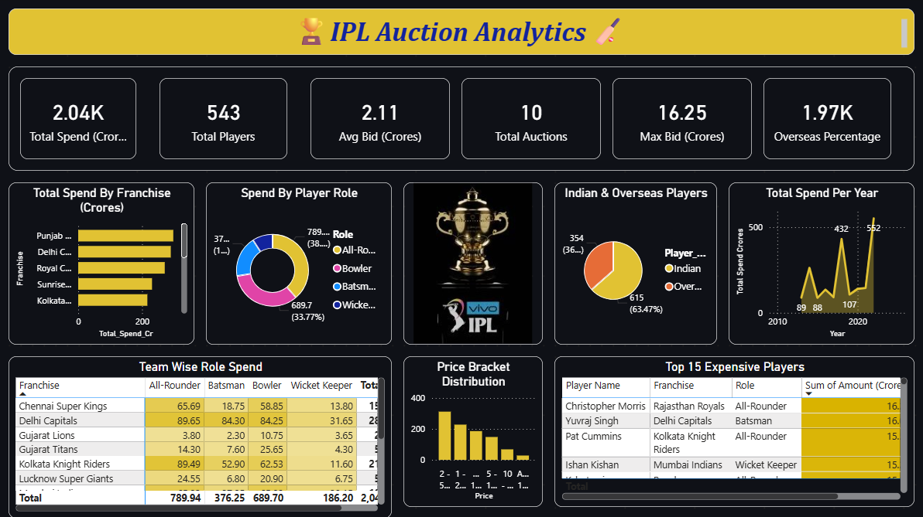
IPL AUCTION ANALYTICS – MAIN DASHBOARD

Slide 4
KEY PERFORMANCE INDICATORS
💰
🏏
📊
₹2.04K Cr
543
₹2.11 Cr
Total Spend
Total Players
Avg Bid Price
Across all seasons
Auctioned 2013–2022
Per player average
🗓️
🥇
🌍
10
₹16.25 Cr
36.21%
Total Auctions
Max Single Bid
Overseas Players
Season coverage
Christopher Morris
197 overseas players

Slide 5
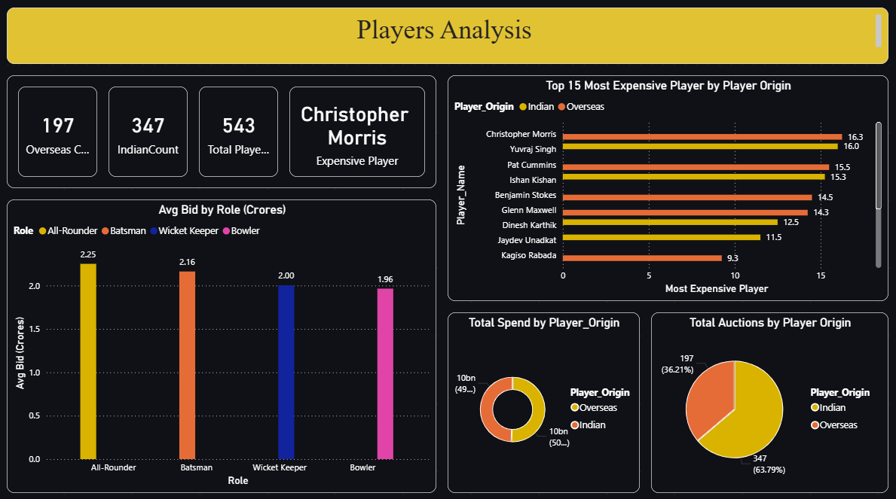
PLAYER ANALYTICS DASHBOARD

Slide 6
PLAYER INSIGHTS & ANALYSIS
Top 5 Most Expensive Players
Player | Role | Amount
Christopher Morris | All-Rounder | ₹16.25 Cr
Yuvraj Singh | Batsman | ₹16.00 Cr
Pat Cummins | All-Rounder | ₹15.50 Cr
Ishan Kishan | Wicket Keeper | ₹15.25 Cr
Benjamin Stokes | All-Rounder | ₹14.50 Cr
347
197
Indian Players (63.79%)
Overseas Players (36.21%)

Slide 7
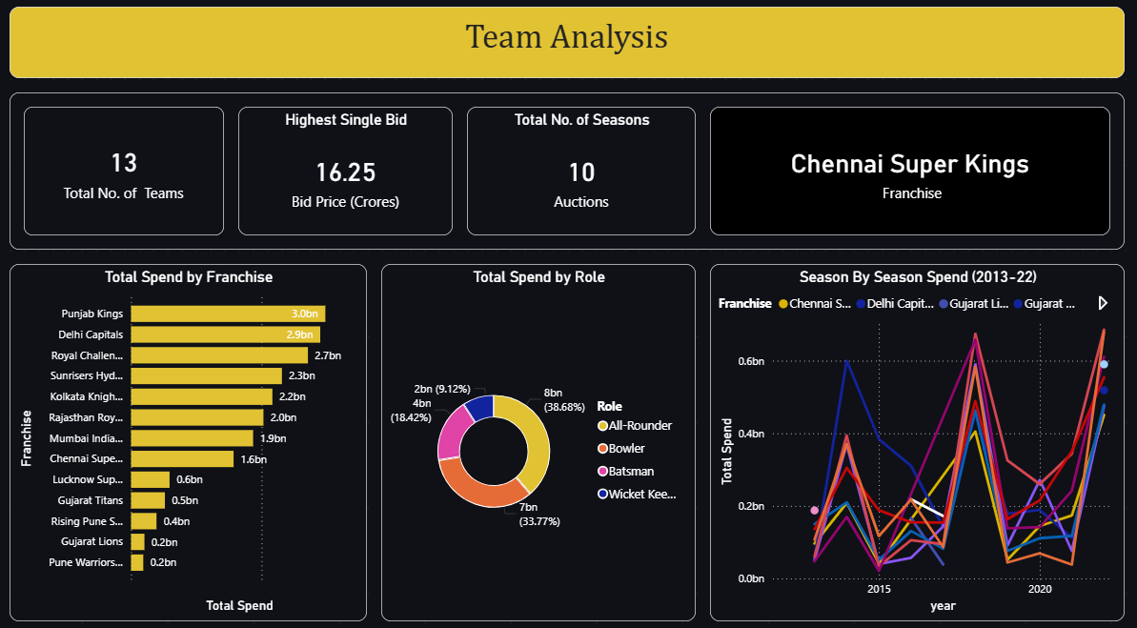
TEAM ANALYSIS DASHBOARD

Slide 8
FRANCHISE SPENDING ANALYSIS
Key Insights
Punjab Kings leads with ₹3.0Bn total spend
All-Rounders attract 38.68% of total budget
Bowlers command 33.77% of spending
2022 season saw highest spend at ₹562 Cr

Slide 9
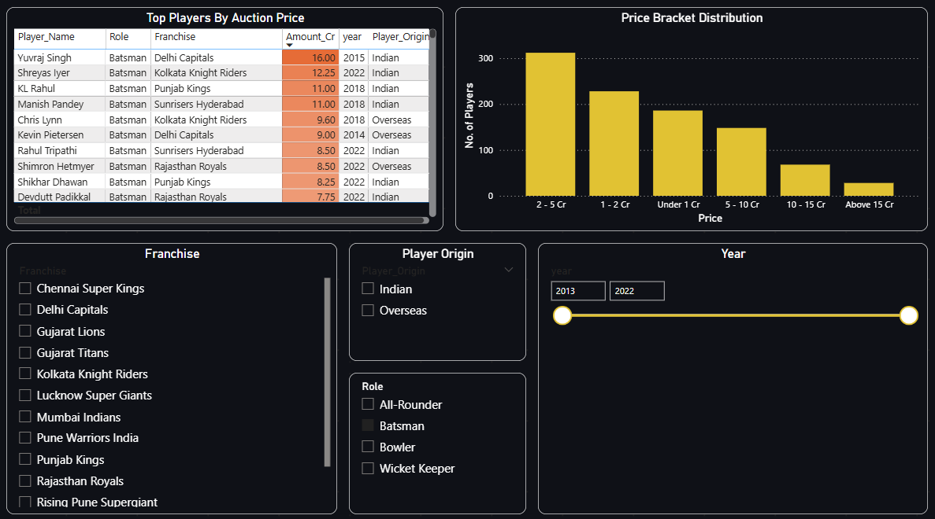
PRICE BRACKET & AUCTION EXPLORER

Slide 10
PRICE BRACKET DISTRIBUTION
Bracket Highlights
2 – 5 Cr
302 players • Most Common
1 – 2 Cr
227 players • 2nd Most
Under 1 Cr
193 players • Budget Picks
Above 15 Cr
22 players • Elite Players

Slide 11
CONCLUSION
Franchise Strategy
Role Valuation
Punjab Kings, Delhi Capitals, and Royal Challengers spent the most, indicating aggressive team-building strategies across all seasons.
All-Rounders command the highest average bids (₹2.25 Cr) and receive the largest share of team budgets (38.68%), reflecting their versatility.
Player Origin
Price Trends
Indian players dominate in count (63.79%) but overseas players like Christopher Morris, Pat Cummins, and Ben Stokes command record prices.
Most players fall in the ₹2–5 Cr bracket, but only 22 elite players exceeded ₹15 Cr. The 2022 season saw a record high spend of ₹562 Cr.
🏆 Data Source: IPL Auction Records 2013–2022 | Tool: Microsoft Power BI

Slide 12
REPORT SUMMARY
IPL Auction Analytics 2013-2022 | Key Findings & Insights
₹2.04K Cr
Total Spend
543 Players
Auctioned 2013-2022
₹2.11 Cr
Avg Bid Price
₹16.25 Cr
Highest Single Bid
Franchise Spending
Punjab Kings led with ₹3.0Bn total spend. Delhi Capitals (₹2.9Bn) and Royal Challengers (₹2.7Bn) followed, reflecting aggressive multi-season strategies. Chennai SK and Mumbai Indians spent more conservatively.
Role Valuation
All-Rounders commanded the highest average bids (₹2.25 Cr) and 38.68% of franchise budgets due to their batting and bowling versatility. Bowlers followed at 33.77%, Batsmen at 18.42%, and Wicket Keepers at 9.12%.
Scope & Methodology
Covers 10 seasons (2013-2022), 13 franchises, and 543 players. Visualized using interactive Power BI dashboards spanning spending trends, player analytics, and price bracket analysis.
Player Origin
Indian players dominated the pool at 63.79% (347 players). Overseas players (36.21%, 197 players) consistently fetched premium prices, with Christopher Morris (₹16.25 Cr), Pat Cummins (₹15.50 Cr), and Ben Stokes (₹14.50 Cr) setting records.
Price Distribution
The ₹2-5 Cr bracket was most common (302 players, 55.6%). Only 22 elite players exceeded ₹15 Cr. The 2022 season set a record spend of ₹562 Cr, indicating rising valuations over time.
Key Takeaway
Franchise auction success hinges on prioritizing All-Rounders and selectively acquiring high-impact overseas players, while balancing budget constraints across seasons.
🏆 Data Source: IPL Auction Records 2013-2022 | Tool: Microsoft Power BI

