Slide 1



KONGU ENGINEERING COLLEGE
PERUNDURAI ERODE-638060
DEPARTMENT OF
ARTIFICIAL INTELLIGENCE
20ADP71 – PROJECT WORK – II – Phase I
Enhanced Classification of Colorectal Tract Abnormalities Using Transfer Learning on Endoscopic Images
Team Mentor: Ms O.Abhila Anju AP / AI
Team Members: SNEHAVARSHINI S 21ADR048
BHUVANESHWARI C 21ADR009
SOUNDHARYA M 21ADR050

Slide 2
PROBLEM STATEMENT
To improve the early detection of colorectal tract abnormalities from endoscopic images, there is a critical need for automated systems in colorectal cancer assessment.
The goal is to develop a model capable of accurately identifying abnormal patterns, such as polyps and other precancerous lesions, to support timely diagnosis and intervention in colorectal cancer.

Slide 3
OBJECTIVE
To develop a classification model that accurately detects and classifies colorectal tract abnormalities from endoscopic images for early diagnosis.
To compare the performance of the attention-enhanced ResNet model with baseline models to identify the better-performing architecture.
To incorporate visualization techniques like GRAD CAM to identify critical regions contributing to the classification.

Slide 4

LITERATURE SURVEY
PUBLISHER | TITLE | DATASET | METHODOLOGY | COMPARISON METHODS
MDPI | GIT-Net: An Ensemble Deep Learning-Based GI Tract Classification of Endoscopic Images. | KVASIR v2 dataset. | ResNet50, DenseNet201, and InceptionV3. | Accuracy - 92 % , specificity, sensitivity, recall, and precision.
Science Direct | Transformer-based multi-task learning for classification and segmentation of gastrointestinal tract endoscopic images | CVC-ClinicDB | GoogLeNet, VGG-16, AlexNet, ResNet-50 | Accuracy – 93 %, specificity, sensitivity, recall, and precision.

Slide 5
LITERATURE SURVEY
PUBLISHER | TITLE | DATASET | METHODOLOGY | COMPARISON METHODS
MDPI | ANewApproachforGastrointestinal Tract Findings Detection and Classification: Deep Learning-Based Hybrid Stacking Ensemble Models | Kvasir dataset | Stacking Ensemble methods- Multilayer perceptron , Logistic regression , linear SVM, KNN | Accuracy – 90%, Precision , Recall , F1 Score
IEEE | Automated Gastrointestinal Disease Recognition for Endoscopic Images | Kvasir dataset. | ResNet50 and DenseNet121, | Accuracy

Slide 6
LITERATURE SURVEY
PUBLISHER | TITLE | DATASET | METHODOLOGY | COMPARISON METHODS
MDPI | Efficient Gastrointestinal Disease Classification Using Pretrained Deep Convolutional Neural Network | Kvasir Dataset. | ImageNet , Fine tuned MobileNet v2 | Accuracy – 94 %
Springer | A Comprehensive Analysis of Deep Learning‑Based Approaches for the Prediction of Gastrointestinal Diseases Using Multi‑class Endoscopy Images | Kvasir Dataset. | DenseNet201, EfficientNetB4, Xception, Inception v2 , Resnet50. | Accuracy – 90%, Loss, RMSE, Precision, Recall , F1-score

Slide 7
DATASET DESCRIPTION
The dataset is obtained from Kaggle, representing a public dataset.
The dataset comprises images from individuals with colorectal tract abnormalities through the endoscopic method.
The dataset includes 8 types of tract abnormalities, each with 500 images.
It encompasses both a training set and a validation set to facilitate model development and assessment.
The eight types of GI tract conditions mentioned here are Dyed-lifted polyps, Dyed-resection margins, Polyps, Ulcerative colitis, Esophagitis, Barrett's, esophagus, Z-line, Normal mucosa

Slide 8
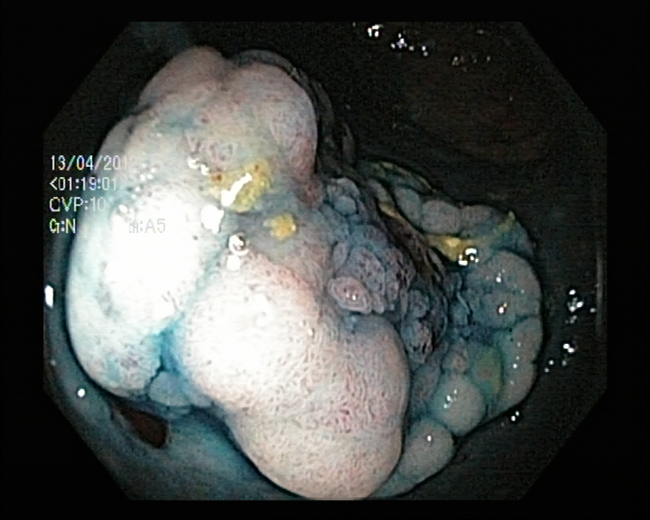
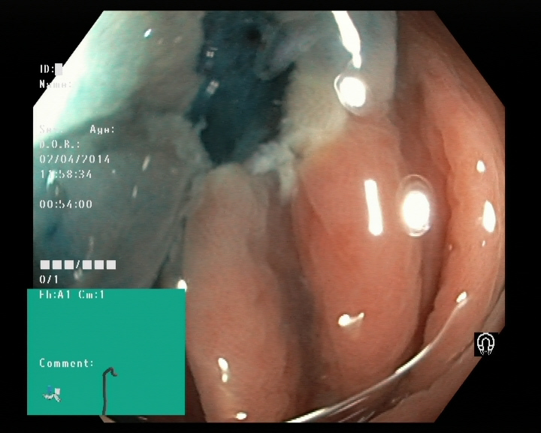
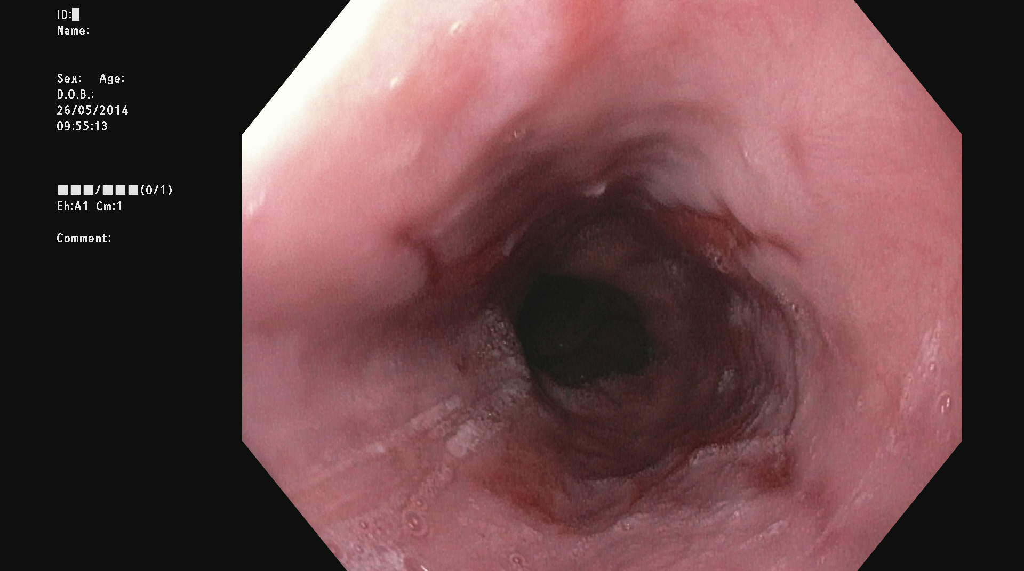
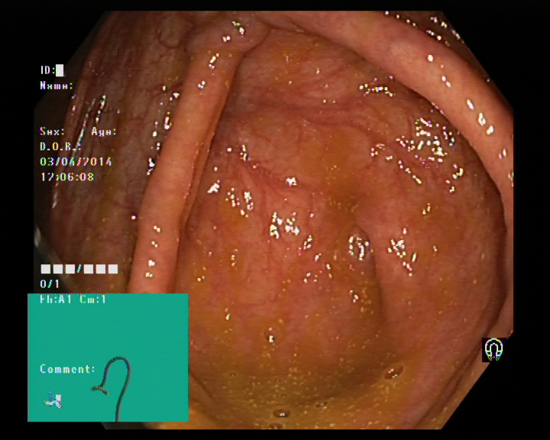
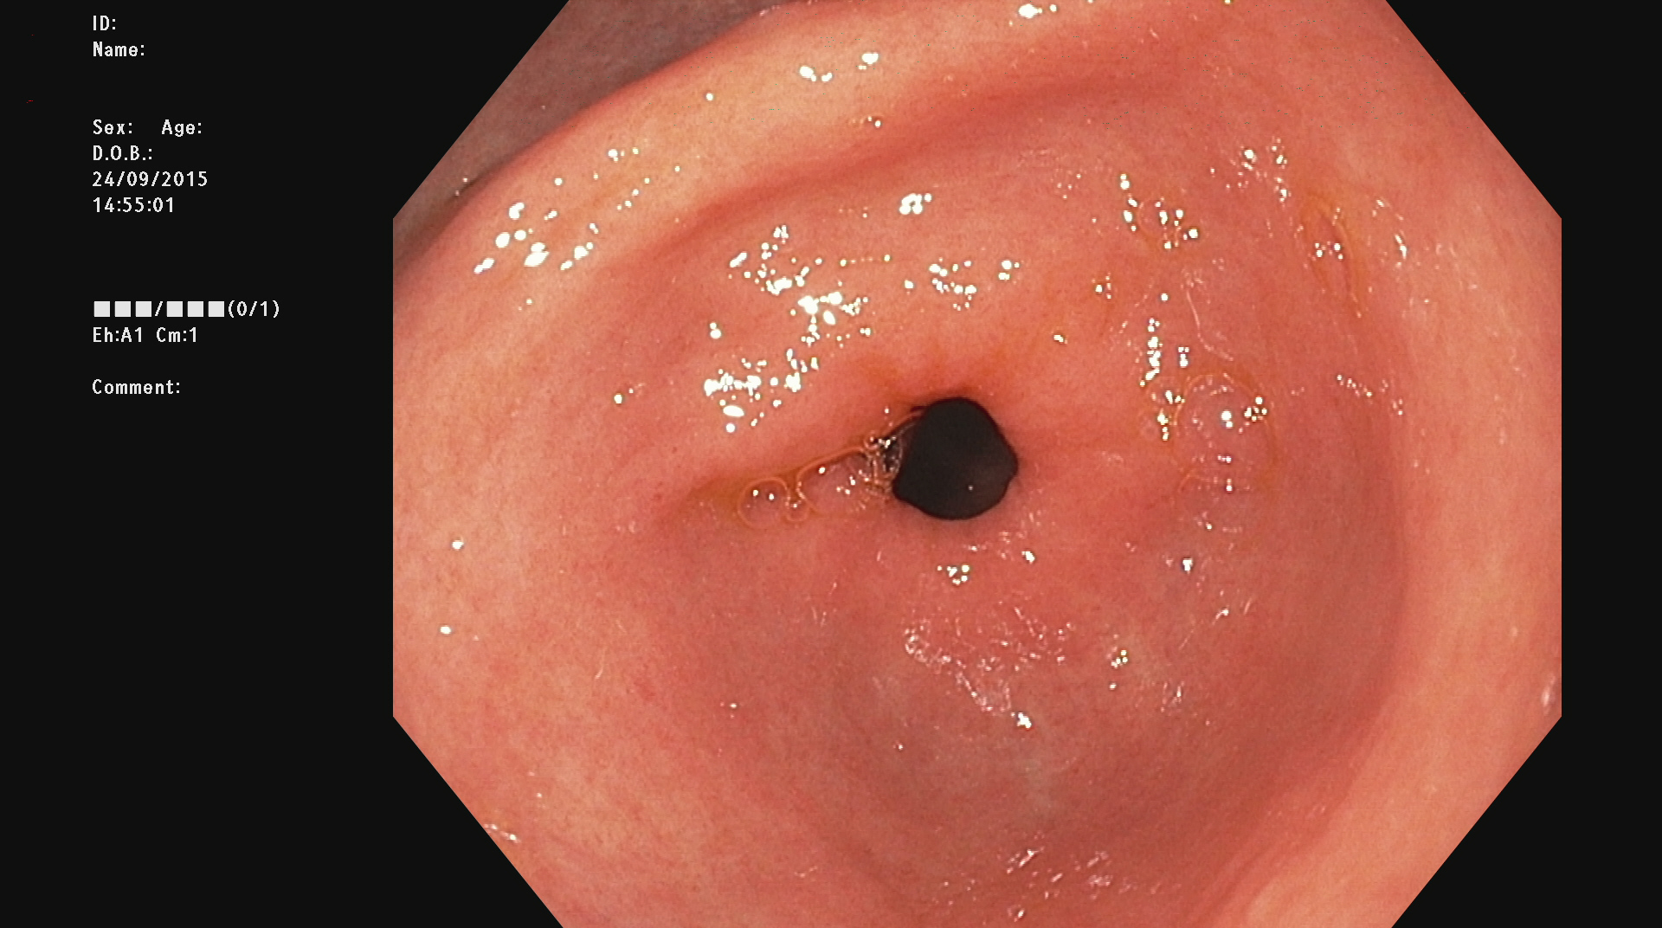
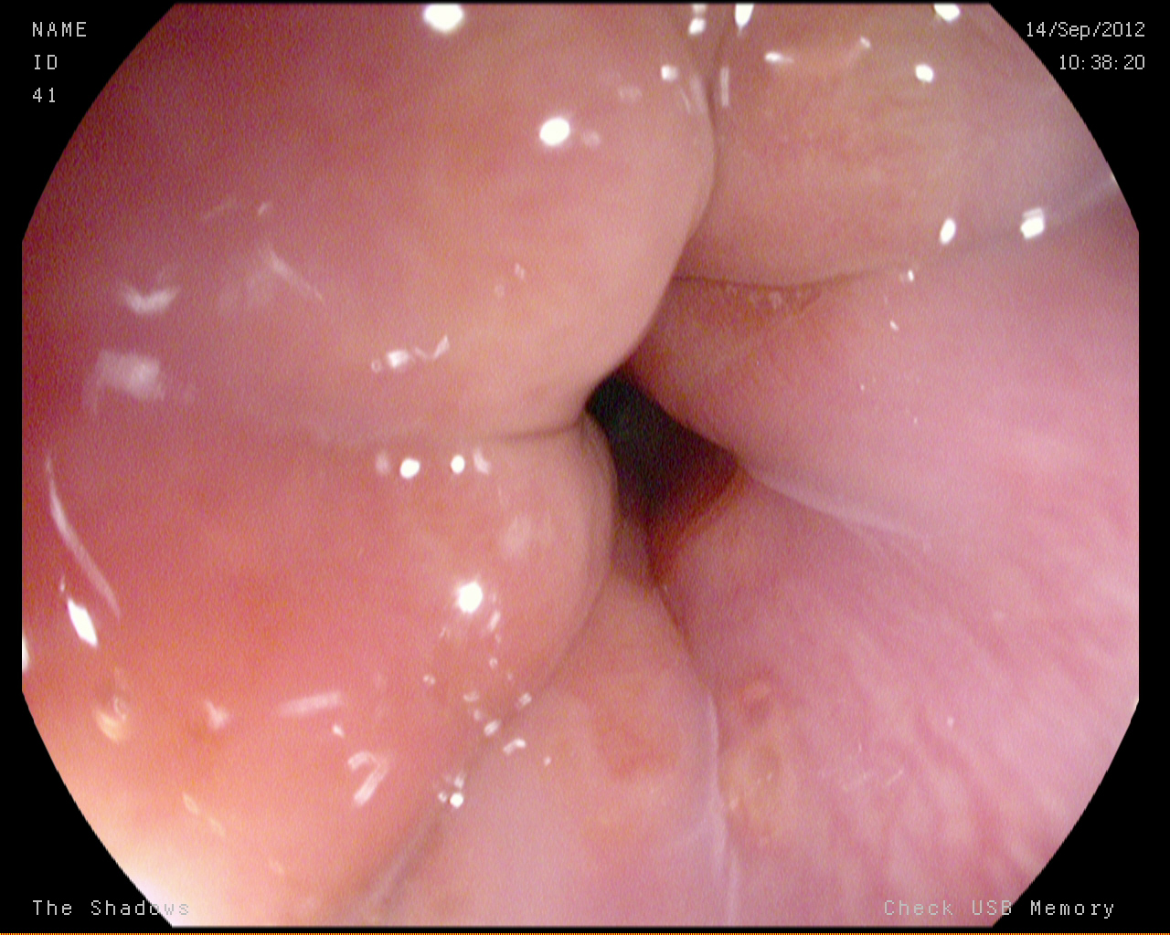
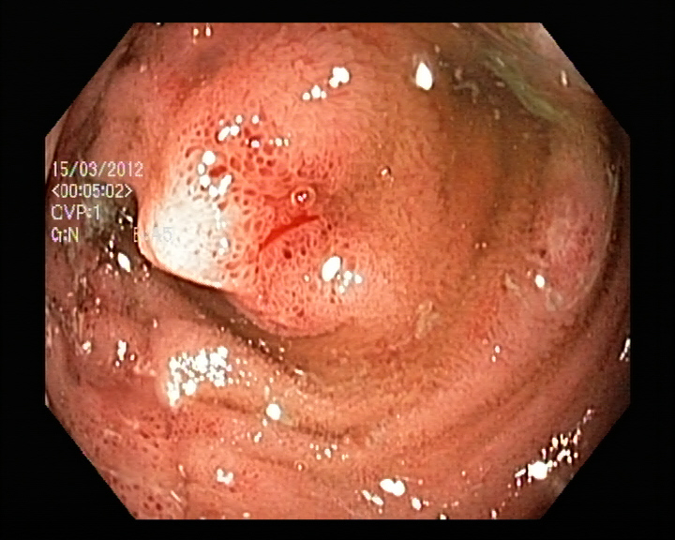
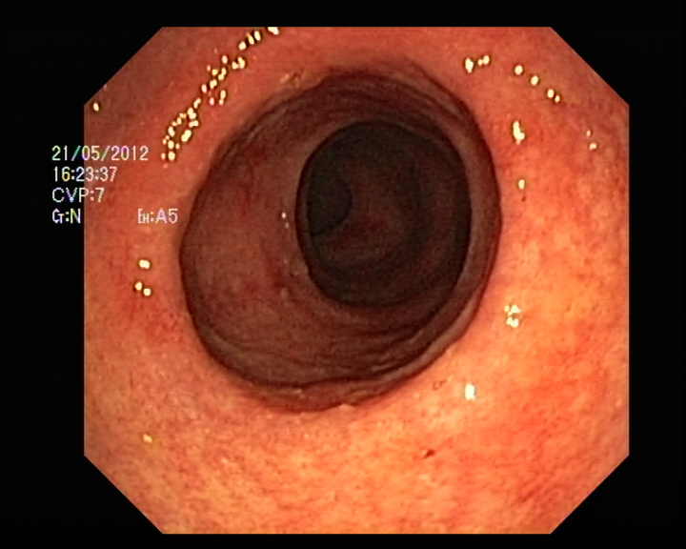
DATASET SAMPLE
Dyed – resection - margins.
Esophagitis
Normal Cecum
Dyed – lifted – Polyps.
Normal Pylorus
Normal Z line.
Polyps
Ucerative Colitis

Slide 9
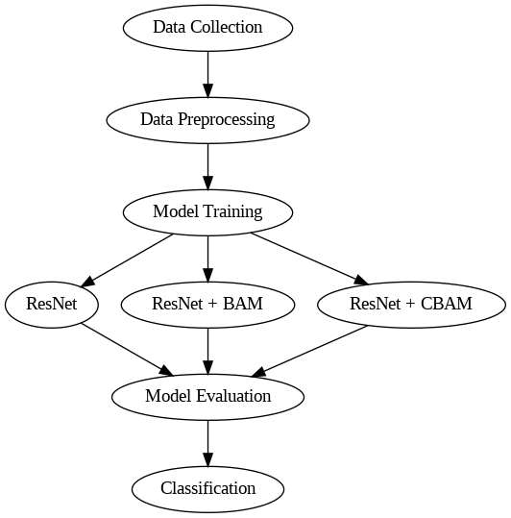
MODULES - IMPLEMENTATION

Slide 10
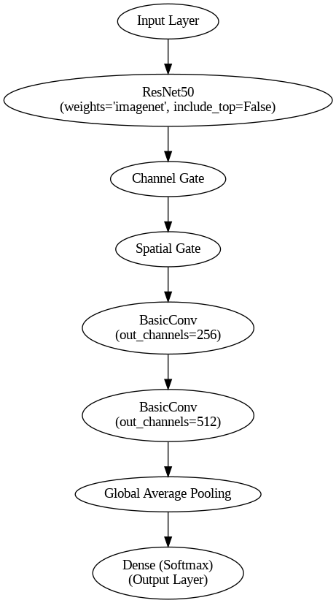
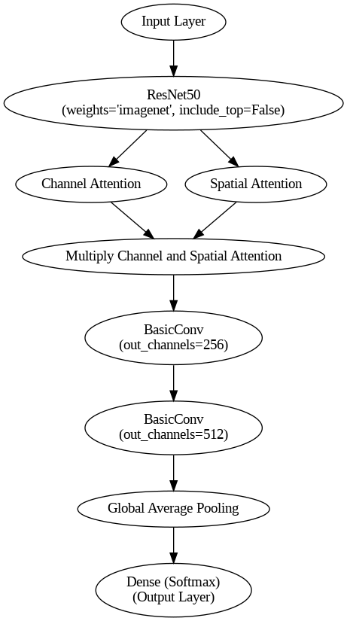
Model Architecture
BAM MODEL ARCHITECTURE
CBAM MODEL ARCHITECTURE

Slide 11
BAM MODEL ARCHITECHTURE
Channel Attention Module: Performs Global Average Pooling on the feature map, followed by a small MLP and Batch Normalization to generate a channel attention map.
Spatial Attention Module: Applies 1x1 and 3x3 dilated convolutions with Batch Normalization to generate a spatial attention map.
Combination: Combines the channel and spatial attention maps through element-wise attention, creating a final attention map.
Refinement: Multiplies the final attention map with the original feature map and adds the original feature map to the result for refinement.
Integration: The BAM is placed at bottleneck layers in ResNet, refining features at different stages of the network.

Slide 12
CBAM MODEL ARCHITECHTURE
Channel Attention Module: Performs Global Average Pooling on the feature map, followed by a shared Multi-Layer Perceptron (MLP) with ReLU activation to generate a channel attention map
Spatial Attention Module: Applies 7x7 convolution on concatenated feature maps from Global Average and Max Pooling to generate a spatial attention map.
Combination: Sequentially combines the channel and spatial attention maps through element-wise multiplication, refining the feature map step by step.
Refinement: Multiplies the final attention map with the original feature map and adds the original feature map to the result for refinement.
Integration: CBAM is placed inside residual blocks in ResNet architecture, refining features at different stages and improving model performance by focusing on the most informative regions.

Slide 13
MODULES – TRAINING AND EVALUATION
EVALUATION METRICS
The following metrics provide insights into the model's performance in classifying colorectal tract abnormalities
Accuracy
Categorical cross entrophy

Slide 14
RESULTS
Model | Training Accuracy | Testing Accuracy | Training Loss | Testing Loss
Resnet50 | 38 % | 40.5 % | 1.5575 | 1.4061
ResNet50 + BAM | 70 % | 77 % | 2.1655 | 2.3652
ResNet50 + CBAM | 85.% | 84 % | 0.5640 | 0.5750

Slide 15
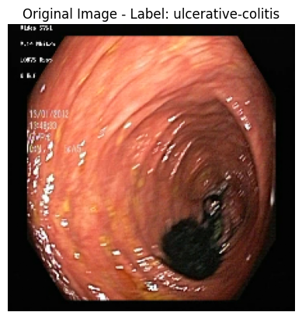
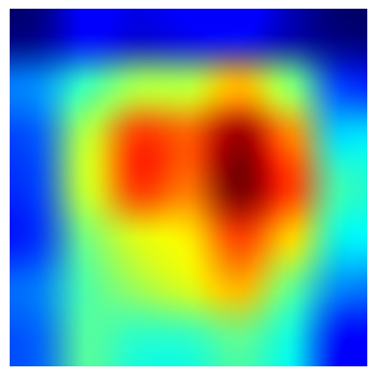
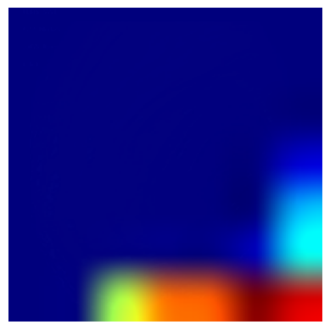
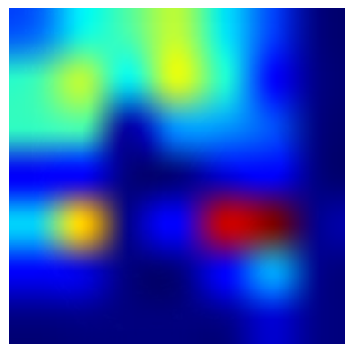
GRAD CAM VISUALIZATIONS.
Original Image
Image Under ResNet Model
Image Under CBAM Model
Image Under BAM Model

Slide 16
REFERENCES
GIT-Net: An Ensemble Deep Learning-Based GI Tract Classification of Endoscopic Images by Hemalatha Gunasekaran 1ORCID,Krishnamoorthi Ramalakshmi
Transformer-based multi-task learning for classification and segmentation of gastrointestinal tract endoscopic images by Suigu Tang a , Xiaoyuan Yu
Colorectal cancer prediction via histopathology segmentation using DC-GAN and VAE-GAN R. Sujatha1, Mahalakshmi
A New Approach for Gastrointestinal Tract Findings Detection and Classification: Deep Learning-Based Hybrid Stacking Ensemble Models by Esra Sivari 1,Erkan Bostanci
A Comprehensive Analysis of Deep Learning-Based Approaches for the Prediction of Gastrointestinal Diseases Using Multi-class Endoscopy Images by Sanjeev kumar , Yogesh kumar
Efficient Gastrointestinal Disease Classification Using Pretrained Deep Convolutional Neural Network by Muhammad Nouman Noor 1,Muhammad Nazir

Slide 17
THANK YOU

