Slide 1

States Incurring Losses
A small profit is better than a big loss. - By Ron Rash
Unicorn Company
Presented By:
Faustina
Megha
Sneha

Slide 2

Introduction
Uncovering where Unicorn is losing money and its solutions.

Slide 3
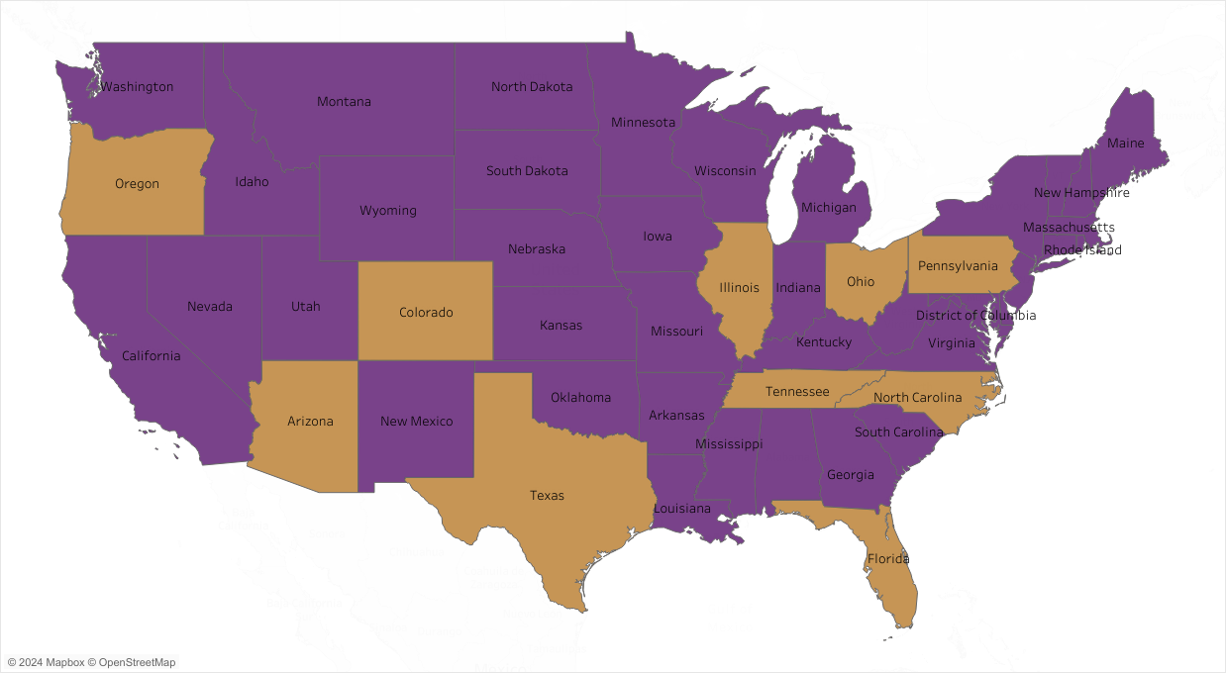
Profit & Loss By State
Loss
Profit

Slide 4
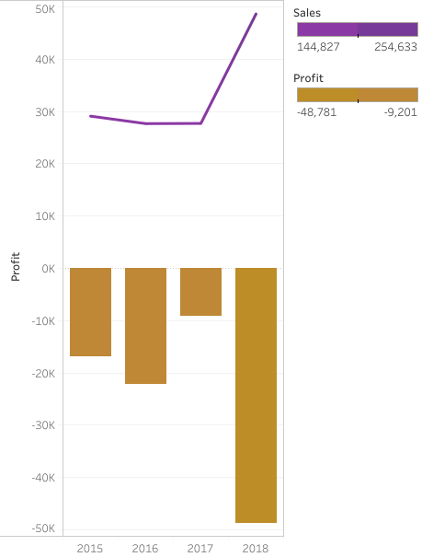
Investigating Negative correlation between sales and profit in 2015-2018 ( States in Losses)

Slide 5
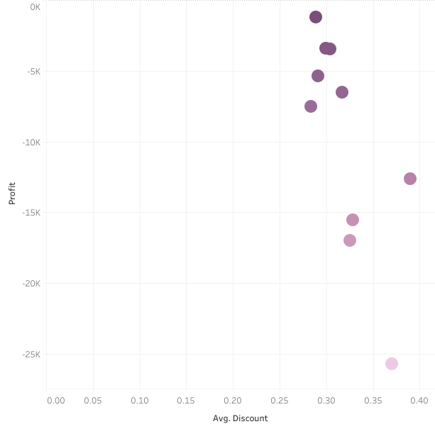
Negative correlation between Average Discount and Profit (States).
Illinois
Pennsylvania
Ohio
Texas

Slide 6
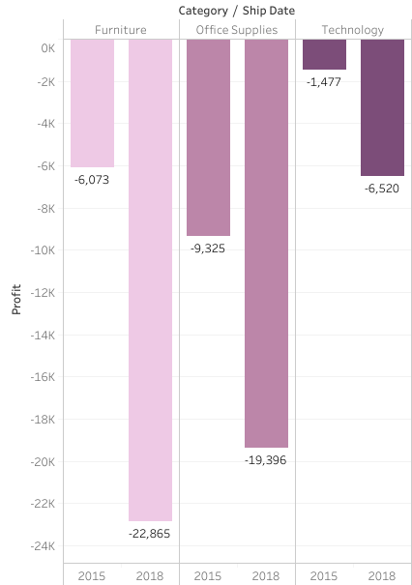
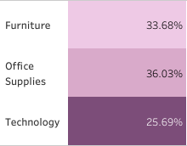
High discount rates incurring losses in all the categories.

Slide 7
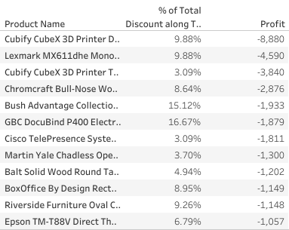
Furniture category products incur significant losses as a result of extensive discounting !

Slide 8
Recommendations
Conduct a comprehensive analysis of the states that are Incurring losses.
Delve deeper into the between Average discount/ Profit relationship in the Furniture category.
Investigate the worst performing products in this category.

