Slide 1

VECTOR
AI-Powered Quality Engineering pipeline

Slide 2

QE Challenges
• Analysis/planning/documentation →Time consuming
• Writing test cases → Inconsistent quality
• Automation creation → coding skills
• Bug reporting → Missing details
• Test maintenance → High effort
• Requirement changes → Rework
• Regression execution → Slow
• Knowledge dependency → High

Slide 3
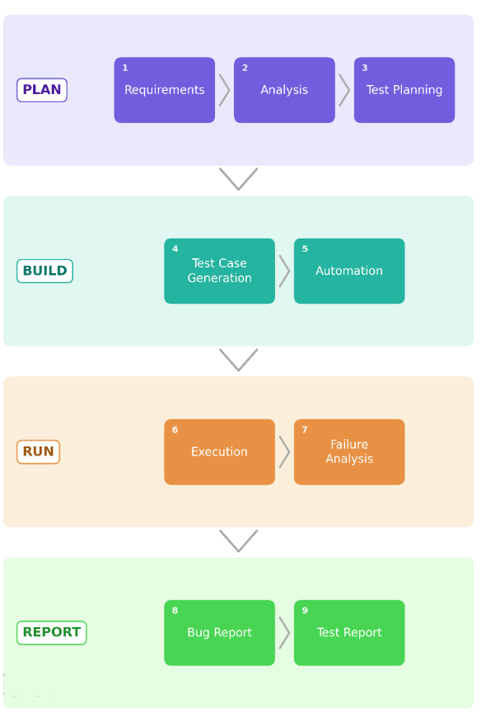
Vector – AI
Key phases

Slide 4
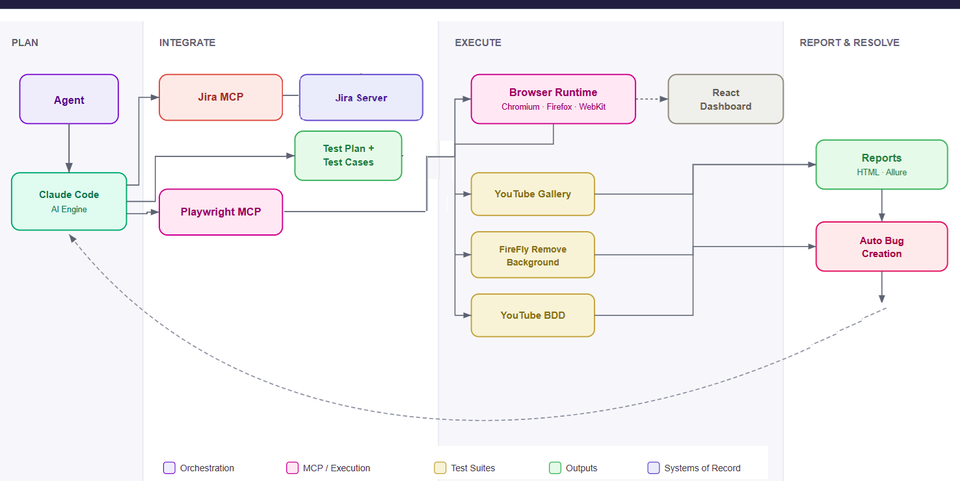

Slide 5
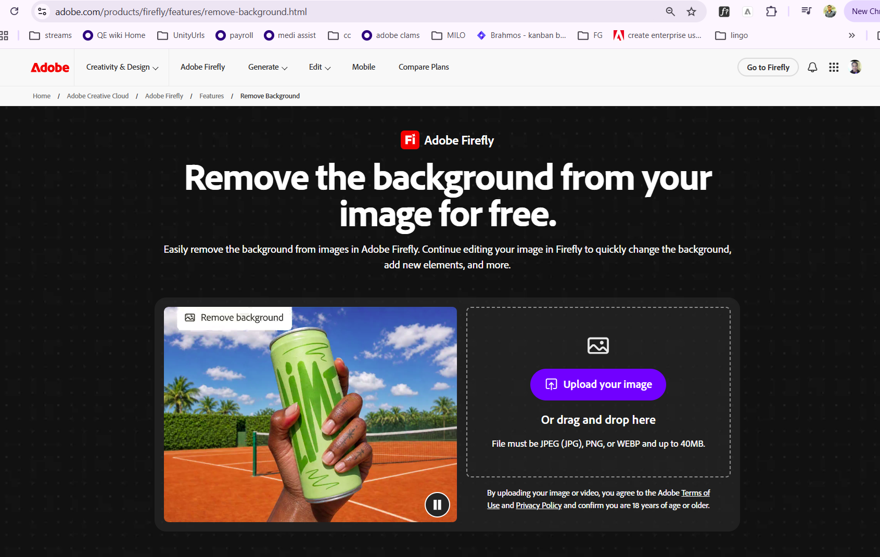
DEMO:
Doodle Bug Remove Back ground

Slide 6
Savings & metrics*
IMPACT FACTOR | MEASUREMENT | TARGET | Before / After
TEST planning | person hrs spent | 90% reduction | 1.5 Hrs / 5 mins
Test case creation | Time spent in hrs | 90% reduction | 2 hrs / 5 mins
Automation scripting | Time spent in hrs | 90% reduction | 10 hrs / 12 mins
Bug report | Time spent in hrs | 90% reduction | 30 mins / 2 mins
Retesting & Release | Time spent in hrs | 90% reduction | 2hrs / 15 mins

Slide 7

Complete workflow demo

Slide 8
QE teams are consistently expected to deliver high-quality releases within increasingly compressed timelines, while managing evolving requirements, extended regression cycles, and frequent end-to-end rework.
Successful delivery depends heavily on deep product knowledge, clearly defined quality requirements, and timely collaboration across multiple teams; however, gaps in these areas often create dependencies, delays, and execution risks.
To meet aggressive release commitments, we frequently rely on borrowed resources, which impacts productivity, increases onboarding effort, and makes it difficult to maintain consistent quality and delivery predictability.

