Slide 1
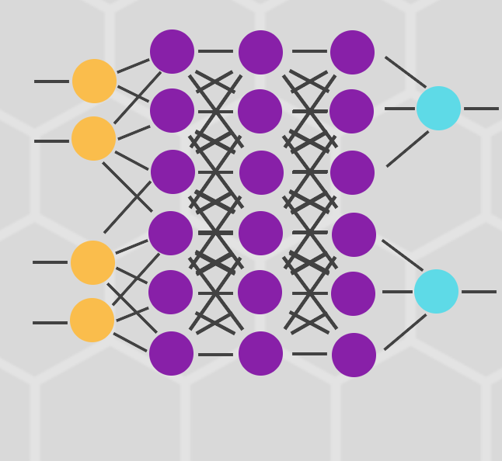

Artificial Neural Network
This Photo by Unknown author is licensed under CC BY.

Slide 2
What is Artificial Neural Network?
The term "Artificial neural network" refers to a biologically inspired sub-field of artificial intelligence modeled after the brain
An Artificial neural network is usually a computational network based on biological neural networks that construct the structure of the human brain
Like a human brain has neurons interconnected to each other, artificial neural networks also have neurons that are linked to each other in various layers of the networks
These neurons are known as nodes

Slide 3
What is Artificial Neural Network?
The term "Artificial Neural Network" is derived from Biological neural networks that develop the structure of a human brain
Similar to the human brain that has neurons interconnected to one another, artificial neural networks also have neurons that are interconnected to one another in various layers of the networks
These neurons are known as nodes

Slide 4
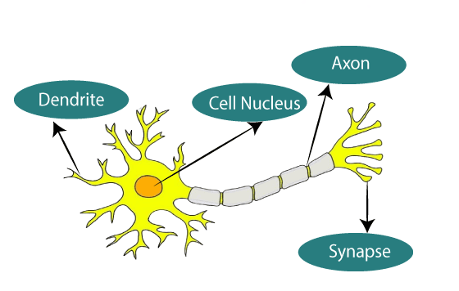
Typical diagram of Biological Neural Network

Slide 5
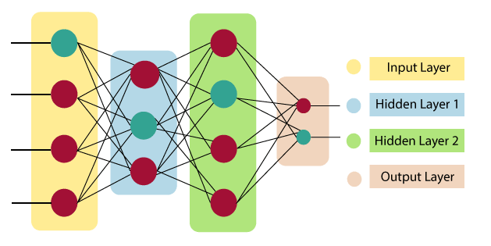
Artificial Neural Network primarily consists of three layers:

Slide 6
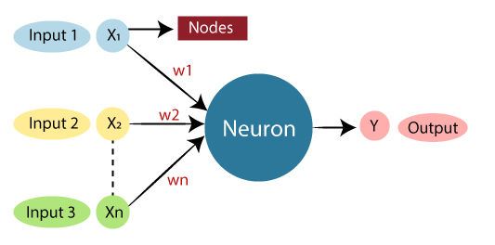
Typical diagram of Artificial Neural Network

Slide 7
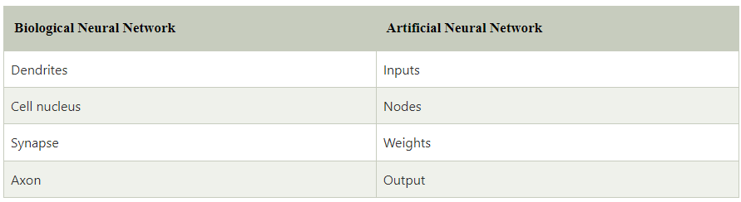
Typical diagram of Artificial Neural Network

Slide 8
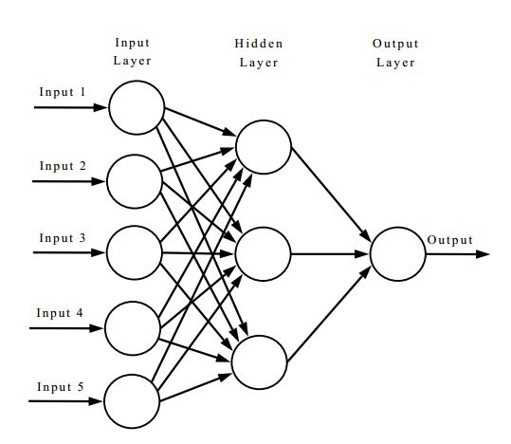
Biological Neural Network
Dendrites from Biological Neural Network represent inputs in Artificial Neural Networks, cell nucleus represents Nodes, synapse represents Weights, and Axon represents Output
This Photo by Unknown author is licensed under CC BY-SA.

Slide 9

ANN
An Artificial Neural Network in the field of Artificial intelligence where it attempts to mimic the network of neurons makes up a human brain
Computers will have an option to understand things and make decisions in a human-like manner
The artificial neural network is designed by programming computers to behave simply like interconnected brain cells

Slide 10
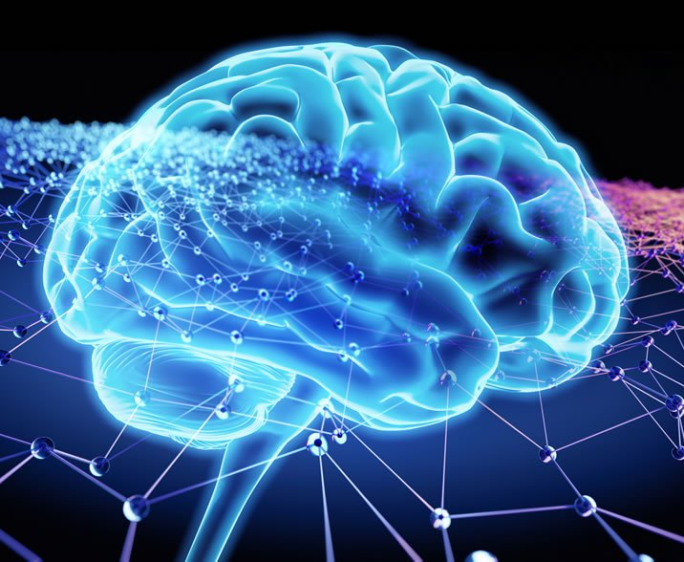
ANN
There are around 1000 billion neurons in the human brain
Each neuron has an association point somewhere in the range of 1,000 and 100
In the human brain, data is stored in such a manner as to be distributed, and we can extract more than one piece of this data when necessary from our memory parallelly
We can say that the human brain is made up of incredibly amazing parallel processors
This Photo by Unknown author is licensed under CC BY-SA.

Slide 11
The architecture
Input Layer
Hidden layer
Output layer
This Photo by Unknown author is licensed under CC BY-SA.

Slide 12




The architecture of an artificial neural network
In order to define a neural network that consists of a large number of artificial neurons, which are termed units arranged in a sequence of layers
Input Layer
As the name suggests, it accepts inputs in several different formats provided by the programmer
Hidden Layer
The hidden layer presents in-between input and output layers
Output Layer
The input goes through a series of transformations using the hidden layer, which finally results in output that is conveyed using this layer

Slide 13
The architecture of an artificial neural network
The artificial neural network takes input and computes the weighted sum of the inputs and includes a bias
It determines weighted total is passed as an input to an activation function to produce the output
Activation functions choose whether a node should fire or not
Only those who are fired make it to the output layer
There are distinctive activation functions available that can be applied upon the sort of task we are performing

