Slide 1


Understanding ANN Learning

Slide 2
Type of learning
Supervised learning
Unsupervised learning
Reinforcement learning

Slide 3




Supervised learning
Supervised learning consists of two words supervised and learning
Supervise intends to guide
We have supervisors whose duty is to guide and show the way
We can see a similar case in the case of learning

Slide 4
Supervised learning
Here the machine or program is learning with the help of the existing data set
We have a data set, and we assume the results of new data relying upon the behavior of the existing data sets
It implies the existing data sets acts as a supervisor or boss to find the new data
A basic example being electronic gadgets price prediction
The price of electronic gadgets is predicted depending on what is observed with the prices of other digital gadgets

Slide 5
Supervised learning
During the training of ANN under supervised learning, the input vector is given to the network, which offers an output vector
Afterward, the output vector is compared with the desired output vector
An error signal is produced if there is a difference between the actual output and the desired output vector
Based on this error signal, the weight is adjusted until the actual output is matched with the desired output

Slide 6





Unsupervised learning
As the name suggests, unsupervised learning refers to predict something without any supervision or help from existing data
In this learning, the program learns by dividing the data with similar characteristics into similar groups
In supervised learning, the data are grouped, relying upon similar characteristics
In this situation, there are no existing data to look for direction
In other words, there is no supervisor

Slide 7
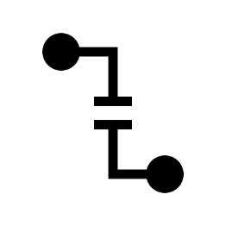
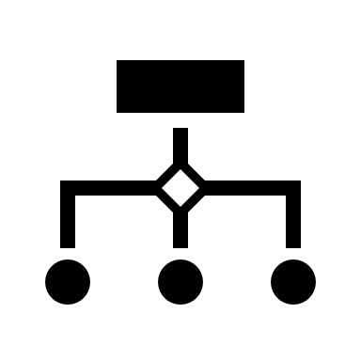


Unsupervised learning
During the training of the artificial neural network under unsupervised learning, the input vectors of a comparative type are joined to form clusters
At the point when a new input pattern is implemented, then the neural network gives an output response showing the class to which the input pattern belongs
There is no feedback from the environment about what should be the ideal output and if it is either correct or incorrect
Consequently, in this type of learning, the network itself must find the patterns and features from the input data and the connection for the input data over the output

Slide 8



Reinforcement learning
Reinforcement Learning is a technique that helps to solve control optimization issues
By using control optimization, we can recognize the best action in each state visited by the system in order to optimize some objective function
Typically, reinforcement learning comes into existence when the system has a huge number of states and has a complex stochastic structure, which is not responsible to closed-form analysis

Slide 9
Reinforcement learning
If issues have a relatively small number of states, then the random structure is relatively simple, so that one can utilize dynamic programming
As the name suggests, this kind of learning is used to strengthen the network over some analyst data
This learning procedure is like supervised learning
However, we may have very little information

Slide 10
Reinforcement learning
In reinforcement learning, during the training of the network, the network gets some feedback from the system
This makes it fairly like supervised learning
The feedback acquired here is evaluative, not instructive, which implies there is no instructor as in supervised learning
After getting the feedback, the networks perform modifications of the weights to get better Analyst data in the future

