Slide 1

SONAR IMAGE CLASSIFICATION & ANALYSIS
Objective:
Approach:
Automate the classification of underwater SONAR images to identify objects such as ships, mines, planes, humans, fishes and seafloor regions.
Apply transfer learning with established CNN backbones for classification.
Build a custom dataset by combining multiple publicly available SONAR sources.
Reduce reliance on manual inspection by building a reliable deep learning–based system.
Use augmentation and balancing strategies to overcome uneven class distributions.
Ensure the model’s outputs are interpretable, so that results can be trusted in critical applications.
Integrate Explainable AI tools (LIME & SP-LIME) to provide visual, human-understandable explanations for model predictions.

Slide 2
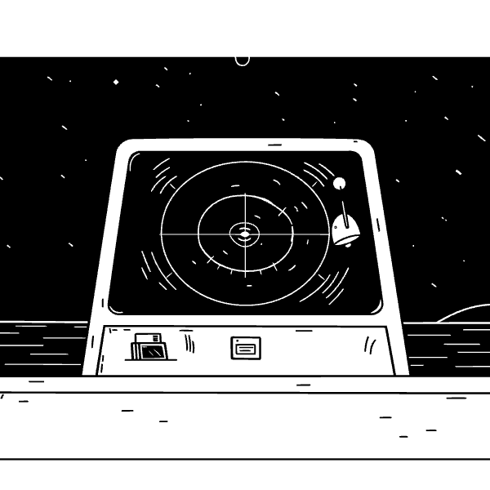
Problem & Relevance :
Why is it important?
What problem does this project address?
Enhances maritime security by enabling faster detection of threats such as mines.
Scientific/Technical: Automating the classification of underwater SONAR images with deep learning and explainability.
Supports ocean exploration & research, where accurate classification saves time and resources.
Business/Operational: Manual inspection is slow, inconsistent, and costly; automation can significantly improve efficiency.
Builds trustworthy AI systems by making predictions transparent through explainable AI.
Potential Use Cases :
Defense & Naval Security → Detecting suspicious underwater objects in real-time.
Marine Industry → Locating wrecks, pipelines, and underwater infrastructure.
Environmental Monitoring → Identifying fish populations, reefs, and ecological patterns.
Search & Rescue → Rapidly spotting aircraft or shipwreck debris and human divers in distress.

Slide 3

Scope
Implementation :
Web-based SONAR Classification System → Interactive React frontend with Node.js backend for real-time image upload and classification
Transfer Learning Implementation → DenseNet121 model fine-tuned on custom SONAR dataset with weighted cross-entropy loss
Explainable AI Integration → Grad-CAM visualizations to highlight important image regions for classification decisions
Custom Dataset Processing → Automated preprocessing pipeline for multi-source SONAR image datasets
In-Scope :
Out-of-Scope :
Six-class classification (Fish, Human, Mine, Plane, Seafloor, Ship)
Real-time SONAR hardware integration
Multi-object detection within single images
Real-time web interface for image upload and prediction
Advanced image enhancement techniques
Visual explanations through Grad-CAM heatmaps
Model performance metrics and confusion matrices

Slide 4

Proposed Solution
Enhanced Model Optimization
Weighted Cross-Entropy Loss: Implemented to address class imbalance, ensuring improved accuracy in rare class detection compared to standard categorical cross-entropy.
Scalable Web Application
Responsive React Frontend & Node.js Backend: Developed a modern web interface to make the model accessible via browsers, supporting seamless interaction with the system.
Improved Explainability
Grad-CAM Visualizations: Replaced traditional explainability techniques (LIME/SP-LIME) with Grad-CAM, offering faster, more intuitive, and accurate visual heatmaps to show decision-making regions in the model.
Production-Ready System
Containerized Deployment: Leveraged Docker for easy scalability and portability, enabling smooth deployment with REST API endpoints for integration with external systems.
OUTCOMES
Fully functional web application achieving >95% classification accuracy on SONAR images
Real-time explainable predictions with visual heatmaps showing decision-making regions
Comprehensive performance dashboard with metrics, confusion matrices, and model insights
Scalable system architecture ready for deployment in maritime security applications

Slide 5

Workflow
Input Layer
1
User uploads SONAR image through React web interface
Image validation and format checking
Automatic resizing to 224x224 pixels
2
Frontend (React)
Image preview and upload component
Real-time prediction display
Backend API (Node.js + Express)
3
Interactive Grad-CAM visualization
RESTful endpoints for image processing
Results dashboard with metrics
Image preprocessing pipeline
Model inference orchestration
4
ML Processing Pipeline
Response formatting and error handling
Preprocessing: Normalization, RGB conversion, tensor formatting
Classification: DenseNet121 with weighted cross-entropy loss
Output Delivery
5
Explanation: Grad-CAM heatmap generation
Class prediction with confidence percentage
Post-processing: Confidence scoring and result formatting
Grad-CAM heatmap overlay on original image
Classification probabilities for all 6 classes
Downloadable results and visualizations
Tech Stack Flow
Frontend: React → Axios HTTP client → REST API calls
Backend: Node.js → TensorFlow.js/Python bridge → Model inference
ML: Custom DenseNet121 → Grad-CAM → Visual explanations
Data Flow: Image upload → Preprocessing → Prediction → Visualization → User display

Slide 6





Conclusion & FUTURE work
High-Precision Classification Model
Enhanced AI Interpretability
Robust classification accuracy over 95% on diverse SONAR imagery, validating DenseNet121 efficacy for critical object identification.
Grad-CAM integrated for clear, visual explanations, significantly increasing trust and transparency in AI-driven decisions.
Production-Ready Web Application
Optimized Class Imbalance Handling
Containerized web platform developed for real-time SONAR image classification, ensuring scalable deployment and seamless user interaction.
Weighted cross-entropy loss mitigated class imbalance, ensuring reliable detection performance across all six target classes.

