Slide 1
Underwater image classification & analysis using explainable AI
Presented by: S. Neeraja Reddy – 23P81A0556
Team Name: G622
Mentor: Mrs. K. Navatha
Team Members:
S. Akshitha – 23P81A6747
G. Snehith – 23P81A6727
M. Sri Charan – 23P81A6737
B. Sri watsava – 23P81A6713
An end-to-end system for SONAR image classification using Deep Learning and Explainable AI to make underwater object detection accurate, secure, and interpretable.

Slide 2
Project Overview
Automated Sonar Analysis
AI-driven solution for automated classification of underwater SONAR images — identifying ships, mines, planes, fishes, humans, and seafloor elements with deep learning and explainable AI.
Secure Authentication
Implements Schnorr-based challenge–response cryptography for secure login and JWT token sessions, ensuring data integrity and authorized system access.
Web Platform
Built using React.js frontend, Express.js backend, and MongoDB database. Integrates with Google Colab ML API for real-time inference through RESTful endpoints.
Data Preprocessing
Preprocessing with Sharp for image resizing and noise handling before ML inference. Supports standard SONAR data formats with format validation and normalization
Model Inference
Transfer-learning CNN (DenseNet121) performs 6-class SONAR classification. Integrated LIME and Grad-CAM provide interpretability through visual explanations.
Explainable AI Integration
LIME highlights influential pixel regions; Grad-CAM generates heatmaps indicating decision regions — improving transparency and user trust in AI outputs.
Explainable AI Integration
LIME highlights influential pixel regions; Grad-CAM generates heatmaps indicating decision regions — improving transparency and user trust in AI outputs.
Performance
Achieved 90–97% classification accuracy with high precision and recall. Robust system performance validated through repeated testing.
f

Slide 3
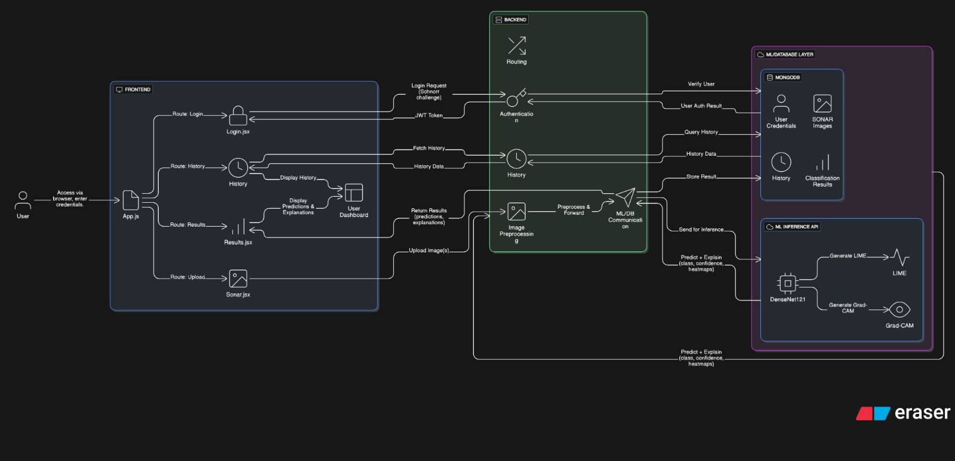
System Architecture

Slide 4
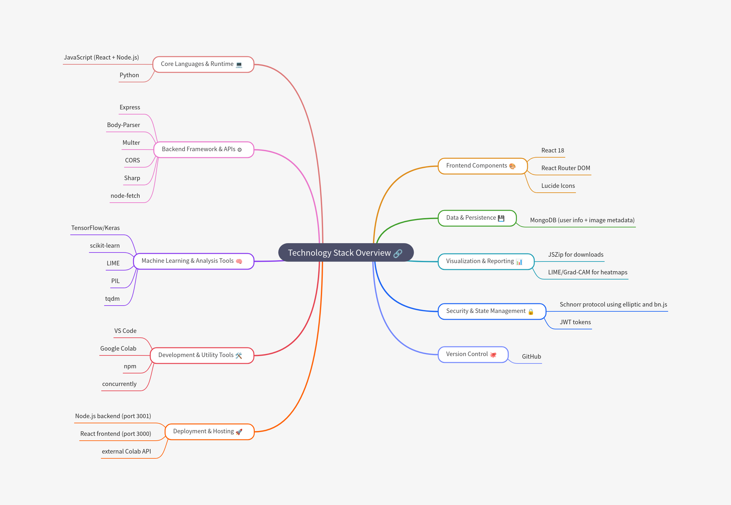
Technology Stack & Tools

Slide 5
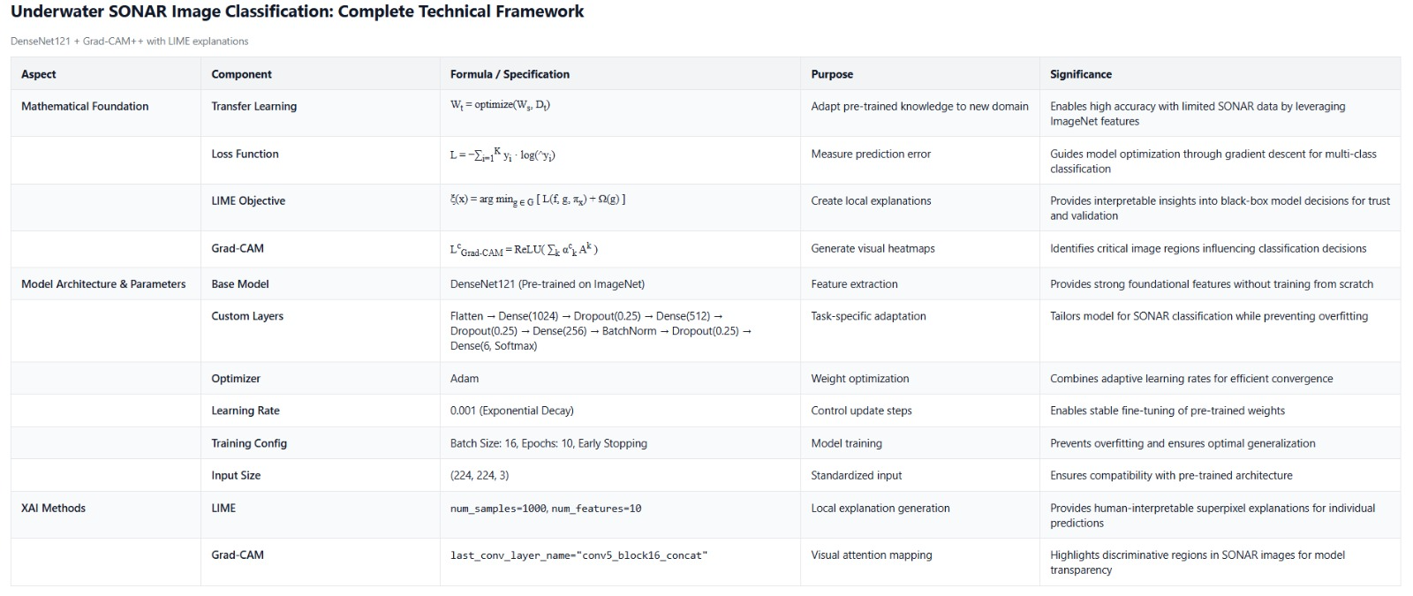
Mathematical Foundation

Slide 6
Demo

Slide 7
Improvements & Key Learnings
Key Learnings:
Enhanced understanding of multi-level AI pipelines, model tuning, and Explainable AI integration within a full-stack system.
Real-World Applications:
Automated SONAR image analysis for faster, explainable underwater object detection.
Performance Analysis:
Optimized DenseNet121 with balanced sampling, achieving higher accuracy and reduced inference time.
Improvements Made:
Tuned models, improved preprocessing, added secure login, modular backend, and interactive web interface with LIME & Grad-CAM.
Comparison with Original Paper:
Extended to a complete end-to-end deployable system with authentication, explainability, and history tracking.
Challenges & Solutions:
Tackled overfitting (dropout, augmentation), cleaned data formats, and resolved model loading & API sync issues.
Limitations & Future Work:
Currently limited to six object classes; plans to extend to more data types and multimodal fusion.
Key Learnings: Enhanced understanding of multi-level AI pipelines, model tuning, and Explainable AI integration within a full-stack system. | Performance Analysis: Optimized DenseNet121 with balanced sampling, achieving higher accuracy and reduced inference time. | Comparison with Original Paper: Extended to a complete end-to-end deployable system with authentication, explainability, and history tracking. | Limitations & Future Work: Currently limited to six object classes; plans to extend to more data types and multimodal fusion.
Real-World Applications: Automated SONAR image analysis for faster, explainable underwater object detection. | Improvements Made: Tuned models, improved preprocessing, added secure login, modular backend, and interactive web interface with LIME & Grad-CAM. | Challenges & Solutions: Tackled overfitting (dropout, augmentation), cleaned data formats, and resolved model loading & API sync issues.

