Slide 1

Customer Shopping Behavior — End-to-End Analytics
Python • MySQL • SQL • Power BI — analysis of 3,900 purchase records producing actionable business insights and a one-page Power BI dashboard.

Slide 2

Executive Summary
Dataset
High-level Metrics
3,900 records, 18 attributes covering demographics, products, spend, ratings, subscriptions, shipping, discounts, and frequency.
Total revenue $233,081; average purchase $59.76; average rating 3.75/5.
Top Insights
Clothing = largest revenue category; males account for larger share of revenue; subscribers do not outspend non-subscribers on average.

Slide 3
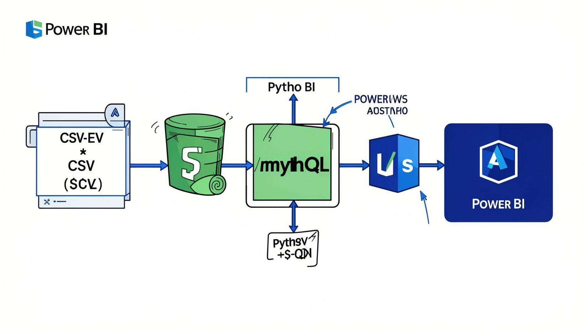
Project Objectives & Workflow
01
1. Data Prep
Load and inspect CSV with Python / Pandas.
02
2. Storage
Write cleaned data to MySQL (analysis.customer) via SQLAlchemy / PyMySQL.
03
3. Analysis & Viz
Run SQL queries for business questions and build a Power BI dashboard.

Slide 4
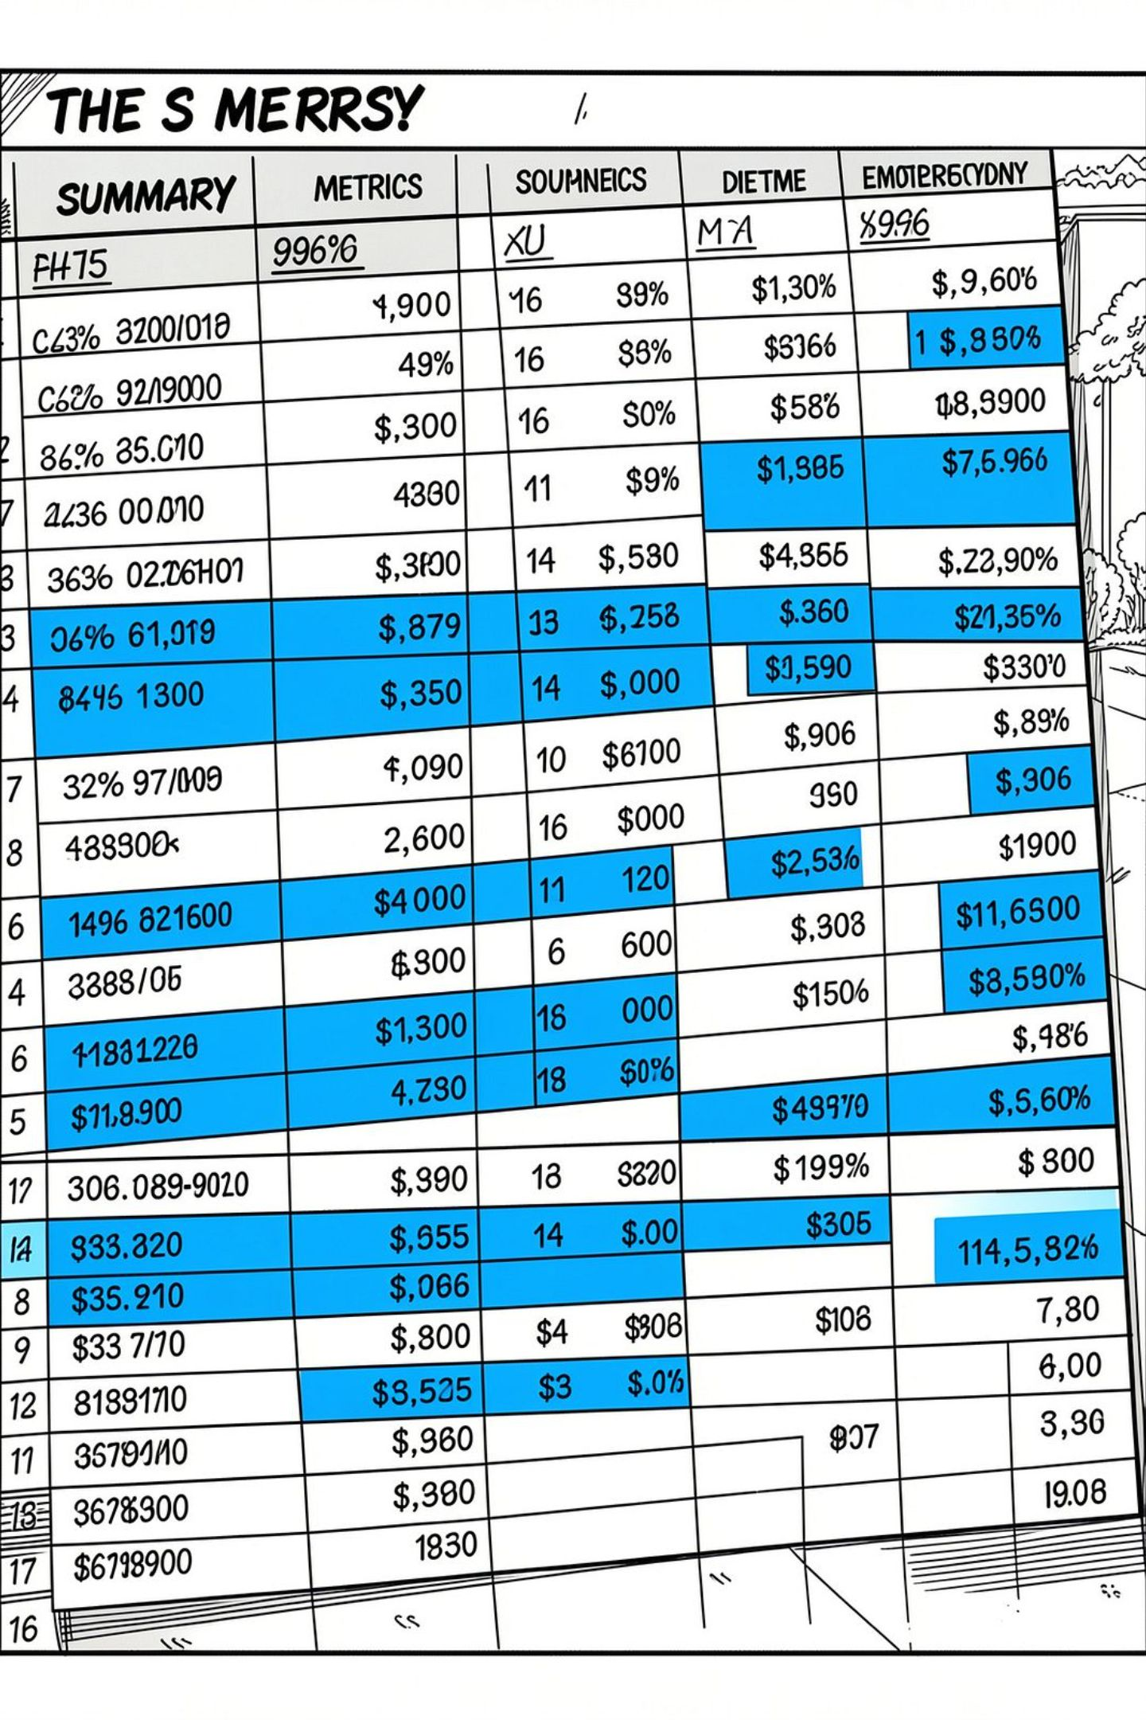
Dataset Overview — Key Metrics
3,900
Records
Rows in dataset
$233,081
Total Revenue
Recorded revenue
$59.76
Avg Purchase
Average transaction amount
3.75/5
Avg Rating
Average review score

Slide 5

SQL Findings — Revenue & Segments
Revenue by Gender
Male: $157,890 • Female: $75,191 — difference reflects totals, not per-customer causation.
Subscribers vs Non-Subscribers
No: 2,847 customers, avg $59.87, total $170,436. Yes: 1,053 customers, avg $59.49, total $62,645. Avg spend nearly identical.

Slide 6

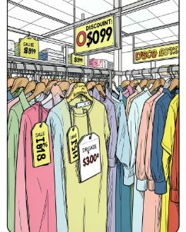
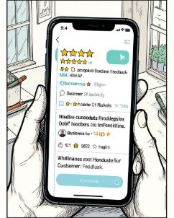
Product, Discounts & Ratings
Top Revenue Category
Discount Rates
Top Rated Products
Top discounted items: Hat (50%), Sneakers (49.66%), Coat (49.07%), Sweater (48.17%), Pants (47.37%).
Top 5 average ratings: Gloves 3.86, Sandals 3.84, Boots 3.82, Hat 3.80, Skirt 3.79.
Clothing generates the largest share of revenue, followed by Accessories, Footwear, Outerwear.

Slide 7
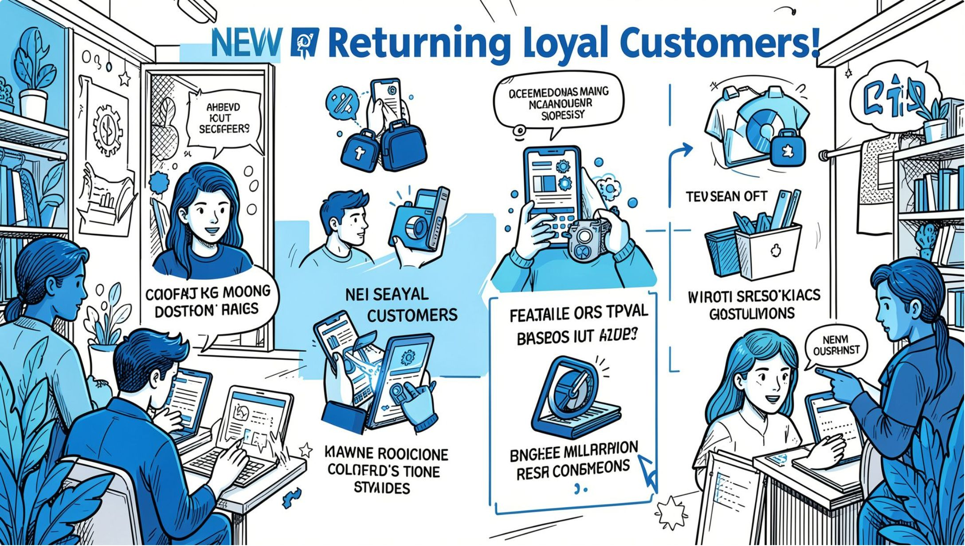
Behavioral Segmentation & Repeat Buyers
Customer Segments (corrected)
New (0–1 previous purchases): 83 • Returning (2–10): 701 • Loyal (>10): 3,116.
Repeat Buyers & Subscription
Customers with >5 previous purchases: Yes = 958 (27.6%), No = 2,518 (72.4%). Distribution mirrors overall subscription split.

Slide 8
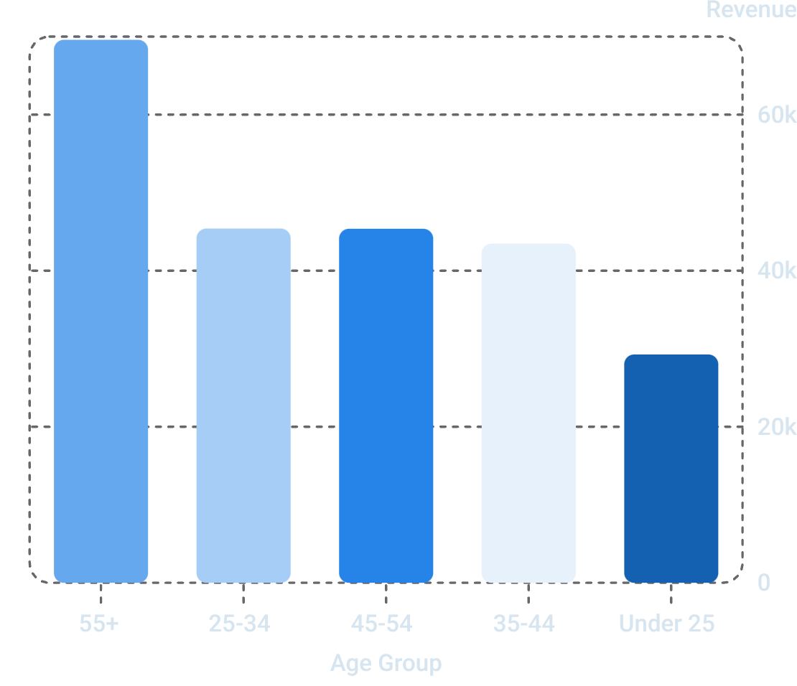

Age Group Revenue
Highest revenue comes from 55+ ($69,590). Use age segmentation in dashboard visuals; create explicit Age Group fields to avoid mismatched chart grouping.

Slide 9
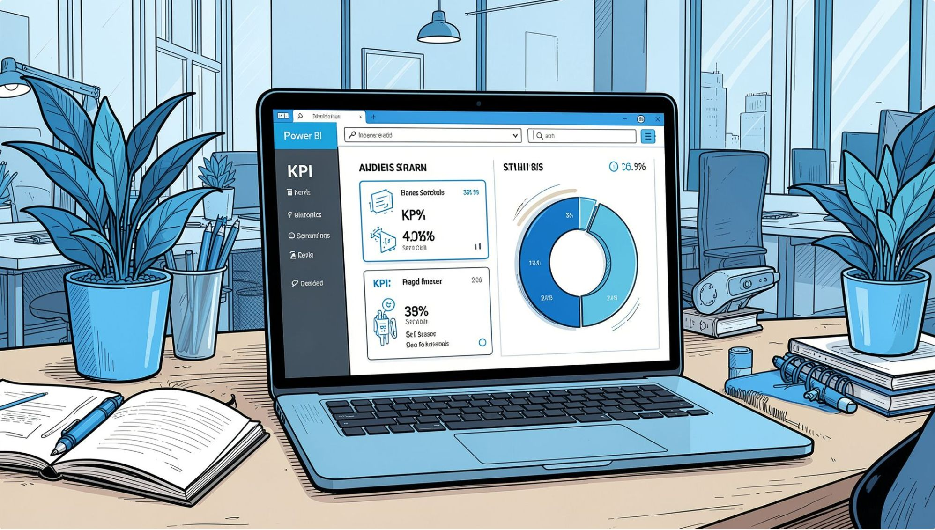
Power BI Dashboard & Quality Notes
One-page report: KPI cards, subscription donut, category revenue & sales charts, slicers, age visuals. Use an explicit Age Group column for correct grouping.
Include decision-focused KPIs and consistent metric naming.
Use informative tooltips and dedicated Age Group measures.

Slide 10


Recommendations, Limitations & Next Steps
Data & DB
Analytics
Standardize column names (e.g., purchase_amount); validate types during load; keep credentials out of notebooks (env vars / secrets manager).
Add date fields for time-series, analyze conversion by segment, compare discount effectiveness by product, margin, and repeat behavior.
Dashboard
Limitations
Use explicit Age Group fields, consistent naming, focused KPIs and clearer visuals to support decisions.
Snapshot data — no causation claims; revenue excludes cost/margin/returns; segmentation is rule-based and requires validation.

