Slide 1
Brain Tumour classification using Deep Learning Network

Slide 2
Abstract
The tumor is the undesired mass in the body. The brain tumor is the abnormal growth of brain cells and is hazardous for a patient, whether malignant or benign syndrome. It drags to a minutely minuscular life cycle in the highest degree. The manual method of classifying is difficult and time-consuming. Computer-Aided Diagnosis (CAD) system improves the classification accuracy of brain images. Magnetic Resonance Imaging (MRI) is the most suitable among other modalities. It is a non-intrusive procedure for obtaining high-resolution images of living tissues. MRI modalities produce varieties of tissue contrast images that provide essential structural information, enabling tumor diagnosis. In this work, we explored the deep learning network, ResNet-50, to extract the essential features required to classify brain MRI images. The proposed method's performance in terms of classification precision and accuracy is measured and satisfactory.
Keywords: brain tumor, malignant, benign, MRI, ResNet-50

Slide 3
Problem Statement
Manual method of classifying the Brain MRI images to detect tumor is difficult and time consuming. In this work, classification of brain MRI images for detection of brain tumor based on deep learning network, ResNet-50 is considered.

Slide 4
Objectives
To review the existing methods used for brain tumour classification.
To develop efficient algorithm using deep learning network for Brain tumour classification.
Scope
The dataset is limited to MRI images of Human brain.
The model will classify whether tumour is present or not.

Slide 5
Life Cycle Model
Brain MRI Data set Collection
Designing the Model
Training the ResNet Model
Testing the Model
Improving the accuracy of the model
Analysing and Pre-processing
Notes:
Designing the model with suitable model parameters
Accuracy improvement may be obtained by fine tuning the model hyper parameters.

Slide 6
Requirements
Hardware Requirements
RAM 4GB
Disk Space 2GB
Software Requirements:
Python -3.6
Numpy, Pandas, Matplotlib
Opencv(cv2), tensor flow, sklearn

Slide 7
Data set
The data set we have used are obtained from The Cancer Imaging Archive (TCIA).
TCIA is a service which de-identifies and hosts a large archive of medical images for public download.
Data set correspond to Brain MRI images together with manual FLAIR abnormality segmentation masks
Images are genomic data of 110 patients from 5 institutions with lower-grade gliomas from The Cancer Genome Atlas.

Slide 8
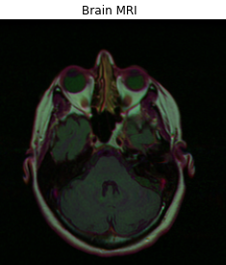
Data set
Fluid-attenuated inversion recovery (FLAIR) is an MRI sequence with an inversion recovery set to null fluids.
The MRI images are Tag Image File (.tif) format[9].
The dataset has 3929 images which are divided into train and test in 85 and 15 percentage ratio.

Slide 9
Methodology
Data Pre-processing
Feature Extraction
Detection of the tumour
Classification of the tumour

Slide 10
Methodology
Data Pre-processing
Pre-processing of dataset is an important step in advance to the training, validation and testing phases of model on images.
In the dataset we have brain MRI images and there corresponding Segmented images
These brain MRI images are normalized by rescaling them into the 0 and 1 range.
Brain MRI Images of 255x255 size
Normalizing the Images
Rescaled Images

Slide 11
Methodology
The dataset has 3929 brain MRI images in (.tif) format
It is divided into train set and test set in 85 and 15 percentage ratio.
From train data 15 % of images are used for validation.
The MRI classifier model is trained with the train data which has 3006 images.
The model is trained with then validated using data which has 333 images
The classifier model is then tested with the test data which has 590 images
Brain MRI Images
Training set
Validation set
Testing set

Slide 12
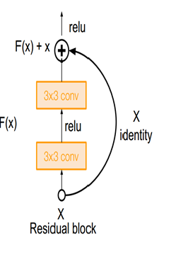
Methodology
Feature Extraction and Detection of the tumour
Before performing feature extraction images are split into three sets as training, validation and testing.
ResNet50 is used to extract the features from the Images.
ResNet-50 is Residual network with 50 layers. And it is called Residual because we have Skip connections.
From the obtained features we detect the tumor location
Normalized Brain MRI Images
ResNet50
Feature Vectors
Detection of tumor

Slide 13
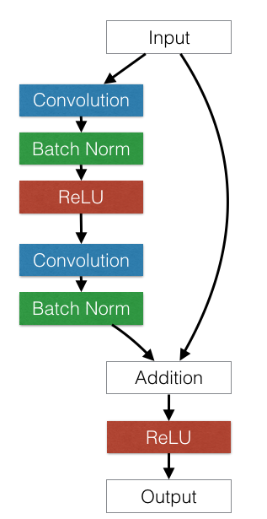
Methodology
For our model we use the following layers for extract the features
In Convolution layer the AveragePooling2D calculates the average value for each patch on the feature map.
Flatten, which adds an extra channel dimension, but doesn’t affect the batch size.
Dense function is used to implements the operations Relu.
Relu outputs the input image if the value is positive else it gives Zero.

Slide 14
Methodology
Classification of the image
In general in Neural networks as the number of layers increases the it becomes difficult to train the network.
So here we used callback is an object that can perform actions at various stages of training i.e., at the start or end of an epoch, before or after a single batch.
EarlyStopping, ModelCheckpoint are the classes used for callback.
Finally we test the model by using the test data, which we created in the earlier stage.
Tumor is present
Test the model
Tumor is not present

Slide 15
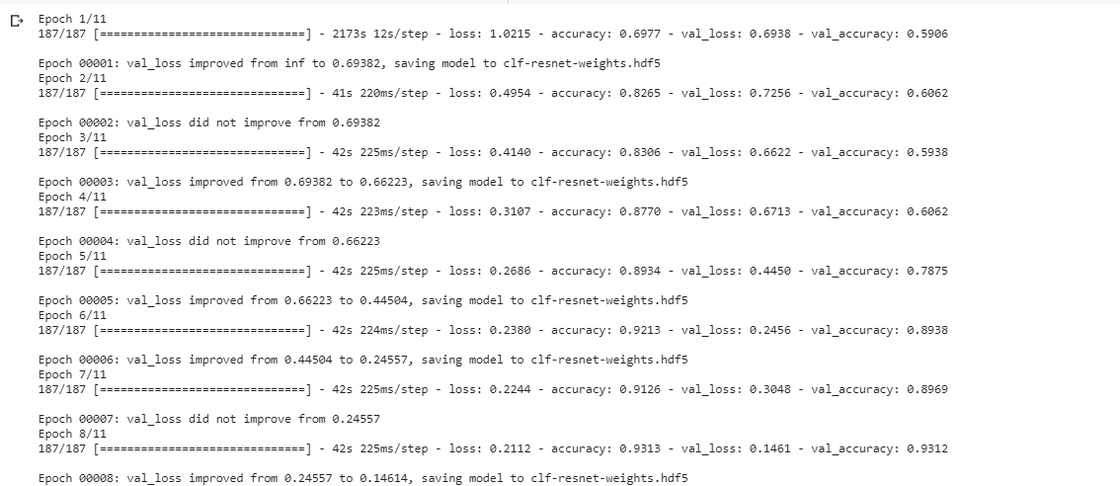
Result and Analysis
Training the model

Slide 16
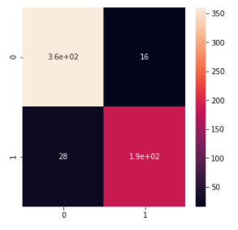
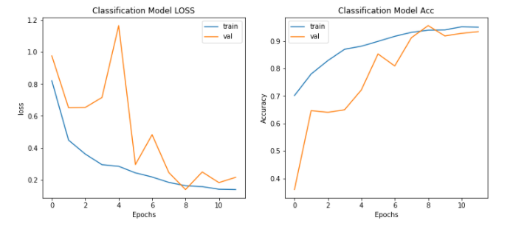
Result and Analysis
Model accuracy
Confusion matrix

Slide 17
Conclusion and Future Work
Our current work detected the tumor if present with a test accuracy of 92.54 from Brain MRI Images using a pre-trained Deep Neural network architecture Residual Network(ResNet-50).
In Major Project, We want to classify MRI images into multiple classes, namely glioma, meningioma and pituitary tumor, which are different variants of the tumor.

