Slide 1
Detection of GAN Generated Fake Satellite
Images using Deep Learning

Slide 2
Abstract
Fake Images generation has become a common practice nowadays and this process has become elementary with the advent of Generative Adversarial Networks. Even though counterfeit images are entertaining and have their advantages, they also have some adverse effects. Satellite images, in general, provide essential information that helps in monitoring various applications such as spatial resolution, Spectral characteristics and Sensor Sensitivity, etc. From these images, essential features required for multiple applications can be obtained on an immense scale. However, manipulating these images by removing, adding, or cloning objects leads to misconceptions of reality. Our proposed objective is to detect these kinds of counterfeit Satellite images. To identify the fake images, we employ deep learning architectures, which will distinguish original and counterfeit Satellite images.
Keywords: Deep Learning, GANs, Neural Network, Handcrafted features, Residual Network.

Slide 3
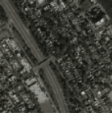
Introduction
Satellite images are one of the most powerful and important tools used by the meteorologist. They are essentially the eyes in the sky and they give a good representation of what is happening at every point in the world. In order to produce images by feeding the characteristics of the learned satellite image properties onto a different base map synthetic images are created using the Generative Adversarial Networks, which contains generator and discriminator networks. The generator, which creates the phony multimedia content, asks the discriminator to determine whether the content is real or artificial.
Fig 1. Satellite Image

Slide 4
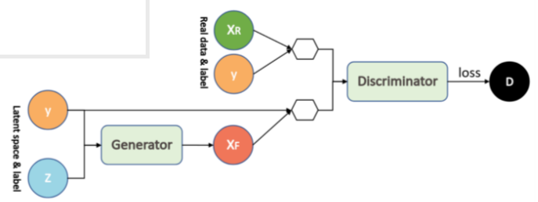
Pix2Pix GAN
Pix2Pix is a Generative Adversarial Network, or GAN, model designed for general purpose image-to-image translation. The Pix2Pix model is a type of conditional GAN, or cGAN, where the generation of the output image is conditional on an input, which is a source image. The discriminator is provided both with a source image and the target image which is generated by the generator and must determine whether the target is a plausible transformation of the source image.
Fig 2. Pix2Pix GAN ^{[1]}

Slide 5
GLCM
A statistical method of examining texture that considers the spatial relationship of pixels is the gray-level co-occurrence matrix (GLCM), also known as the gray-level spatial dependence matrix.
The GLCM functions characterize the texture of an image by calculating how often pairs of pixel with specific values and in a specified spatial relationship occur in an image, creating a GLCM, and then extracting statistical measures from this matrix.

Slide 6
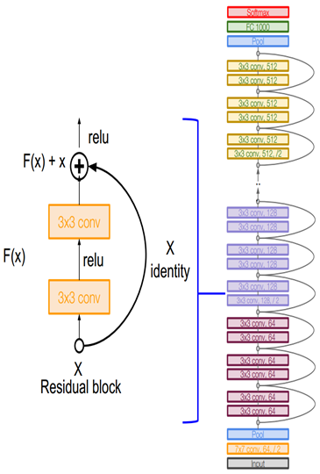
ResNet
● ResNet, which was proposed in 2015 by researchers at Microsoft Research introduced a new architecture called Residual Network.
● In order to solve the problem of the vanishing exploding gradient, this architecture introduced the concept called Residual Network. In this network we use a technique called skip connections .
● The skip connection skips training from a few layers and connects directly to the output.
Fig 3. ResNet Architecture ^{[2]}

Slide 7
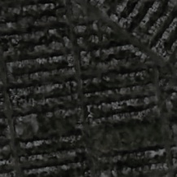
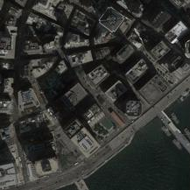
Data Collection
The dataset consists of 4388 images which are both original and fake images out of which 2194 are GAN generated images.
The coloured image is of size 217 X 217 pixels.
The images are in both “.png” and “.jpg” formats.
Fig. 4(a) Fake Satellite Image
Fig. 4(b) Original Satellite Image ^{[5]}

Slide 8
Methodology
Fake Image Generation
Features Extraction
Combining Handcrafted features and ResNet Features
Classification of Fake Satellite Images

Slide 9
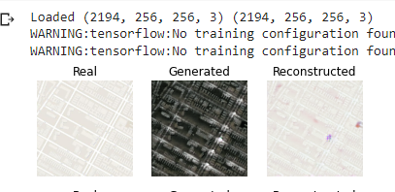
Fake Image Generation
Each image will be loaded, rescaled, and split into the satellite and Google map elements. The result will be colour image pairs with the width and height of 256×256 pixels.
The encoder and decoder of the generator are comprised of standardized blocks of convolutional, batch normalization, dropout, and activation layers.
Training the Pix2Pix model results in many saved models and samples of generated images for each. The Best Model is chosen based on the quality of the generated images and it is used to perform image-to-image translation.
Fig. 5 Fake Image generation

Slide 10
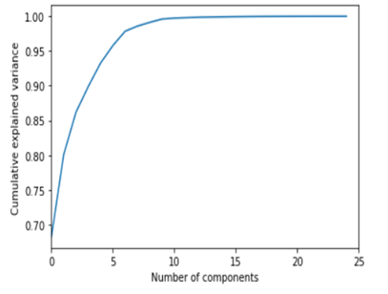
Features Extraction
GLCM technique is employed here, where Angular Second Moment of GLCM, Contrast of GLCM, Entropy of GLCM, Inverse Different Moment of GLCM for describing the colorfulness and to measure the clarity of images .
Similarly the four quadratic statistics were recalculated based on GLCM of frequency spectra to describe the frequency characteristics namely FASM, FCON, FENT, FIDM.
In Histogram domain the features taken are Mean, STD, SKEW, KURT, GET and three color moments CM1, CM2, CM3.
Principal Component Analysis which does dimensionality reduction to obtain the best features from the above 26 features that are considered from the three domains.
Fig. 6 Features Variance Ratio

Slide 11
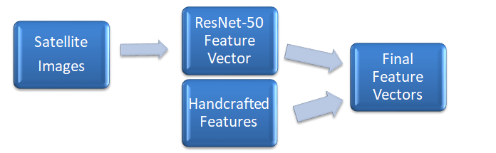
Combining Handcrafted and ResNet Features
Her initially ResNet-50 is pre-trained with the Imagenet weights.
The ResNet -50 is used to extract the features and the feature vector is of size 4388X 2048.
Now the 9 handcrafted features are combined with the ResNet features.
The resultant feature vector size is 4388X2057.
Fig.7 Combining Handcrafted and ResNet Features

Slide 12
Classification of Fake Satellite Images
The Dataset is divided into train set and test set in 80 and 20 ratio and shuffled.
To stop the model to over fit a dropout layer is added.
Finally a dense layer is added where the activation function Sigmoid is used as binary classification is performed, the Last layer of ResNet-50 performs classification.
Here Adam optimizer is employed and learning rate is set to 0.01
ReduceLROnPlateau is used which is a call back that reduce the learning rate when a metric has stopped improving
ModelCheckpointer is used to save the best model weights.
Finally we test the model by using the test data, which we created in the earlier stage.

Slide 13
Algorithm for Classification of Fake Satellite Images
Step 1: Load the CSV file which contains image paths and class labels.
Step 2: Rescale the Satellite images.
Step 3: Divide the dataset into train and test sets in 80% and 20% ratio.
Step 4: Now again divide train set in validation in 90% and 10% ratio.
Step 5: Extract features from the images using ResNet
Step 6: Combine the ResNet features and Handcrafted features
Step 7: Define the callbacks namely EarlyStopping and ModelCheckpoint
Step 8: Train the Model on the Train data.
Step 9: Finally test the Test set on the trained model.

Slide 14
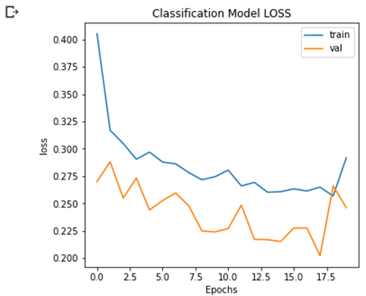
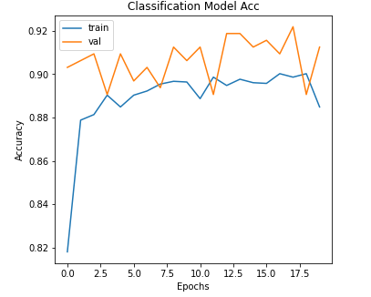
Results and Analysis
Fig. 8(a) Model Loss Curve
Fig. 8(b) Model Accuracy Curve

Slide 15
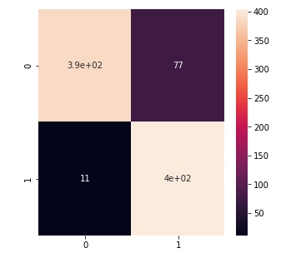
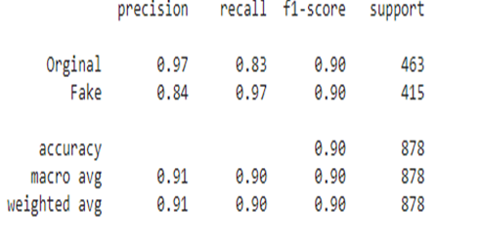
Results and Analysis
Fig. 9 Confusion matrix
Fig.10 Performance metrics

Slide 16
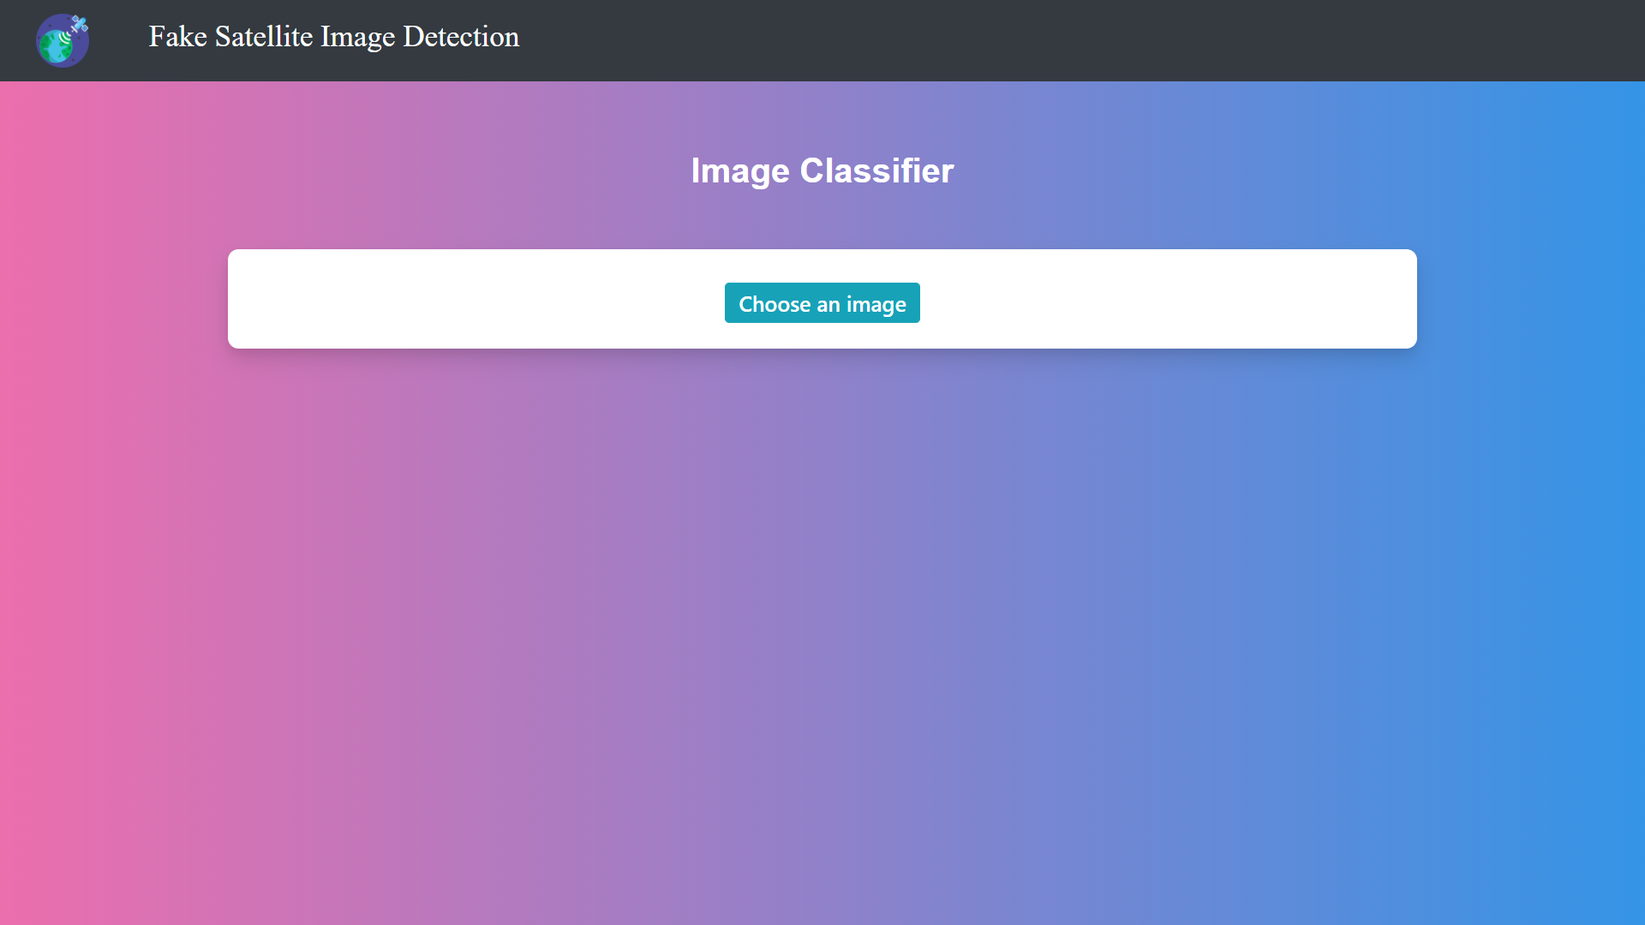
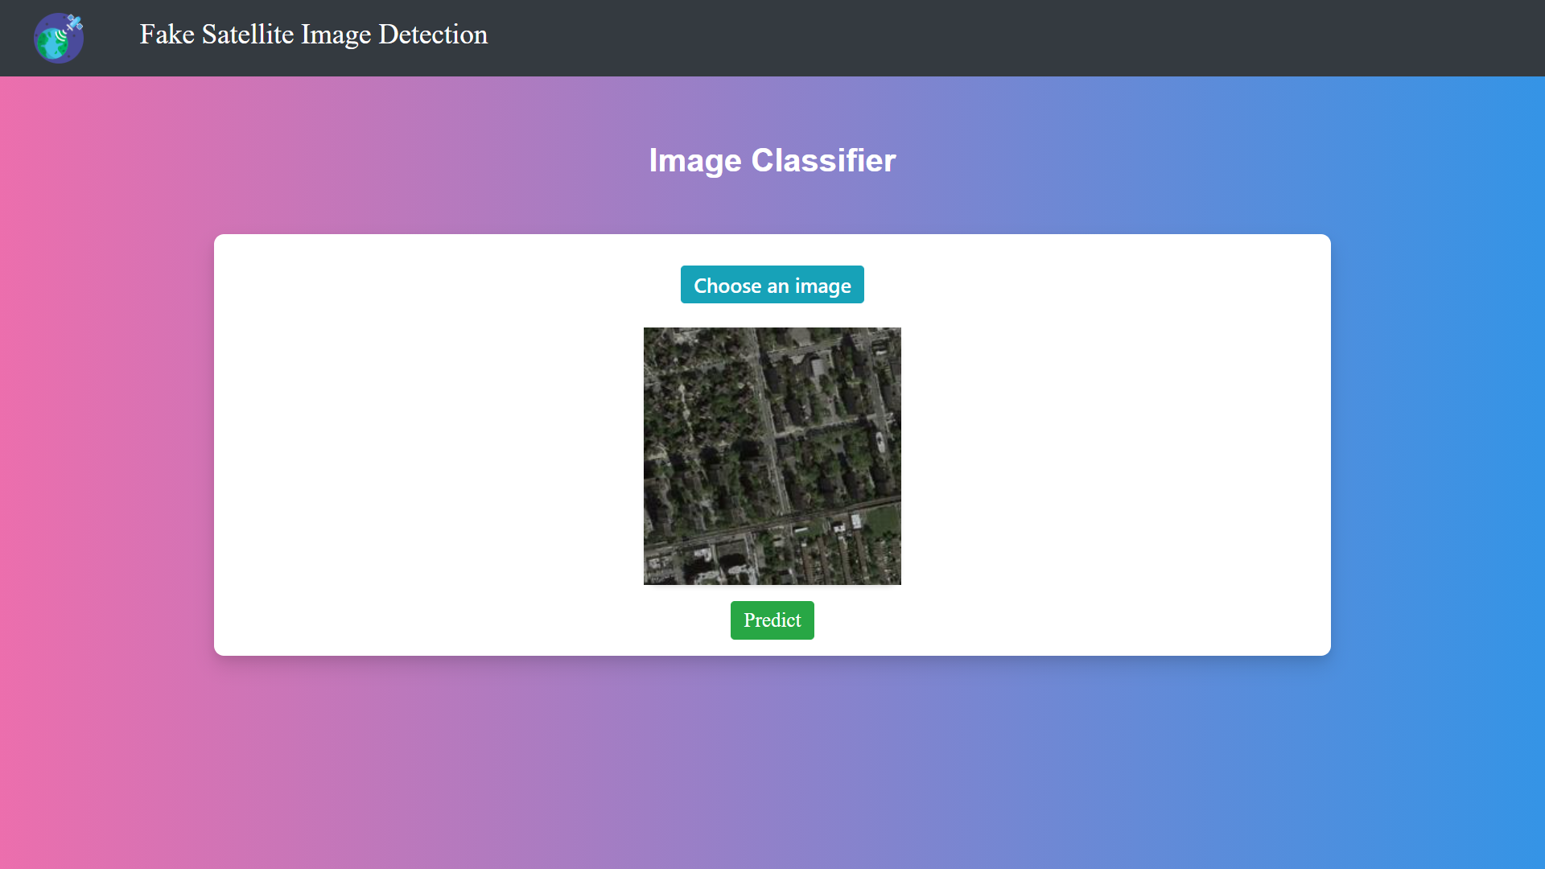
Results and Analysis
Fig. 11 GUI Output Screens

Slide 17
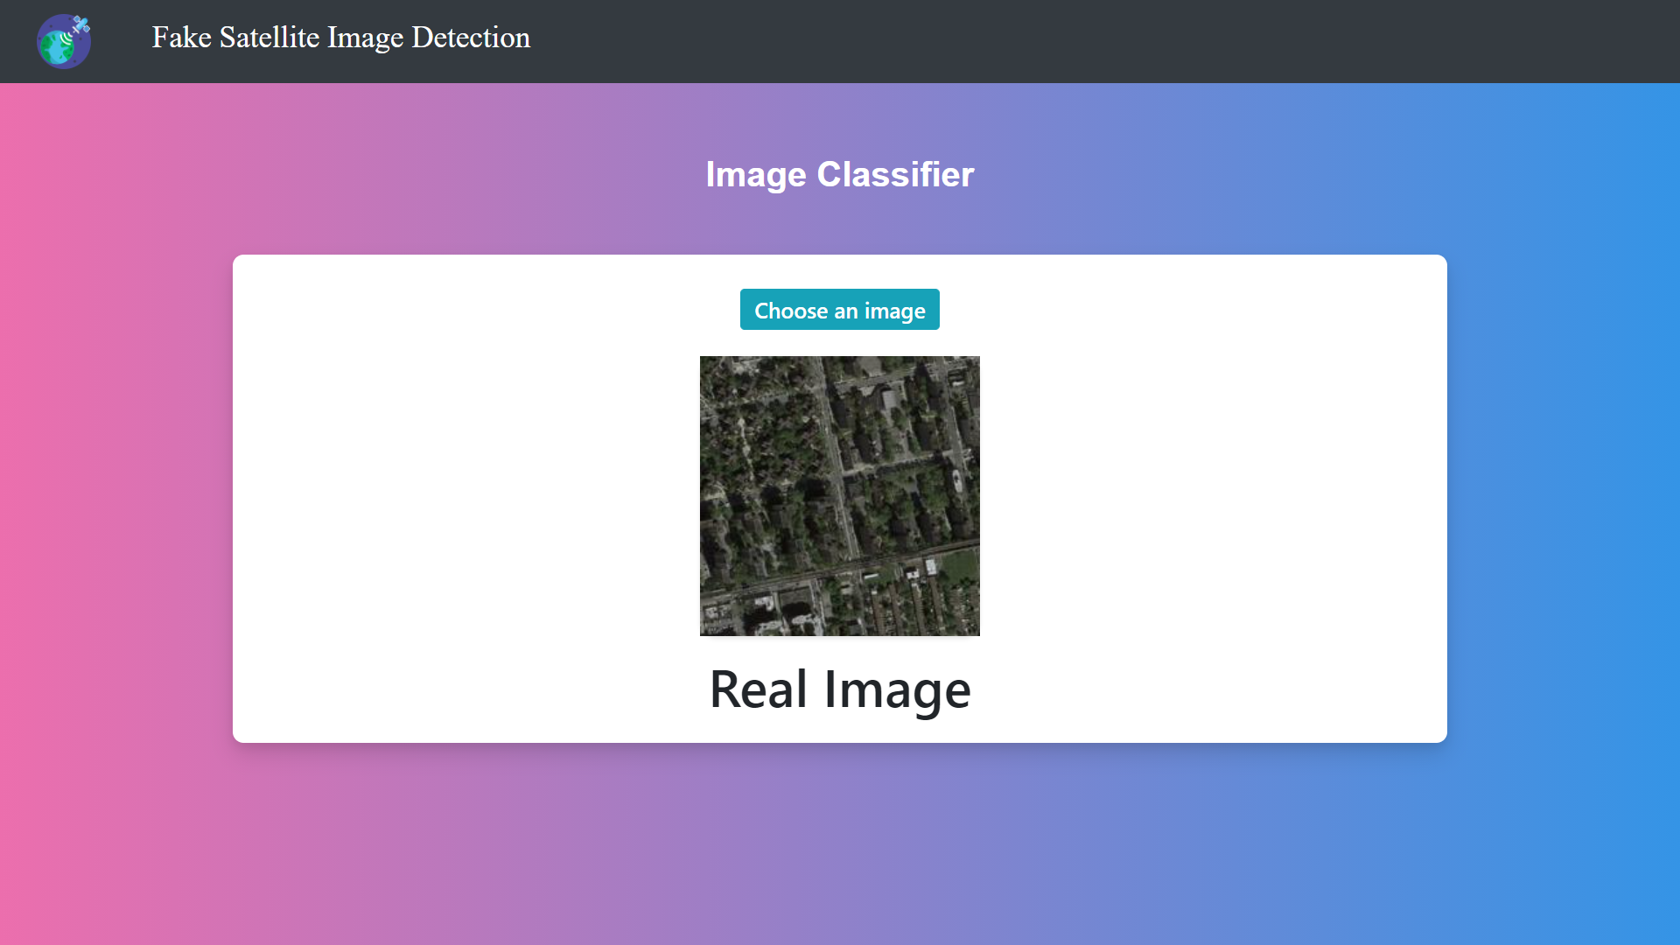
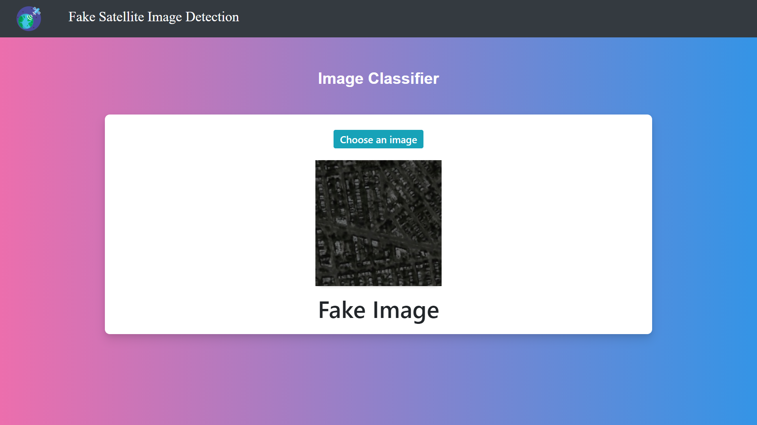
Results and Analysis
Fig. 12 Prediction of Satellite Images

Slide 18
Conclusion and Future Work
The proposed model classifies a Satellite image as real or fake. It detects fake satellite images generated by Pix2Pix GAN with test accuracy of 92% using Residual Network (ResNet50). By combining the Handcrafted features are extracted from the satellite images with ResNet features resulted in best performance. In future work we would like to incorporate fake images generated by different GANS and also use advanced deep learning models for improving the model performance.

Slide 19
References
[1] P. Isola, J. Zhu, T. Zhou and A. A. Efros- “Image-to-Image Translation with Conditional Adversarial Networks”. IEEE Conference on Computer Vision and Pattern Recognition (CVPR), 2017, pp. 5967-5976.
[2] K. He, X. Zhang, S. Ren and J. Sun -“Deep Residual Learning for Image Recognition” in 2016 IEEE Conference on Computer Vision and Pattern Recognition (CVPR).
[3] Zhao, Bo, Shaozeng Zhang, Chunxue Xu, Yifan Sun, and Chengbin Deng. "Deep fake geography? When geospatial data encounter Artificial Intelligence." Cartography and Geographic Information Science 48, no. 4 (2021).
[4] Z. Mi, X. Jiang, T. Sun and K. Xu, - "GAN-Generated Image Detection With Self-Attention Mechanism Against GAN Generator Defect," in 2020, IEEE Journal of Selected Topics in Signal Processing
[5] Dataset accessed from https://tariq-hasan.github.io/assets/images/resnet.png , Last Accessed on 10th January 2022.

Slide 20
References
[6] Guarnera, Luca & Giudice, Oliver & Battiato, Sebastiano,- “Fighting Deepfake by Exposing the Convolutional Traces on Images” in 2020, IEEE Access (Volume 8), Electronic ISSN: 2169-3536
[7] A. Parekhji, M. Pandya and P. Kanani, "Comparing GANs for Translating Satellite Images to Maps," 2021 5th International Conference on Computing Methodologies and Communication (ICCMC), 2021, pp. 1267-1274, doi: 10.1109/ICCMC51019.2021.9418017.
[8]. S. Sehgal, H. Singh, M. Agarwal, V. Bhasker and Shantanu, "Data analysis using principal component analysis," 2014 International Conference on Medical Imaging, m-Health and Emerging Communication Systems (MedCom), 2014, pp. 45-48.
[9] Nanni, Loris, Stefano Ghidoni, and Sheryl Brahnam. "Handcrafted vs. non-handcrafted features for computer vision classification." Pattern Recognition 71 (2017): 158-172.
[10] Goodfellow, I.J., Pouget-Abadie, J., Mirza, M., Xu, B., WardeFarley, D., Ozair, S., Courville, A. and Bengio, Y., 2014. Generative adversarial networks.

