Slide 1
AI ASSIGNMENT -2

Slide 2
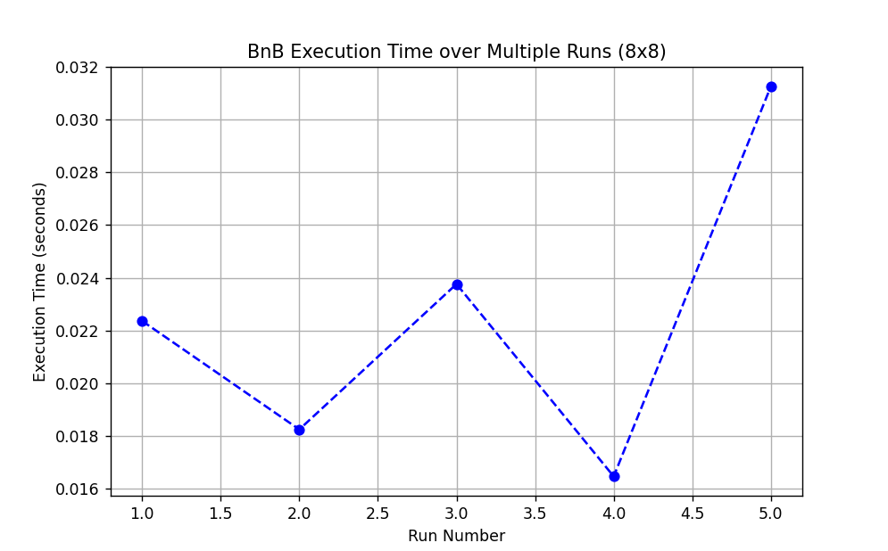
DFS Branch and Bound
Average Time: 0.0224sec

Slide 3
Reasons for BnB's Performance
Doesn't use heuristics, so it explores more paths.
Follows a depth-first approach, which can lead to dead ends.
Pruning is only effective after finding a good solution early.
Struggles in environments like Frozen Lake with many traps.
Comparison with IDA*
Slower (0.0224s vs. 0.0075s) due to uninformed search.
Explores more paths than IDA*, which uses heuristics.
Higher variation across runs due to deeper and broader search.
Less efficient at avoiding dead ends.

Slide 4
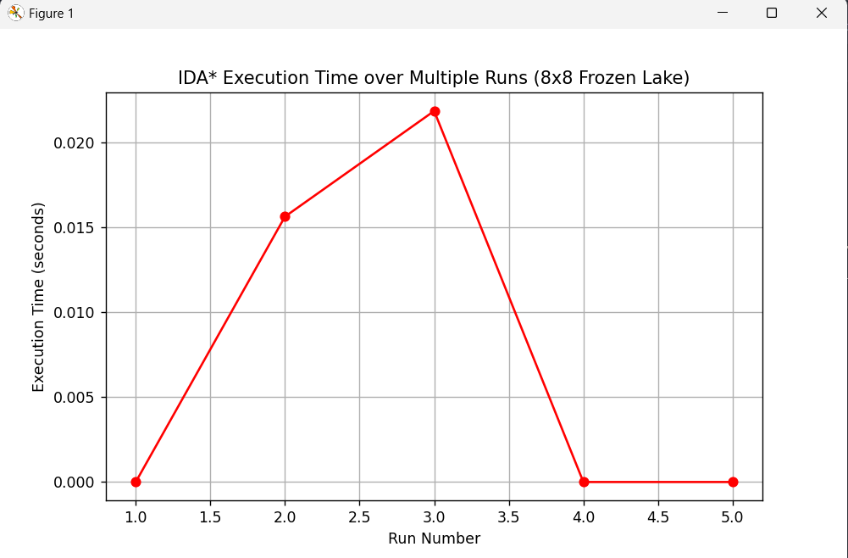
Iterative Deepening A* (IDA*)
Average Time: 0.0075sec

Slide 5
Heuristic used: Manhattan distance
Reasons for IDA's Performance*
Uses heuristics (e.g., Manhattan distance) for guided search.
Memory-efficient and fast in grid environments.
Re-explores some paths, but overhead is small on 8x8 grids.
Consistently fast with low average runtime.
Comparison with BnB
Faster and more consistent due to heuristic guidance.
Avoids traps and dead ends more efficiently.
Explores fewer nodes than BnB.
Better suited for structured environments like Frozen Lake.

Slide 6
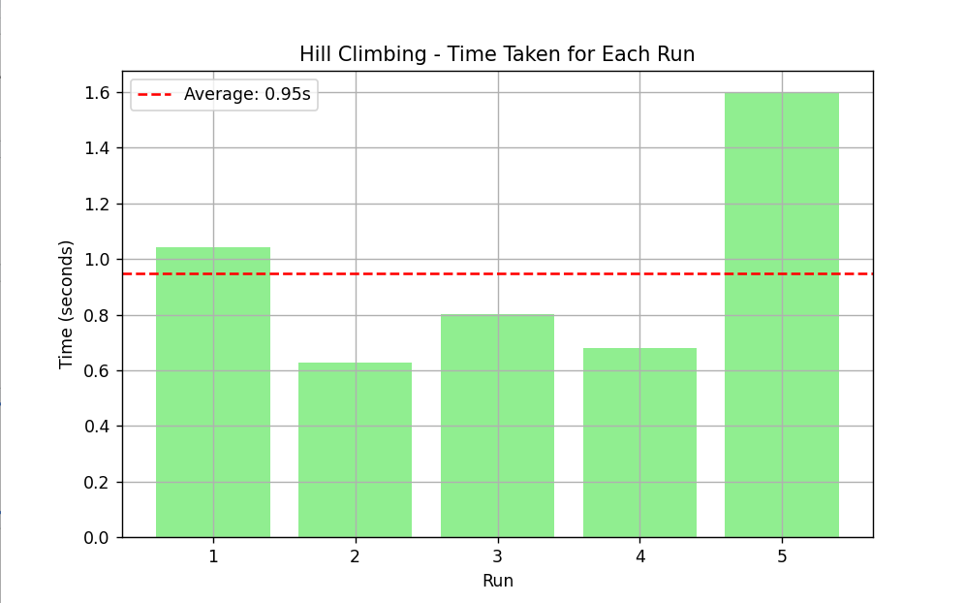
Hill Climbing
Average Time: 0.95sec

Slide 7
Reasons for Hill Climbing’s Performance
Average Time: 0.95 sec — relatively fast.
Hill Climbing is a greedy algorithm that quickly converges to a local optimum.
Efficient in smaller TSP instances due to simple move evaluation.
However, can get stuck in local minima, which sometimes leads to early but suboptimal solutions.
Comparison with Simulated Annealing
Much faster (0.95s vs 17.06s) due to greedy decisions and no randomness.
Less exploration: Doesn’t escape local minima, while Simulated Annealing does.
Suitable when a fast, good-enough solution is needed, but not ideal for complex TSPs with many local optima.
Less reliable in terms of finding globally optimal paths.

Slide 8
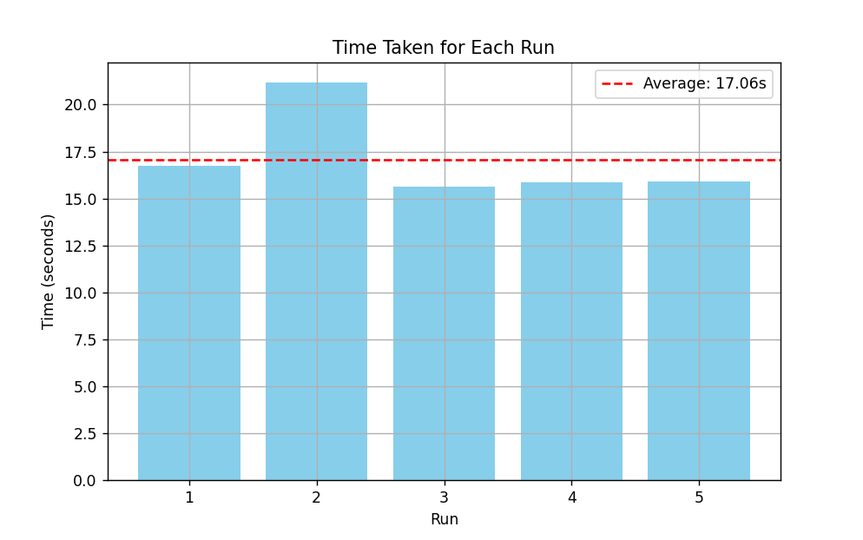
Simulated Annealing
Average Time:17.06sec

Slide 9
Reasons for Simulated Annealing’s Performance
Average Time: 17.06 sec — much higher due to its iterative, probabilistic nature.
Simulated Annealing accepts worse solutions initially to escape local minima.
Performs better on complex TSP instances as it explores the solution space more thoroughly.
Time increases due to cooling schedule, gradual convergence, and randomness.
Comparison with Hill Climbing
Slower, but more likely to find a global optimum.
Better suited for complex or large-scale TSPs.
The randomness and acceptance of worse solutions make it more robust.
Hill Climbing is quicker but more prone to failure in rugged search spaces.

