Slide 1
HIGH AVAILABILITY · AZURE
Azure Availability Zone
Deployment for a
Critical Workload
Distributing a critical workload across three Azure Availability Zones to survive a single-zone failure.
Azure Availability Zone Deployment for a Critical Workload
1

Slide 2

PROJECT OVERVIEW
Building resilience into a single critical workload
This project asks three student teams to take one production-critical workload and re-architect its deployment so that no single Azure datacenter failure can take it offline. The deliverable is a working, zone-redundant deployment plus a documented failure test.
PROJECT GOAL
PROJECT AT A GLANCE
Design and deploy a workload that keeps serving traffic through a full zone outage — validated, not assumed.
High Availability track
3
Availability Zones per region
Deploy compute across 3 zones in a zone-enabled region
Front the workload with a zone-redundant load balancer
1
critical workload, re-architected
Replicate data using zone-redundant storage (ZRS)
Prove resilience with a controlled zone-failure test
1
controlled zone-failure test
Azure Availability Zone Deployment for a Critical Workload
2

Slide 3
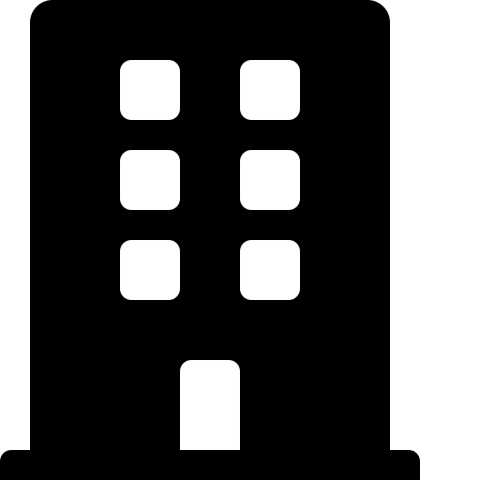
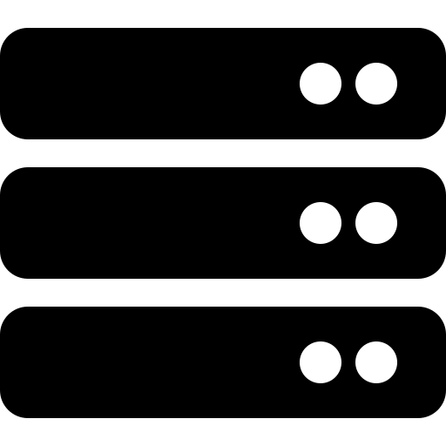
CORE CONCEPT
What is an Availability Zone?
An Azure region is a set of datacenters. Where supported, that region is split into 3+ Availability Zones — each its own physical location with independent power, cooling, and networking. Losing one zone should never take down a properly distributed workload.
AZURE REGION · e.g. East Asia
Availability Zone 1
Availability Zone 2
Availability Zone 3
Independent power & cooling
Independent networking
Separate physical facility
1+ physical datacenters
1+ physical datacenters
1+ physical datacenters
Azure Availability Zone Deployment for a Critical Workload
3

Slide 4


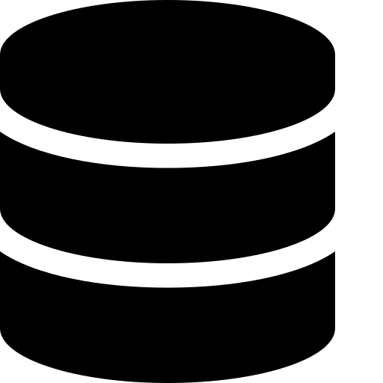
Zone-redundant deployment pattern
Client Traffic
Standard Load Balancer — Zone-Redundant
Single front-end IP, always reachable even if one zone is down
Zone 1
Zone 2
Zone 3
VM / VMSS instance
VM / VMSS instance
VM / VMSS instance
ZRS data replica
ZRS data replica
ZRS data replica
Zone-redundant storage (ZRS) synchronously replicates data across all three zones, so a single-zone loss causes zero data loss.
Azure Availability Zone Deployment for a Critical Workload
4

Slide 5
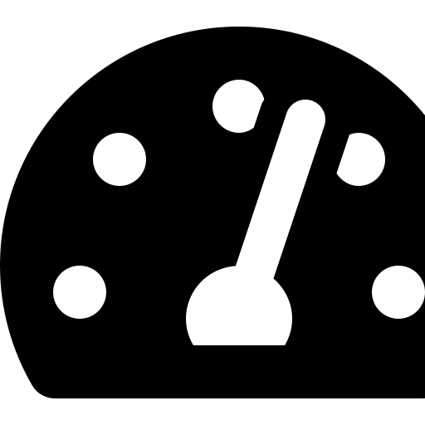
USE CASE 01
Distribute a workload across three zones
Rather than running every instance in one datacenter, teams spread compute evenly so that normal, day-to-day traffic is already being served from all three zones at once.
Even instance spread
Zone-redundant front end
No performance penalty
Provision VMSS or AKS node pools with zone balancing so each zone carries a roughly equal share of load.
A Standard Load Balancer or Application Gateway v2 spans all zones behind one IP.
Zones within a region are connected by low-latency, high-bandwidth links — cross-zone calls stay fast.
Azure Availability Zone Deployment for a Critical Workload
5

Slide 6

USE CASE 02
Survive a single zone failure
The real test: simulate the loss of one entire zone and confirm the workload keeps serving traffic without intervention.
NORMAL OPERATION
ZONE 1 OUTAGE
Zone 1
Zone 2
Zone 3
Zone 1
Zone 2
Zone 3
Active
Active
Active
Down
Active
Active
All three zones actively serve traffic; load balances evenly across every instance.
Load balancer routes traffic only to healthy zones; ZRS data already exists in zones 2 & 3, so no data is lost.
Azure Availability Zone Deployment for a Critical Workload
6

Slide 7




BOTTLENECK 01
Not all services and regions support zones equally
Zone support is set per-service and per-region — teams need to verify both before locking in a design, not assume every region behaves the same way.
Where teams get surprised: a service works fine in one region, then the same design fails to deploy in another because that region has no zones — or only partial support.
Region check
Per-service check
Fallback plan
Confirm the target region publishes 3 Availability Zones on the Azure reliability docs.
Verify each service in the design (compute, LB, storage, DB) individually supports zone redundancy in that region.
For services without zone support, document a fallback (e.g. multi-region pairing) instead of assuming.
Azure Availability Zone Deployment for a Critical Workload
7

Slide 8



BOTTLENECK 02
Zone-redundant storage changes the cost model
ZRS pays for synchronous replication across three physical zones instead of one datacenter. Teams should price this out, not just note it as a line item.
WHAT DRIVES THE DELTA
Synchronous replication
Every write is copied to 3 zones before it's acknowledged — more infrastructure, higher price per GB.
Redundancy tier matters
LRS < ZRS < GZRS/RA-GZRS — each added layer of resilience adds cost.
Price it before you commit
Run the workload's expected storage volume through the Azure Pricing Calculator for each tier.
Azure Availability Zone Deployment for a Critical Workload
8

Slide 9



DELIVERABLES
What “done” looks like
Each team demonstrates the following before the project is considered complete.
Zone-aware deployment
Zone-redundant front end
Zone-redundant storage
Compute provisioned across all 3 zones in a region confirmed to support them.
Standard Load Balancer or App Gateway v2 distributing traffic across zones.
Data layer using ZRS (or GZRS), with cost tier documented and justified.
Failure test executed
Cost comparison
Findings documented
A single zone deliberately taken offline; workload availability logged throughout.
LRS vs. ZRS vs. GZRS priced out for the workload's actual storage volume.
Bottlenecks hit, decisions made, and lessons learned written up for review.
Azure Availability Zone Deployment for a Critical Workload
9

Slide 10
KEY TAKEAWAYS
Resilience is a design
choice, not a default
Spreading a workload across zones only pays off if it's validated with a real failure test.
Zone support must be checked per-service and per-region before the design is locked in.
Higher resilience (ZRS/GZRS) is a deliberate cost trade-off — price it, don't guess it.
SCOPE
3 Availability Zones · 1 critical workload · 1 failure test
Azure Availability Zone Deployment for a Critical Workload
10

Slide 11
HIGH AVAILABILITY · AZURE
Thank You
Azure Availability Zone Deployment for a Critical Workload
11

