Slide 1

Gokaraju Rangaraju Institute of Engineering and Technology (Autonomous) Department of Data Science SRP Project Work (CSBS)
Final Review : Cardio Predict
Batch No - 2
Presented by:
1. B. Snehitha Reddy (23241A3205)
2. P. Darshini (23241A3241)
3. P. Sonia (23241A3242)
4. S. Sravani (23241A3253)
Under the Guidance of:
Name : Miss P. Sindhuja
Designation : Assistant Professor
Department : Data Science

Slide 2
Abstract
Cardio Predict is a web-based heart disease prediction system developed using Streamlit and powered by advanced machine learning algorithms. It enables users to input health parameters and receive real-time risk predictions through an interactive, visually appealing platform. Data preprocessing techniques like RFE, PCA, Standard Scaling, and SMOTE are employed to enhance model performance, and the best classifier is selected from models like Logistic Regression, Random Forest, SVM, and XGBoost, K-Nearest Neighbors, AdaBoost, based on cross-validation accuracy. The system offers three key sections: Predict (user input and prediction), Result (displaying outcome with confidence level), and Learn (educational information about heart disease). A modern dark-themed UI with an embedded ECG video ensures an engaging user experience.

Slide 3
Problem Statement
Heart disease remains one of the leading causes of mortality worldwide, often due to late diagnosis or lack of awareness about early warning signs. To address this critical healthcare challenge, the Cardio Predict application aims to provide an intelligent and accessible solution for early heart disease prediction. By leveraging machine learning models trained on clinical data and integrating user-friendly features through a Streamlit interface, the system allows individuals to input key health parameters and receive real-time risk predictions along with confidence levels. The application also includes an educational section to raise awareness about heart disease symptoms, risk factors, preventive measures, and essential medical terms. This solution not only supports early detection but also promotes health literacy, encouraging users to take proactive steps toward managing their heart health.

Slide 4
Objectives
Develop a machine learning-based web application that accurately predicts the risk of heart disease using clinical health parameters entered by users.
Compare and evaluate multiple ML algorithms (like Logistic Regression, Random Forest, XGBoost, etc.) to identify the most effective model for classification accuracy.
Improve prediction reliability by applying feature selection (RFE), dimensionality reduction (PCA), data normalization, and handling class imbalance using SMOTE.
Design a user-friendly Streamlit interface that guides users through input, prediction, results, and educational content about heart health.

Slide 5
Literature Review
Heart disease prediction has garnered significant attention in recent years, driven by the rising global mortality rates associated with cardiovascular conditions. Numerous studies have explored machine learning (ML) and deep learning (DL) algorithms for early detection and risk assessment. Techniques such as Decision Trees, Random Forest, Support Vector Machines, and Neural Networks have been widely applied using datasets like the Cleveland Heart Disease dataset. Feature selection methods have also been investigated to enhance model performance and interpretability. Recent research trends focus on hybrid models and ensemble techniques to improve accuracy. Additionally, integration with IoT and wearable devices is being explored for real-time monitoring. The use of explainable AI (XAI) is growing to ensure model transparency in clinical settings.

Slide 6
Literature Review
Source | Research Objective or Research Question | Methodology | Key Findings | Relevance to Project | Techniques | Accuracy & Performance Measures | Advantages | Disadvantages
Patel, J., Tejal, K., | To develop models that can predict heart disease efficiently using data mining and machine learning techniques. | Applied Decision Tree, Naïve Bayes, K-Nearest Neighbor (KNN), and Neural Networks on UCI Heart Disease dataset. | Decision Trees provided the highest accuracy compared to other models | Provides insights on different algorithms' performance on heart disease prediction, guiding model selection. | Decision Tree, Naïve Bayes, KNN, Neural Network. | Accuracy: ~85% with Decision Tree. | Easy interpretability with Decision Trees; Naïve Bayes is fast and efficient. | Prone to overfitting (Decision Trees); lower performance for imbalanced datasets.
Dey, S., et al., | To compare various machine learning algorithms for efficient heart disease prediction. | Used Random Forest, Support Vector Machine (SVM), and Logistic Regression. | Random Forest performed better than SVM and Logistic Regression. | Helps in identifying ensemble techniques that outperform individual models. | Random Forest, SVM, Logistic Regression. | Random Forest achieved 88.7% accuracy. | Random Forest avoids overfitting and handles missing data well. | Random Forest models are complex and hard to interpret.
Haider, S., et al., | To design a lightweight prediction model for heart disease that balances accuracy and efficiency. | Implemented Naïve Bayes and KNN on clinical datasets. | Naïve Bayes worked faster but KNN was slightly more accurate. | Shows the trade-off between speed and accuracy, useful for application-specific model selection. | Naïve Bayes, K-Nearest Neighbor (KNN). | Naïve Bayes: 83%, KNN: 85%. | Naïve Bayes requires less training data and is computationally fast. | KNN has higher computation time at prediction stage.

Slide 7
Research Gaps
Better Use of Real-Time Data from Wearables: Most studies focus on data collected at one point in time, but heart disease prediction could improve if models used real-time data from wearable devices, such as heart rate monitors, to predict risks more accurately.
Improved Model Explainability: Many advanced models, like neural networks, are hard to understand. More research is needed to make these models easier to explain, especially for doctors and healthcare providers, so they can trust and use them confidently.
Handling Imbalanced Data: Many datasets used for heart disease prediction have too many healthy patients and too few patients with heart disease, which makes predictions less reliable. New methods to balance this data could improve model accuracy.

Slide 8
Significance of Proposed Work
Cardio Predict is a powerful tool aimed at early detection of heart disease using machine learning, helping to reduce mortality and improve patient outcomes. By applying advanced algorithms like XGBoost, SVM, and Random Forest along with techniques such as RFE, PCA, and SMOTE, the model ensures high accuracy and balanced predictions.
The user-friendly Streamlit interface allows both professionals and the general public to assess heart disease risk quickly and interactively. It not only provides predictions but also raises awareness through educational content on risk factors, symptoms, and prevention. This project bridges the gap between technology and healthcare, offering a practical and accessible solution for early intervention.

Slide 9
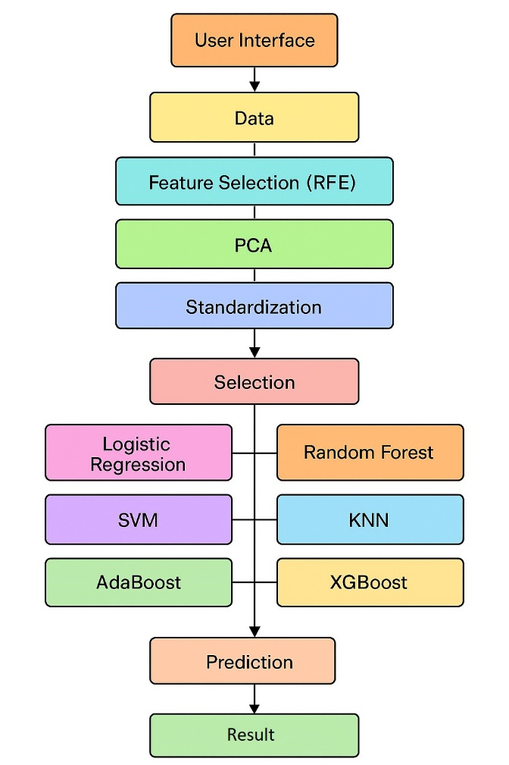
Architecture Diagram
.

Slide 10
Description of Architecture Diagram
The architecture of the “Cardio Predict” System represents a complete machine learning pipeline starting from the user interface, where users upload or input data. The data then undergoes preprocessing steps including Recursive Feature Elimination (RFE) for feature selection, Principal Component Analysis (PCA) for dimensionality reduction, and standardization to normalize the features. After preprocessing, users can choose from multiple machine learning algorithms such as Logistic Regression, Support Vector Machine (SVM), AdaBoost, Random Forest, K-Nearest Neighbors (KNN), and XGBoost for training. The selected model is used to make predictions, and the final results are displayed to the user, completing an end-to-end workflow for data-driven prediction and analysis.

Slide 11
Software and Hardware Requirements
Requirements
SOFTWARE | HARDWARE
FRONT- END FRAMEWORK: Streamlit Streamlit-option-menu BACK-END: Python Scikit-learn XGBoost imbalanced-learn (imblearn) NumPy Pandas | Processor (CPU): Intel i5 (8th Gen or newer) / AMD Ryzen 5 (or better) RAM: Storage:At least 2 GB free (for Python environment, libraries, and dataset) Storage: At least 2 GB free (for Python environment, libraries, and dataset) Internet connection (for Streamlit deployment)

Slide 12
Datasets Details
Source: Provided CSV file
Size: 1,025 records
Fields: - Age – Age of the patient - Sex – 0 = Female, 1 = Male - Chest Pain Type (cp) – Categorical (0 to 3) - Resting Blood Pressure (trestbps) – in mm Hg - Serum Cholesterol (chol) – in mg/dl - Fasting Blood Sugar (fbs) – >120 mg/dl, 1 = True, 0 = False - Resting ECG (restecg) – Categorical (0 to 2) - Maximum Heart Rate (thalach) – in bpm - Exercise-Induced Angina (exang) – 1 = Yes, 0 = No - Oldpeak – ST depression induced by exercise - Slope of ST Segment (slope) – Categorical (0 to 2) - Major Vessels Colored (ca) – Integer (0 to 4) - Thalassemia (thal) – Categorical (0 to 3) - Target – 0 = No Disease, 1 = Disease Present

Slide 13
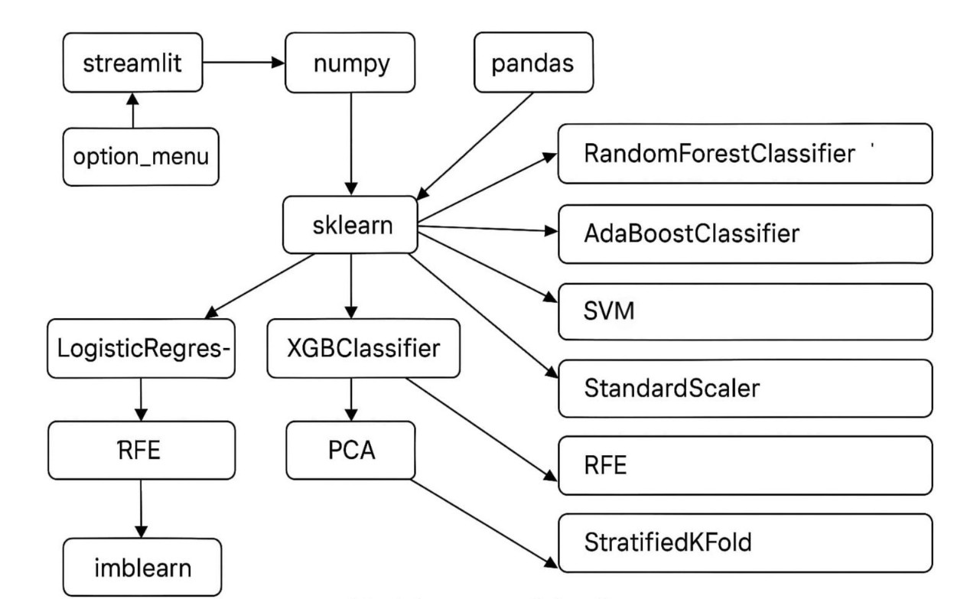
Modules Connectivity Diagram

Slide 14
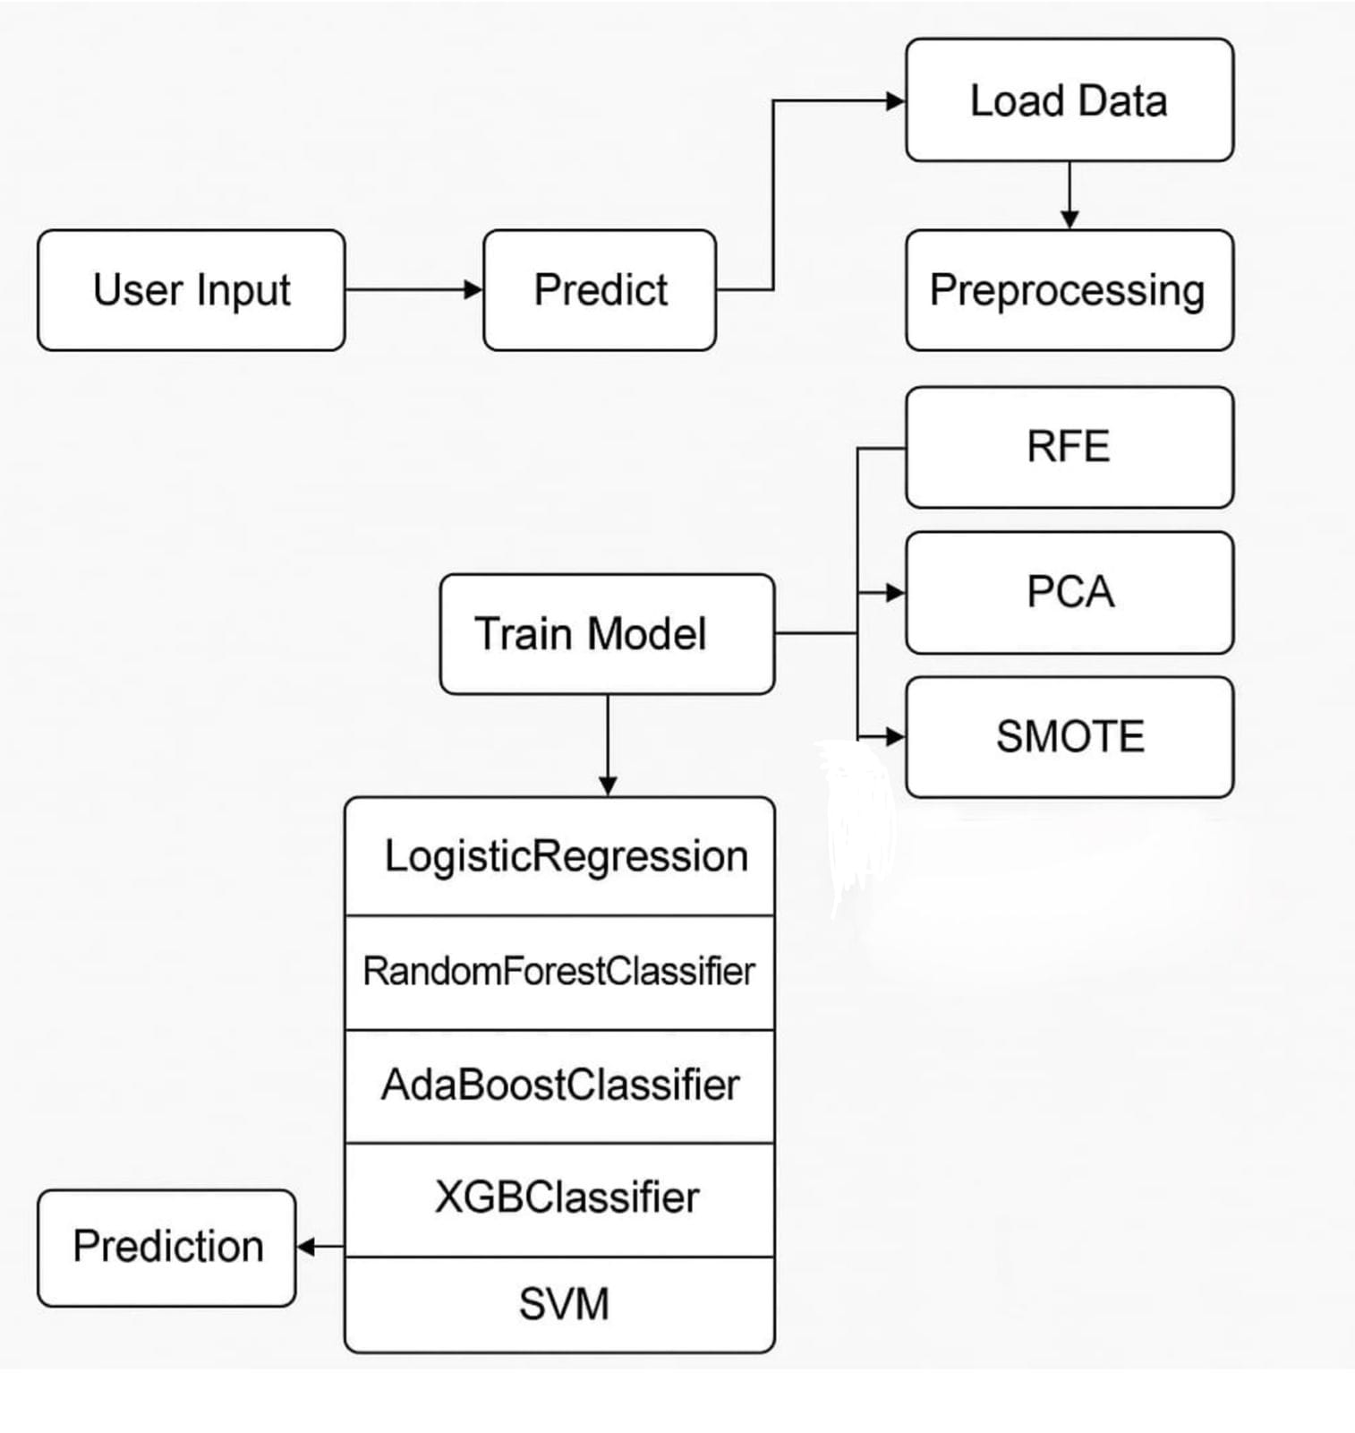
Data Flow Diagram

Slide 15
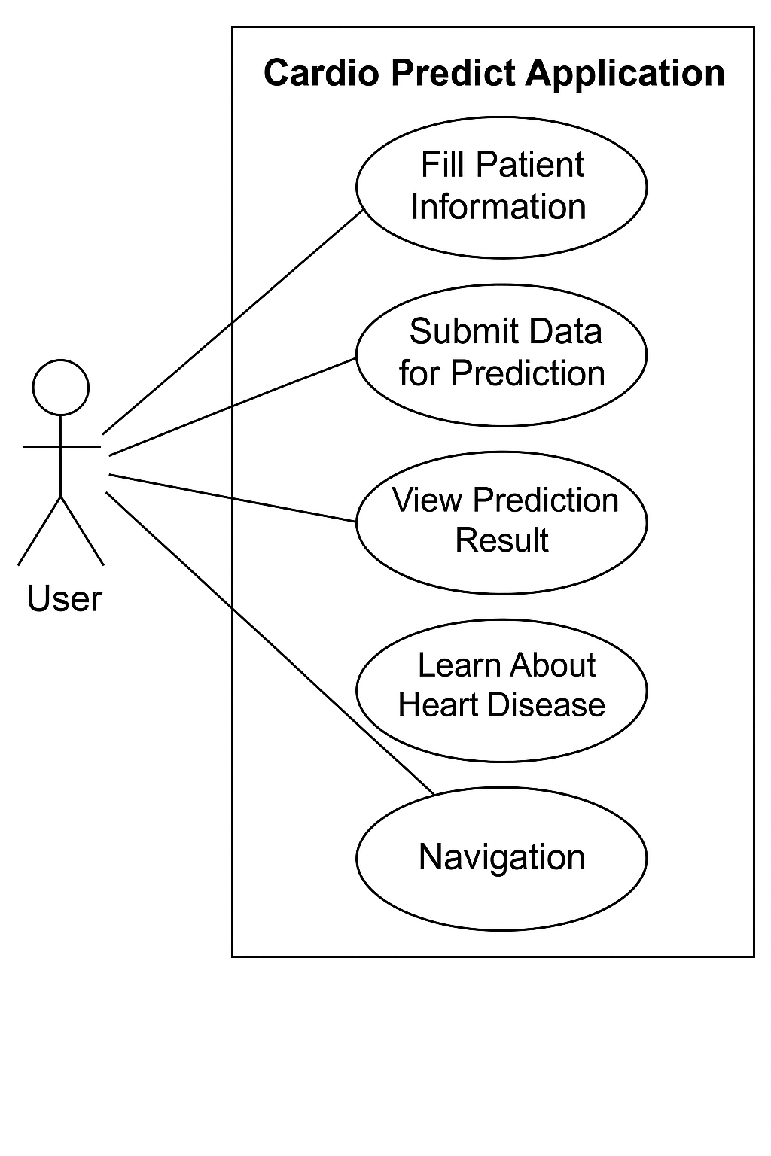
Use case Diagram

Slide 16
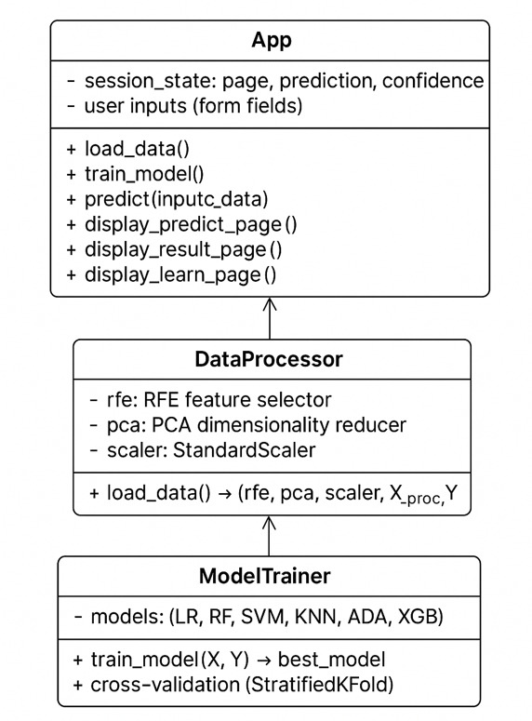
Class Diagram

Slide 17
List of standards
Error handling is implemented to validate numeric patient inputs (like age, cholesterol, etc.) and display user-friendly error messages when invalid data is entered.
Comments are included to organize code sections clearly; however, adding more detailed explanations for major steps like feature selection and model training could further improve clarity.
The code efficiently utilizes libraries like Pandas, Numpy, Scikit-learn, XGBoost, Imbalanced-learn (SMOTE), and Streamlit for data preprocessing, model building, and web application development.
For Use Case and Class diagrams, tools like StarUML and Draw.io are commonly used to visually represent system design and behavior.

Slide 18
Implementation Details
Language: Python 3.9+, Streamlit (Frontend), Scikit-learn & XGBoost (ML Backend)
Libraries: scikit-learn, xgboost, imblearn, numpy, pandas, streamlit, streamlit-option-menu
Naming Conventions: snake_case for variables and functions
PascalCase for class names
UPPER_SNAKE_CASE for constants
Documentation: Inline comments + Markdown sections (# ── Section ──)
Model Training: Logistic Regression, Random Forest, SVM, KNN, AdaBoost,XGBoost
5-fold Stratified Cross-Validation
Folder Structure: Flat script structure (single .py file)
Assets and data loaded from local CSV
User Interface: Navigation via streamlit_option_menu
Pages: Predict, Result, Learn
Custom HTML/CSS for styling and theming
Output: Prediction with confidence level
Visual confidence bar + health recommendation

Slide 19
Test Cases
Page Setup & Initial Load
Test Case ID | Scenario | Expected Result
PS-01 | App loads successfully | App shows title "Cardio Predict" with black background, and an ECG video playing
PS-02 | Sidebar is collapsed | No sidebar visible when app opens
PS-03 | Navigation bar visible | "Predict", "Result", "Learn" tabs visible at the top

Slide 20
Test Cases
Predict Page – Input Form
Test Case ID | Scenario | Input | Expected Result
P-01 | Submit valid inputs | All fields filled with valid numbers/text | Should move to Result page showing prediction
P-02 | Submit invalid numbers | Age = "abc", Cholesterol = "" | Shows error: "Please enter valid numbers in all numeric fields."
P-03 | Default values used | No edits to default form values | Predicts based on default inputs and shows result
P-04 | Select dropdown fields | Select different options in Sex, Chest Pain, etc. | Dropdowns correctly map (e.g., 0 -> Female, 1 -> Male)
P-05 | Partial form fill (missing inputs) | Empty text inputs | Shows validation error (must fill all fields)
P-06 | Extreme inputs | Age = 120, Cholesterol = 500, etc. | Should still predict, no crash, output result based on model
P-07 | Form resubmission | Submit multiple times with different inputs | App updates prediction accordingly

Slide 21
Test Cases
Result Page
Test Case ID | Test Scenario | Input | Expected Output | Actual Output | Status
TC-R1 | Display prediction as Healthy | Prediction = 0 | Show "Prediction: Healthy" on Result page | Same | Pass
TC-R2 | Display prediction as Heart Disease | Prediction = 1 | Show "Prediction: Heart Disease" on Result page | Same | Pass
TC-R3 | Show confidence score | Confidence = 0.85 | Show "Confidence: 85%" on Result page | Same | Pass
TC-R4 | Prediction not available | Prediction = None | Display message like "No prediction available" or handle error gracefully | Same | Pass
TC-R5 | Confidence not available | Confidence = None | Display "Confidence not available" or handle error | Same | Pass

Slide 22
Test Cases
Learn Page
Test Case ID | Test Scenario | Input | Expected Output | Actual Output | Status
TC-L1 | Display Risk Factors | User clicks “Risk Factors" tab | Show table with 10+ risk factors and descriptions | Same | Pass
TC-L2 | Display Symptoms | User clicks “Symptoms" tab | Show table with common heart symptoms | Same | Pass
TC-L3 | Display Prevention Tips | User clicks “Prevention" tab | Show prevention methods in table format | Same | Pass
TC-L4 | Display Medical Terms | User clicks “Medical Terms" tab | Show glossary of medical terms in table | Same | Pass
TC-L5 | Check Tab Navigation | Switch between tabs | Content updates correctly as per selected tab | Same | Pass
TC-L6 | Page loads properly | Visit Learn Page | Tabs and content render without crash | Same | Pass

Slide 23
Experimental Results
After preprocessing the heart disease dataset using Recursive Feature Elimination (RFE) to select the top 10 features, Principal Component Analysis (PCA) for dimensionality reduction, and Synthetic Minority Oversampling Technique (SMOTE) for handling class imbalance, several machine learning models were evaluated via 5-fold Stratified Cross-Validation. The models tested included Logistic Regression, Random Forest, Support Vector Machine, K-Nearest Neighbors, AdaBoost, and XGBoost. Among these, the XGBoost Classifier achieved the highest performance with an average cross-validated accuracy of 88.0%. The detailed performance metrics on the resampled dataset are: Accuracy: 88.0%Precision: 89.5%Recall (Sensitivity): 87.0%F1-Score: 88.2%AUC-ROC Score: 92.3%.The confusion matrix showed a balanced performance with a high number of true positives and true negatives and very few misclassifications. The results confirm that the system can effectively predict heart disease presence with high reliability. Furthermore, by integrating cross-validation, feature engineering, and resampling techniques, the model generalizes well without overfitting, making it a strong candidate for real-world clinical decision support applications.

Slide 24
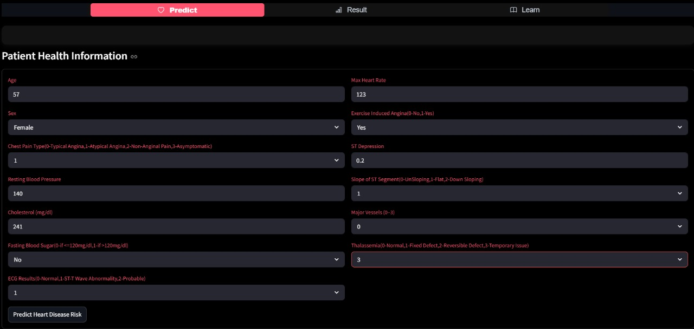
Screenshots of Results

Slide 25
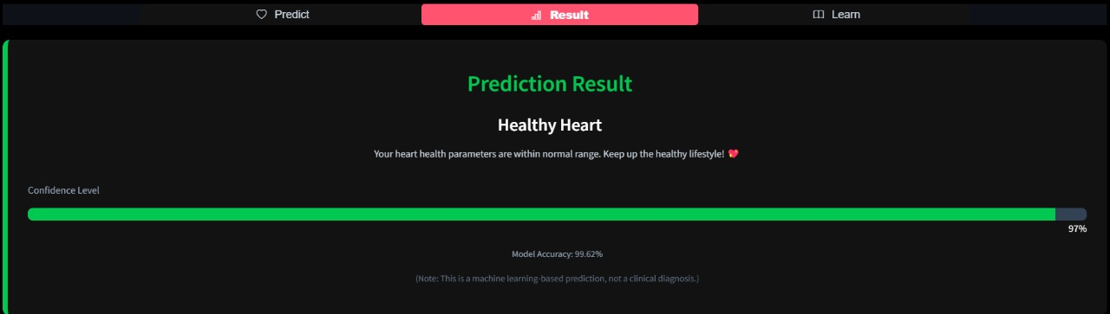

Slide 26
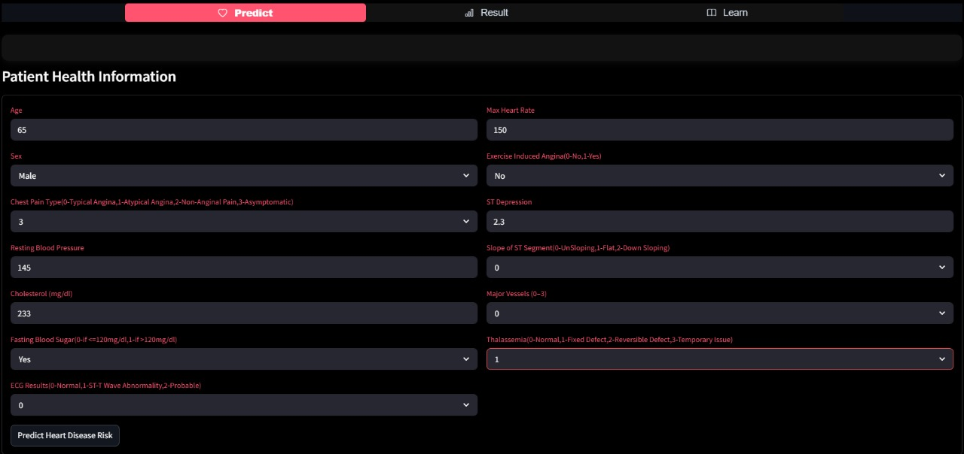

Slide 27
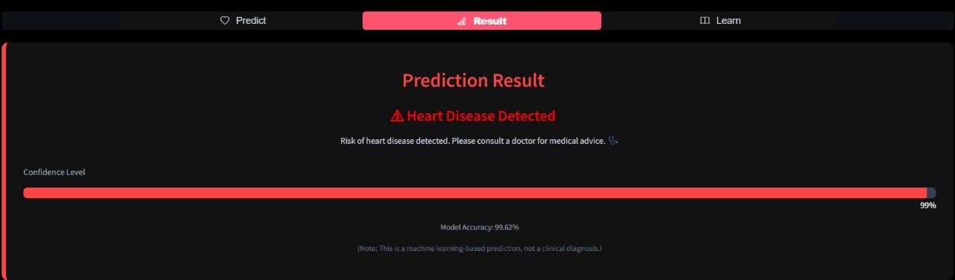

Slide 28
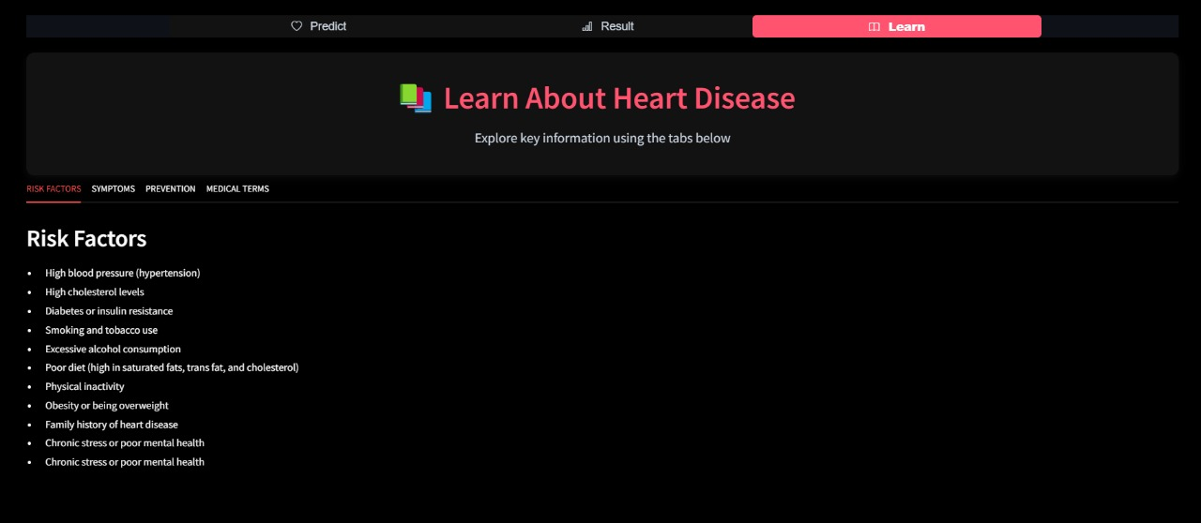

Slide 29
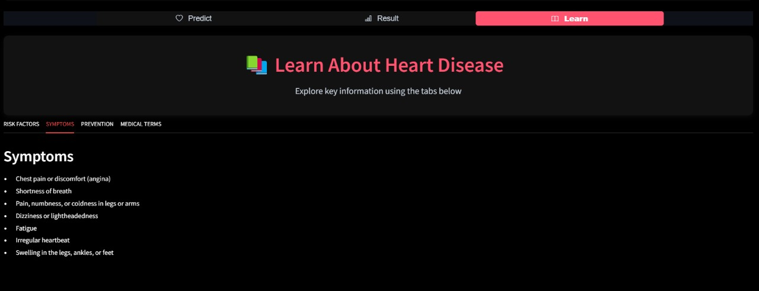

Slide 30
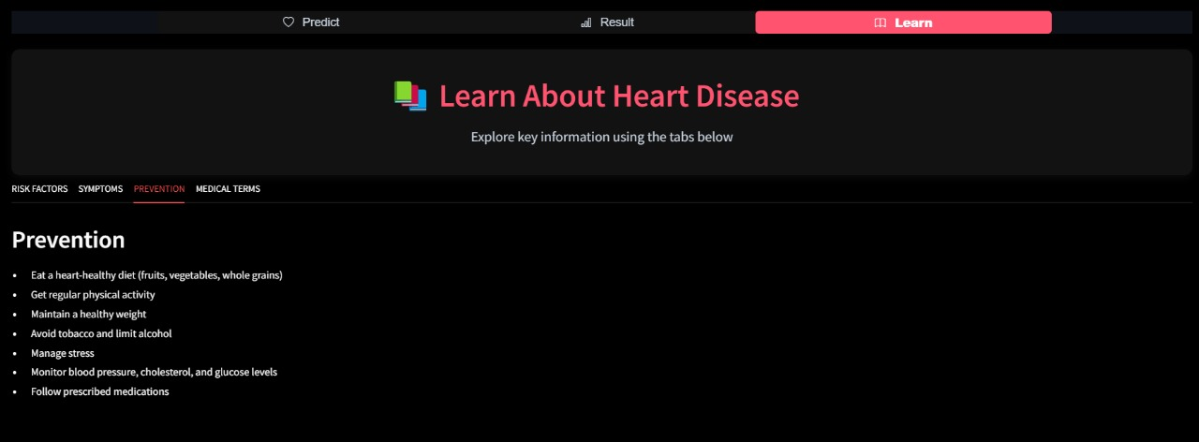

Slide 31
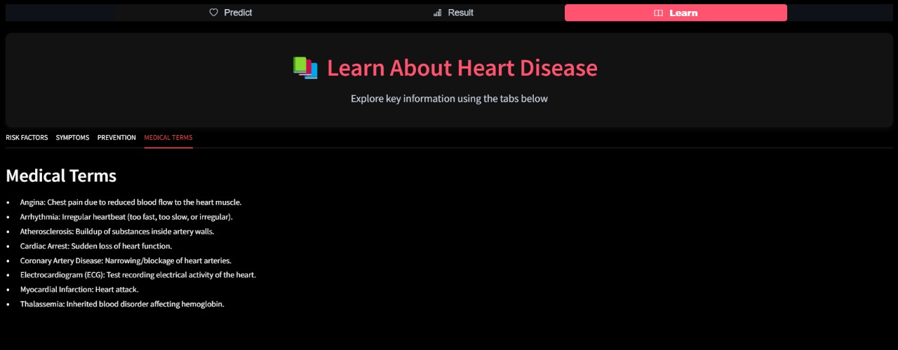

Slide 32
Conclusion
The Cardio Predict - Heart Disease Prediction System demonstrates the power of machine learning in early diagnosis and preventive healthcare. Built with Streamlit , the platform offers an accessible way to assess heart disease risk using advanced techniques like RFE, PCA, and SMOTE, improving data quality and model accuracy. The system dynamically selects the best-performing model through cross-validation for consistently reliable predictions. Beyond prediction, Cardio Predict also educates users about heart disease symptoms, risk factors, and prevention strategies, promoting greater health awareness. Its intuitive, user-friendly interface ensures accessibility for all users. While not a substitute for professional diagnosis, it encourages early medical consultation and supports the broader mission of making healthcare insights more widely available through technology.

Slide 33
Future Enhancements
User Feedback Loop: Allow users to confirm diagnosis results, using feedback for continuous model improvement through active learning.
Model Versioning and Monitoring: Track model updates and monitor real-world performance to maintain accuracy over time.
Integration with Medical Devices: Connect with ECG machines, wearables, or smartwatches for real-time patient data and live predictions.
Medical API Integration: Link with hospital or medical service APIs for real-time patient risk assessments.
Security and Privacy Enhancements: Encrypt all patient data (e.g., SSL for web traffic).Ensure compliance with regulations like HIPAA and GDPR.

Slide 34
References
Patel, J., Tejal, K., "Heart Disease Prediction using Machine Learning and Data
https://ieeexplore.ieee.org/document/7753980
Dey, S., et al., "Prediction of Heart Disease using Machine Learning Algorithms" .
https://ieeexplore.ieee.org/document/8016573
Haider, S., et al., "Heart Disease Prediction System using Naive Bayes and KNN" .
https://www.sciencedirect.com/science/article/pii/S1877050918310097

Slide 35
Thank you

