Slide 1
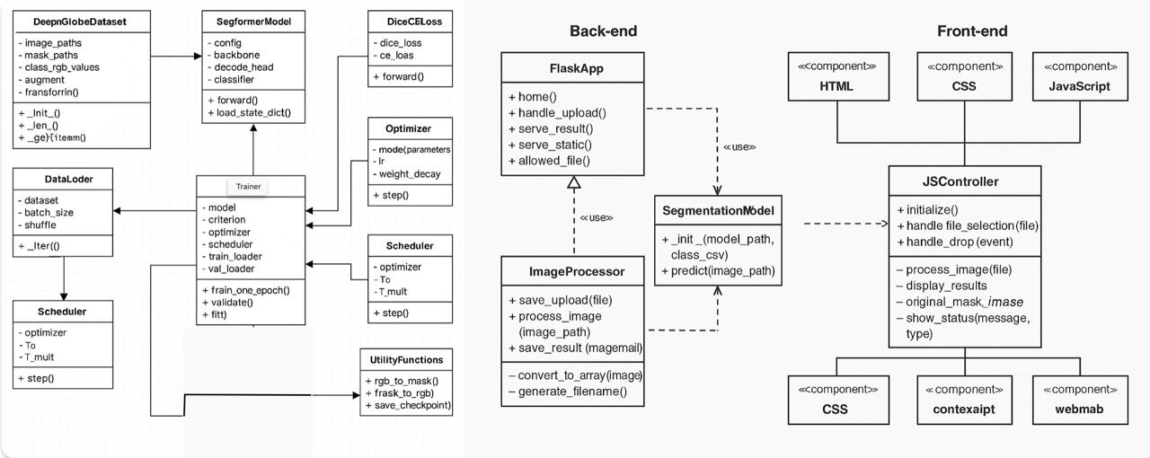
END-TO-END PIPELINE FOR SEGMENTATION

