Slide 1


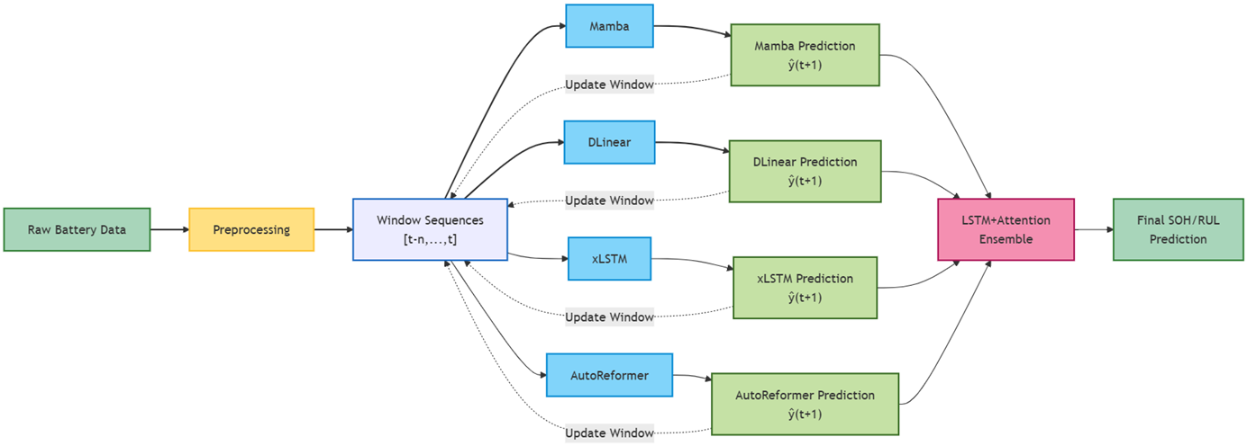
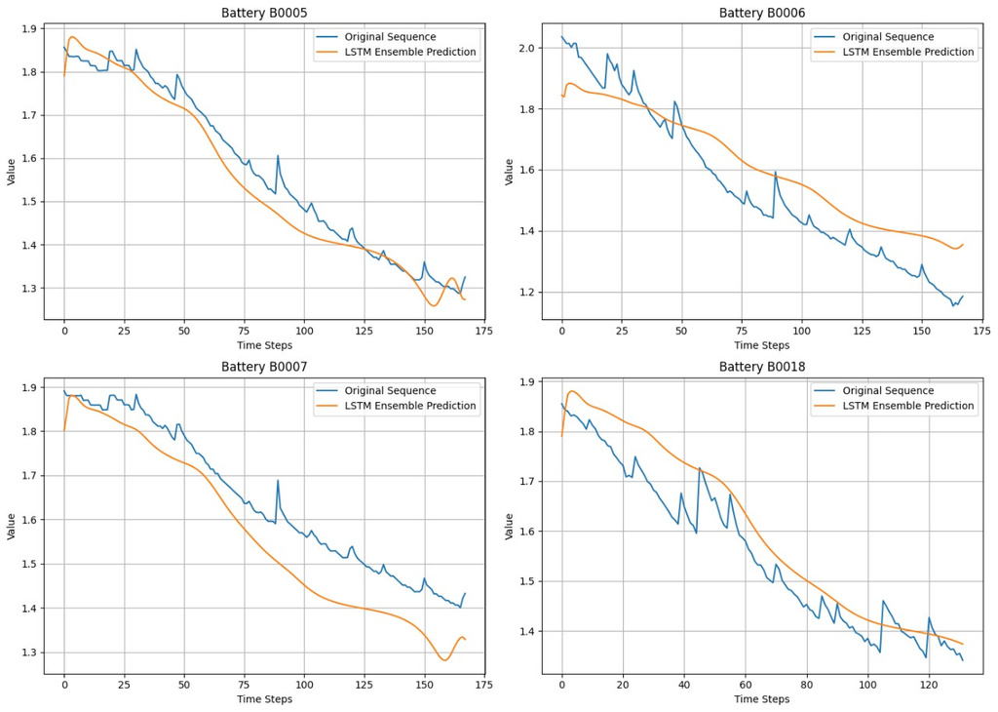
Battery SOH and Remaining Useful Life Estimation
Raw data is preprocessed to extract meaningful features.
Ensemble module combines outputs to improve accuracy.
Predictions are generated using multiple models.
Final predictions provide SOH and RUL estimates.

