Slide 1
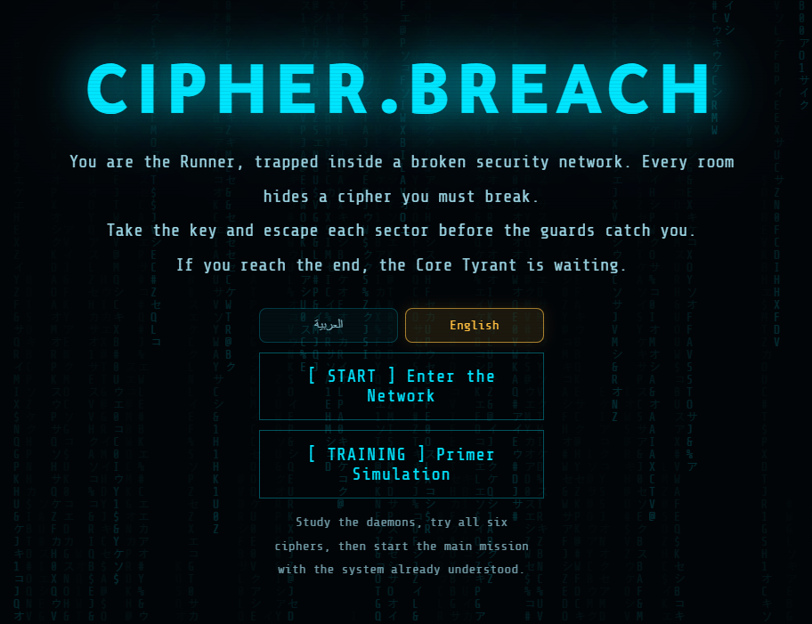
CIPHER.BREACH
A 3D Cryptography Game
CS320 Computer Security
Supervised by Dr. Abdullah Albuali
Date: May 2026
PROJECT GROUP
Abdullah Ali Alkhulaifi
223002824
Bashar Ibrahim Farhat
223039656
Ayed Ahmed Almutairi
223041875
Abdulelah Adel Alhinity
223023047
Ahmed Amer Abdulmalik
223049879
Kingdom of Saudi Arabia | Ministry of Education
King Faisal University
College of Computer Sciences & Information Technology

Slide 2
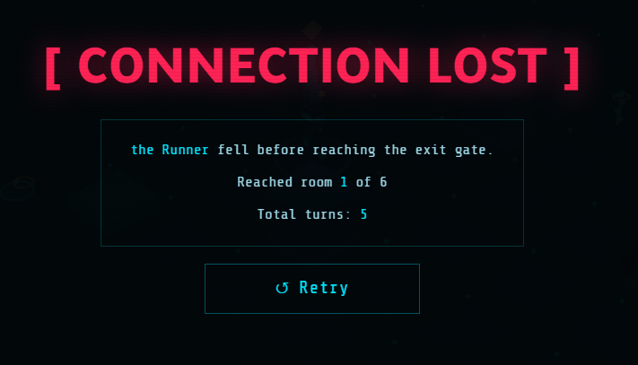
What is CIPHER.BREACH?
A 3D browser game that turns classical ciphers into a cybersecurity escape mission.
Design Philosophy
Teach security through interaction
Cyber visual style, clean UI
Simple controls: move, solve, escape
Small project that feels complete
Escape a hostile digital network by decrypting ciphers
ROOMS
LANGUAGES
PLATFORMS
STACK
6 + 1 hidden
AR / EN
Desktop + mobile
HTML / CSS / JS

Slide 3
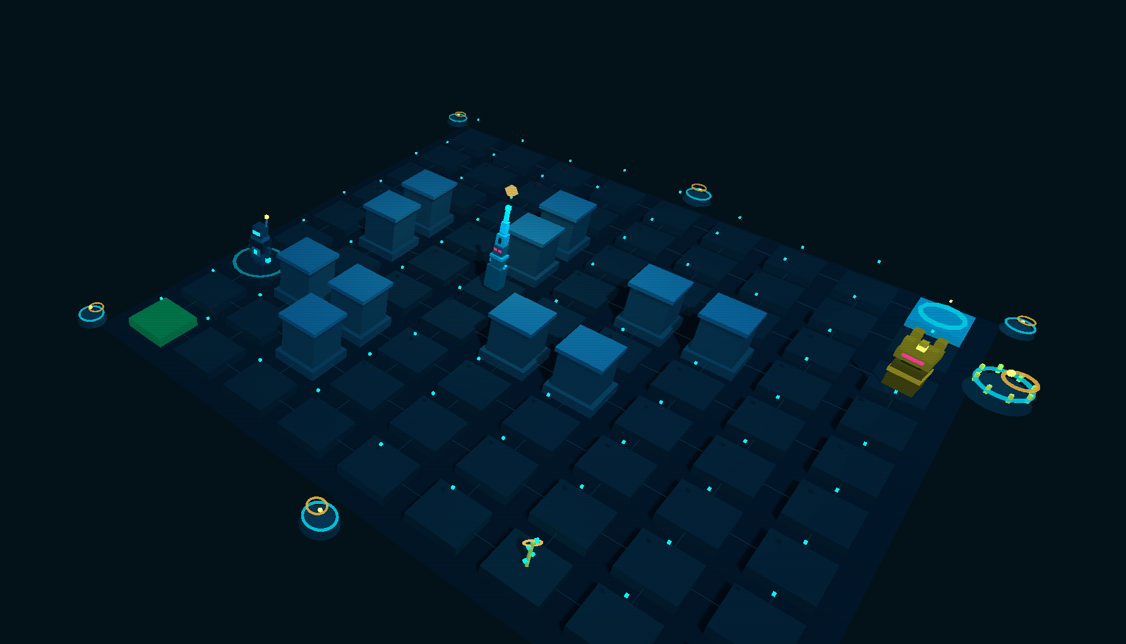
Core gameplay loop
Start each room at spawn node
Find and reach the keyholder
Daemons patrol, detect, then chase
Caught by daemon = cipher battle
Solve puzzle to secure exit key
Hints cost HP, guessing isn't free
Daemon Types
Med kit
Hints
Rook & Bishop
+5 Health
-2 Health

Slide 4
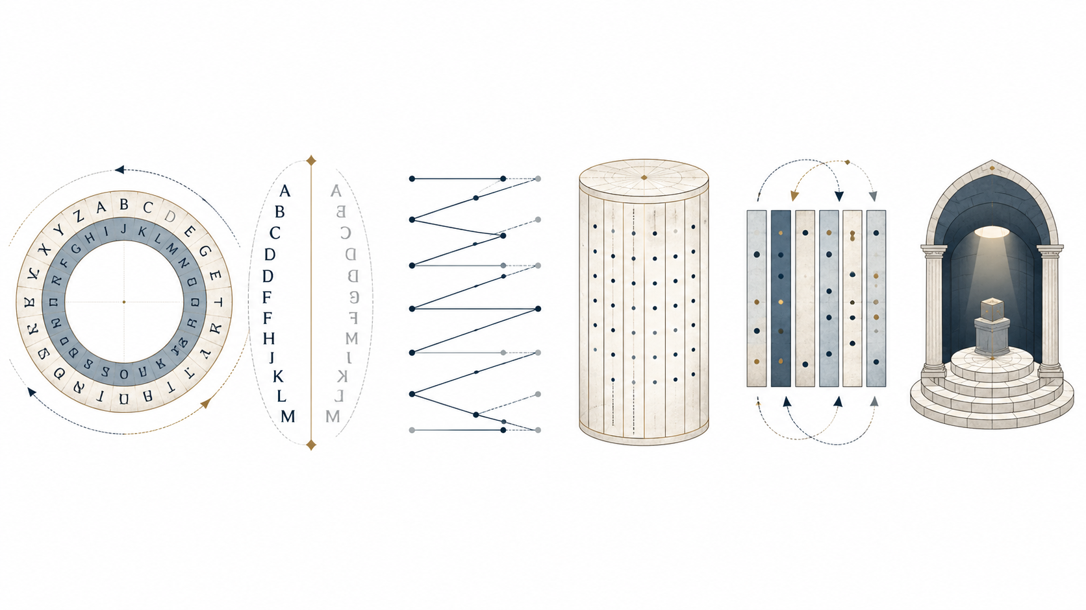
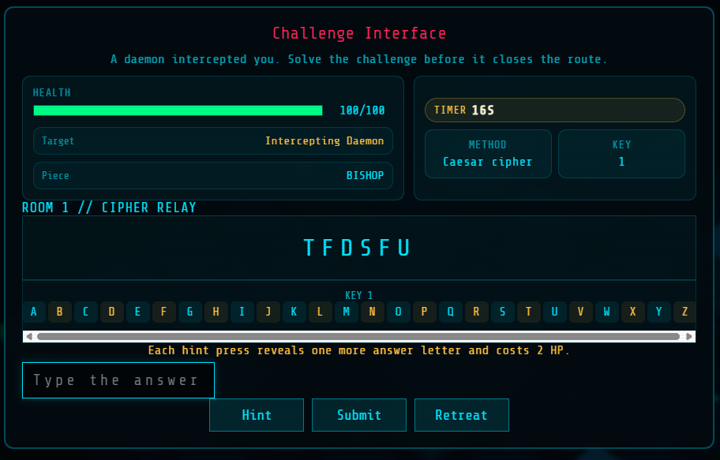
Cipher room progression
1
Cipher Relay
Caesar cipher
Cryptography
2
Token Cache
Reverse
Cryptography
3
Password Vault
Atbash
Authentication
4
Identity Gate
Rail Fence
Authentication
5
Payroll Gate
Scytale
Access Control
6
Contractor Window
Columnar Transposition
Access Control
7
Secret
Classified
????

Slide 5
Systems that create pressure
Daemons
Battles
Health
Progress
Mobile HUD
Patrol, detect, chase the player.
Daemon catches player → cipher opens.
Wrong answers, hints, timer all drain HP.
Key first, then exit. Always.
Controls were adjusted so buttons do not cover play.
Balancing values constants in game.js
hero hp = 100 | battle time = 17 | medkit heal = 5 | wrong answer damage = 5 | hint damage = 2 | room daemons = [2,2,3,3,4,4]

Slide 6
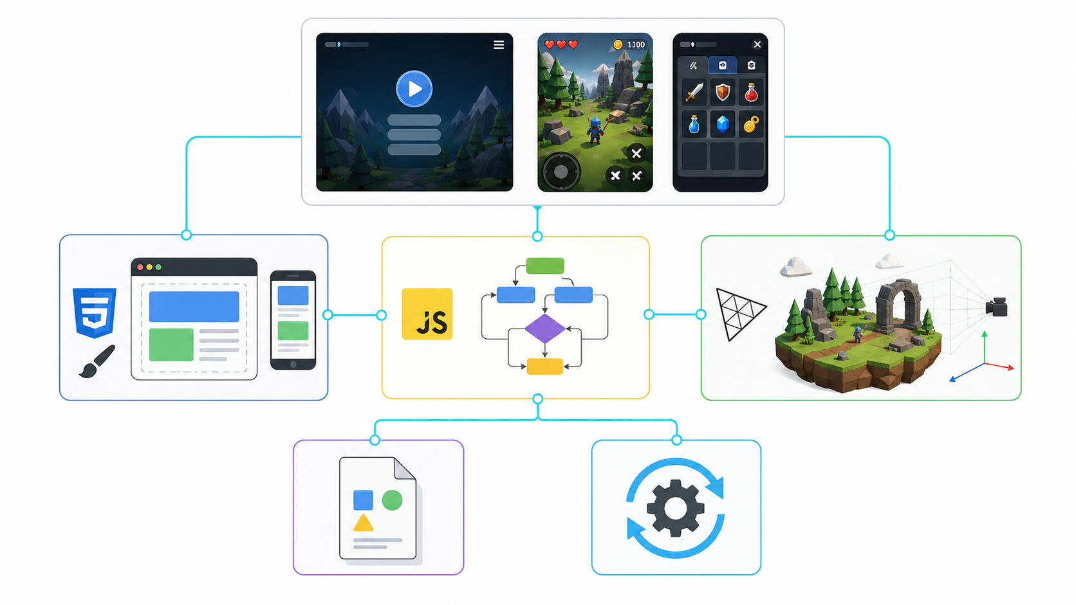
Implementation architecture
Main files:
index.html - screens, HUD, overlays, menus.
styles.css - layout, style, mobile rules.
game.js - all logic and game state.
manifest + sw.js - PWA install ability.
GitHub language split

Slide 7
Conclusion
PROJECT RESULT
FINAL TAKEAWAY
Single-page browser game, desktop + mobile.
Six rooms plus one hidden final room.
Security concepts taught through gameplay.
Fully deployed, desktop and mobile ready.

Slide 8
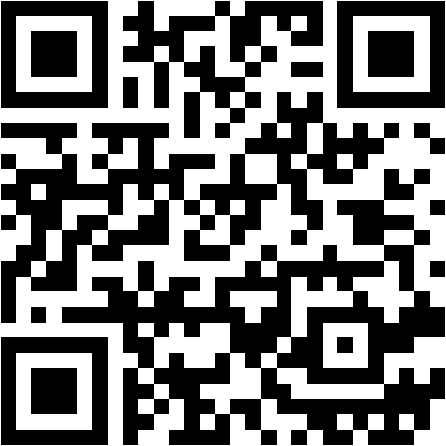
Thank You.
Try The Game!

