Slide 1
DENOISE IMAGE USING DEEP CNN AUTOENCODER
PRESENTED BY:
SNEKA S(730321104051)
III-YEAR
BUILDERS ENGINEERING COLLEGE

Slide 2

PROJECT TITLE
Denoise Image using CNN Autoencoded in Deep Learning

Slide 3

AGENDA
PROBLEM STATEMENT
PROJECT OVERVIEW
WHO ARE THE END USERS?
YOUR SOLUTION AND ITS VALUE PROPOSITION
THE WOW IN YOUR SOLUTION
MODELLING
RESULTS

Slide 4

PROBLEM STATEMENT
Problem:
Noisy images have reduced clarity and distortions, impacting their usefulness in analysis or presentation.
Solution:
Our project employs a CNN autoencoder to intelligently learn and remove noise patterns, enhancing image quality.
Outcome:
Capable of removing noise from corrupted images while preserving essential features and details.

Slide 5

PROJECT OVERVIEW
Objective:
Develop a convolutional neural network (CNN) auto encoder model to de-noise images by removing unwanted noise while preserving important features.
Approach:
Acquire a dataset of noisy images with corresponding clean versions.
Preprocess images, including resizing, normalization, and introducing synthetic noise.
Design a CNN-based encoder to extract meaningful representations from noisy images.
Construct a symmetric CNN-based decoder to reconstruct clean images from encoded representations.

Slide 6
WHO ARE THE END USERS?
Photographers and Graphic Designers
Medical Imaging Professionals
Researchers in Computer Vision and Image Processing
Companies in Various Industries
Social Media Platforms

Slide 7
YOUR SOLUTION AND ITS VALUE PROPOSITION
SOLUTION:
Robust Model Architecture
Optimized Training Procedure
Comprehensive Evaluation Metrics
User-Friendly Deployment
PROPOSITION:
High-Quality Denoising
Time and Cost Efficiency
Versatility
Enhanced Image Quality
Cutting-Edge Technology

Slide 8
THE WOW IN YOUR SOLUTION
Super Clear Pictures: Our special computer program makes pictures look super clear by getting rid of the messy stuff called "noise."
Instant Results: Unlike other methods that take a long time, our program works really fast. You can see the difference right away!
Learns from Different Pictures: Our program is like a smart student. It learns from lots of different pictures, so it knows how to make all kinds of pictures look better.
See Before and After: With our program, you can compare how the picture looked before and after it got cleaned up. It's like magic!
Works for Everyone: Whether you're a photographer, doctor, or just someone who loves taking pictures, our program can make your photos look amazing.
Easy to Use: Even if you're not a computer expert, you can still use our program easily. It's designed to be simple and user-friendly.

Slide 9
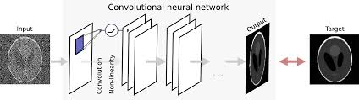
MODELLING
Import Modules
Load the Dataset
Add Noise to the Image
Exploratory Data Analysis
Model Creation
Visualize the Results

Slide 10
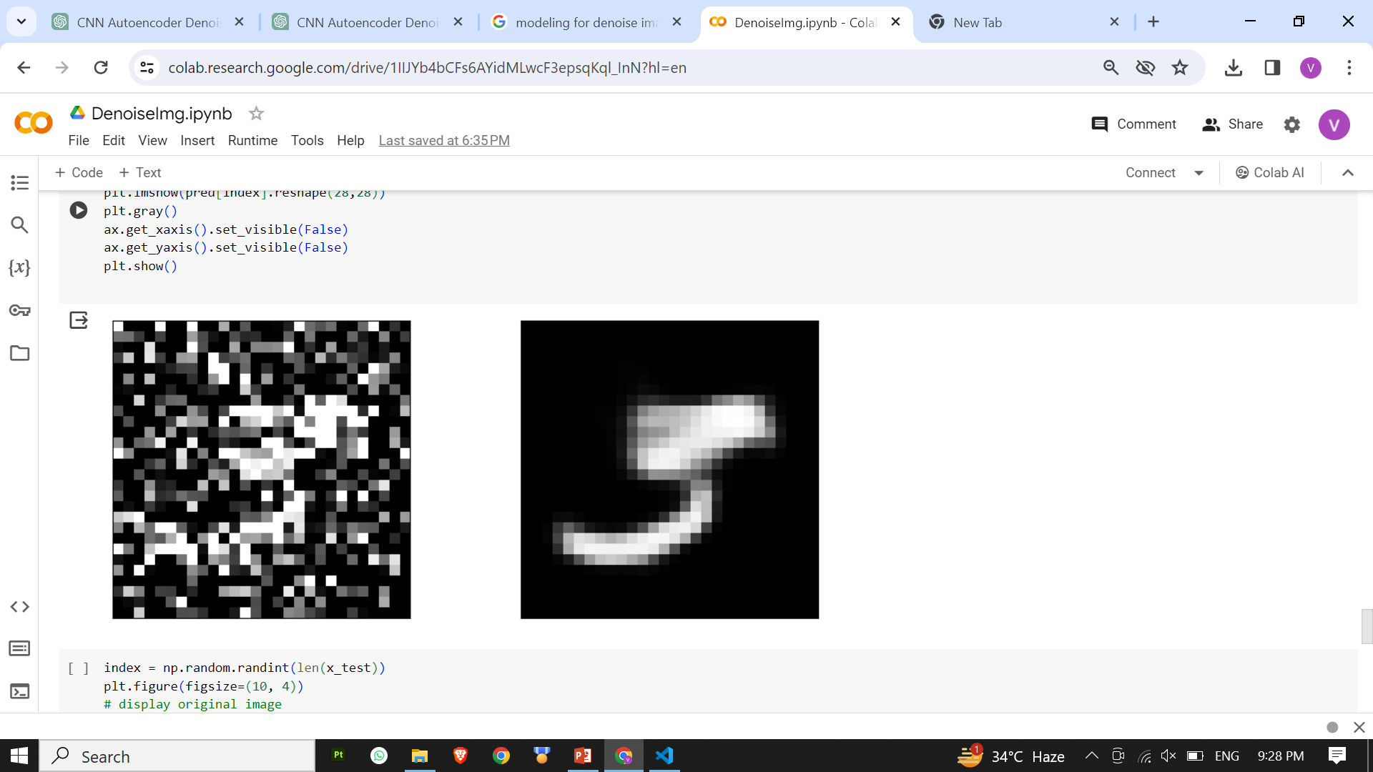
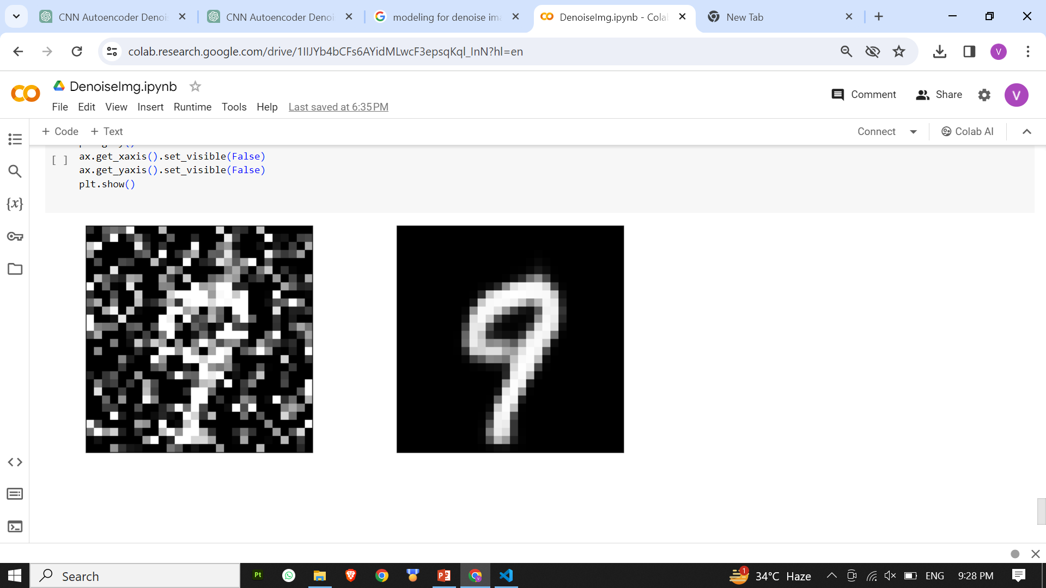
RESULTS

Slide 11


