Slide 1
Presented by: A Sneka B.TECH AI&DS III Sir Issac Newton College Of Engineering & Technology
AI for Earth Observation and Climate Analysis

Slide 2


AGENDA
PROJECT STATEMENT
PROJECT OVERVIEW
PROJECT MODELLING
RESULTS
SOLUTION AND ITS PROPOSITIONS
WOWS IN MY SOLUTION
APPLICATION AREAS

Slide 3
PROJECT STATEMENT
Utilizing AI to transform Earth observation and climate analysis, facilitating proactive environmental management and informed decision-making.
Objective: Revolutionize monitoring and analysis using AI algorithms.
Approach: Integrate AI with Earth observation systems and foster interdisciplinary collaboration.
Impact: Accurate monitoring, improved climate understanding, empowered decision-makers, and sustainable solutions.
Milestones: Data collection, AI model development, collaborative testing, stakeholder engagement, continuous improvement.

Slide 4

PROJECT OVERVIEW
Traditional methods of Earth observation and climate analysis struggle to keep pace with the complexity and scale of environmental data, hindering our ability to understand and mitigate the impacts of climate change and environmental degradation.
Leveraging artificial intelligence presents an opportunity to revolutionize Earth observation and climate analysis by improving data processing efficiency, enhancing predictive capabilities, and enabling timely, actionable insights for decision-makers.

Slide 5

WHO ARE THE END USERS?
Policymakers & Government Agencies: Inform policy decisions on environmental conservation and disaster management.
Environmental Scientists & Researchers: Conduct in-depth analysis for studying climate trends and ecological changes.
Non-Governmental Organizations (NGOs): Support conservation efforts and community resilience initiatives.
Industries & Corporations: Implement sustainable practices and comply with environmental regulations.
General Public: Access real-time environmental data for informed decision-making.

Slide 6

YOUR SOLUTION AND ITS VALUE PROPOSITION
Integration of advanced AI techniques with Earth observation systems.
Accuracy and Efficiency: Improved data analysis for precise monitoring.
Timely Insights: Proactive measures based on real-time data.
Predictive Capabilities: Reliable weather forecasts and climate projections.
Cross-Disciplinary Collaboration: Holistic approaches to environmental challenges.
User-Friendly Interfaces: Accessible decision-support tools for diverse stakeholders.
Sustainability and Resilience: Building a sustainable and resilient future.

Slide 7

THE WOW IN YOUR SOLUTION
Unprecedented Precision: AI unlocks unparalleled accuracy in data analysis, providing insights at an unprecedented scale and detail.
Real-Time Actionability: Instant processing enables proactive decision-making, responding swiftly to emerging environmental threats.
Next-Level Predictive Power: AI models revolutionize forecasting accuracy, offering foresight into climate patterns and environmental changes.
Collaborative Innovation: Interdisciplinary collaboration amplifies collective intelligence to tackle environmental challenges with innovative strategies.
Accessible Empowerment: Intuitive interfaces democratize environmental insights, empowering stakeholders across sectors.
Transformational Sustainability: AI doesn't just address issues; it revolutionizes our approach, paving the way for a sustainable future.
3/21/2024 Annual Review

Slide 8
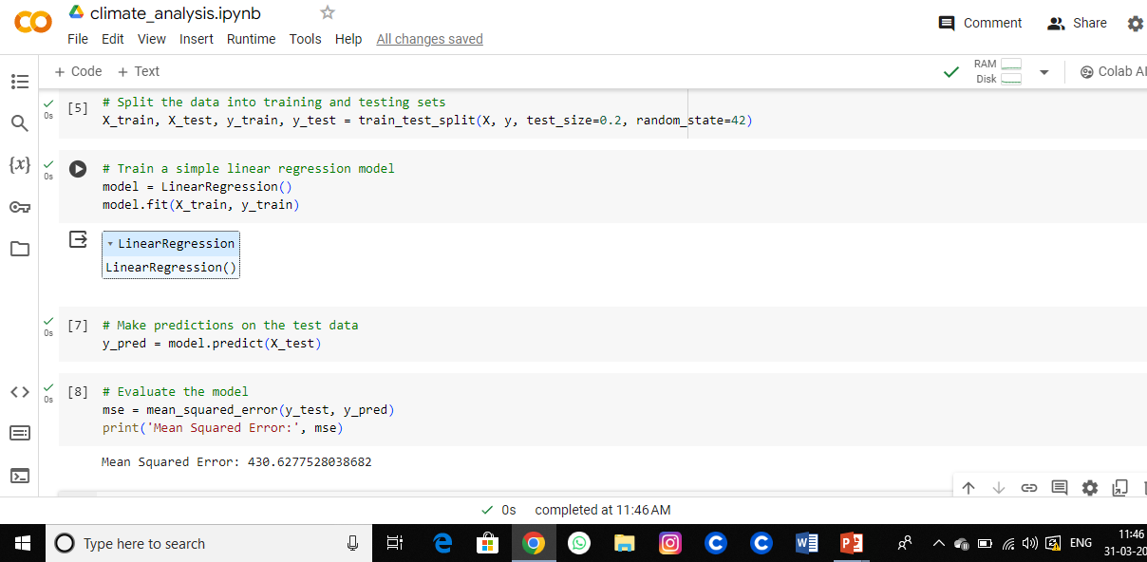
MODELLING

Slide 9
RESULTS
Unprecedented Precision: AI unlocks unparalleled accuracy in data analysis, providing insights at an unprecedented scale and detail.
Real-Time Actionability: Instant processing enables proactive decision-making, responding swiftly to emerging environmental threats.
Next-Level Predictive Power: AI models revolutionize forecasting accuracy, offering foresight into climate patterns and environmental changes.
Collaborative Innovation: Interdisciplinary collaboration amplifies collective intelligence to tackle environmental challenges with innovative strategies.
Accessible Empowerment: Intuitive interfaces democratize environmental insights, empowering stakeholders across sectors.
Transformational Sustainability: AI doesn't just address issues; it revolutionizes our approach, paving the way for a sustainable future.
Demo Link

Slide 10
APPLICATION AREAS
Environmental Monitoring: Tracking environmental changes such as deforestation and pollution levels.
Climate Prediction: Forecasting weather patterns and long-term climate trends.
Disaster Management: Early detection and response to natural disasters.
Sustainable Development: Supporting ecosystem conservation and land use planning.
Policy Support: Providing data-driven insights for environmental policymaking.
Public Awareness: Educating and engaging the public on environmental issues using real-time data.

Slide 11
THANK YOU
CONTACT:
SNEKAAARTHI2004@GMAIL.COM

