Slide 1
KEYLOGGER
Presented By:
Sneka P
Dr.Sivanthi Aditanar College Of Engineering
B.TECH-INFORMATION TECHNOLOGY

Slide 2
OUTLINE
Problem Statement
Proposed System/Solution
System Development Approach
Algorithm & Deployment
Result
Conclusion
Future Scope
References

Slide 3
Problem Statement
In today's digital age, where cybersecurity threats loom large, one of the significant concerns is the proliferation of keyloggers, stealthy software tools designed to monitor and record keystrokes on a user's computer without their knowledge. Keyloggers pose a severe threat to individuals and organizations as they can capture sensitive information such as passwords, credit card details, and other personal data, leading to identity theft, financial loss, and privacy breaches.

Slide 4
Proposed Solution
1. Restrict Keylogger Execution:
Permissions:
Run as a non-administrator user with limited permissions.
Implement application whitelisting to control which programs can run.
Antivirus/Anti-malware:
Utilize updated antivirus and anti-malware software to detect and block keyloggers.
2. Encryption and Password Protection:
Encrypt Sensitive Data
Password Managers.
3. Secure Data Handling:
Virtual Keyboards: Use virtual keyboards for logins and password entries to thwart keylogging.
Two-Factor Authentication: Enable two-factor authentication for sensitive accounts to add an extra layer of security.
4. Code-Specific Recommendations (If Applicable):
5. General Security Practices

Slide 5
System Approach
The "System Approach" section outlines the overall strategy and methodology for developing and implementing the
keyloggers system. Here's a suggested structure for this section:
1. Application Whitelisting and Permissions Management:
Implement application whitelisting on your system. This allows only pre-approved programs to run, effectively blocking
unauthorized keyloggers.
Enforce strict user account controls. Limit user privileges, especially for non-administrator accounts, to prevent unauthorized
installation of keyloggers.
2. Endpoint Security and Detection:
Deploy a robust endpoint security solution with real-time monitoring capabilities. These solutions can detect suspicious
behavior associated with keyloggers and prevent them from running.
Utilize anti-malware software with keylogger detection features. Regularly update the software to ensure it has the latest threat signatures.
Consider implementing a behavior-based detection system. These systems monitor system processes for unusual activity,
potentially identifying keyloggers that haven't yet been flagged as malicious.
3. User Awareness and Training:
Educate users about keylogger threats and how to identify suspicious behavior.
Train users on safe browsing practices, avoiding untrusted links and attachments, and exercising caution when installing software.
Encourage the use of virtual keyboards for sensitive information like passwords.
4. Secure Data Management Practices:
Enforce strong password policies. Enforce multi-factor authentication (MFA) on all accounts whenever possible.
This adds an extra layer of security, making it difficult for attackers to gain access even if they steal login credentials.
Implement encryption for sensitive data at rest and in transit.

Slide 6
Algorithm & Deployment
Harden System:
a) Whitelist Apps: Only allow approved programs to run. (IT Admin Needed)
b) Limit User Permissions: Grant users minimum access required.
Deploy Endpoint Security:
a) Install Security Solution: Choose a real-time endpoint security tool with keylogger detection.
b) Update Anti-Malware: Keep anti-malware software up-to-date.
Train and Educate Users:
a) Train on Threats: Educate users on keylogger risks and how to identify them.
b) Promote Safe Practices: Encourage virtual keyboards and strong passwords with MFA.
Secure Data:
a) Enforce Strong Passwords: Minimum length, complexity, and regular changes.
b) Enable Multi-Factor Authentication (MFA): Add an extra layer of security.
c) Encrypt Sensitive Data: Protect data at rest and in transit.
Deployment:
Integrate Security Tools: Ensure compatibility with existing infrastructure.
Test and Monitor: Thoroughly test implemented solutions and monitor for suspicious activity.
User Impact: Consider potential impact of stricter access controls and provide support/training

Slide 7
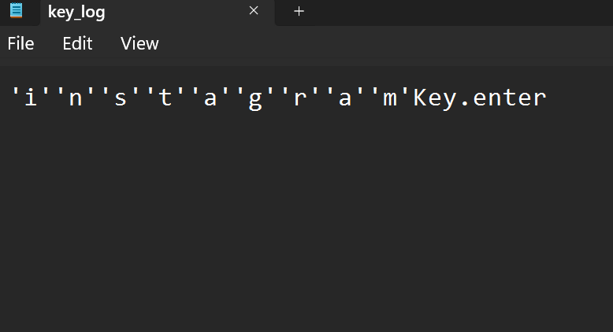
Result

Slide 8
Conclusion
This keylogger, a layered approach is crucial to effectively prevent keylogging threats in a real-world environment. By combining system hardening, endpoint security deployment, user training, and data security measures, you can significantly reduce the risk of keyloggers capturing sensitive information.

Slide 9
Future scope
Advanced Detection Methods: Develop AI-powered detection systems that can identify sophisticated keyloggers that evade traditional signature-based detection.
Behavioral Biometrics: Integrate behavioral biometrics like typing patterns or mouse movements to identify anomalies that might indicate unauthorized keylogging activity.
Zero-Trust Security: Implement a zero-trust security model where all users and devices are continuously authenticated and authorized before granting access, further reducing the potential impact of keyloggers.
User Education Enhancements: Develop interactive training modules and phishing simulations to improve user awareness and ability to recognize social engineering tactics used to spread keyloggers.
Cloud-based Security Solutions: Explore cloud-based security solutions that can provide real-time protection and centralized management of keylogger defense strategies.

Slide 10
References
National Institute of Standards and Technology (NIST) Special Publication 800-63B: This publication by NIST provides guidance for implementing effective security controls, including those relevant to keylogger prevention (https://pages.nist.gov/800-63-3/sp800-63b.html).

Slide 11
THANK YOU

