Slide 1

LDMS Version 4.3 Tutorial Part 1: Basics https://github.com/ovis-hpc/ovis/tree/OVIS-4
OGC | Open Grid Computing, Austin, TX
Sandia National Laboratories
Open Grid Computing, Inc.
SAND2017-5153 O
Sandia National Laboratories is a multi-mission laboratory managed and operated by National Technology and Engineering Solutions of Sandia, LLC., a wholly owned subsidiary of Honeywell International, Inc., for the U.S. Department of Energy’s National Nuclear Security Administration under contract DE-NA-0003525.

Slide 2
Advance Set-up (site specific: wifi UCF_Guest)
We will be using docker containers hosted at Open Grid Computing
$ ssh <user>@ldmscon2020.ogc.us
$ password: <machine generated password sent to you>
$ ssh user#@node-<#> (No password needed as ssh keys are set up)
Note: You will be provided with a node number to log into. Please only log into that node as you will collide with another user otherwise.

Slide 3
Tutorial Format (Basic)
Overview of the Lightweight Distributed Metric Service (LDMS) (3 slides)
  Overview of the LDMS framework
  LDMS architecture description
Setup (3 slides)
  Environment setup description and verification
  Introduction to helper scripts and configurations for use in lab work
Hands-on exercises, instructor walk through, and facilitated student exploration:
  Exercise 1: Located under “Additional Exercises”
  Configuring and deploying a distributed monitoring system with storage
  Exercise 2: Configuring and Running Samplers (24 slides – ~45 min)
    Sampler startup and local and remote verification
    Intro to ldmsd_controller and ldms_ls
  Exercise 3: Configure Aggregators (13 slides – ~30 min)
    Aggregation startup and verification using local samplers
    Aggregation of all other attendees’ (remote) samplers
  Exercise 4: Aggregating From Remote Hosts: Building a Distributed Monitoring System (3 slides – ~25 min)
  Exercise 5: Dynamic Configurations and Resilience (4 slides – ~5 min)
  Exercise 6: Storing Data In CSV Format (4 slides – ~10 min)
  Additional Exercises: memeater (Exercise 1 – 1 slide)
    change sampler interval (Exercise 2 – 2 slides)
    Check metrics using memeater (Exercise 3 – 1 slide)
    Using the distributed system (Exercise 4 – 1 slide )
    Manual aggregator configuration (Exercise 6 – 5 slides)

Slide 4
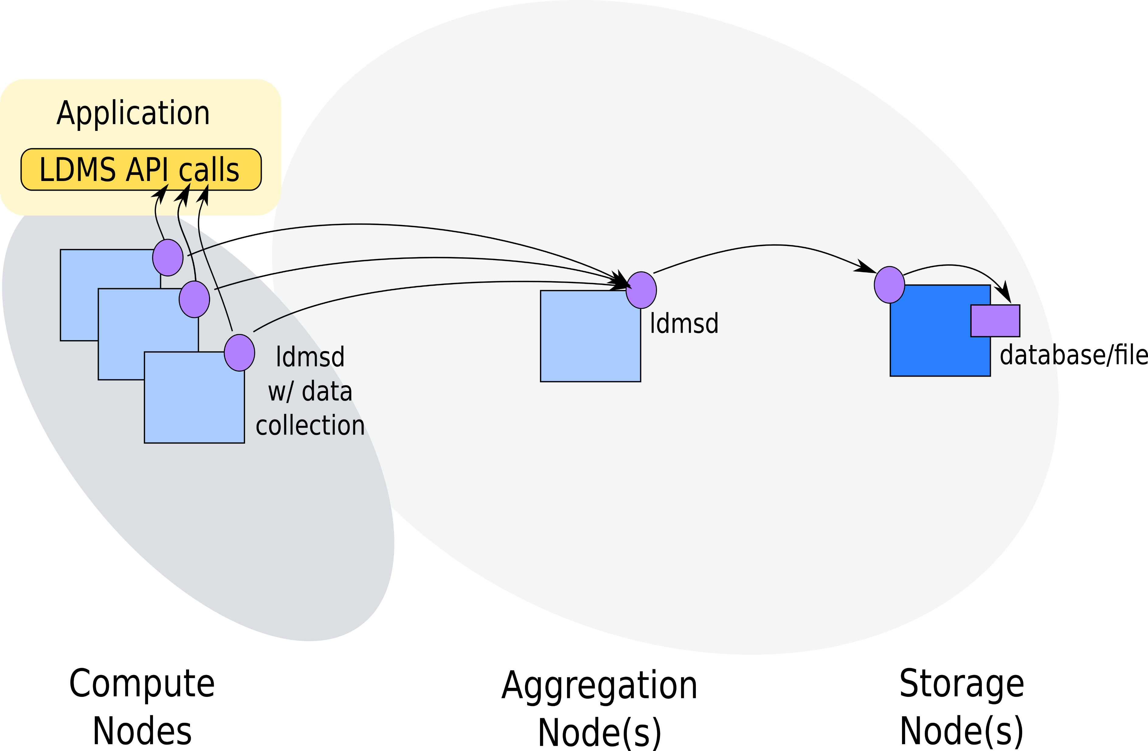
Lightweight Distributed Metric Service (LDMS) High Level Overview
* Only the current data is retained on-node

Slide 5
LDMS Plugin Architecture
Memory
Sampler Plug-in Interface
Storage Plug-in Interface
Storage
Memory Sampler
HSN Sampler
CSV
Store
Other
Store
CSV
Metric Set
LDMS Daemon
Metric Set
LDMS API (libldms)
LDMS API (libldms)
Rabbit
Metric Set
Transport Driver Interface
Metric Set
SOS
RDMA Transport
Socket Transport
Notes:
HSN = High Speed Network

Slide 6


Slide 7
Exercise 1: Setup

Slide 8
Getting started: Log in and set up your environment
$ ssh user<#>@72.48.214.73
$ password: <machine generated password sent to you>
$ ssh user#@node-<#> (No password needed as ssh keys are set up)
Note: Please ssh to the node assigned to you so as to not have port # conflicts
Note: “/home/<user>/ldmscon2020/basic/exercises/ldms/env/ldms-env.sh” can be used to set up LDMS environment.
You will want at least 2 terminal windows up for the tutorial

Slide 9
Container directory structure:
Home directories include scripts and configuration files for every exercise.
Directory structure:
/home/<user>/ldmscon2020/basic/exercises/ # Location of exercise related directories
/home/<user>/ldmscon2020/basic/exercises/ldms/conf/ # Exercise configuration files
/home/<user>/ldmscon2020/basic/exercises/ldms/data/ # LDMS data
/home/<user>/ldmscon2020/basic/exercises/ldms/env/ # Script to configure environment variables
/home/<user>/ldmscon2020/basic/exercises/ldms/scripts/ # Helper scripts for deploying LDMS
/home/<user>/ldmscon2020/basic/ exercises/ldms/logs/ # Place to write log files
/tmp/run/ # Place to write pid files

Slide 10
Getting started: Set up and verify your environment
Edit environment configuration file (ldms-env.sh)
TOP=/opt/ovis
#System environment variables
export PATH=${TOP}/bin/:${TOP}/sbin/:${PATH}
export LD_LIBRARY_PATH=${TOP}/lib/:${LD_LIBRARY_PATH}
export PYTHONPATH=${TOP}/lib/python2.7/site-packages/:${PYTHONPATH}
#LDMS environment variables
export ZAP_LIBPATH=${TOP}/lib/ovis-ldms
export LDMSD_PLUGIN_LIBPATH=${TOP}/lib/ovis-ldms
Source your environment configuration file
$ source ldmscon2020/basic/exercises/ldms/env/ldms-env.sh

Slide 11
Exercise 2: Configuring and Running Samplers

Slide 12
LDMS Plugin Architecture
Memory
Sampler Plug-in Interface
Storage Plug-in Interface
Storage
Memory Sampler
HSN Sampler
CSV
Store
Other
Store
CSV
Metric Set
LDMS Daemon
Metric Set
LDMS API (libldms)
LDMS API (libldms)
Rabbit
Metric Set
Transport Driver Interface
Metric Set
SOS
RDMA Transport
Socket Transport

Slide 13
Start and Configure a LDMS Daemon
Exercise Goals:
Basic LDMS daemon startup and configuration flags/args
  Manual and run-time configuration options
  Output options
    Log files and
  man pages
    man ldmsd – displays ldmsd man pages
    man ldmsd_controller – displays “ldmsd_controller” man pages
Use of ldms_ls utility as a diagnostic tool
  man pages
    man ldms_ls – displays ldms_ls man pages

Slide 14
Exercise: Start a LDMS Daemon
Start ldmsd with minimum configuration
ldmsd –x sock:10001 \
–l /home/<user>/ldmscon2020/basic/exercises/ldms/logs/sampler1.log
-x: Transport : listening port
-l: Specify the log file path and name(this is not strictly necessary)
NOTES:
Commands should be typed in the command prompt window. Copy and paste may introduce non-printable characters and cause unexpected results.
You will receive a “permission denied” error in the “sampler1.log” file. The default pid file location of /var/run/ is not accessible by user. This will not affect the operation of your daemon.
  -r : The path to the pid file. Please review man page “/ldms/man/ldmsd.man” for more information
Notes:
May remove pid from the basic

Slide 15
Exercise: Check ldmsd Running Status
Using ps
ps auxw | grep ldmsd | grep –v grep
  Returns something like:
    “ovis_pu+ 3582 0.0 0.1 401604 2204 ? Ssl 12:51 0:00 ldmsd -x sock:10001“ if running
  Returns: blank line if not running
Using ldms_ls
ldms_ls –h localhost –x sock –p 10001
  Returns: “Connection failed/rejected.” if ldmsd specified does not exist or authentication fails
  Returns: blank line if the ldmsd specified exists but has no metric sets configured
  Remote: Replace “localhost” in the command above with another container e.g., “node<#>”
Also check ports
netstat –an | grep 000
tcp 0 0 0.0.0.0:10001 0.0.0.0:* LISTEN
Troubleshooting: Also check the log for clues if operation seems wrong.

Slide 16
EXAMPLE: Start and Check LDMSD Daemon
*Directories and file names may differ from those presented in the slides.
*Run in “Slide Show” format (Slide Show -> From Current Slide)

Slide 17
Manually Load and Configure a Sampler Plugin
Additional Exercise Goals:
Basic sampler plugin operation
  Manual dynamic configuration using the “ldmsd_controller” utility
  Static configuration using a configuration file
  man pages
    man Plugin_meminfo – opens meminfo plugin man pages
    man Plugin_vmstat – opens vmstat plugin man pages
Use of ldms_ls utility as a diagnostic tool
  man pages
    man ldms_ls – opens ldms_ls man pages

Slide 18
LDMS Plugin Architecture
Memory
Sampler Plug-in Interface
Storage Plug-in Interface
Storage
Memory Sampler
HSN Sampler
CSV
Store
Other
Store
CSV
Metric Set
LDMS Daemon
Metric Set
LDMS API (libldms)
LDMS API (libldms)
Rabbit
Metric Set
Transport Driver Interface
Metric Set
SOS
RDMA Transport
Socket Transport

Slide 19
Configure LDMS Daemon Sampler Plugin
Goals:
Load the “meminfo” sampler plugin
Configure loaded “meminfo” sampler plugin
  Provide the set name (instance)
  Provide the node name (producer)
  Provide the component ID
  Provide any additional Plugin-specific arguments
Start sampler plugin with a particular sampling interval and offset
optional

Slide 20
Exercise: Connect ldmsd_controller To An ldmsd
Set up “ldmsd_controller” connection to the aggregator
$ldmsd_controller --host localhost --port 10001
Welcome to the LDMSD control processor
sock:localhost:10001> help
See “LDMS HELP” slides for help results
Note 1: The prompt tells you <transport>:<hostname>:<port>
Note 2: You can use “quit” or Ctrl-d to exit or Ctrl-c to kill the ldmsd_controller

Slide 21
Example: ldmsd_controller: “help” Topics
sock:localhost.10001> help
Documented commands (type help <topic>):
========================================
EOF logrotate setgroup_del term
comment oneshot setgroup_ins udata
config plugn_sets setgroup_mod udata_regex
connect prdcr_add setgroup_rm updtr_add
daemon_exit prdcr_del shell updtr_del
daemon_status prdcr_hint_tree source updtr_match_add
env prdcr_set_status start updtr_match_del
failover_config prdcr_start stop updtr_prdcr_add
failover_peercfg_start prdcr_start_regex strgp_add updtr_prdcr_del
failover_peercfg_stop prdcr_status strgp_del updtr_start
failover_start prdcr_stop strgp_metric_add updtr_status
failover_status prdcr_stop_regex strgp_metric_del updtr_stop
failover_stop prdcr_subscribe strgp_prdcr_add updtr_task
greeting publish strgp_prdcr_del usage
help quit strgp_start version
include say strgp_status
load set_route strgp_stop
loglevel setgroup_add subscribe
Undocumented commands:
======================
example plugn_status script status try
Use to load and config plugin
Use to start samplers
Use to start aggregators
Use to aggregators that store
Get help and daemon status

Slide 22
Example: ldmsd_controller - Command Help
sock:localhost:10001> help prdcr_add
Add an LDMS Producer to the Aggregator
Parameters:
name= A unique name for this Producer
xprt= The transport name [sock, rdma, ugni]
host= The hostname of the host
port= The port number on which the LDMS is listening
type= The connection type [active, passive]
interval= The connection retry interval (us)

Slide 23
Exercise: Interactive Daemon Configuration Using The ldmsd_controller
Load the “meminfo” sampler plugin:
  sock:localhost:10001> load name=meminfo
Configure the “meminfo” sampler plugin:
sock:localhost:10001> config name=meminfo producer=<$HOSTNAME> instance=<$HOSTNAME>/meminfo component_id=<host number>
EXAMPLE:
sock:localhost:10001> load name=meminfo *enter*
sock:localhost:10001> config name=meminfo producer=node-1 instance=node-1/meminfo component_id=1 *enter*
producer: Initialize the name of the sampler (can be a string)
Instance: Initialize the name of the node the sampler is running on
component_id: Initialize with an integer

Slide 24
Exercise: Query Current Sets On An LDMS Daemon Using “ldms_ls”
Use ldms_ls to query the current sets available on an LDMS daemon
$ ldms_ls –h localhost -x sock -p 10001
node-1/meminfo

Slide 25
Exercise: Get The Set Information Before Starting The “meminfo” Sampler Plugin
$ ldms_ls –h localhost -x sock -p 10001 –v node-<#>/meminfo
Schema Instance Flags Msize Dsize UID GID Perm Update Duration Info
-------------- ------------------------ ------ ------ ------ ------ ------ ---------- ----------------- ----------------- --------
meminfo node-1/meminfo L 1952 416 596 742 -rwxrwxrwx 0.000000 0.000000 "updt_hint_us"="1000000:0"
-------------- ------------------------ ------ ------ ------ ------ ------ ---------- ----------------- ----------------- --------
Total Sets: 1, Meta Data (kB): 1.95, Data (kB) 0.42, Memory (kB): 2.37
NOTE: The “node-1/meminfo” is optional. It is suggested as it will be easier to identify certain sampler daemons when multiple are running on the same host and port.

Slide 26
EXAMPLE: Interactive Configuration Using The ldmsd_controller
*Directories and file names may differ from those presented in the slides.
*Run in “Slide Show” format (Slide Show -> From Current Slide)

Slide 27
Exercise: Query Current Metric Values Before Starting The “meminfo” Sampler Plugin
$ ldms_ls -x sock -p 10001 -l node-<#>/meminfo
node-1/meminfo: inconsistent, last update: Wed Dec 31 17:00:00 1969 -0700 [0us]
M u64 component_id 1
D u64 job_id 0
D u64 app_id 0
D u64 MemTotal 0
D u64 MemFree 0
D u64 MemAvailable 0
D u64 Buffers 0
D u64 Cached 0
D u64 SwapCached 0
D u64 Active 0
D u64 Inactive 0
D u64 Active(anon) 0
D u64 Inactive(anon) 0
Set is “inconsistent”
Values have not yet been collected

Slide 28
Exercise: Start The “meminfo” Sampler Plugin
Start the “meminfo” sampler with a 1 second interval
  sock:localhost:10001> start name=meminfo interval=1000000 offset=0
This starts the sampler updating the metric values every 1,000,000 micro-seconds = 1 second
Note 1: “offset” defines micro-seconds after the second
Note 2: If offset is not specified the timer starts when the sampler starts

Slide 29
Exercise: Query Current Metric Values After Starting The “meminfo” Sampler Plugin
$ ldms_ls -x sock -p 10001 -l node-<#>/meminfo
node-1/meminfo: consistent, last update: Tue Oct 08 17:52:45 2019 -0600 [2058us]
M u64 component_id 1
D u64 job_id 0
D u64 app_id 0
D u64 MemTotal 131899768
D u64 MemFree 129843340
D u64 MemAvailable 129364708
D u64 Buffers 20076
D u64 Cached 458024
D u64 SwapCached 0
D u64 Active 184380
D u64 Inactive 393140
D u64 Active(anon) 125324
D u64 Inactive(anon) 284684
Set is “consistent”
Values have been collected

Slide 30
Exercise: Check Data Source (/proc/meminfo) For Confirmation
$ cat /proc/meminfo
MemTotal: 131899768 kB
MemFree: 129828892 kB
MemAvailable: 129350280 kB
Buffers: 20076 kB
Cached: 458076 kB
SwapCached: 0 kB
Active: 192340 kB
Inactive: 393064 kB
Active(anon): 133212 kB
Inactive(anon): 284680 kB
Active(file): 59128 kB

Slide 31
EXAMPLE: “meminfo” Sampler Plugin
*Directories and file names may differ from those presented in the slides.
*Run in “Slide Show” format (Slide Show -> From Current Slide)

Slide 32
Kill Currently Running Daemons
Kill all of your ldmsd in preparation for the next section
  $ killall ldmsd
  $ pkill ldmsd
Kill a particular ldmsd
  $ ps auxw | grep ldmsd | grep –v grep
  $ ovis_pu+ 3582 0.0 0.1 401604 2204 ? Ssl 12:51 0:00 ldmsd -x sock:10001 -S samplerd.sock
  $ kill 3582
Check to make sure it is dead
  $ ps auxw | grep ldmsd | grep –v grep

Slide 33
Exercise 2.1: Start a ldmsd and Sampler Plugin Using a Configuration File
A ldmsd can be started using a configuration file
  Syntax is identical to that used for manual configuration
  Can be used to run and configure BOTH sampler and aggregator ldmsd
Edit the sample configuration file, as appropriate, for the meminfo example:
$ cat ~/ldmscon2020/basic/exercises/ldms/conf/E2.1/simple_sampler.conf
NOTE: If the “simple_sampler.conf” is not there, then please create this file in this directory and populate it with the content below:
load name=meminfo
config name=meminfo producer=<$HOSTNAME> instance=<$HOSTNAME>/meminfo component_id=<host number>
start name=meminfo interval=1000000
Run an ldmsd using this configuration file (argument after the –c flag). Modify <user> to your user name. Or run ~/ldmscon2020/basic/exercises/ldms/scripts/E2.1/start_ldms_simple.sh
$ ldmsd -x sock:10001 \
-l /home/<user>/exercises/ldms/logs/sampler1.log \
–c /home/<user>/ldmscon2020/basic/exercises/ldms/conf/E2.1/simple_sampler.conf

Slide 34
Exercise 2.1: Query The Metric Values: The “meminfo” Sampler Is Configured And Running
$ ldms_ls -x sock -p 10001 -l node-<#>/meminfo
node-1/meminfo: consistent, last update: Tue Oct 08 17:52:45 2019 -0600 [2058us]
M u64 component_id 1
D u64 job_id 0
D u64 app_id 0
D u64 MemTotal 131899768
D u64 MemFree 129843340
D u64 MemAvailable 129364708
D u64 Buffers 20076
D u64 Cached 458024
D u64 SwapCached 0
D u64 Active 184380
D u64 Inactive 393140
D u64 Active(anon) 125324
D u64 Inactive(anon) 284684
Set is “consistent”
Values have been collected

Slide 35
Exercise 2.1: Multiple Sampler Plugins
Uncomment the lines for the vmstat plugin in simple_sampler.conf and restart the ldmsd.
  load name=vmstat
  config name=vmstat producer=<hostname> instance=<hostname>/vmstat component_id=<hostnum>
  start name=vmstat interval=1000000 offset=0
Kill (kill *pid* or killall ldmsd) and Restart daemon
Query the ldmsd:
  ldms_ls -h localhost -x sock -p 10001
  node-1/vmstat
  node-1/meminfo
Note: hostname is just a string and hostnum is just a uint_64. Example: hostname=node-1, hostnum=1

Slide 36
Multiple Sampler Plugins - EXAMPLE
*Directories and file names may differ from those presented in the slides.
*Run in “Slide Show” format (Slide Show -> From Current Slide)

Slide 37
Exercise 3: Configure Aggregators

Slide 38
LDMS Plugin Architecture
Memory
Sampler Plug-in Interface
Storage Plug-in Interface
Storage
Memory Sampler
HSN Sampler
CSV
Store
Other
Store
CSV
Metric Set
LDMS Daemon
Metric Set
LDMS API (libldms)
LDMS API (libldms)
Rabbit
Metric Set
Transport Driver Interface
Metric Set
SOS
RDMA Transport
Socket Transport

Slide 39
Configure a LDMS daemon (ldmsd) to Aggregate metric set(s)
Goals:
Add list of connections to a ldmsd (connections to sampler ldmsd(s))
Start the connections
Create an “update policy”
  Define an “update policy” update period
  Define which sets an update policy refers to
Start the “update policy”

Slide 40
Exercise: Start a ldmsd That Will Be Used For Aggregation
(Re)start the sampler ldmsd from exercise 2.1 (can keep both meminfo and vmstat)
Start new aggregator ldmsd with minimum configuration:
$ ldmsd –x sock:20001 –l /home/<user>/ldmscon2020/basic/exercises/ldms/logs/agg1.log
-x: Transport : listening port
-l: Specify the log file path and name (this is not strictly necessary)
NOTE:
We will be using a different port number. Instead of 10001 we will be running a daemon on port 20001.
Please refer to slides for help in re-creating a sampler daemon
Notes:
May remove pid from the basic

Slide 41
Exercise: Interactive Aggregator Configuration
Set up “ldmsd_controller” connection to the aggregator over socket
$ ldmsd_controller --host localhost --port 20001
Welcome to the LDMSD control processor
sock:localhost:20002>

Slide 42
Exercise: Simple Aggregator Producer Configuration
Configure the aggregator to aggregate the “meminfo” set from your sampler daemon (listening on port 10001)
  sock:localhost:20001> prdcr_add name=prdcr1 host=$HOSTNAME port=10001 xprt=sock type=active interval=20000000
  sock:localhost:20001> prdcr_start name=prdcr1
name: policy tag (this is just a string)
host: hostname for the sampler daemon (e.g. node-<#>)
port: Listener port of the sampler daemon
xprt: Transport the sampler daemon listens on
type: Always “active” (the aggregator will initiate the connection with the sampler)
interval: Re-connect interval (not aggregation interval)

Slide 43
Exercise: Check Aggregator Status
(after producer (prdcr) is started but before the updater (updtr) is started)
sock:localhost:20001> status
Name Type Interval Offset Libpath
------------ ------------ ------------ ------------ ------------
Name Host Port Transport State
---------------- ---------------- ------------ ------------ ------------
prdcr1 nid00062 10001 sock CONNECTED
nid00062 /meminfo meminfo_x86_ven0000fam0006mod003F START
nid00062 /vmstat vmstat_x86_ven0000fam0006mod003F START
Name Interval Offset Mode State
---------------- ------------ ------------ --------------- ------------
Name Container Schema Plugin State
---------------- ---------------- ---------------- ---------------- ------------

Slide 44
Exercise: Query Current Metric Values On The Aggregator
$ ldms_ls –h localhost -x sock -p 20001 -l
$
Note: While status (previous slide) shows that the aggregator knows what sets the producer has, the ldms_ls query returns nothing because the updater had not yet been run and the set has not been populated with data.

Slide 45
EXAMPLE: Simple Aggregator Producer Configuration
*Directories and file names may differ from those presented in the slides.
*Run in “Slide Show” format (Slide Show -> From Current Slide)

Slide 46
Exercise: Simple Aggregator Updater Configuration
Configure the aggregator to update the “meminfo” set
sock:localhost:20001> updtr_add name=updtr1 interval=1000000 offset=200000
sock:localhost:20001> updtr_prdcr_add name=updtr1 regex=.*
sock:localhost:20001> updtr_start name=updtr1
name: policy tag (string)
interval: update (pull) interval (in usec)
  Example: interval=1000000 means pull data from sampler every 1 seconds
offset: Target (in us) from <epoc sec>.000000
  Example: offset=10000 means aggregate every <interval> seconds at 10ms into the second. If aggregator pulls while sampler is running then the set will be inconsistent
regex: regular expression to match the target producers tag(s)

Slide 47
Exercise: Check Aggregator Status
(after starting both producer (prdcr) and updater (updtr) policies)
sock:localhost:20001> status
Name Type Interval Offset Libpath
------------ ------------ ------------ ------------ ------------
Name Host Port Transport State
---------------- ---------------- ------------ ------------ ------------
prdcr1 node-1 10001 sock CONNECTED
nid00062/meminfo meminfo_x86_ven0000fam0006mod003F READY
nid00062/vmstat vmstat_x86_ven0000fam0006mod003F READY
Name Interval Offset Mode State
---------------- ------------ ------------ --------------- ------------
updtr1 1000000 200000 Pull RUNNING
prdcr1 node-1 10001 sock CONNECTED
Name Container Schema Plugin State
---------------- ---------------- ---------------- ---------------- ------------

Slide 48
Exercise: Query Current Metric Values On The Aggregator
$ ldms_ls -h localhost -x sock -p 20001 -l node-<#>/meminfo
Node-1/meminfo: consistent, last update: Wed Oct 09 18:30:49 2019 -0600 [2093us]
M u64 component_id 1
D u64 job_id 0
D u64 app_id 0
D u64 MemTotal 131899768
D u64 MemFree 129834752
D u64 MemAvailable 129356628
D u64 Buffers 20228
D u64 Cached 458892
D u64 SwapCached 0
D u64 Active 196708
D u64 Inactive 393768
D u64 Active(anon) 137336

Slide 49
EXAMPLE: Simple Aggregator Updater Configuration
*Directories and file names may differ from those presented in the slides.
*Run in “Slide Show” format (Slide Show -> From Current Slide)

Slide 50
Exercise 3.1: Start ldmsd and Aggregation Using a Configuration File
A ldmsd for performing aggregation can be started using a configuration file in the same manner as a ldmsd for sampling
Configuration file syntax is identical to that used for manual configuration
Edit your sample configuration file to reflect your host:
$ cat /home/<user>/ldmscon2020/basic/exercises/ldms/conf/E3.1/simple_agg.conf
NOTE: If the “simple_agg.conf” is not there, then please create this file in this directory and populate it with the content below:
Kill your aggregator and restart your aggregator ldmsd:
$ ldmsd -x sock:20001 -l /home/<user>/ldmscon2020/basic/exercises/ldms/log/aggd.log \
–c /home/<user>/ldmscon2020/basic/exercises/ldms/conf/E3.1/simple_agg.conf
You can also run the following script to start an aggregator daemon using a configuration file:
$ ~/ldmscon2020/basic/exercises/ldms/scripts/E3.1/start_ldms_simple_agg.sh
    prdcr_add name=prdcr1 host=$HOSTNAME port=10001 xprt=sock type=active interval=20000000
    prdcr_start name=prdcr1
  updtr_add name=updtr1 interval=1000000 offset=200000
  updtr_prdcr_add name=updtr1 regex=.*
  updtr_start name=update_all

Slide 51
Exercise 3.1: Start ldmsd and Aggregation Using a Configuration File
A ldmsd for performing aggregation can be started using a configuration file in the same manner as a ldmsd for sampling
Configuration file syntax is identical to that used for manual configuration
Edit your sample configuration file to reflect your host:
$ cat /home/<user>/ldmscon2020/basic/exercises/ldms/conf/E3.1/simple_agg.conf
NOTE: If the “simple_agg.conf” is not there, then please create this file in this directory and populate it with the content below:
Kill your aggregator and restart your aggregator ldmsd:
$ ldmsd -x sock:20001 -l /home/<user>/ldmscon2020/basic/exercises/ldms/log/aggd.log \
–c /home/<user>/ldmscon2020/basic/exercises/ldms/conf/E3.1/simple_agg.conf
You can also run the following script to start an aggregator daemon using a configuration file:
$ ~/ldmscon2020/basic/exercises/ldms/scripts/E3.1/start_ldms_simple_agg.sh
    prdcr_add name=prdcr1 host=$HOSTNAME port=10001 xprt=sock type=active interval=20000000
    prdcr_start name=prdcr1
  updtr_add name=updtr1 interval=1000000 offset=200000
  updtr_prdcr_add name=updtr1 regex=.*
  updtr_start name=update_all

Slide 52
Exercise 3.1: Query Current Metric Values On The Aggregator
$ldms_ls -x sock -p 20001 -l node-<#>/meminfo
node-1/meminfo: consistent, last update: Wed Oct 09 18:30:49 2019 -0600 [2093us]
M u64 component_id 1
D u64 job_id 0
D u64 app_id 0
D u64 MemTotal 131899768
D u64 MemFree 129834752
D u64 MemAvailable 129356628
D u64 Buffers 20228
D u64 Cached 458892
D u64 SwapCached 0
D u64 Active 196708
D u64 Inactive 393768

Slide 53
EXAMPLE: Simple Aggregator with Configuration File
*Directories and file names may differ from those presented in the slides.
*Run in “Slide Show” format (Slide Show -> From Current Slide)

Slide 54
Exercise 4: Aggregating From Remote Hosts: Building a Distributed Monitoring System

Slide 55
Exercise 4.1: Aggregate From All Containers
Kill aggregator ldmsd
Edit /home/<user>/ldmscon2020/basic/exercises/ldms/conf/E4.1/agg.conf:
  $ cat /home/<user>/exercises/ldms/conf/E4.1/agg.conf
  #prdcr_add name=prdcr1 type=active host= node-1 port=10001 xprt=sock interval=20000000
  #prdcr_add name=prdcr2 type=active host= node-2 port=10001 xprt=sock interval=20000000
  #prdcr_add name=prdcr3 type=active host= node-3 port=10001 xprt=sock interval=20000000
  prdcr_start_regex regex=.* START (connect to) ALL PRODUCERS
  updtr_add name=updtr1 interval=1000000 offset=200000 UPDATE AT 1 SEC INTERVALS
  updtr_prdcr_add name=updtr1 regex=.* DO THIS ON ALL PRODUCERS
  updtr_match_add name=updtr1 match=schema regex=meminfo RESTRICT TO SETS WITH schema=meminfo
  updtr_start name=updtr1 START UPDATER POLICY “updtr1”
  updtr_add name=updtr2 interval=2000000 offset=200000 UPDATE AT 2 SECOND INTERVALS
  updtr_prdcr_add name=updtr2 regex=.* DO THIS ON ALL PRODUCERS
  updtr_match_add name=updtr2 match=schema regex=vmstat RESTRICT TO SETS WITH schema=vmstat
  updtr_start name=updtr2 START UPDATER POLICY “updtr1”
Notes:
Container or containers?

Slide 56
Exercise 4.1: Aggregate From All Containers (cont’d)
Restart ldmsd using your edited configuration file
$ ldmsd -x sock:20001 -l /home/<user>/ldmscon2020/basic/exercises/ldms/log/aggd.log \
–c /home/<user>/ldmscon2020/basic/exercises/ldms/conf/E4.1/agg.conf
NOTE: If the “agg.conf” has not yet been populated, then create this file by first copying the “simple_aggregator.conf” and adding the content from the previous slide at the end of the file.
Can also run the following script file:
$ ~/home/<user>/ldmscon2020/basic/exercises/ldms/conf/E4.1/agg.sh
LDMS supports complex topologies:
Multiple ldmsd (aggregators) can pull from the same ldmsd (sampler or aggregator)
Can daisy chain aggregators
  Hierarchical
  Support both fan-in and fan-out topologies

Slide 57
Exercise 4.1: Check Aggregator Status
sock:localhost:20001> status
Name Type Interval Offset Libpath
------------ ------------ ------------ ------------ ------------
Name Host Port Transport State
---------------- ---------------- ------------ ------------ ------------
prdcr1 nid00062 10001 sock CONNECTED
nid00062/meminfo meminfo_x86_ven0000fam0006mod003F READY
nid00062/vmstat vmstat_x86_ven0000fam0006mod003F READY
prdcr2 nid00063 10001 sock CONNECTED
nid00063/meminfo meminfo_x86_ven0000fam0006mod003F READY
nid00063/vmstat vmstat_x86_ven0000fam0006mod003F READY
prdcr3 nid00012 10001 sock DISCONNECTED
Name Interval Offset Mode State
---------------- ------------ ------------ --------------- ------------
updtr1 1000000 200000 Pull RUNNING
prdcr1 nid00062 10001 sock CONNECTED
prdcr2 nid00063 10001 sock CONNECTED
prdcr3 nid00012 10001 sock DISCONNECTED
Name Container Schema Plugin State
---------------- ---------------- ---------------- ---------------- ------------

Slide 58
EXAMPLE: Aggregate from Multiple VMs
*Directories and file names may differ from those presented in the slides.
*Run in “Slide Show” format (Slide Show -> From Current Slide)

Slide 59
Exercise 5: Basic Dynamic Configurations and Resilience

Slide 60
Basic Dynamic Configuration Changes
Dynamic configuration
  Sampler daemons (from exercise 1)
    Stopping sampler plugins
    Starting sampler plugins with different intervals
  Aggregator daemons
    Automatic detection of new metric sets on connected sampler ldmsd
    Stopping producer (prdcr) and updater (updtr) policies
    Changing updater intervals

Slide 61
Dynamically Changing a Sampler Plugin’s Interval Parameters (also exercise 1)
Using ldmsd_controller, stop the plugin:
sock:localhost:10001> stop name=meminfo
Note: Querying with ldms_ls will show that the sampler has stopped
  Restart the plugin with a different interval:
  sock:localhost:10001> start name=meminfo interval=5000000 offset=0
  Note: Querying with ldms_ls will show that the metric set is now updating only every five seconds

Slide 62
Dynamic Changes and Aggregator Robustness
On-the-fly additions of samplers will be discovered by the aggregating ldmsd
  Exercise – one student will add the vmstat sampler, using ldmsd_controller, to their running sampler ldmsd.
    All others will see it, using ldms_ls, appear in their aggregators which are pulling from that sampler.
  Exercise – one student will stop their meminfo sampler, using ldmsd_controller, on their running sampler ldmsd.
    All others will see, using ldms_ls, that the timestamp in that student’s metric set ceases to update.
  Exercise – the same student will restart their meminfo sampler, using ldmsd_controller, on their running ldmsd.
    All others will see, using ldms_ls, that the timestamp in that student’s metric set resumes updating.

Slide 63
Dynamic Changes and Robustness (cont’d)
Samplers and Aggregators can be started in any order
  Exercise – Use your modified configuration files to start the aggregator ldmsd before starting the sampler ldmsd
    Use ldms_ls to convince yourself that, whether a sampler ldmsd is started before or after an aggregator ldmsd, you are able to see the data generated at the sampler ldmsd on the aggregator ldmsd when both are running
LDMS collection and transport are robust to Samplers and Aggregators being killed and restarted
  Exercise – one student will kill their sampler ldmsd. All other students will see from ldms_ls timestamp that the student’s metric set is removed from the list.
  Exercise – the same student will restart their sampler ldmsd. All other students will see from ldms_ls timestamp that the metric set reappears and resumes updating (after up to the producer reconnect interval of 20 seconds).
  Exercise – Each student will stop and re-start their aggregator ldmsd and verify, using ldms_ls, that they are able to see appropriate data.

Slide 64
Exercise 6: Storing Data In CSV Format

Slide 65
LDMS Plugin Architecture
Memory
Sampler Plug-in Interface
Storage Plug-in Interface
Storage
Memory Sampler
HSN Sampler
CSV
Store
Other
Store
CSV
Metric Set
LDMS Daemon
Metric Set
LDMS API (libldms)
LDMS API (libldms)
Rabbit
Metric Set
Transport Driver Interface
Metric Set
SOS
RDMA Transport
Socket Transport

Slide 66
Storing Data: CSV Store Plugin
Goals:
  Configure an aggregator ldmsd with a CSV store plugin using a configuration file
  Minimal store options (don’t buffer data)
  (Optional) Configure an aggregator ldmsd with a CSV store plugin using ldmsd_controller.
Example output from the “meminfo” sampler:
#Time,Time_usec,ProducerName,component_id,job_id,MemTotal,MemFree,MemAvailable,Buffers,Cached,SwapCached,Active,Inactive,Active(anon),Inactive(anon),Active(file),Inactive(file),Unevictable,Mlocked,SwapTotal,SwapFree,Dirty,Writeback,AnonPages,Mapped,Shmem,Slab,SReclaimable,SUnreclaim,KernelStack,PageTables,NFS_Unstable,Bounce,WritebackTmp,CommitLimit,Committed_AS,VmallocTotal,VmallocUsed,VmallocChunk,HardwareCorrupted,AnonHugePages,HugePages_Total,HugePages_Free,HugePages_Rsvd,HugePages_Surp,Hugepagesize,DirectMap4k,DirectMap2M
1487105964.002482,2482,node-1, 1,
0,1884188,571028,1688632,0,1212004,6108,104536,1122496,8276,8580,96260,1113916,0,0,839676,793956,420,0,10552,24812,1796,52124,40104,12020,1792,3280,0,0,0,1781768,387984,34359738367,7216,34359728128,0,2048,0,0,0,0,2048,47040,2050048
1487105963.002583,2583, node-3,3,
0,1884188,1665280,1671132,948,107512,0,71540,80920,44128,8308,27412,72612,0,0,839676,839676,0,0,44000,22264,8436,35680,24304,11376,1600,2940,0,0,0,1781768,296444,34359738367,7216,34359728128,0,6144,0,0,0,0,2048,34752,2062336
1487105963.001964,1964, node-8, 8,
0,1884188,1623168,1644996,948,129700,0,89312,101956,60788,8332,28524,93624,0,0,839676,839676,0,0,60620,23912,8500,36456,24608,11848,1872,4364,0,0,0,1781768,403252,34359738367,7216,34359728128,0,16384,0,0,0,0,2048,44992,2052096

Slide 67
Exercise 6.1: CSV Store - Start and Configure Aggregator Using a Configuration File
Edit aggregator configuration file, as appropriate, at: /home/<user>/ldmscon2020/basic/exercises/ldms/conf/E6.1/agg_store_csv.conf
  load name=store_csv
  config name=store_csv path=/home/<user>/exercises/ldms/data/CSV buffer=0 strgp_add name=meminfo-store_csv plugin=store_csv container=memory_metrics schema=meminfo
  strgp_start name=meminfo-store_csv
Kill your aggregator and restart your aggregator ldmsd using the configuration file:
/home/<user>/ldmscon2020/basic/exercises/ldms/conf/E6.1/agg_store_csv.conf
Can also run the aggregator daemon with CSV store by running the following script:
$ ./ldmscon2020/basic/exercises/ldms/scripts/E3.1/start_ldms_simple_agg.sh

Slide 68
Exercise 6.1: CSV Store - LDMSD Status
sock:localhost:20001> status
Name Type Interval Offset Libpath
------------ ------------ ------------ ------------ ------------
csv store 1000000 0 /home/<user>/Build/OVIS-4.3.1/lib/ovis-ldms/libstore_csv.so
Name Host Port Transport State
---------------- ---------------- ------------ ------------ ------------
prdcr1 nid00052 10001 sock CONNECTED
nid00052/meminfo meminfo READY
nid00052/vmstat vmstat READY
prdcr2 nid00053 10001 sock CONNECTED
nid00053/meminfo meminfo READY
nid00053/vmstat vmstat READY
Name Interval Offset Mode State
---------------- ------------ ------------ --------------- ------------
updtr1 1000000 200000 Pull RUNNING
prdcr1 nid00052 10001 sock CONNECTED
prdcr2 nid00053 10001 sock CONNECTED
Name Container Schema Plugin State
---------------- ---------------- ---------------- ---------------- ------------
meminfo_store_csv memory_metrics meminfo store_csv RUNNING
producers:
metrics: component_id job_id app_id MemTotal MemFree MemAvailable Buffers Cached SwapCached Active Inactive Active(anon) Inactive(anon) Active(file) Inactive(file) Unevictable Mlocked SwapTotal SwapFree Dirty Writeback AnonPages Mapped Shmem Slab SReclaimable SUnreclaim KernelStack PageTables NFS_Unstable Bounce WritebackTmp CommitLimit Committed_AS VmallocTotal VmallocUsed VmallocChunk HardwareCorrupted HugePages_Total HugePages_Free HugePages_Rsvd HugePages_Surp Hugepagesize DirectMap4k DirectMap2M DirectMap1G

Slide 69
Exercise 6.1: Examining The CSV File
Exercise: Check the CSV file
  $ head /home/<user>/ldmscon2020/basic/exercises/ldms/data/CSV/ memory_metrics/meminfo
  $ tail -f /home/<user>/ldmscon2020/basic/exercises/ldms/data/CSV/memory_metrics/meminfo
  If aggregating from others’ containers, you will see multiple hosts in the output

Slide 70
EXAMPLE: CSV Store - Start and Configure Aggregator Using a Configuration File
*Directories and file names may differ from those presented in the slides.
*Run in “Slide Show” format (Slide Show -> From Current Slide)

Slide 71
Basics End

Slide 72
Additional Exercises: Exercise 1 - Memeater

Slide 73
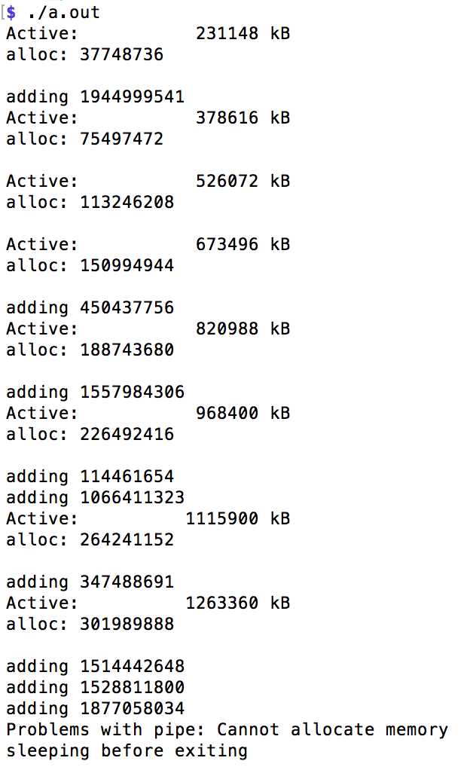
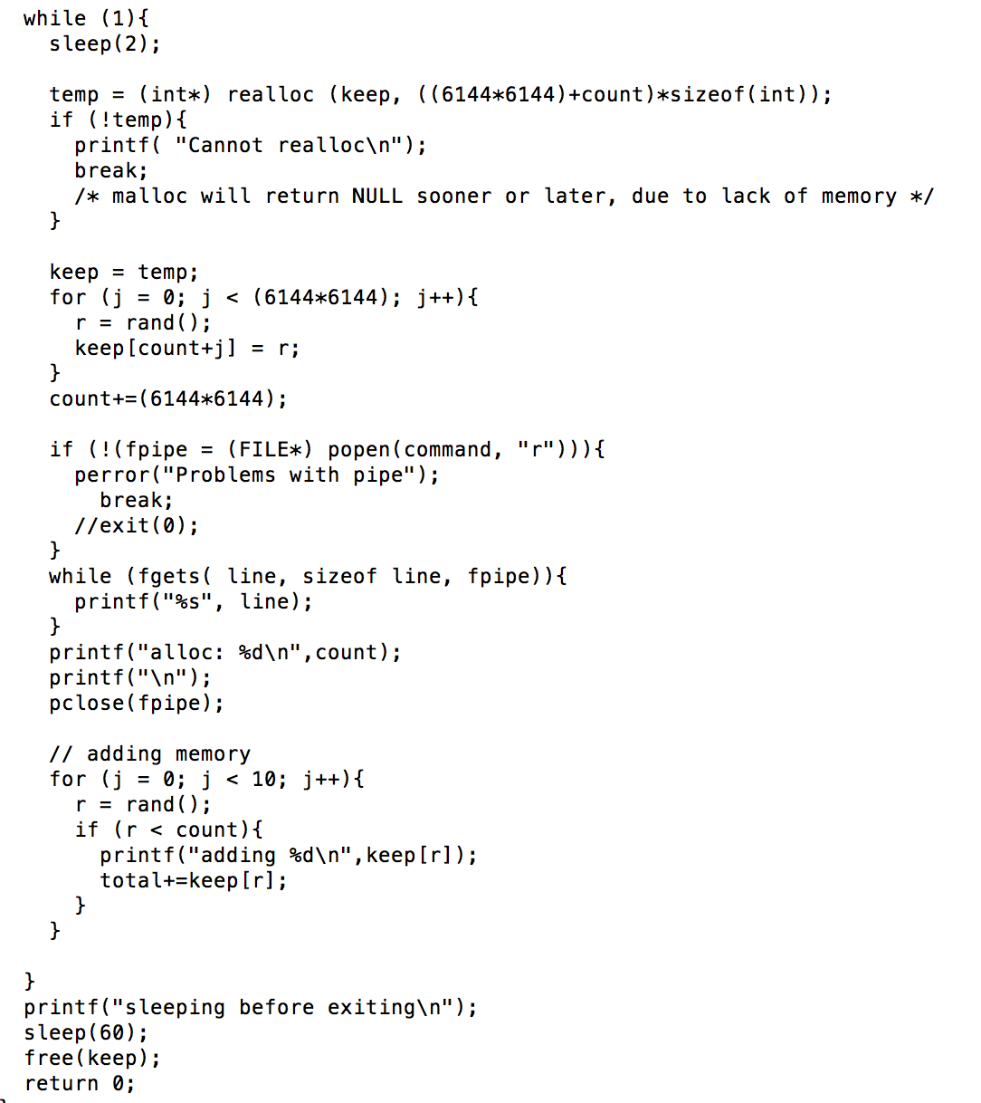
Compile Test Code: memeater.c
Memeater code repeatedly allocs memory.
Run in conjunction with LDMS to see changes in memory utilization values reported in /proc/meminfo.
Code is located at: /home/<user>/ldmscon2020/basic/exercises/ldms/code/memeater.c
$ cd /home/<user>/ldmscon2020/basic/exercises/ldms/code/memeater.c
Compile with cc: cc –o memeater memeater.c
Sleep between alloc. Change this wrt sampling frequency.
Periodically increase memory allocated
./memeater
…
…
Sleep before releasing memory

Slide 74
Exercise: Periodically Re-Query Sampler and Run “memeater” (Deferred – use with exercise 1)
$ while true; do ldms_ls -h localhost -x sock -p 10001 -l | grep “Active ”; sleep 1; done
D u64 Active 192308
D u64 Active 192308
D u64 Active 191884
D u64 Active 192396
D u64 Active 192444
D u64 Active 192420
D u64 Active 192528
D u64 Active 192516
In a separate terminal window, run the “memeater” executable to see both timestamps and values change:
$ /home/<user>/ldmscon2020/basic/exercises/ldms/code/memeater
Note: You can edit and re-compile to change the allocation amounts and sleep time to adjust the rate of change.
Note how the values change without/with “memeater” running

Slide 75
Additional Exercises: Exercise 2 - Changing Sampling Interval

Slide 76
Dynamically Change The Sampling Interval
Using ldmsd_controller, stop the plugin:
sock:localhost:10001> stop name=meminfo
Note: Querying with ldms_ls will show that the sampler is not updating
Note: We are still using the same sampler daemon from earlier. It should not be killed yet.
  Restart the plugin with a different (5 sec) interval:
  sock:localhost:10001> start name=meminfo interval=5000000 offset=0
  Note: Querying with ldms_ls will show that the metric set is now updating only every five seconds
  (More on dynamic configuration and resilience in Exercise 5)

Slide 77
EXAMPLE - Change Sample Interval
*Directories and file names may differ from those presented in the slides.
*Run in “Slide Show” format (Slide Show -> From Current Slide)

Slide 78
Additional Exercises: Exercise 3 - Check Metrics using memeater

Slide 79
Check To See That Metrics Change In Both Samplers and Aggregators
In a third window, run the memeater executable to see changes in the dataset values in both the samplers and aggregators:
$ /home/<user>/ldmscon2020/basic/exercises/ldms/code/memeater
Check sampler using ldms_ls:
$ while true; do ldms_ls -h localhost -x sock -p 10001 -l | grep "Active "; sleep 1; done
Check aggregator using ldms_ls:
$ while true; do ldms_ls -h localhost -x sock -p 20001 -l | grep "Active "; sleep 1; done

Slide 80
Additional Exercises: Exercise 4 - Using the Distributed System

Slide 81
Using The Distributed System
Exercise - Loop ldms_ls while running your memeater executable – see your and others data values change
$ while true; do ldms_ls -h localhost -x sock -p 20001 -l | grep "Active ” –B9; sleep 1; done
Explore basic dynamic configuration changes and resilience in the next exercise

Slide 82
Additional Exercises: Exercise 6 - Manual Aggregator Configuration

Slide 83
CSV Store: Manual Aggregator Configuration
Configure the aggregator to store the “meminfo” set to a CSV file using ldmsd_controller
  Create a directory for the CSV data
  Load the store_csv plugin
  Configure the plugin
$ mkdir –p /home/<user>/ldmsdcon2020/basic/exercises/ldms/data/CSV
$ ldmsd_controller --host localhost --port 20001
sock:localhost:20001> load name=store_csv
sock:localhost:20001> config name=store_csv path=/home/<user>/ldmscon2020/basic/exercises/ldms/data/CSV buffer=0
Check status
sock:localhost:20001> status
Name Type Interval Offset Libpath
------------ ------------ ------------ ------------ ------------
csv store 1000000 0 /home/<user>/Build/OVIS-4.3.1/lib/ovis-ldms/libstore_csv.so
name: plugin name
path: Path to the base directory for the csv file container. This directory must pre-exist.
buffer: ‘0’ to disable buffering # USE WITH CAUTION!
man page:
  man Plugin_store_csv – opens store_csv plugin man pages

Slide 84
CSV Store: Manual Aggregator Configuration (cont.)
Configure the aggregator to store the “meminfo” set to a csv file.
sock:localhost:20001> strgp_add name=meminfo_store_csv plugin=store_csv container=memory_metrics schema=meminfo
Check status
sock:localhost:20001> status
Name Container Schema Plugin State
---------------- ---------------- ---------------- ---------------- ------------
meminfo_store_csv memory_metrics meminfo store_csv STOPPED
producers:
metrics:
name: storage policy tag
plugin: store plugin used for storing metric set data
container: the storage backend container name. For csv, this is the directory where the output file will go. This will be created.
schema: metric set schema to be stored

Slide 85
CSV Store: Manual Aggregator Configuration (cont.)
sock:localhost:20001> strgp_start name=meminfo_store_csv
Check status
sock:localhost:20001> status
Name Container Schema Plugin State
---------------- ---------------- ---------------- ---------------- ------------
meminfo_store_csv memory_metrics meminfo store_csv RUNNING
producers:
metrics: component_id job_id app_id MemTotal MemFree MemAvailable Buffers Cached SwapCached Active Inactive Active(anon) Inactive(anon) Active(file) Inactive(file) Unevictable Mlocked SwapTotal SwapFree Dirty Writeback AnonPages Mapped Shmem Slab SReclaimable SUnreclaim KernelStack PageTables NFS_Unstable Bounce WritebackTmp CommitLimit Committed_AS VmallocTotal VmallocUsed VmallocChunk HardwareCorrupted HugePages_Total HugePages_Free HugePages_Rsvd HugePages_Surp Hugepagesize DirectMap4k DirectMap2M DirectMap1G
name: storage policy tag

Slide 86
CSV Store: LDMSD Status
sock:localhost:20001> status
Name Type Interval Offset Libpath
------------ ------------ ------------ ------------ ------------
csv store 1000000 0 /home/<user>/Build/OVIS-4.3.1/lib/ovis-ldms/libstore_csv.so
Name Host Port Transport State
---------------- ---------------- ------------ ------------ ------------
prdcr1 1 10001 sock CONNECTED
nid00052/meminfo meminfo READY
nid00052/vmstat vmstat READY
prdcr2 nid00053 10001 sock CONNECTED
nid00053/meminfo meminfo READY
nid00053/vmstat vmstat READY
Name Interval Offset Mode State
---------------- ------------ ------------ --------------- ------------
updtr1 1000000 200000 Pull RUNNING
prdcr1 nid00052 10001 sock CONNECTED
prdcr2 nid00053 10001 sock CONNECTED
Name Container Schema Plugin State
---------------- ---------------- ---------------- ---------------- ------------
meminfo_store_csv memory_metrics meminfo store_csv RUNNING
producers:
metrics: component_id job_id app_id MemTotal MemFree MemAvailable Buffers Cached SwapCached Active Inactive Active(anon) Inactive(anon) Active(file) Inactive(file) Unevictable Mlocked SwapTotal SwapFree Dirty Writeback AnonPages Mapped Shmem Slab SReclaimable SUnreclaim KernelStack PageTables NFS_Unstable Bounce WritebackTmp CommitLimit Committed_AS VmallocTotal VmallocUsed VmallocChunk HardwareCorrupted HugePages_Total HugePages_Free HugePages_Rsvd HugePages_Surp Hugepagesize DirectMap4k DirectMap2M DirectMap1G

Slide 87
EXAMPLE: CSV Store - Manual Aggregator Configuration
*Directories and file names may differ from those presented in the slides.
*Run in “Slide Show” format (Slide Show -> From Current Slide)

Slide 88
Additional Notes

Slide 89
LDMS Overview
What is the Lightweight Distributed Metric Service (LDMS)?
  Daemon based data sampling
    Collect numeric data
  Move and aggregate data
  Store data
  Analyze data
    Troubleshooting
    Optimization
    Inform future designs
Typical use cases
  Identify applications memory (and other resource) utilization behaviors
  Identify network congestion
  Determine over-provisioned resources
  Identify heavy Lustre users

Slide 91
Configuration Tools Summary
Dynamic/manual configuration (remote or local)
ldmsd_controller – Python script that can connect to a ldmsd via a configured network socket or a local Unix Domain Socket (supports command completion)
ldmsctl – C-based utility that can connect to a ldmsd via a configured network socket or a local Unix Domain Socket (doesn’t support command completion)
Static configuration (local)
Configuration file – loaded at ldmsd run time

Slide 92
Resources
Documentation (Building, Using)
  https://github.com/ovis-hpc/ovis/wiki
Source Code
  https://github.com/ovis-hpc/ovis
  git clone https://github.com/ovis-hpc/ovis.git
  git branch –a # Will show all available branches
  git branch -a | grep "\-4.3” # Will show all version 4.3 branches
  git checkout –b OVIS-4.3.<x> origin/OVIS-4.3.<x> # Will check out branch origin/OVIS-4.3.<x> under the name OVIS-4.3.<x>
  git branch # Will show currently checked out branch
Publications:
  https://ovis.ca.sandia.gov
How you can contribute
  Post an issue at: https://github.com/ovis-hpc/ovis/issues
Support
  Bug reporting and questions: Post an issue at: https://github.com/ovis-hpc/ovis/issues
  Development services: contact tom@ogc.us
  Support services: contact tom@ogc.us, ldms@sandia.gov

Slide 93
Supported platforms and networks
Linux support
  Rhel 6 and 7
  SLES 11 & 12
  Ubuntu
Vendor hardware platforms running supported software
  Cray XE6, XK and XC
  Generic Linux clusters
  IBM P8 & P9 (both big and little endian)
Transports
  Socket
  Cray ugni
    Aries
    Gemini
  RDMA
    Infiniband
    iWarp
    libfabric

Slide 94
Build dependencies
Typical compute node environment
  Autoconf >=2.63, automake, libtool (collectively called autotools)
  OpenSSH-devel
  libpapi-devel for papi and syspapi samplers
  libpfm-devel for syspapi sampler
  libfabric-devel if applicable transport available
End use hosts (monitor cluster, special aggregation hosts, etc.)
  Python 3.x
  Swig 2.0.x
  Doxygen for documentation
  Cython needed for SOS
    Get from pip
  libcurl & libcurl-devel if using influx_store

Slide 95
LDMS Installation methods
Manually build and install using autoconf and automake
Deployment using RPMs
Note1: For this tutorial, LDMS is pre-installed on student VMs in /opt/ovis
Note2: We will be building and installing to local directories and will use the pre-installed software for all other exercises

