Slide 1

LDMS Version 4.3 Tutorial Part 1: Basics https://github.com/ovis-hpc/ovis
OGC | Open Grid Computing, Austin, TX
Jim Brandt, Ann Gentile, Ben Allan
Sandia National Laboratories
Tom Tucker
Open Grid Computing, Inc.
04/2017
SAND2017-5153 O
Sandia National Laboratories is a multi-mission laboratory managed and operated by National Technology and Engineering Solutions of Sandia, LLC., a wholly owned subsidiary of Honeywell International, Inc., for the U.S. Department of Energy’s National Nuclear Security Administration under contract DE-NA-0003525.

Slide 2
Advance Set-up (site specific: wifi UCF_Guest)
We will be using virtual machines hosted at Open Grid Computing
$ ssh user<#>@ldmscon.ogc.us
$ password: user<#>
$ ssh user#@compute<#>
$ password: user<#>

Slide 3
Schedule
9:00 – 10:30 Instruction (Basics)
10:30 – 10:45 Break
10:45 – 12:30 Instruction (Basics)
12:30 – 1:30 Lunch
1:30 – 3:00 Instruction
3:00 – 3:15 Break
3:15 – 5:00 Instruction

Slide 4
Tutorial Format (Basic)
Overview of the Lightweight Distributed Metric Service (LDMS) (9 slides)
Overview of the LDMS framework
LDMS architecture description
Setup (3 slides)
Environment setup description and verification
Introduction to support programs and helper scripts for use in lab work
Hands-on exercises, instructor walk through, and facilitated student exploration:
Exercise 1: Memeater (1 slide)
Configuring and deploying a distributed monitoring system with storage
Exercise 2: Configuring and Running Samplers (37 slides – ~1 hour)
Sampler startup and local and remote verification
Intro to ldmsd_controller and ldms_ls
Exercise 3: Configure Aggregators (13 slides – ~30 min)
Aggregation startup and verification using local samplers
Aggregation of all other attendees’ (remote) samplers
Exercise 4: Aggregating From Remote Hosts: Building a Distributed Monitoring System (4 slides – ~45 min)
Exercise 5: Dynamic Configurations and Resilience (4 slides – ~20 min)
Exercise 6: Storing Data In CSV Format (8 slides – ~20 min)

Slide 5
LDMS Overview
What is the Lightweight Distributed Metric Service (LDMS)?
Daemon based data sampling
Collect numeric data
Move and aggregate data
Store data
Analyze data
Troubleshooting
Optimization
Inform future designs
Typical use cases
Identify applications memory (and other resource) utilization behaviors
Identify network congestion
Determine over-provisioned resources
Identify heavy Lustre users

Slide 7
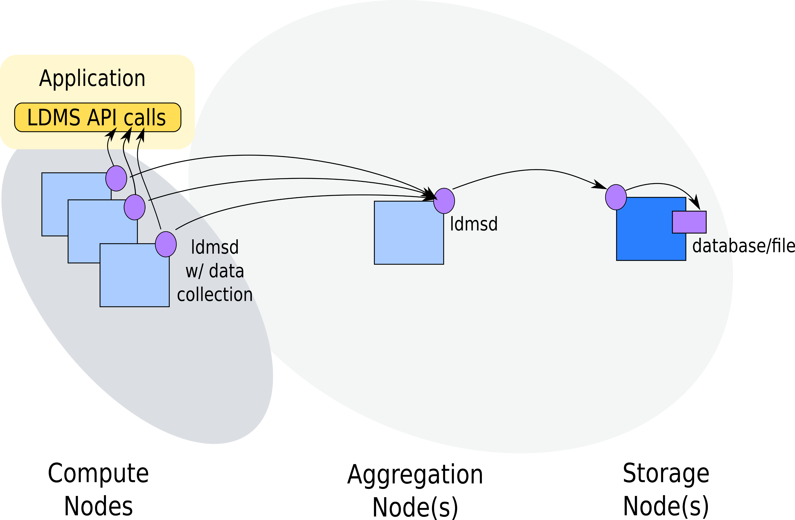
Lightweight Distributed Metric Service (LDMS) High Level Overview
* Only the current data is retained on-node

Slide 8
LDMS Plugin Architecture
Memory
Sampler Plug-in Interface
Storage Plug-in Interface
Storage
Memory Sampler
HSN Sampler
CSV
Store
Other
Store
CSV
Metric Set
LDMS Daemon
Metric Set
LDMS API (libldms)
LDMS API (libldms)
Rabbit
Metric Set
Transport Driver Interface
Metric Set
SOS
RDMA Transport
Socket Transport

Slide 9


Slide 10
Resources
Documentation (Building, Using)
https://github.com/ovis-hpc/ovis/wiki
Source Code
https://github.com/ovis-hpc/ovis
git clone https://github.com/ovis-hpc/ovis.git
git branch –a # Will show all available branches
git branch -a | grep "\-4.3” # Will show all version 4.3 branches
git checkout –b OVIS-4.3.<x> origin/OVIS-4.3.<x> # Will check out branch origin/OVIS-4.3.<x> under the name OVIS-4.3.<x>
git branch # Will show currently checked out branch
Publications:
https://ovis.ca.sandia.gov
How you can contribute
Post an issue at: https://github.com/ovis-hpc/ovis/issues
Support
Bug reporting and questions: Post an issue at: https://github.com/ovis-hpc/ovis/issues
Development services: contact tom@ogc.us
Support services: contact tom@ogc.us, ldms@sandia.gov

Slide 11
Supported platforms and networks
Linux support
Rhel 6 and 7
SLES 11 & 12
Ubuntu
Vendor hardware platforms running supported software
Cray XE6, XK and XC
Generic Linux clusters
IBM P8 & P9 (both big and little endian)
Transports
Socket
Cray ugni
Aries
Gemini
RDMA
Infiniband
iWarp
libfabric

Slide 12
Build dependencies
Typical compute node environment
Autoconf >=2.63, automake, libtool (collectively called autotools)
OpenSSH-devel
libpapi-devel for papi and syspapi samplers
libpfm-devel for syspapi sampler
libfabric-devel if applicable transport available
End use hosts (monitor cluster, special aggregation hosts, etc.)
Python 3.x
Swig 2.0.x
Doxygen for documentation
Cython needed for SOS
Get from pip
libcurl & libcurl-devel if using influx_store

Slide 13
LDMS Installation methods
Manually build and install using autoconf and automake
Deployment using RPMs
Note1: For this tutorial, LDMS is pre-installed on student VMs in /opt/ovis
Note2: We will be building and installing to local directories and will use the pre-installed software for all other exercises

Slide 14
Setup

Slide 15
Getting started: Log in and set up your environment
ssh user<#>@ldmscon.ogc.us
user<#>@ldmscon.ogc.us password: user<#>
$ ssh user<#>@compute<#>
Note: “/home/<user>/exercises/ldms/env/ldms-env.sh” is used to set up LDMS environment. You may need to create this file first.
You will want at least 2 terminal windows up for the tutorial

Slide 16
VM directory structure
VMs include source code, scripts and configuration files for every exercise, helper mini-applications for use in the exercises, and supporting visualization tools (e.g., gnuplot).
Directory structure:
/home/<user>/exercises/ # Location of exercise related directories
/home/<user>/exercises/ldms/conf/ # Exercise configuration files
/home/<user>/exercises/ldms/ data/ # LDMS data
/home/<user>/exercises/ldms/ env/ # Scripts to configure environment variables
/home/<user>/exercises/ldms/ scripts/ # Helper scripts for deploying LDMS daemons
/home/<user>/exercises/ldms/ code/ # memeater code
/home/<user>/exercises/ldms/ logs/ # Place to write log files
/home/<user>/exercises/ldms/ run/ # symlink to /tmp/run – place to write pid files

Slide 17
Getting started: Set up and verify your environment
Edit environment configuration file (ldms_env.conf)
OVIS_HOME=/opt/ovis
#System environment variables
export PATH=${OVIS_HOME}/bin/:${OVIS_HOME}/sbin/:${PATH}
export LD_LIBRARY_PATH=${OVIS_HOME}/lib/:${LD_LIBRARY_PATH}
export PYTHONPATH=${OVIS_HOME}/lib/python2.7/site-packages/:${PYTHONPATH}
#LDMS environment variables
export ZAP_LIBPATH=${OVIS_HOME}/lib/ovis-lib
export LDMSD_PLUGIN_LIBPATH=${OVIS_HOME}/lib/ovis-ldms
Source your environment configuration file
$ source ldms_env.conf
*A live example of these commands can be found here:
Verify Environment Variables

Slide 18
Exercise 1: Memeater

Slide 19
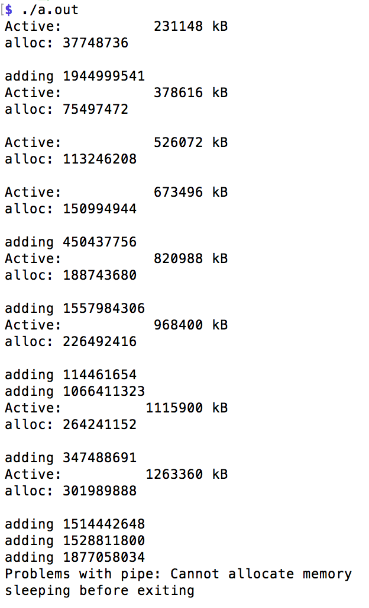
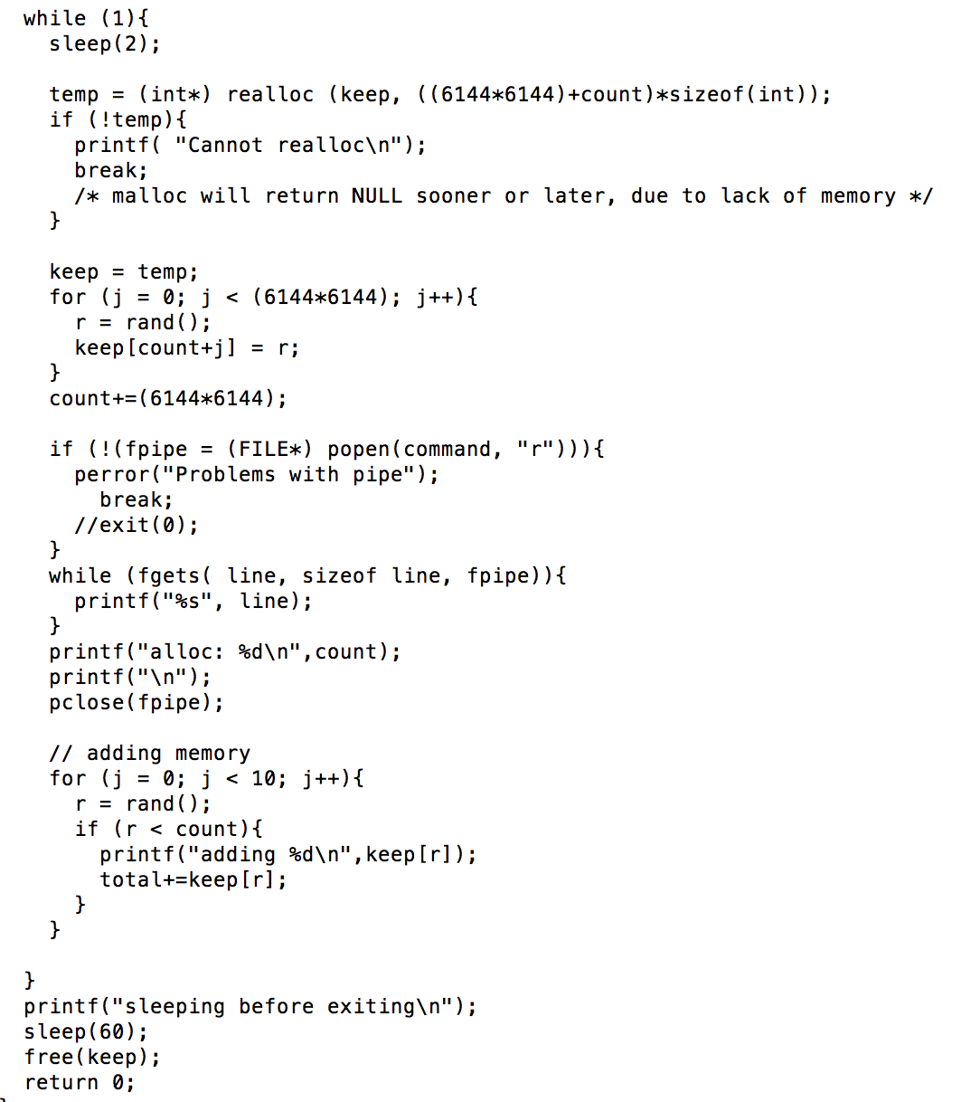
Compile Test Code: memeater.c
Memeater code repeatedly allocs memory.
Run in conjunction with LDMS to see changes in memory utilization values reported in /proc/meminfo.
Code is located at: /home/<user>/exercises/ldms/code/memeater.c
$ cd /home/<user>/exercises/ldms/code/memeater.c
Compile with cc: cc –o memeater memeater.c
Sleep between alloc. Change this wrt sampling frequency.
Periodically increase memory allocated
./memeater
…
…
Sleep before releasing memory

Slide 20
Exercise 2: Configuring and Running Samplers

Slide 21
LDMS Plugin Architecture
Memory
Sampler Plug-in Interface
Storage Plug-in Interface
Storage
Memory Sampler
HSN Sampler
CSV
Store
Other
Store
CSV
Metric Set
LDMS Daemon
Metric Set
LDMS API (libldms)
LDMS API (libldms)
Rabbit
Metric Set
Transport Driver Interface
Metric Set
SOS
RDMA Transport
Socket Transport

Slide 22
Start and Configure a LDMS Daemon
Exercise Goals:
Basic LDMS daemon startup and configuration flags/args
Manual and run-time configuration options
Output options
Log files and
man pages
man ldmsd – displays ldmsd man pages
man ldmsd_controller – displays “ldmsd_controller” man pages
Use of ldms_ls utility as a diagnostic tool
man pages
man ldms_ls – displays ldms_ls man pages

Slide 23
Start a LDMS daemon
Start ldmsd with minimum configuration
ldmsd –x sock:10001 –l /home/<user>/exercises/ldms/logs/sampler1.log
-x: Transport : listening port
-l: Specify the log file path and name(this is not strictly necessary)
NOTES:
If you receive a “permission denied” error in the “sampler1.log” file, you will need to add “-r ldmsd.pid” at the end of the ldmsd command.
-r : The path to the pid file. Please review man page “/ldms/man/ldmsd.man” for more information
Commands should be written in the command prompt window. Copy and paste may cause unnecessary issues with the command line interface
Notes:
May remove pid from the basic

Slide 24
Check ldmsd Running Status
Using ps
ps auxw | grep ldmsd | grep –v grep
Returns something like:
“ovis_pu+ 3582 0.0 0.1 401604 2204 ? Ssl 12:51 0:00 ldmsd -x sock:10001“ if running
Returns: blank line if not running
Using ldms_ls
ldms_ls –h localhost –x sock –p 10001
Returns: “Connection failed/rejected.” if ldmsd specified does not exist or authentication fails
Returns: blank line if the ldmsd specified exists but has no metric sets configured
Remote: Replace “localhost” in the command above with another student vm e.g., “ovis-demo-28”
Also check ports
netstat –an | grep 000
tcp 0 0 0.0.0.0:10001 0.0.0.0:* LISTEN
Troubleshooting: Also check the log for clues if operation seems wrong.

Slide 25
EXAMPLE: Start and Check LDMS Daemon
Please see the Start and Check an LDMS daemon to view a live example of these commands (slides 23-24).

Slide 26
Manually Load and Configure a Sampler Plugin
Additional Exercise Goals:
Basic sampler plugin operation
Manual dynamic configuration using the “ldmsd_controller” utility
Static configuration using a configuration file
man pages
man Plugin_meminfo – opens meminfo plugin man pages
man Plugin_vmstat – opens vmstat plugin man pages
Use of ldms_ls utility as a diagnostic tool
man pages
man ldms_ls – opens ldms_ls man pages

Slide 27
LDMS Plugin Architecture
Memory
Sampler Plug-in Interface
Storage Plug-in Interface
Storage
Memory Sampler
HSN Sampler
CSV
Store
Other
Store
CSV
Metric Set
LDMS Daemon
Metric Set
LDMS API (libldms)
LDMS API (libldms)
Rabbit
Metric Set
Transport Driver Interface
Metric Set
SOS
RDMA Transport
Socket Transport

Slide 28
Configure LDMS Daemon Sampler Plugin
Goals:
Load the “meminfo” sampler plugin
Configure loaded “meminfo” sampler plugin
Give the set name (instance)
Give the node name (producer)
Give the component ID
Plugin-specific arguments
Start sampler plugin with a particular sampling interval and offset
optional

Slide 29
Connect ldmsd_controller To An ldmsd
Set up “ldmsd_controller” connection to the aggregator
$ldmsd_controller --host localhost --port 10001
Welcome to the LDMSD control processor
sock:localhost:10001> help
See “LDMS HELP” slides starting at slide 77 for help results
Note 1: The prompt tells you <transport>:<hostname>:<port>
Note 2: You can use “quit” or Ctrl-d to exit or Ctrl-c to kill the ldmsd_controller
*A live example of these commands can be found here:
LDMSD Controller Interface Video

Slide 30
Interactive Configuration Using The ldmsd_controller
Load the “meminfo” sampler plugin:
sock:localhost:10001> load name=meminfo
Configure the “meminfo” sampler plugin:
sock:localhost:10001> config name=meminfo producer=<$HOSTNAME> instance=<$HOSTNAME>/meminfo component_id=<host number>
EXAMPLE:
sock:localhost:10001> load name=meminfo *enter*
sock:localhost:10001> config name=meminfo producer=ovis-demo-01 instance=ovis-demo-01/meminfo component_id=1 *enter*
producer: Initialize the name of the sampler
Instance: Initialize the name of the node the sampler is running on
component_id: Initialize with a number

Slide 31
Query Current Sets On An LDMS Daemon Using “ldms_ls”
Use ldms_ls to query the current sets available on an LDMS daemon
$ ldms_ls –h localhost -x sock -p 10001
ovis-demo-01/meminfo

Slide 32
Get The Set Information Before Starting The “meminfo” Sampler Plugin
$ ldms_ls –h localhost -x sock -p 10001 –v ovis-demo-01/meminfo
Schema Instance Flags Msize Dsize UID GID Perm Update Duration Info
-------------- ------------------------ ------ ------ ------ ------ ------ ---------- ----------------- ----------------- --------
meminfo ovis-demo-01/meminfo L 1952 416 596 742 -rwxrwxrwx 0.000000 0.000000 "updt_hint_us"="1000000:0"
-------------- ------------------------ ------ ------ ------ ------ ------ ---------- ----------------- ----------------- --------
Total Sets: 1, Meta Data (kB): 1.95, Data (kB) 0.42, Memory (kB): 2.37
NOTE: The “ovis-demo-01/meminfo” is optional. It is suggested as it will be easier to identify certain sampler daemons when multiple are running on the same host and port.

Slide 33
EXAMPLE: Interactive Configuration Using The ldmsd_controller
Please see Configuration Using LDMSD Controller Interface to view a live example of these commands (slides 30-32).

Slide 34
Start The “meminfo” Sampler Plugin
Start the “meminfo” sampler with a 1 second interval
sock:localhost:10001> start name=meminfo interval=1000000 offset=0
This starts the sampler updating the metric values every 1,000,000 micro-seconds = 1 second
Note 1: “offset” defines micro-seconds after the second
Note 2: If offset is not specified the timer starts when the sampler starts

Slide 35
Query Current Metric Values Before Starting The “meminfo” Sampler Plugin
$ ldms_ls -x sock -p 10001 -l ovis-demo-01/meminfo
ovis-demo-01/meminfo: inconsistent, last update: Wed Dec 31 17:00:00 1969 -0700 [0us]
M u64 component_id 62
D u64 job_id 0
D u64 app_id 0
D u64 MemTotal 0
D u64 MemFree 0
D u64 MemAvailable 0
D u64 Buffers 0
D u64 Cached 0
D u64 SwapCached 0
D u64 Active 0
D u64 Inactive 0
D u64 Active(anon) 0
D u64 Inactive(anon) 0
Set is “inconsistent”
Values have not yet been collected

Slide 36
Query Current Metric Values After Starting The “meminfo” Sampler Plugin
$ ldms_ls -x sock -p 10001 -l ovis-demo-01/meminfo
ovis-demo-01/meminfo: consistent, last update: Tue Oct 08 17:52:45 2019 -0600 [2058us]
M u64 component_id 62
D u64 job_id 0
D u64 app_id 0
D u64 MemTotal 131899768
D u64 MemFree 129843340
D u64 MemAvailable 129364708
D u64 Buffers 20076
D u64 Cached 458024
D u64 SwapCached 0
D u64 Active 184380
D u64 Inactive 393140
D u64 Active(anon) 125324
D u64 Inactive(anon) 284684
Set is “consistent”
Values have been collected

Slide 37
Periodically Re-Query Sampler and Run “memeater”
$ while true; do ldms_ls -h localhost -x sock -p 10001 -l | grep “Active ”; sleep 1; done
D u64 Active 192308
D u64 Active 192308
D u64 Active 191884
D u64 Active 192396
D u64 Active 192444
D u64 Active 192420
D u64 Active 192528
D u64 Active 192516
In a separate terminal window, run the “memeater” executable to see both timestamps and values change:
$ /home/<user>/memeater/memeater
Note: You can edit and re-compile to change the allocation amounts and sleep time to adjust the rate of change.
Note how the values change without/with “memeater” running

Slide 38
Check Source (/proc/meminfo) For Reference
$ cat /proc/meminfo
MemTotal: 131899768 kB
MemFree: 129828892 kB
MemAvailable: 129350280 kB
Buffers: 20076 kB
Cached: 458076 kB
SwapCached: 0 kB
Active: 192340 kB
Inactive: 393064 kB
Active(anon): 133212 kB
Inactive(anon): 284680 kB
Active(file): 59128 kB

Slide 39
EXAMPLE: “meminfo” Sampler Plugin
Please see Meminfo Sampler Daemon to view a live example of these commands (slides 34-38).

Slide 40
Dynamically Change The Sampling Interval
Using ldmsd_controller, stop the plugin:
sock:localhost:10001> stop name=meminfo
Note: Querying with ldms_ls will show that the sampler is not updating
Note: We are still using the same sampler daemon from earlier. It should not be killed yet.
Restart the plugin with a different (5 sec) interval:
sock:localhost:10001> start name=meminfo interval=5000000 offset=0
Note: Querying with ldms_ls will show that the metric set is now updating only every five seconds
(More on dynamic configuration and resilience in Exercise 3)

Slide 41
Kill Currently Running Daemons
Kill all of your ldmsd in preparation for the next section
$ killall ldmsd
Kill a particular ldmsd
$ ps auxw | grep ldmsd | grep –v grep
$ ovis_pu+ 3582 0.0 0.1 401604 2204 ? Ssl 12:51 0:00 ldmsd -x sock:10001 -S samplerd.sock
$ kill 3582
Check to make sure it is dead
$ ps auxw | grep ldmsd | grep –v grep

Slide 42
EXAMPLE: Change Sample Interval
Please see Change Sample Interval for Meminfo to view a live example of these commands (slides 40-41).

Slide 43
Start a ldmsd and Sampler Plugin Using a Configuration File
A ldmsd can be started using a configuration file
Syntax is identical to that used for manual configuration
Can be used to run and configure BOTH sampler and aggregator ldmsd
Edit the sample configuration file, as appropriate, for the meminfo example:
$ cat /home/<user>/exercises/ldms/conf/simple_sampler.conf
NOTE: If the “simple_sampler.conf” is not there, then please create this file in this directory and populate it with the content below:
load name=meminfo
config name=meminfo producer=<$HOSTNAME> instance=<$HOSTNAME>/meminfo component_id=<host number>
start name=meminfo interval=1000000
Run an ldmsd using this configuration file (argument after the –c flag). Modify <user> to your user name.
$ ldmsd -x sock:10001 \
-l /home/<user>/exercises/ldms/logs/sampler1.log \
–c /home/<user>/exercises/ldms/conf/simple_sampler.conf

Slide 44
Query The Metric Values: The “meminfo” Sampler Is Configured And Running
$ ldms_ls -x sock -p 10001 -l ovis-demo-01/meminfo
ovis-demo-01/meminfo: consistent, last update: Tue Oct 08 17:52:45 2019 -0600 [2058us]
M u64 component_id 62
D u64 job_id 0
D u64 app_id 0
D u64 MemTotal 131899768
D u64 MemFree 129843340
D u64 MemAvailable 129364708
D u64 Buffers 20076
D u64 Cached 458024
D u64 SwapCached 0
D u64 Active 184380
D u64 Inactive 393140
D u64 Active(anon) 125324
D u64 Inactive(anon) 284684
Set is “consistent”
Values have been collected

Slide 45
Multiple Sampler Plugins
Uncomment and edit to reflect your host the lines for the vmstat plugin in simple_sampler.conf and restart the ldmsd.
load name=vmstat
config name=vmstat producer=<hostname> instance=<hostname>/vmstat component_id=<hostnum>
start name=vmstat interval=1000000 offset=0
Query the ldmsd:
ldms_ls -h localhost -x sock -p 10001
ovis-demo-01/vmstat
ovis-demo-01/meminfo
Note: hostname is just a string and hostnum is just a uint_64. Example: hostname=ovis-demo-01, hostnum=1

Slide 46
EXAMPLE: Multiple Sampler Plugins
Please see Multiple Plugin Sampler Deamon to view a live example of these commands (slides 43-45).

Slide 47
Configuration Tools Summary
Dynamic/manual configuration (remote or local)
ldmsd_controller – Python script that can connect to a ldmsd via a configured network socket or a local Unix Domain Socket (supports command completion)
ldmsctl – C-based utility that can connect to a ldmsd via a configured network socket or a local Unix Domain Socket (doesn’t support command completion)
Static configuration (local)
Configuration file – loaded at ldmsd run time

Slide 48
Exercise 3: Configure Aggregators

Slide 49
LDMS Plugin Architecture
Memory
Sampler Plug-in Interface
Storage Plug-in Interface
Storage
Memory Sampler
HSN Sampler
CSV
Store
Other
Store
CSV
Metric Set
LDMS Daemon
Metric Set
LDMS API (libldms)
LDMS API (libldms)
Rabbit
Metric Set
Transport Driver Interface
Metric Set
SOS
RDMA Transport
Socket Transport

Slide 50
Configure a LDMS daemon (ldmsd) to Aggregate metric set(s)
Goals:
Add list of connections to a ldmsd (connections to sampler ldmsd(s))
Start the connections
Create an “update policy”
Define an “update policy” update period
Define which sets an update policy refers to
Start the “update policy”

Slide 51
Start a ldmsd That Will Be Used For Aggregation
(Re)start the sampler ldmsd from the previous exercise (can keep both meminfo and vmstat)
Start new aggregator ldmsd with minimum configuration:
$ ldmsd –x sock:20001 –l /home/<user>/exercises/ldms/logs/agg1.log
-x: Transport : listening port
-l: Specify the log file path and name (this is not strictly necessary)
NOTE:
We will be using a different port number. Instead of 10001 we will be running a daemon on port 20001.
Please refer to slides 41 & 42 for help in re-creating a sampler daemon
Notes:
May remove pid from the basic

Slide 52
Interactive Aggregator Configuration
Set up “ldmsd_controller” connection to the aggregator over socket
$ ldmsd_controller --host localhost --port 20001
Welcome to the LDMSD control processor
sock:localhost:20002>

Slide 53
Simple Aggregator Producer Configuration
Configure the aggregator to aggregate the “meminfo” set from your sampler daemon (listening on port 10001)
sock:localhost:20001> prdcr_add name=prdcr1 host=$HOSTNAME port=10001 xprt=sock type=active interval=20000000
sock:localhost:20001> prdcr_start name=prdcr1
name: policy tag (this is just a string)
host: hostname for the sampler daemon (e.g. ovis-demo-01)
port: Listener port of the sampler daemon
xprt: Transport the sampler daemon listens on
type: Always “active” (the aggregator will initiate the connection with the sampler)
interval: Re-connect interval (not aggregation interval)

Slide 54
Check Aggregator Status (after producer (prdcr) is started but before the updater (updtr) is started)
sock:localhost:20001> status
Name Type Interval Offset Libpath
------------ ------------ ------------ ------------ ------------
Name Host Port Transport State
---------------- ---------------- ------------ ------------ ------------
prdcr1 nid00062 10001 sock CONNECTED
nid00062/meminfo meminfo_x86_ven0000fam0006mod003F START
nid00062/vmstat vmstat_x86_ven0000fam0006mod003F START
Name Interval Offset Mode State
---------------- ------------ ------------ --------------- ------------
Name Container Schema Plugin State
---------------- ---------------- ---------------- ---------------- ------------

Slide 55
Query Current Metric Values On The Aggregator
$ ldms_ls –h localhost -x sock -p 20001 -l
$
Note: While status (previous slide) shows that the aggregator knows what sets the producer has, the ldms_ls query returns nothing because the updater had not yet been run and the set has not been populated with data.

Slide 56
EXAMPLE: Simple Aggregator Producer Configuration
Please see the simple Aggregator Producer Configuration to view a live example of these commands (slides 51-55).

Slide 57
Simple Aggregator Updater Configuration
Configure the aggregator to update the “meminfo” set
sock:localhost:20001> updtr_add name=updtr1 interval=1000000 offset=200000
sock:localhost:20001> updtr_prdcr_add name=updtr1 regex=.*
sock:localhost:20001> updtr_start name=updtr1
name: policy tag (string)
interval: update (pull) interval (in usec)
Example: interval=1000000 means pull data from sampler every 1 seconds
offset: Target (in us) from <epoc sec>.000000
Example: offset=10000 means aggregate every <interval> seconds at 10ms into the second.
regex: regular expression to match the target producers tag(s)

Slide 58
Check Aggregator Status (after starting both producer (prdcr) and updater (updtr) policies)
sock:localhost:20001> status
Name Type Interval Offset Libpath
------------ ------------ ------------ ------------ ------------
Name Host Port Transport State
---------------- ---------------- ------------ ------------ ------------
prdcr1 nid00062 10001 sock CONNECTED
nid00062/meminfo meminfo_x86_ven0000fam0006mod003F READY
nid00062/vmstat vmstat_x86_ven0000fam0006mod003F READY
Name Interval Offset Mode State
---------------- ------------ ------------ --------------- ------------
updtr1 1000000 0 Pull RUNNING
prdcr1 nid00062 10001 sock CONNECTED
Name Container Schema Plugin State
---------------- ---------------- ---------------- ---------------- ------------

Slide 59
Query Current Metric Values On The Aggregator
$ ldms_ls -h localhost -x sock -p 20001 -l ovis-demo-01/meminfo
nid00062/meminfo: consistent, last update: Wed Oct 09 18:30:49 2019 -0600 [2093us]
M u64 component_id 62
D u64 job_id 0
D u64 app_id 0
D u64 MemTotal 131899768
D u64 MemFree 129834752
D u64 MemAvailable 129356628
D u64 Buffers 20228
D u64 Cached 458892
D u64 SwapCached 0
D u64 Active 196708
D u64 Inactive 393768
D u64 Active(anon) 137336

Slide 60
Check To See That Metrics Change In Both Samplers and Aggregators
In a third window, run the memeater executable to see changes in the dataset values in both the samplers and aggregators:
$ /home/<user>/memeater/memeater
Check sampler using ldms_ls:
$ while true; do ldms_ls -h localhost -x sock -p 10001 -l | grep "Active "; sleep 1; done
Check aggregator using ldms_ls:
$ while true; do ldms_ls -h localhost -x sock -p 20001 -l | grep "Active "; sleep 1; done

Slide 61
EXAMPLE: Simple Aggregator Updater Configuration
Please see Aggregator Updater Configuration to view a live example of these commands (slides 57-60).

Slide 62
Start ldmsd and Aggregation Using a Configuration File
A ldmsd for performing aggregation can be started using a configuration file in the same manner as a ldmsd for sampling
Configuration file syntax is identical to that used for manual configuration
Edit your sample configuration file to reflect your host:
$ cat /home/<user>/exercises/ldms/conf/simple_agg.conf
NOTE: If the “simple_agg.conf” is not there, then please create this file in this directory and populate it with the content below:
prdcr_add name=prdcr1 host=$HOSTNAME port=10001 xprt=sock type=active interval=20000000
prdcr_start name=prdcr1
updtr_add name=updtr1 interval=1000000 offset=200000
updtr_prdcr_add name=updtr1 regex=.*
updtr_start name=update_all
Kill your aggregator and restart your aggregator ldmsd using this configuration file
$ ldmsd -x sock:20001 -l /home/<user>/exercises/ldms/log/aggd.log \
–c /home/<user>/exercises/ldms/conf/simple_agg.conf

Slide 63
Query Current Metric Values On The Aggregator
$ldms_ls -x sock -p 20001 -l ovis-demo-01/meminfo
Ovis-demo-01/meminfo: consistent, last update: Wed Oct 09 18:30:49 2019 -0600 [2093us]
M u64 component_id 62
D u64 job_id 0
D u64 app_id 0
D u64 MemTotal 131899768
D u64 MemFree 129834752
D u64 MemAvailable 129356628
D u64 Buffers 20228
D u64 Cached 458892
D u64 SwapCached 0
D u64 Active 196708
D u64 Inactive 393768

Slide 64
EXAMPLE: Simple Aggregator with Configuration File
Please see Aggregator With Configuration File to view a live example of these commands (slides 62-63).

Slide 65
Exercise 4: Aggregating From Remote Hosts: Building a Distributed Monitoring System

Slide 66
Aggregate From All Student VMs
Kill aggregator ldmsd
Edit /home/<user>/exercises/ldms/conf/agg.conf:
$ cat /home/<user>/exercises/ldms/conf/agg.conf
#prdcr_add name=prdcr1 type=active host=compute1 port=10001 xprt=sock interval=20000000
#prdcr_add name=prdcr2 type=active host=compute2 port=10001 xprt=sock interval=20000000
#prdcr_add name=prdcr3 type=active host=compute3 port=10001 xprt=sock interval=20000000
prdcr_start_regex regex=.* START (connect to) ALL PRODUCERS
updtr_add name=updtr1 interval=1000000 offset=200000 UPDATE AT 1 SEC INTERVALS
updtr_prdcr_add name=updtr1 regex=.* DO THIS ON ALL PRODUCERS
updtr_match_add name=updtr1 match=schema regex=meminfo RESTRICT TO SETS WITH schema=meminfo
updtr_start name=updtr1 START UPDATER POLICY “updtr1”
updtr_add name=updtr2 interval=2000000 offset=200000 UPDATE AT 2 SECOND INTERVALS
updtr_prdcr_add name=updtr2 regex=.* DO THIS ON ALL PRODUCERS
updtr_match_add name=updtr2 match=schema regex=vmstat RESTRICT TO SETS WITH schema=vmstat
updtr_start name=updtr2 START UPDATER POLICY “updtr1”

Slide 67
Aggregate From All Student VMs (cont’d)
Restart ldmsd using your edited configuration file
$ ldmsd -x sock:20001 -l /home/<user>/exercises/ldms/log/aggd.log \
–c /home/<user>/exercises/ldms/conf/agg.conf
NOTE: If the “agg.conf” has not yet been populated, then create this file by first copying the “simple_aggregator.conf” and adding the content from the previous slide at the end of the file.
LDMS supports complex topologies:
Multiple ldmsd (aggregators) can pull from the same ldmsd (sampler or aggregator)
Can daisy chain aggregators
Hierarchical
Support both fan-in and fan-out topologies

Slide 68
Check Aggregator Status
sock:localhost:20001> status
Name Type Interval Offset Libpath
------------ ------------ ------------ ------------ ------------
Name Host Port Transport State
---------------- ---------------- ------------ ------------ ------------
prdcr1 nid00062 10001 sock CONNECTED
nid00062/meminfo meminfo_x86_ven0000fam0006mod003F READY
nid00062/vmstat vmstat_x86_ven0000fam0006mod003F READY
prdcr2 nid00063 10001 sock CONNECTED
nid00063/meminfo meminfo_x86_ven0000fam0006mod003F READY
nid00063/vmstat vmstat_x86_ven0000fam0006mod003F READY
prdcr3 nid00012 10001 sock DISCONNECTED
Name Interval Offset Mode State
---------------- ------------ ------------ --------------- ------------
updtr1 1000000 200000 Pull RUNNING
prdcr1 nid00062 10001 sock CONNECTED
prdcr2 nid00063 10001 sock CONNECTED
prdcr3 nid00012 10001 sock DISCONNECTED
Name Container Schema Plugin State
---------------- ---------------- ---------------- ---------------- ------------

Slide 69
Using The Distributed System
Exercise - Loop ldms_ls while running your memeater executable – see your and others data values change
$ while true; do ldms_ls -h localhost -x sock -p 20001 -l | grep "Active ” –B9; sleep 1; done
Explore basic dynamic configuration changes and resilience in the next exercise

Slide 70
EXAMPLE: Aggregate from Multiple VMs
Please see Aggregate From Multiple VMs to view a live example of these commands (slides 66-69) .

Slide 71
Exercise 5: Basic Dynamic Configurations and Resilience

Slide 72
Basic Dynamic Configuration Changes
Dynamic configuration
Sampler daemons (from exercise 1 slide 40)
Stopping sampler plugins
Starting sampler plugins with different intervals
Aggregator daemons
Automatic detection of new metric sets on connected sampler ldmsd
Stopping producer (prdcr) and updater (updtr) policies
Changing updater intervals

Slide 73
Dynamically Changing a Sampler Plugin’s Interval Parameters (also exercise 1 slide 40)
Using ldmsd_controller, stop the plugin:
sock:localhost:10001> stop name=meminfo
Note: Querying with ldms_ls will show that the sampler has stopped
Restart the plugin with a different interval:
sock:localhost:10001> start name=meminfo interval=5000000 offset=0
Note: Querying with ldms_ls will show that the metric set is now updating only every five seconds

Slide 74
Dynamic Changes and Aggregator Robustness
On-the-fly additions of samplers will be discovered by the aggregating ldmsd
Exercise – one student will add the vmstat sampler, using ldmsd_controller, to their running sampler ldmsd.
All others will see it, using ldms_ls, appear in their aggregators which are pulling from that sampler.
Exercise – one student will stop their meminfo sampler, using ldmsd_controller, on their running sampler ldmsd.
All others will see, using ldms_ls, that the timestamp in that student’s metric set ceases to update.
Exercise – the same student will restart their meminfo sampler, using ldmsd_controller, on their running ldmsd.
All others will see, using ldms_ls, that the timestamp in that student’s metric set resumes updating.

Slide 75
Dynamic Changes and Robustness (cont’d)
Samplers and Aggregators can be started in any order
Exercise – Use your modified configuration files to start the aggregator ldmsd before starting the sampler ldmsd
Use ldms_ls to convince yourself that, whether a sampler ldmsd is started before or after an aggregator ldmsd, you are able to see the data generated at the sampler ldmsd on the aggregator ldmsd when both are running
LDMS collection and transport are robust to Samplers and Aggregators being killed and restarted
Exercise – one student will kill their sampler ldmsd. All other students will see from ldms_ls timestamp that the student’s metric set is removed from the list.
Exercise – the same student will restart their sampler ldmsd. All other students will see from ldms_ls timestamp that the metric set reappears and resumes updating (after up to the producer reconnect interval of 20 seconds).
Exercise – Each student will stop and re-start their aggregator ldmsd and verify, using ldms_ls, that they are able to see appropriate data.

Slide 76
Exercise 6: Storing Data In CSV Format

Slide 77
LDMS Plugin Architecture
Memory
Sampler Plug-in Interface
Storage Plug-in Interface
Storage
Memory Sampler
HSN Sampler
CSV
Store
Other
Store
CSV
Metric Set
LDMS Daemon
Metric Set
LDMS API (libldms)
LDMS API (libldms)
Rabbit
Metric Set
Transport Driver Interface
Metric Set
SOS
RDMA Transport
Socket Transport

Slide 78
Storing Data: CSV Store Plugin
Goals:
Configure an aggregator ldmsd with a CSV store plugin using ldmsd_controller
Configure an aggregator ldmsd with a CSV store plugin using a configuration file
Minimal store options (don’t buffer data)
Example output from the “meminfo” sampler:
#Time,Time_usec,ProducerName,component_id,job_id,MemTotal,MemFree,MemAvailable,Buffers,Cached,SwapCached,Active,Inactive,Active(anon),Inactive(anon),Active(file),Inactive(file),Unevictable,Mlocked,SwapTotal,SwapFree,Dirty,Writeback,AnonPages,Mapped,Shmem,Slab,SReclaimable,SUnreclaim,KernelStack,PageTables,NFS_Unstable,Bounce,WritebackTmp,CommitLimit,Committed_AS,VmallocTotal,VmallocUsed,VmallocChunk,HardwareCorrupted,AnonHugePages,HugePages_Total,HugePages_Free,HugePages_Rsvd,HugePages_Surp,Hugepagesize,DirectMap4k,DirectMap2M
1487105964.002482,2482,ovis-demo-09,9,
0,1884188,571028,1688632,0,1212004,6108,104536,1122496,8276,8580,96260,1113916,0,0,839676,793956,420,0,10552,24812,1796,52124,40104,12020,1792,3280,0,0,0,1781768,387984,34359738367,7216,34359728128,0,2048,0,0,0,0,2048,47040,2050048
1487105963.002583,2583,ovis-demo-02,2,
0,1884188,1665280,1671132,948,107512,0,71540,80920,44128,8308,27412,72612,0,0,839676,839676,0,0,44000,22264,8436,35680,24304,11376,1600,2940,0,0,0,1781768,296444,34359738367,7216,34359728128,0,6144,0,0,0,0,2048,34752,2062336
1487105963.001964,1964,ovis-demo-08,8,
0,1884188,1623168,1644996,948,129700,0,89312,101956,60788,8332,28524,93624,0,0,839676,839676,0,0,60620,23912,8500,36456,24608,11848,1872,4364,0,0,0,1781768,403252,34359738367,7216,34359728128,0,16384,0,0,0,0,2048,44992,2052096

Slide 79
CSV Store: Manual Aggregator Configuration
Configure the aggregator to store the “meminfo” set to a CSV file using ldmsd_controller
Create a directory for the CSV data
Load the store_csv plugin
Configure the plugin
$ mkdir –p /home/<user>/exercises/ldms/data/CSV
$ ldmsd_controller --host localhost --port 20001
sock:localhost:20001> load name=store_csv
sock:localhost:20001> config name=store_csv path=/home/<user>/exercises/ldms/data/CSV buffer=0
Check status
sock:localhost:20001> status
Name Type Interval Offset Libpath
------------ ------------ ------------ ------------ ------------
csv store 1000000 0 /home/<user>/Build/OVIS-4.3.1/lib/ovis-ldms/libstore_csv.so
name: plugin name
path: Path to the base directory for the csv file container. This directory must pre-exist.
buffer: ‘0’ to disable buffering # USE WITH CAUTION!
man page:
man Plugin_store_csv – opens store_csv plugin man pages

Slide 80
CSV Store: Manual Aggregator Configuration (cont.)
Configure the aggregator to store the “meminfo” set to a csv file.
sock:localhost:20001> strgp_add name=meminfo_store_csv plugin=store_csv container=memory_metrics schema=meminfo
Check status
sock:localhost:20001> status
Name Container Schema Plugin State
---------------- ---------------- ---------------- ---------------- ------------
meminfo_store_csv memory_metrics meminfo store_csv STOPPED
producers:
metrics:
name: storage policy tag
plugin: store plugin used for storing metric set data
container: the storage backend container name. For csv, this is the directory where the output file will go. This will be created.
schema: metric set schema to be stored

Slide 81
CSV Store: Manual Aggregator Configuration (cont.)
sock:localhost:20001> strgp_start name=meminfo_store_csv
Check status
sock:localhost:20001> status
Name Container Schema Plugin State
---------------- ---------------- ---------------- ---------------- ------------
meminfo_store_csv memory_metrics meminfo store_csv RUNNING
producers:
metrics: component_id job_id app_id MemTotal MemFree MemAvailable Buffers Cached SwapCached Active Inactive Active(anon) Inactive(anon) Active(file) Inactive(file) Unevictable Mlocked SwapTotal SwapFree Dirty Writeback AnonPages Mapped Shmem Slab SReclaimable SUnreclaim KernelStack PageTables NFS_Unstable Bounce WritebackTmp CommitLimit Committed_AS VmallocTotal VmallocUsed VmallocChunk HardwareCorrupted HugePages_Total HugePages_Free HugePages_Rsvd HugePages_Surp Hugepagesize DirectMap4k DirectMap2M DirectMap1G
name: storage policy tag

Slide 82
CSV Store: LDMSD Status
sock:localhost:20001> status
Name Type Interval Offset Libpath
------------ ------------ ------------ ------------ ------------
csv store 1000000 0 /home/<user>/Build/OVIS-4.3.1/lib/ovis-ldms/libstore_csv.so
Name Host Port Transport State
---------------- ---------------- ------------ ------------ ------------
prdcr1 nid00052 10001 sock CONNECTED
nid00052/meminfo meminfo READY
nid00052/vmstat vmstat READY
prdcr2 nid00053 10001 sock CONNECTED
nid00053/meminfo meminfo READY
nid00053/vmstat vmstat READY
Name Interval Offset Mode State
---------------- ------------ ------------ --------------- ------------
updtr1 1000000 200000 Pull RUNNING
prdcr1 nid00052 10001 sock CONNECTED
prdcr2 nid00053 10001 sock CONNECTED
Name Container Schema Plugin State
---------------- ---------------- ---------------- ---------------- ------------
meminfo_store_csv memory_metrics meminfo store_csv RUNNING
producers:
metrics: component_id job_id app_id MemTotal MemFree MemAvailable Buffers Cached SwapCached Active Inactive Active(anon) Inactive(anon) Active(file) Inactive(file) Unevictable Mlocked SwapTotal SwapFree Dirty Writeback AnonPages Mapped Shmem Slab SReclaimable SUnreclaim KernelStack PageTables NFS_Unstable Bounce WritebackTmp CommitLimit Committed_AS VmallocTotal VmallocUsed VmallocChunk HardwareCorrupted HugePages_Total HugePages_Free HugePages_Rsvd HugePages_Surp Hugepagesize DirectMap4k DirectMap2M DirectMap1G

Slide 83
Examining The CSV File
Exercise: Check the CSV file
$ head /home/<user>/exercises/ldms/data/CSV/memory_metrics/meminfo
$ tail -f /home/<user>/exercises/ldms/data/CSV/memory_metrics/meminfo
If aggregating from others’ vm’s, you will see multiple hosts in the output
Exercise: View data changes:
Run the memeater executable
$ /home/<user>/exercises/ldms/code/memeater
Compare the live memeater output using tail –f “…/meminfo” values

Slide 84
EXAMPLE: CSV Store - Manual Aggregator Configuration
Please see Manual CSV Store to view a live example of these commands (slides 78-83).

Slide 85
CSV Store: Start and Configure Aggregator Using a Configuration File
Edit aggregator configuration file, as appropriate, at: /home/<user>/exercises/ldms/conf/agg.conf
load name=store_csv
config name=store_csv path=/home/<user>/exercises/ldms/data/CSV buffer=0 strgp_add name=meminfo-store_csv plugin=store_csv container=memory_metrics schema=meminfo
strgp_start name=meminfo-store_csv
Restart your aggregator using: /home/<user>/exercises/ldms/scripts/start_agg.conf

Slide 86
EXAMPLE: CSV Store - Start and Configure Aggregator Using a Configuration File
Please see CSV Store Using Configuration File to view a live example of these commands (slide 85).

Slide 87
Basics End

Slide 88
LDMS HELP

Slide 89
ldms_controller: “help” Topics
sock:localhost.10001> help
Documented commands (type help <topic>):
========================================
EOF logrotate setgroup_del term
comment oneshot setgroup_ins udata
config plugn_sets setgroup_mod udata_regex
connect prdcr_add setgroup_rm updtr_add
daemon_exit prdcr_del shell updtr_del
daemon_status prdcr_hint_tree source updtr_match_add
env prdcr_set_status start updtr_match_del
failover_config prdcr_start stop updtr_prdcr_add
failover_peercfg_start prdcr_start_regex strgp_add updtr_prdcr_del
failover_peercfg_stop prdcr_status strgp_del updtr_start
failover_start prdcr_stop strgp_metric_add updtr_status
failover_status prdcr_stop_regex strgp_metric_del updtr_stop
failover_stop prdcr_subscribe strgp_prdcr_add updtr_task
greeting publish strgp_prdcr_del usage
help quit strgp_start version
include say strgp_status
load set_route strgp_stop
loglevel setgroup_add subscribe
Undocumented commands:
======================
example plugn_status script status try
Definitely use for samplerd
Definitely use for aggregators
Definitely use for aggregators that store
Use to load and config plugin
Get help and daemon status

Slide 90
ldmsd_controller: Command Help
sock:localhost:10001> help prdcr_add
Add an LDMS Producer to the Aggregator
Parameters:
name= A unique name for this Producer
xprt= The transport name [sock, rdma, ugni]
host= The hostname of the host
port= The port number on which the LDMS is listening
type= The connection type [active, passive]
interval= The connection retry interval (us)

